Slide 1

Subject of the Master’s thesis: Continuous integration tool that supports the process by an optimal test suite selection. Author: Andrzej Szewczyk, Inżynieria Mechatroniczna, PM Supervisor: dr inż. Lucjan Miękina

Slide 2
Motivation to take up the subject of CI
I have been working on several embedded software projects. Let me briefly describe the typical difficulties these projects were suffering from:
Project A
Safety system for turbines, compressors and engines,
IEC61508 SIL-3 certified,
1100 test cases (95% automated),
Execution of all tests cases took around 3 weeks on two independent test stations,
A lot of unclear ties between software modules,
Bugs were often found after 2 weeks or later,
If any bug found, there was a need to run all tests cases once again for the updated firmware.
Project B
Electronic Engine Control for a turboprop aircraft engine,
Challenging certification process,
65 software engineers involved in the project on 3 continents,
Project activities carried out 24/5,
Numerous software updates every single day,
Software build process and configuration management not well defined,
Need to build 3 separate projects prior to loading the firmware.
If a test fails, can it be stated with absolute certainty that a bug is found?

Slide 3
Continuous Integration
Continuous Integration (CI) is a development practice that requires developers to integrate code into a shared repository several times a day. The starting point when implementing continuous integration is an assumption that a single command should have the capability of building the system.
There are two main objectives of CI: build and test software automatically and provide developers with immediate feedback about quality of the last code build. In order to achieve those objectives, continuous integration relies on the following principles [1]:
Maintain a code repository,
Automate the build,
Make the build self-testing,
Every commit should be built on an integration machine,
Keep the build fast,
Test in a clone of the production environment,
Make it easy for anyone to get the latest executable version,
Everyone can see the results of the latest build,
Automate deployment.

Slide 4
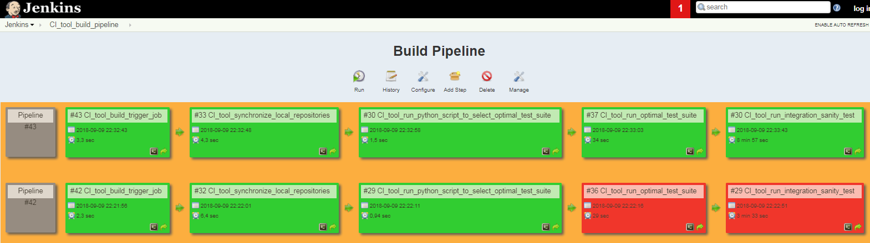
Proposed CI tool
Fig. 1. Jenkins web interface for the build pipeline view.
1) CI_tool_build_trigger_job – listens for push events to the github repository.
2) CI_tool_synchronize_local_repositories – updates local repositories to include all commits that have been pushed to the remote repository.
3) CI_tool_run_python_script_to_select_optimal_test_suite – executes the python script that selects an optimal test suite based on the changes made to the code in the last commit.
4) CI_tool_run_optimal_test_suite – executes an optimal test suite.
5) CI_tool_run_integration_sanity_test – executes the sanity check.
If the CI_tool_build_pipeline finishes successfully, the last commit will be merged to the production branch on the github remote repository.

Slide 5
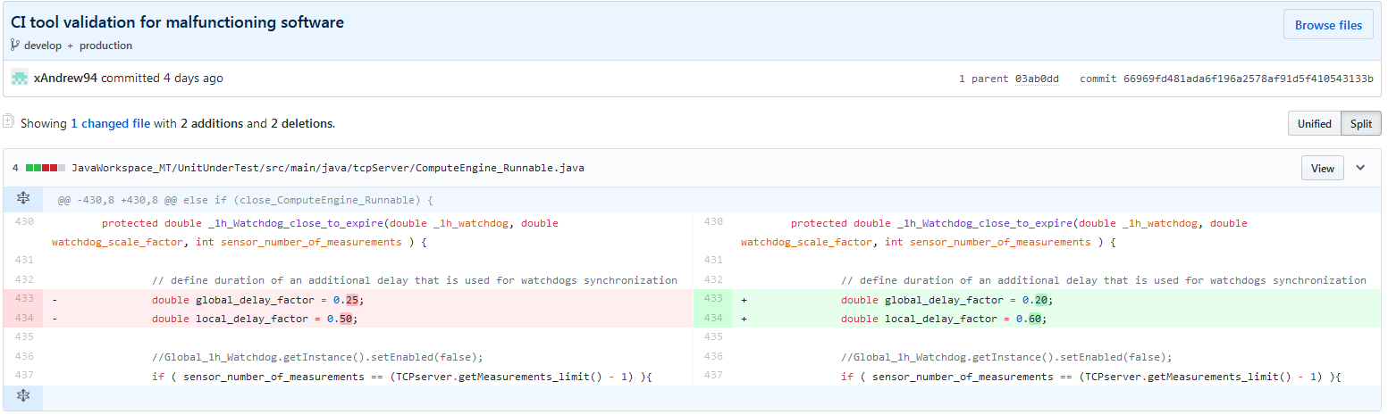
How does the CI tool work?
Fig. 2. Github side-by-side diff for the commit that introduces bugs to the code.

Slide 6
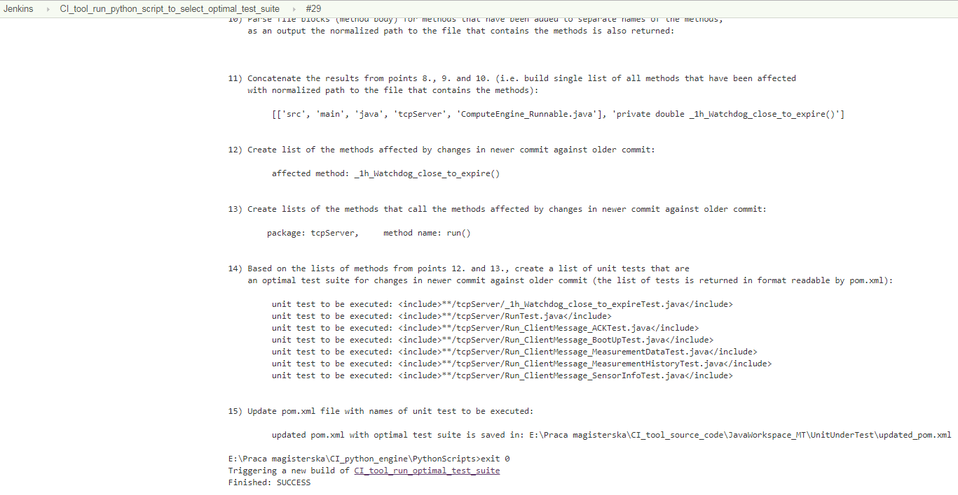
How does the CI tool work?
Fig. 3. Console output of the Jenkins job that selects an optimal test suite for the changes made to the code shown in figure 2. (#29 CI_tool_run_python_script_to_select_optimal_test_suite)

Slide 7
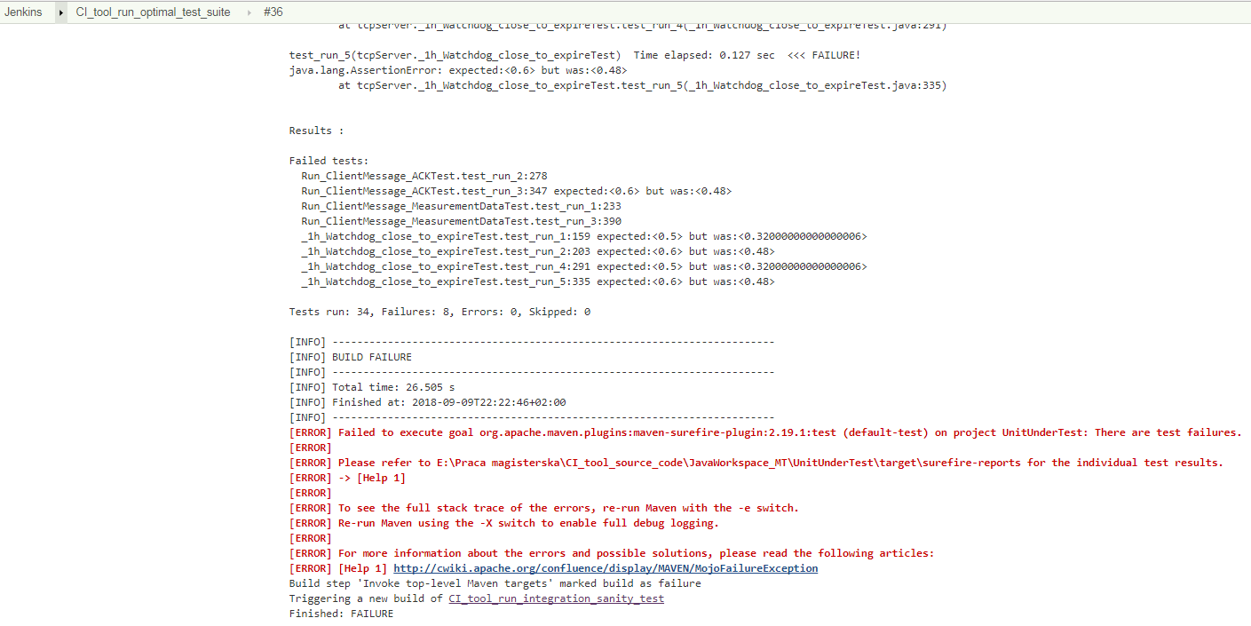
How does the CI tool work?
Fig. 4. Console output of the Jenkins job that runs the previously selected optimal test suite. (#36 CI_tool_run_optimal_test_suite)

Slide 8
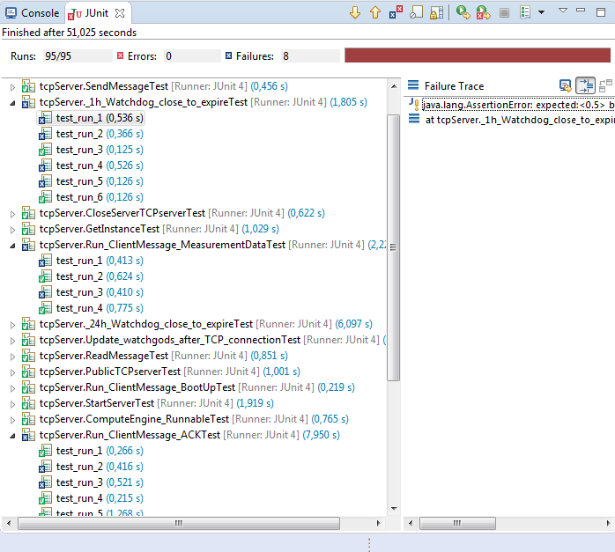
How does the CI tool work?
Fig. 5. Results of the execution of the entire test suite for tcpserver package.

Slide 9
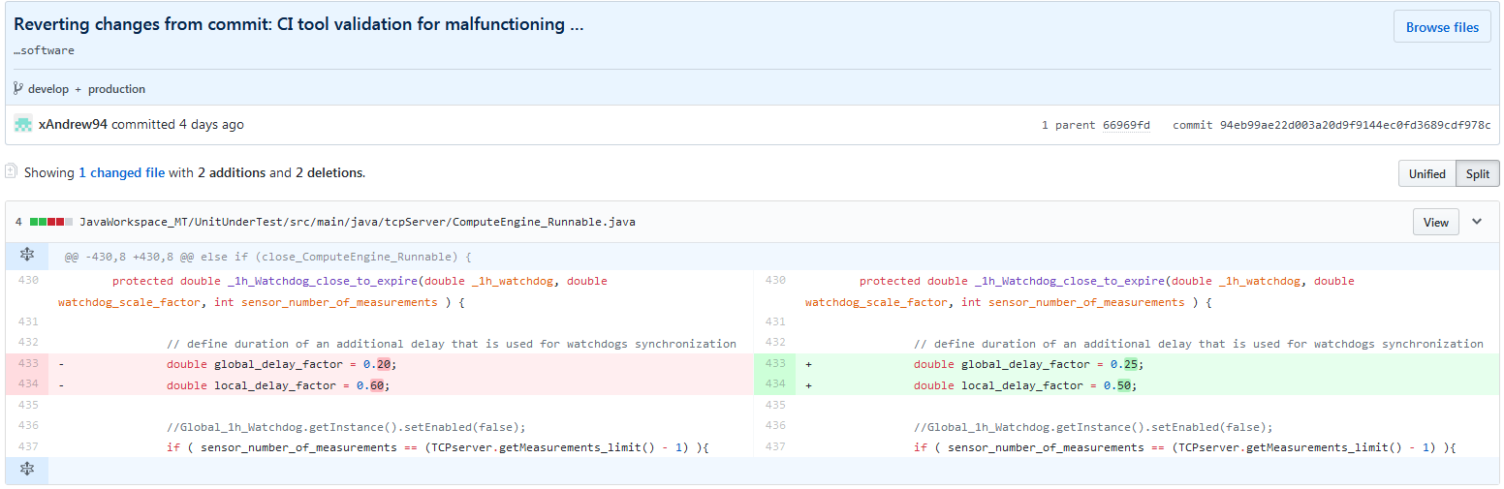
How does the CI tool work?
Fig. 6. Github side-by-side diff for the commit that fixes the previously introduced bugs.

Slide 10
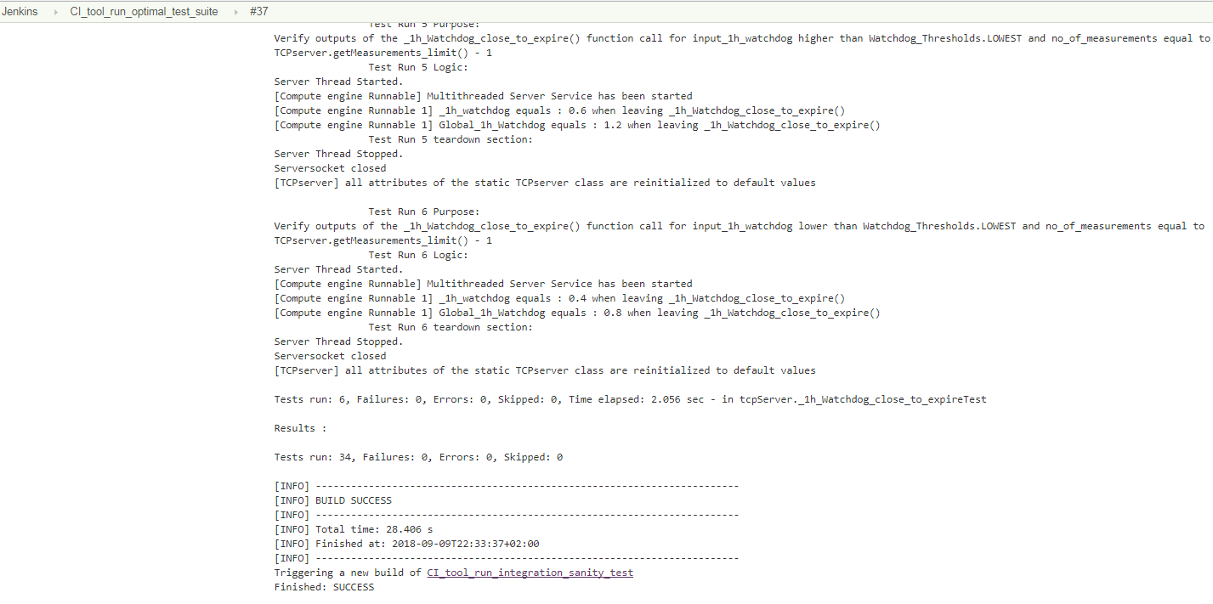
How does the CI tool work?
Fig. 7. Console output of the Jenkins job that runs the previously selected optimal test suite. (#37 CI_tool_run_optimal_test_suite)

Slide 11
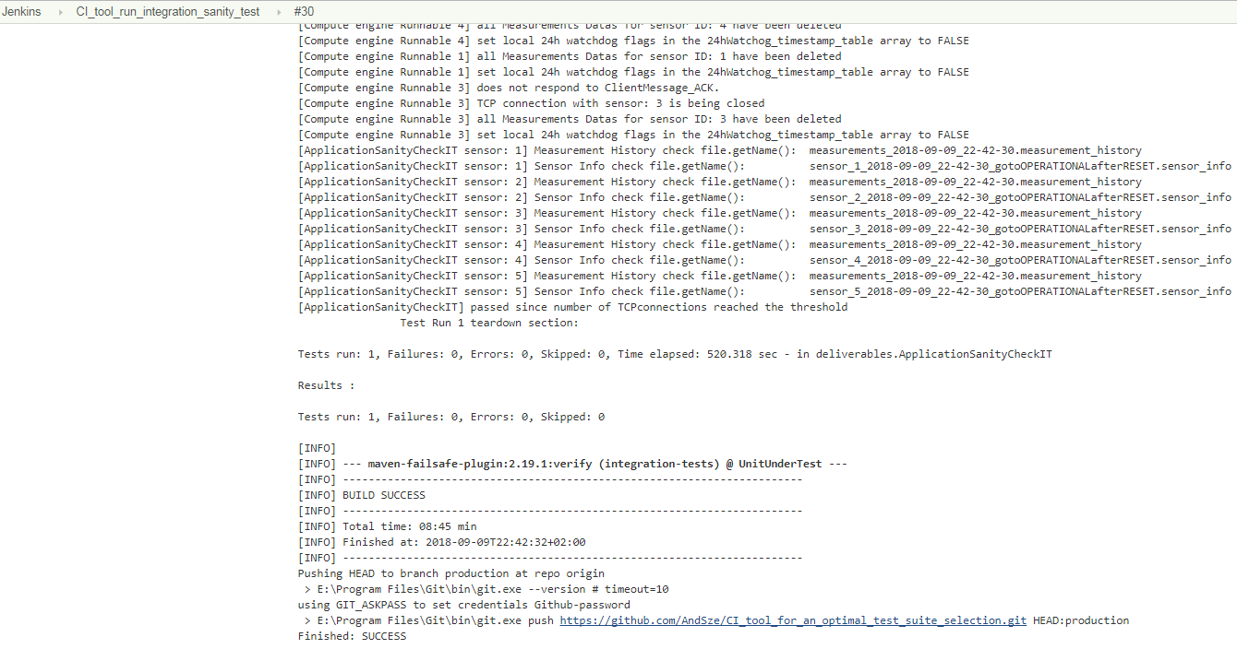
How does the CI tool work?
Fig. 8. Console output of the Jenkins job that runs the sanity check.
(#30 CI_tool_run_integration_sanity_test)

Slide 12
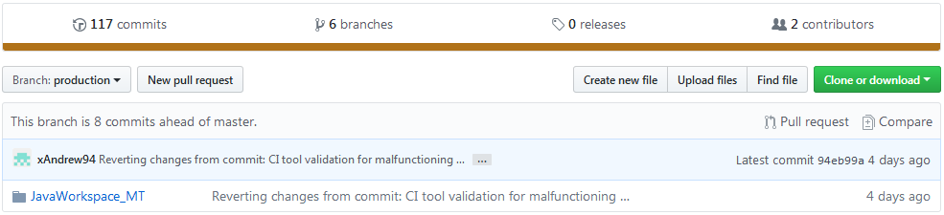
How does the CI tool work?
Fig. 9. Code merged to the production branch after successful execution of the Jenkins pipeline. (#43 CI_tool_build_pipeline)
Branches on the github repository [2]:
1) master - development branch for code of the application and all tests.
2) develop - temporarily development branch, used for testing the CI tool.
3) production - contains the code that has been successfully built and tested by the CI tool pipeline. The code on this branch is always up and running and can be delivered to a customer at any time.
4) tests_selector - contains python scripts used for an optimal test suite selection,
5) JenkinsJobs - contains the Jenkins jobs the CI tool comprises of.
6) documents - contains the official documents required to get Master’s Degree.

Slide 13
Literature review
[1] - NI-CAN Hardware and Software Manual
[2] - CiA Draft Standard 301 – CANopen Application Layer and Communication Profile
[3] - CiA Draft Standard 401 – CANopen Device profile for generic I /O modules
[4] - http://www.ni.com/en-gb.html
[5] - http://www.woodward.com/
[6] - Woodward’s brochure: 505 & 505-XT controllers for industrial steam turbines

