Slide 1

Subject of the Master’s thesis: Continuous integration tool that supports the process by an optimal test suite selection.
Author: Andrzej Szewczyk
Field of Study: Mechatronics engineering
Specializations: Mechatronics design
Supervisor: dr inż. Lucjan Miękina
Reviewer: dr hab. inż. Mariusz Giergiel, prof. AGH

Slide 2
Motivation to take up the subject of CI
I have been working on several embedded software projects. Let me briefly describe the typical difficulties these projects were suffering from:
Project A
Safety system for turbines, compressors and engines,
IEC61508 SIL-3 certified,
1100 test cases (95% automated),
Execution of all tests cases took around 3 weeks on two independent test stations,
A lot of unclear ties between software modules,
Bugs were often found after 2 weeks or later,
If any bug found, there was a need to run all tests cases once again for the updated firmware.
Project B
Electronic Engine Control for a turboprop aircraft engine,
Challenging certification process,
65 software engineers involved in the project on 3 continents,
Project activities carried out 24/5,
Numerous software updates every single day,
Build process and configuration management not well defined,
Need to build 3 separate projects prior to loading the firmware – major integration issues.
If a test fails, can it be stated with absolute certainty that a bug is found?

Slide 3
Continuous Integration
Continuous Integration (CI) is a development practice that requires developers to integrate code into a shared repository several times a day. The starting point when implementing continuous integration is an assumption that a single command should have the capability of building the system.
There are two main objectives of CI: build and test software automatically and provide developers with immediate feedback about quality of the last code build. In order to achieve those objectives, continuous integration relies on the following principles [1]:
Maintain a code repository,
Automate the build,
Make the build self-testing,
Every commit should be built on an integration machine,
Keep the build fast,
Test in a clone of the production environment,
Make it easy for anyone to get the latest executable version,
Everyone can see the results of the latest build,
Automate deployment.

Slide 4
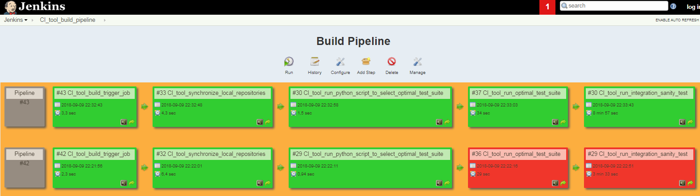
Proposed CI tool
Fig. 1. Jenkins web interface for the build pipeline view.
1) CI_tool_build_trigger_job – listens for push events to the github repository.
2) CI_tool_synchronize_local_repositories – updates local repositories to include all commits that have been pushed to the remote repository.
3) CI_tool_run_python_script_to_select_optimal_test_suite – executes the python script that selects an optimal test suite based on the changes made to the code in the last commit.
4) CI_tool_run_optimal_test_suite – executes an optimal test suite.
5) CI_tool_run_integration_sanity_test – executes the sanity check.
If the CI_tool_build_pipeline finishes successfully, the last commit will be merged to the production branch on the github remote repository.

Slide 5
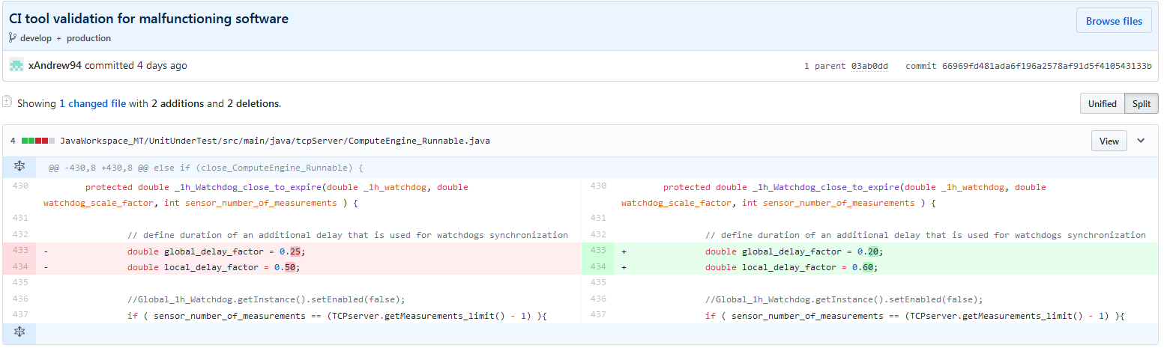
How does the CI tool work?
Fig. 2. Github side-by-side diff for the commit that introduces bugs to the code.

Slide 6
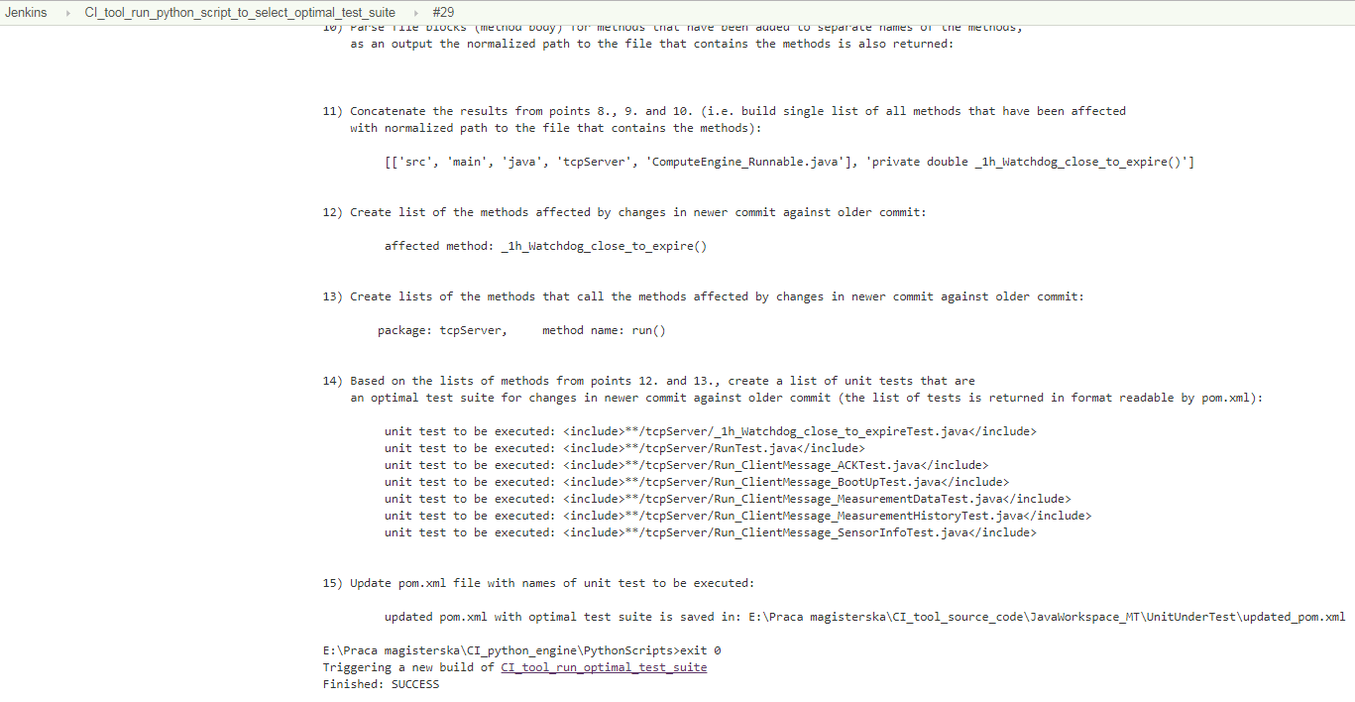
How does the CI tool work?
Fig. 3. Console output of the Jenkins job that selects an optimal test suite for the changes made to the code shown in figure 2. (#29 CI_tool_run_python_script_to_select_optimal_test_suite)

Slide 7
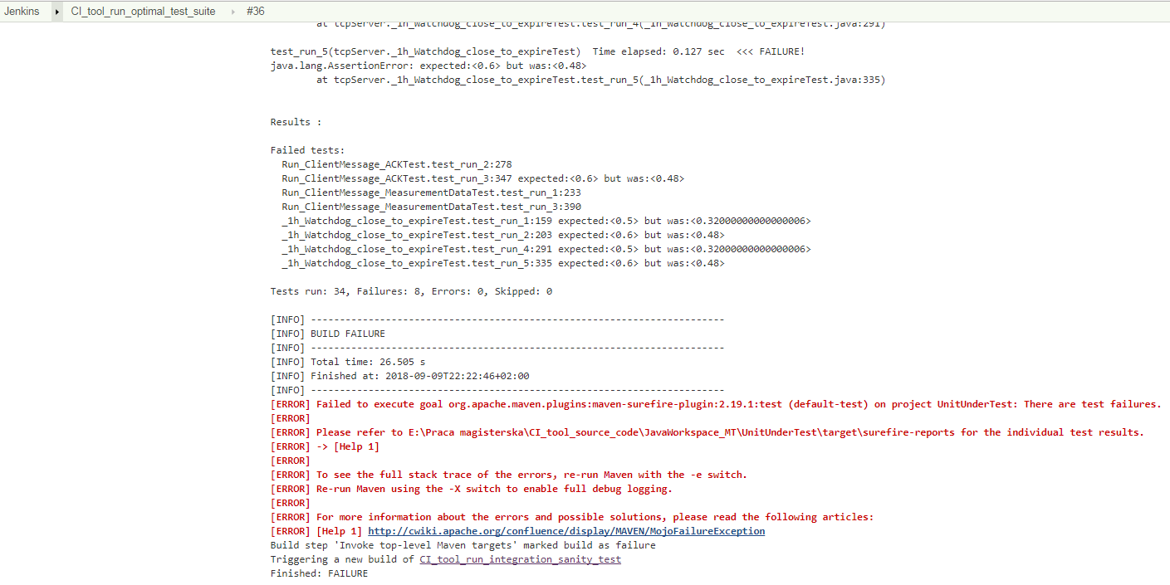
How does the CI tool work?
Fig. 4. Console output of the Jenkins job that runs the previously selected optimal test suite. (#36 CI_tool_run_optimal_test_suite)

Slide 8
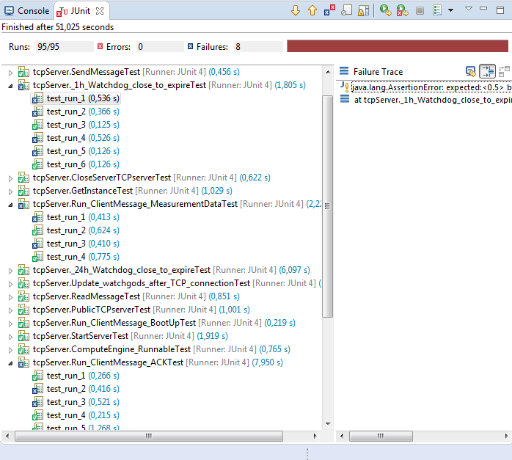
How does the CI tool work?
Fig. 5. Results of the execution of the entire test suite for TCP server.

Slide 9
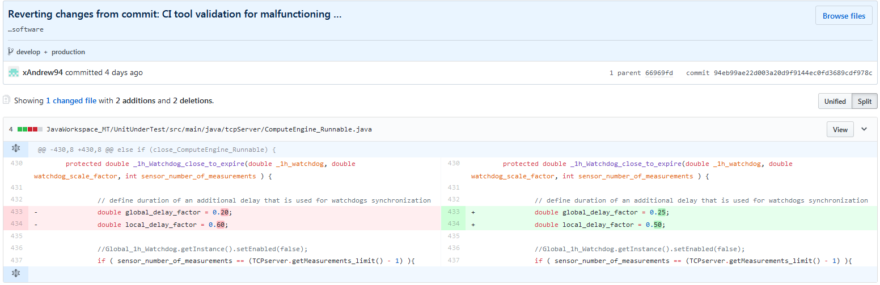
How does the CI tool work?
Fig. 6. Github side-by-side diff for the commit that fixes the previously introduced bugs.

Slide 10
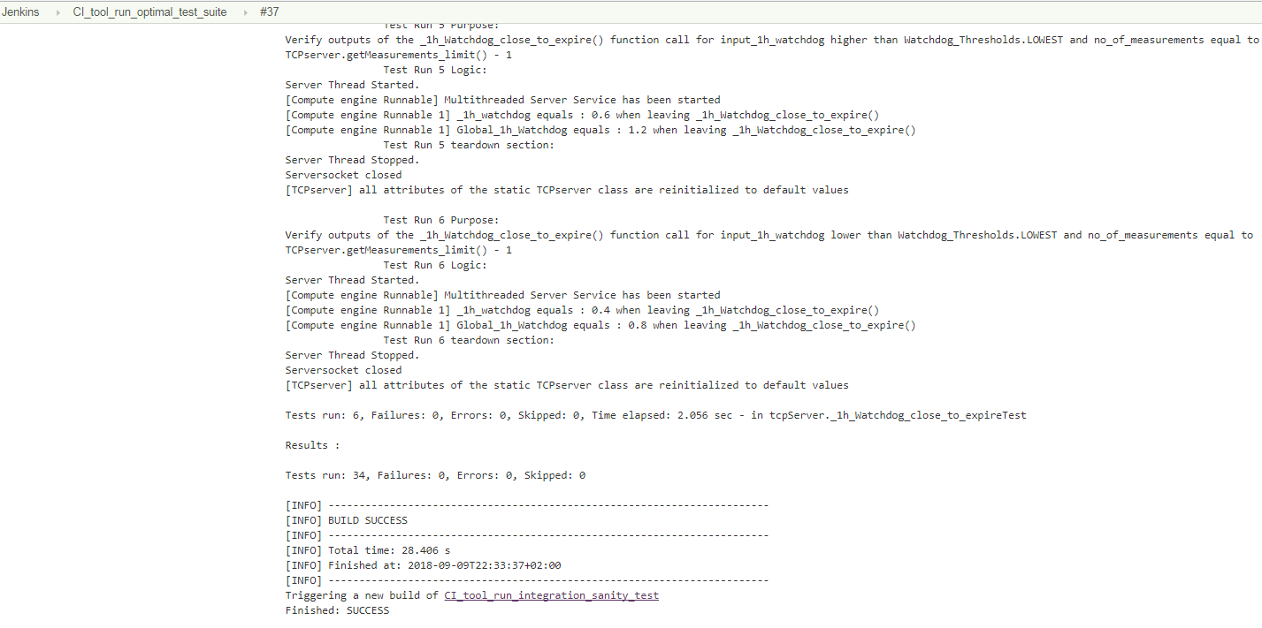
How does the CI tool work?
Fig. 7. Console output of the Jenkins job that runs the previously selected optimal test suite. (#37 CI_tool_run_optimal_test_suite)

Slide 11
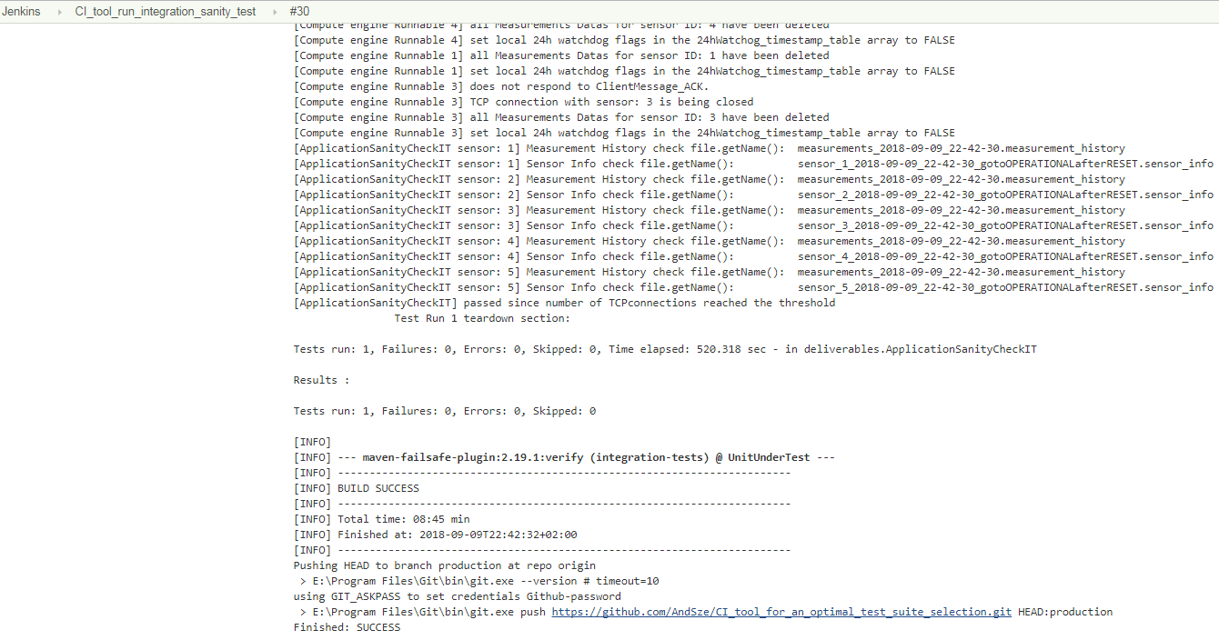
How does the CI tool work?
Fig. 8. Console output of the Jenkins job that runs the sanity check.
(#30 CI_tool_run_integration_sanity_test)

Slide 12
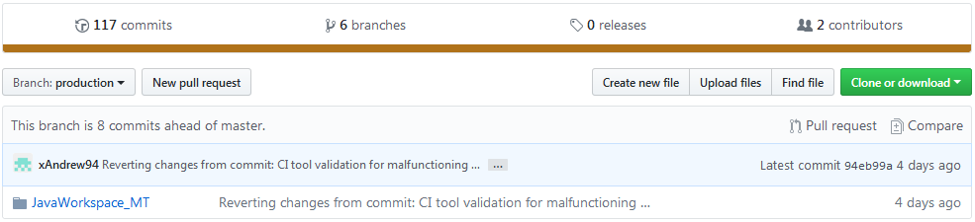
How does the CI tool work?
Fig. 9. Code merged to the production branch after successful execution of the Jenkins pipeline. (#43 CI_tool_build_pipeline)
Branches on the github repository [2]:
1) master - development branch for code of the application and all tests.
2) develop - temporarily development branch, used for testing the CI tool.
3) production - contains the code that has been successfully built and tested by the CI tool pipeline. The code on this branch is always up and running and can be delivered to a customer at any time.
4) tests_selector - contains python scripts used for an optimal test suite selection,
5) JenkinsJobs - contains the Jenkins jobs the CI tool comprises of.
6) documents - contains the official documents required to get Master’s Degree.

Slide 13
The general principles of CI
In order to summarize the material covered by the scope of the thesis there should be a retrospective look at the general principles of the CI process made:
Maintain a code repository,
Automate the build,
Make the build self-testing,
Every commit should be built on an integration machine,
Keep the build fast,
Test in a clone of the production environment,
Make it easy for anyone to get the latest executable version,
Everyone can see the results of the latest build,
Automate deployment.
The above list was mentioned once again on this slide for the purpose of illustrating that the CI tool successfully uses each of the principles.

Slide 14
The benefits of CI
The proposed CI tool besides the general advantages of adopting the CI principles [3]:
Immediate feedback on software quality,
Prevents integration problems, avoids last-minute chaos at release dates,
Repeatable build process,
Constant availability of a “current” build for testing, demo, or release purposes,
Automated testing: code is tested in the same way for every change,
Increases visibility which enables greater communication,
Spends less time debugging and more time adding features,
Helps break down the barriers between developers, testers and customer,
Ease of tracking all of the changes, possibility to revert the code to stable version,
places additional emphasis on:
Measuring system-wide impact of local changes.

Slide 15
Possibility for further improvement
Fig. 10. The types of software life cycle work products with an indication where the scope of the thesis applies to the software development process.

Slide 16

Amount of work for the CI tool
Summary of the software project artifacts the thesis is comprised of:
Application:
more than 5000 lines of code in Java (refactored multiple times to be testable),
Tests:
173 tests in JUnit (60% unit integration tests, 40% unit tests), 95 tests for TCP server, 78 tests for TCP client (updated multiple times to be stable),
sanity check - comprehensive integration test,
Build configuration for the project:
2 Maven POM files,
Optimal test suite selector:
more than 2000 lines of code in Python (powered by GitPython lib.),
Jenkins:
5 Jenkins jobs and Jenkins build pipeline.
Fig. 11. Summary of the push events to the remote repository.

Slide 17
Bibliography
[1] - Continuous Integration: important principles and practices.
Available: https://www.thoughtworks.com/continuous-integration (visited September 14th, 2018)
[2] - Github public repository: CI_tool_for_an_optimal_test_suite_selection
Available: https://github.com/AndSze/CI_tool_for_an_optimal_test_suite_selection
[3] - Top benefits of continuous integration.
Available: https://apiumtech.com/blog/top-benefits-of-continuous-integration-2/ (visited September 14th, 2018)

