Slide 1
And Yet It Compiles
Mary Floyd, Nick Spring, Zoe Baker

Slide 2
Overview
Disney Themed
Party consists of you and two other characters
Traverse a 10 floor Tower
Assist and recruit well known characters
Complete an objective to continue to the next
Character unlock feature

Slide 3
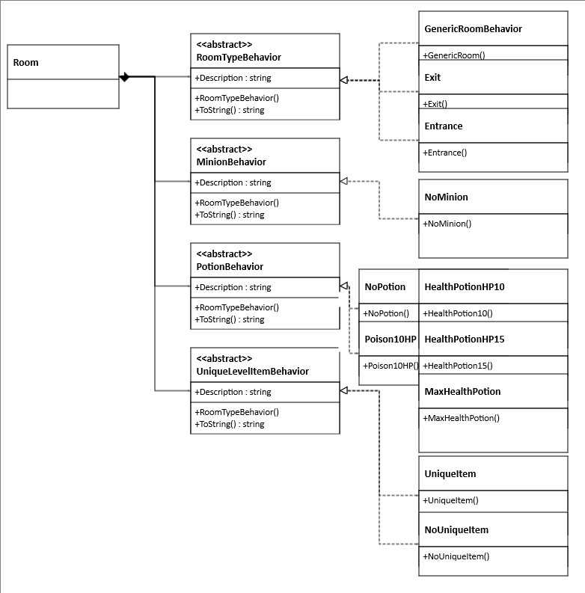
Strategy

Slide 4
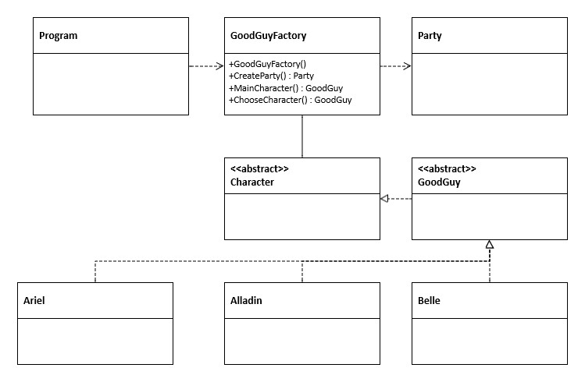
Factory – For Good Guys

Slide 5
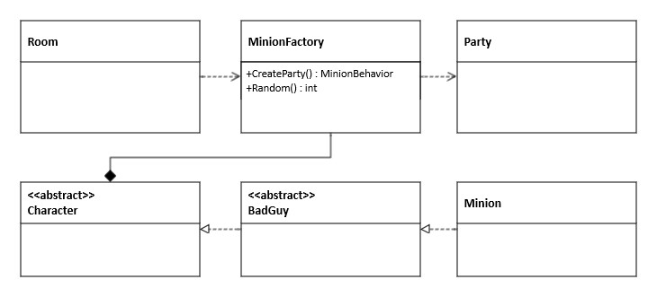
Factory – For Minions

Slide 6
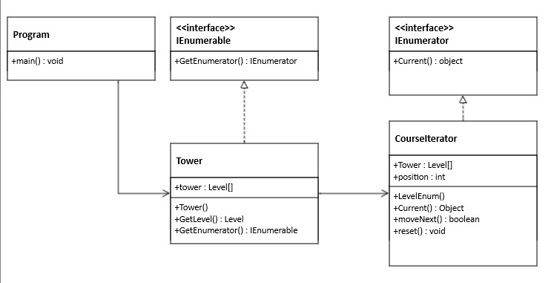
Iterator

Slide 7
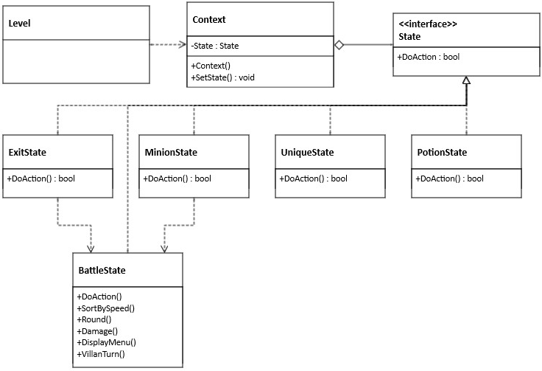
State

Slide 8
Code Demo

