Slide 1
And Yet It Compiles
Mary Floyd
Nick Spring
Zoe Baker

Slide 2
Overview
Disney Themed
Tower Style Dungeon
2 Design Patterns Implemented
Factory
Decorator
Planning to include:
Level-Up System
Recruit-able Characters
Backpack type of inventory
Many more characters

Slide 3
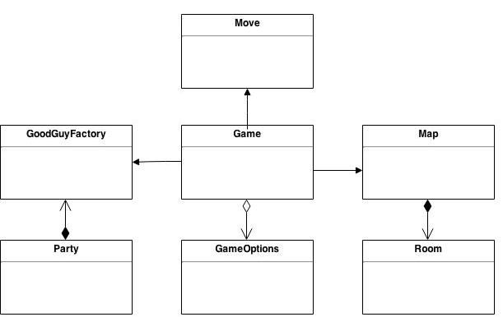
General UML

Slide 4
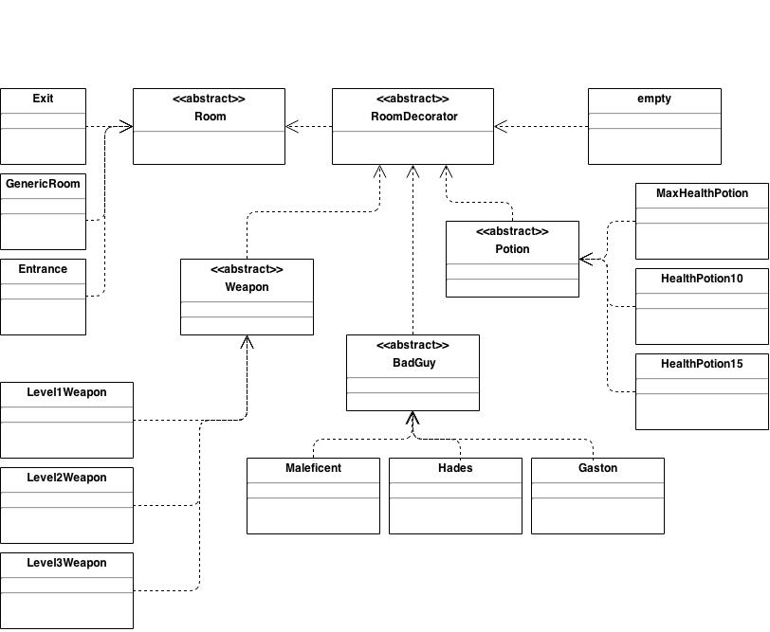
Decorator Pattern
Dashed lines meant to indicate extended classes

Slide 5
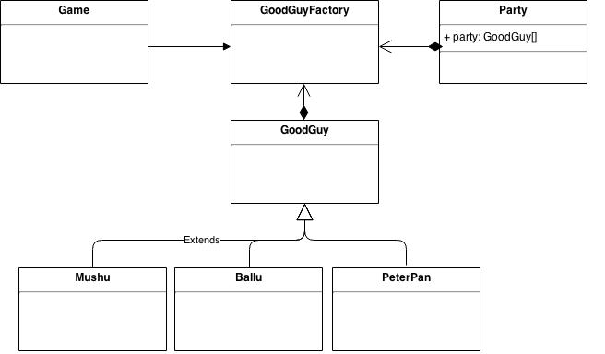
Factory Pattern

