Slide 1

One place for HR, requests and approvals
DEMO ERP: enterprise resource planning software, shaped to your organization
Briefing for Old Massett Village Council · November 2026
Prepared by Andalib Olee
Notes:
Opening. This is a short briefing for Old Massett Village Council on a working prototype of our ERP, enterprise resource planning software: one central system for HR, requests, approvals and team work. The picture on the right is the real Home page of the prototype. All names and figures in the screenshots are fictional. I will show what each part does, how much admin time it needs, and the price and timeline.

Slide 2
The system in one minute
One system where staff fill in timesheets, ask for time off, send requests and track tasks, and where every approval is recorded automatically. Old Massett Village Council chooses the modules it needs.
HR
Timesheets, time off, payroll, reviews, certificates, benefits and pension
Requests
Travel, card purchases, claims and purchase orders, with attachments
Team
My Team and tasks: assign, track and report progress
Operations
Purchasing, stock, projects and contracts
Finance
Can be completely customized to your finance team's needs
≈ 957 h
≈ 48 min
$2,000
Own data
of admin time a year for about 100 staff (to be confirmed), for everything on slide 14
a month for each person, approvals included
a month, with support within 48 hours
kept in one database that Old Massett Village Council owns
Admin time is an estimate for about 100 staff (to be confirmed); how it was worked out is on slide 14.
Notes:
The whole system on one page. Staff fill in timesheets, ask for time off, send requests and claims, and track tasks in one place, and every approval is recorded automatically. There are five modules, and Old Massett Village Council chooses which ones it needs; Finance can be completely customized to the finance team. For about 100 staff (to be confirmed), all of this needs about 957 hours of admin time a year in the system, which is about 48 minutes a month for each person, approvals included. The price is $2,000 a month with support within 48 hours, and the data is kept in one database that Old Massett Village Council owns.

Slide 3
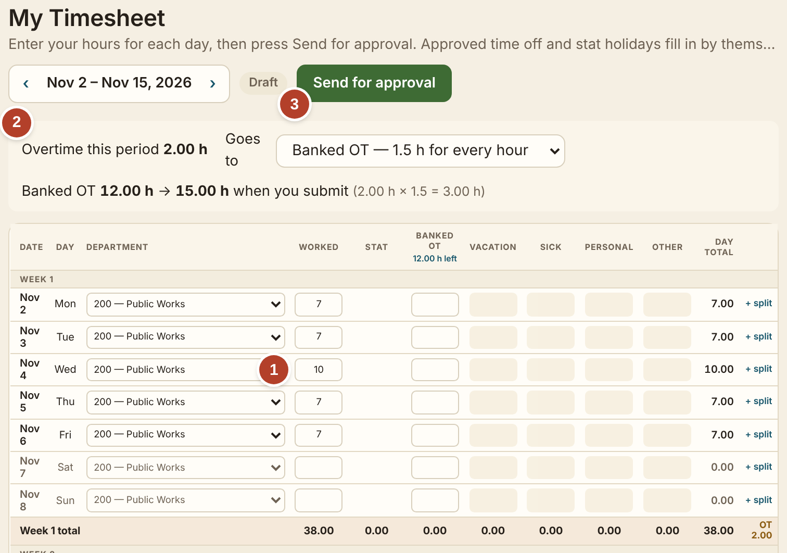
Timesheets: type the hours, the system does the math
1
Type the hours for each day
Here a 10-hour Wednesday among 7-hour days.
2
Overtime is worked out for you
Banked at 1.5 hours for every hour, or paid: the employee chooses.
3
One button sends it for approval
The supervisor approves it on screen.
≈ 7 min admin time per timesheet
Screen: My Timesheet, as an employee sees it.
Notes:
The timesheet. One: the employee types the hours worked each day. Two: the system works out overtime by itself and shows the banked balance; the employee chooses to bank it or have it paid. Three: one button sends it to the supervisor, who approves it on screen. Stat holidays and approved time off are already filled in. In the system a timesheet takes about seven minutes of admin time, the employee's and the supervisor's together.

Slide 4
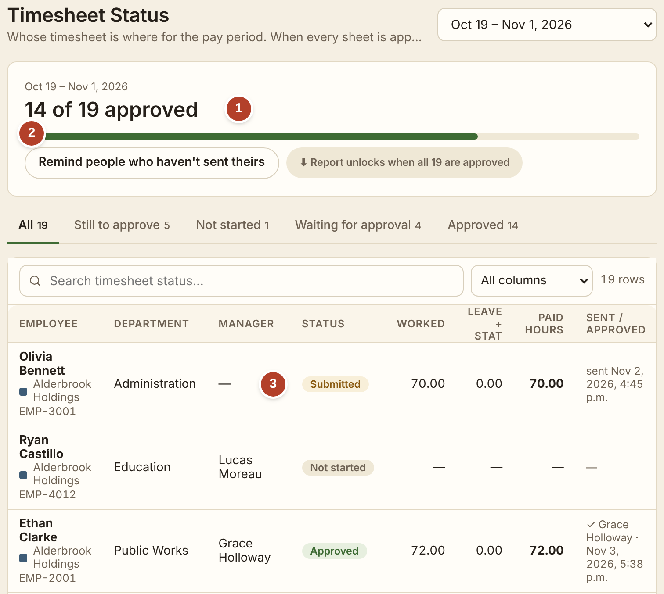
One page shows whose timesheet is missing
1
Progress for the pay period
How many timesheets are approved.
2
One button reminds the rest
Everyone who has not sent theirs gets a reminder.
3
Each person’s status
Not started, submitted or approved.
Ready for payroll on time. Approved hours, overtime and banked time go straight to the pay run.
Screen: Time & Attendance › By pay period.
Notes:
This page is for the person who collects the timesheets each pay period. One: the bar shows how many are approved. Two: one button reminds everyone who has not sent theirs. Three: each person's status: not started, submitted or approved. Approved hours, overtime and banked time go straight to the pay run.

Slide 5
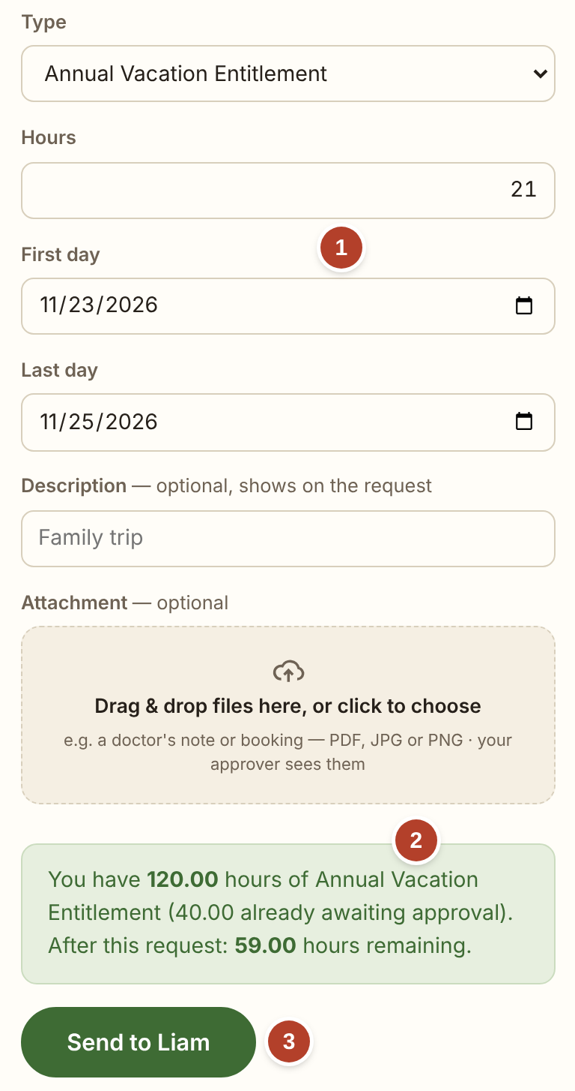
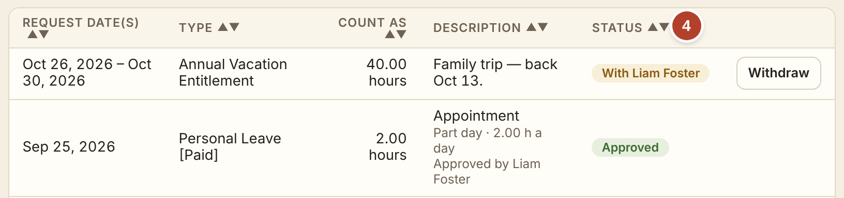
Time off: one short form, approved in one click
1
Pick the type and the days
The hours are worked out for you.
2
See what is left first
The balance after this request, before it is sent.
Balances are always right. Approved days fill the timesheet and the team calendar by themselves.
3
One button sends it
It goes straight to the supervisor.
≈ 5 min admin time per request
4
Follow the status
Who has it, and when it is approved.
Screen: My Time Off.
Notes:
Time off. One: pick the type of leave and the days, and the hours are worked out, leaving out weekends and stat holidays. Two: before anything is sent, the green box shows what will be left. Three: one button sends it to the supervisor; a doctor's note can be attached. Four: the list shows each request and its status. Approved days fill the timesheet and the team calendar by themselves. About five minutes of admin time per request.

Slide 6
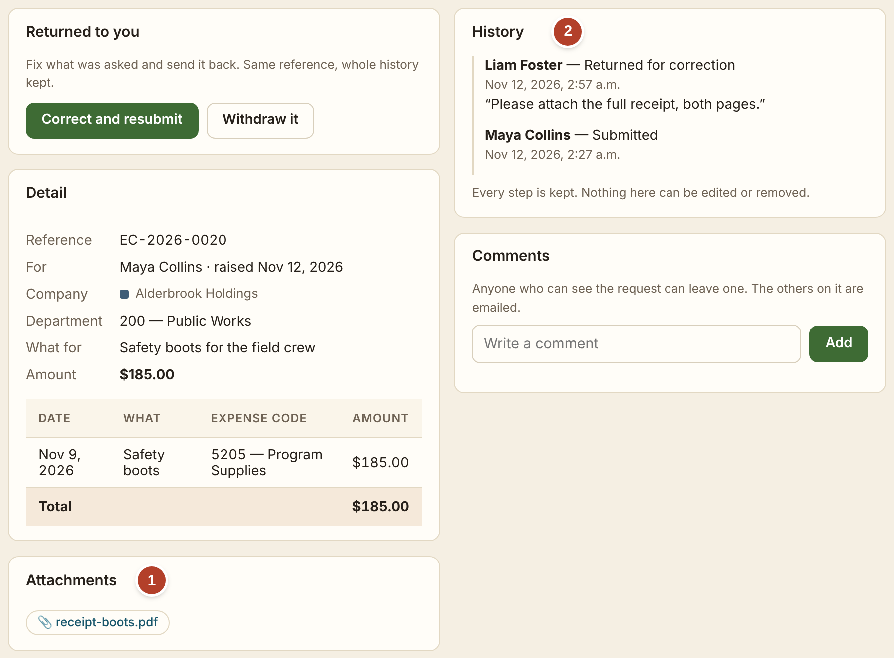
Five kinds of request, each with its files and its history
Travel request
Approval before a trip: where, when and the estimated cost.
1
Files attached
Receipts and quotes are added while filling in the request, and stay with it.
Credit card purchase
Approval before buying on the organization’s card.
2
Its own history
Who sent it, who approved or returned it, when, and any comment.
Travel claim
Mileage, meals and other costs after a trip.
Expense claim
Money spent out of pocket, with the receipt.
Screen: one expense claim opened.
Purchase order
Approval to order from a supplier.
A proper audit trail for every type. The request, its files and each approval are kept together under one number. Nothing can be edited or removed.
Notes:
The five kinds of request: a travel request before a trip, a credit card purchase, a travel claim after a trip, an expense claim and a purchase order. Each is one short form. One: files such as a receipt or a quote are attached while filling in the request, and stay with it. Two: each request has its own history. Here the supervisor returned the claim asking for the full receipt. The request, its files and every approval are kept together under one number, and nothing can be edited or removed.

Slide 7

Every request shows its route and its history
1
The route
Who has approved and who is next.
2
The history
Each step with name, date and comment.
3
The details
Department and expense code are required.
Nobody has to ask where a request is. The requester, the approvers and the people who process it all see the same page.
≈ 30 min admin time per request, all steps
Screen: one request opened. The bar shows the route.
Notes:
One request opened. One: the bar across the top is the route: submitted, approved by the supervisor, and waiting at director level because it is over $5,000. Two: the history lists every step with the person's name, the date and any comment. Three: the details, including department and expense code. About thirty minutes of admin time per request, counting everyone who touches it. If a supervisor is away on approved leave, the request also goes to the next person up.

Slide 8
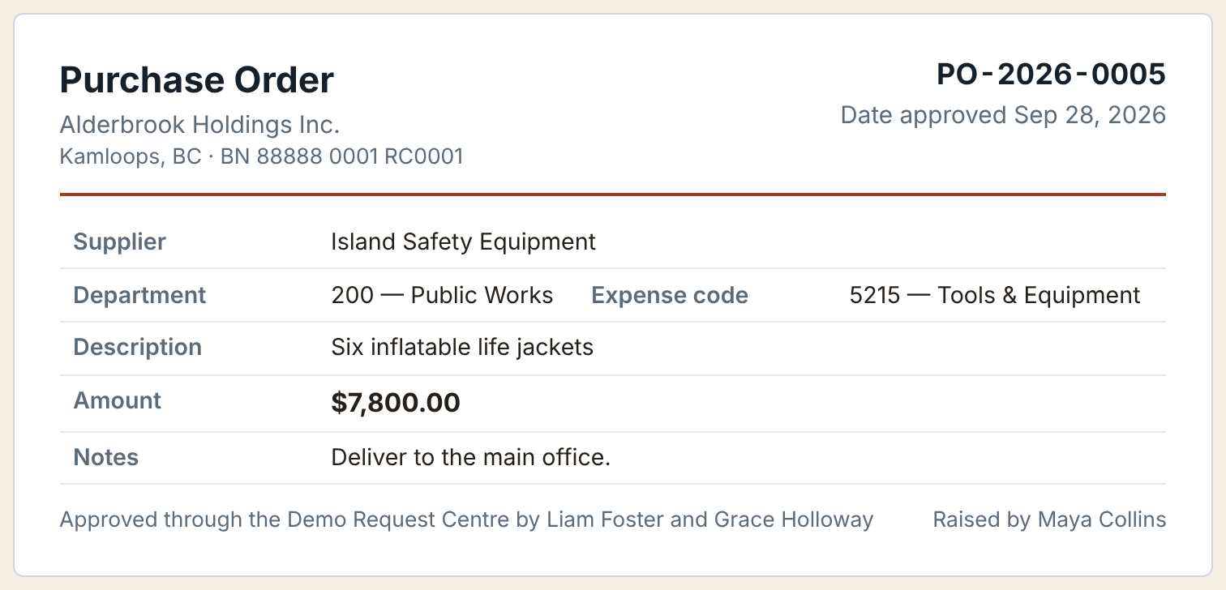
Purchase orders: proper approval every time
1
Every PO has a number
One list shows where each one stands.
2
No step can be skipped
Nobody approves their own order.
3
The PO shows who approved it
The printed order always matches the approval.
Screen: the one-page purchase order, ready to print or download as a PDF.
Employee asks
Supervisor approves
Director level if over $5,000
PO is ready, with its number
≈ 30 min admin time per purchase order
Notes:
Purchase orders. The row of boxes is the path: the employee asks, the supervisor approves, anything over $5,000 also needs director level, and then the system produces the purchase order with its number. The picture is that one-page order, with the names of the people who approved it at the bottom. Nobody can approve their own order and no level can be skipped. The $5,000 limit is a setting an administrator can change. About thirty minutes of admin time per purchase order.

Slide 9
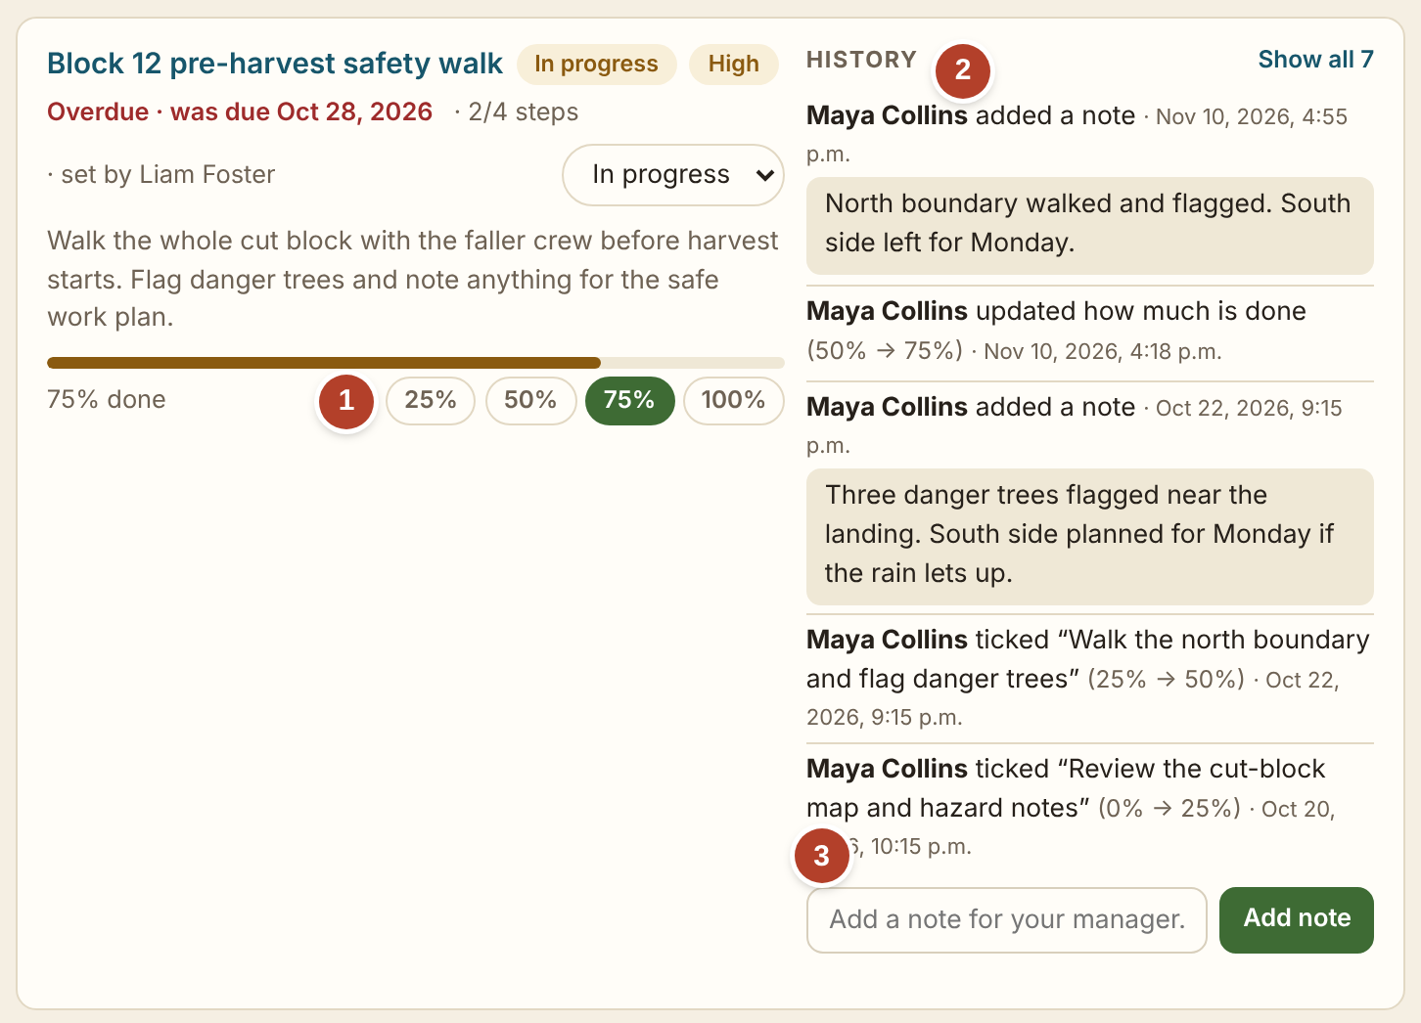
My Tasks: assigned, tracked and reported in one place
1
Progress with one click
25, 50, 75 or 100 percent.
2
The history
Who did what, and when.
3
A note for the manager
Sent straight from the task.
A streamlined workflow and more productive teams. Everyone sees what is assigned, what is late and what is done.
Screen: My Tasks. One task a manager assigned to an employee.
≈ 5 min admin time per update
Notes:
My Tasks. A manager assigns a task with a due date and steps. One: the employee updates progress with one click. Two: the history shows who created the task, who it was assigned to, each step and each note, with dates. Three: a note goes straight to the manager. Managers see the whole team's tasks on one page, with what is late or stuck. About five minutes per update.

Slide 10
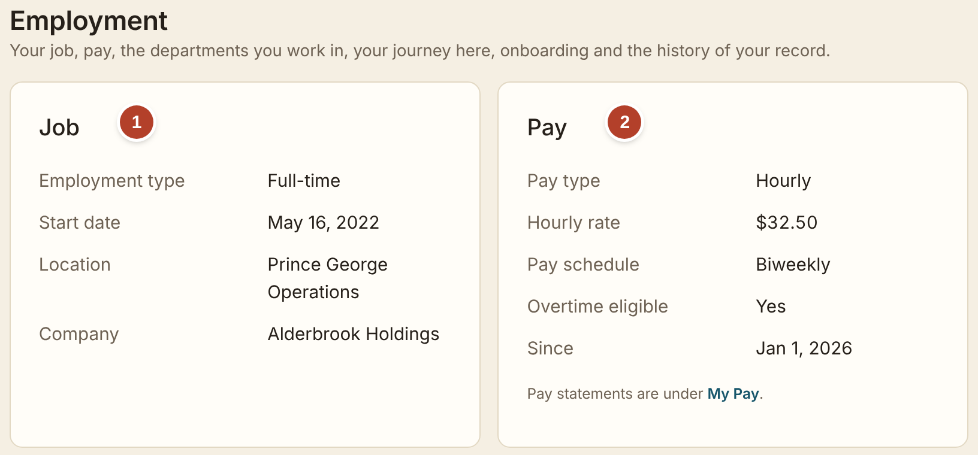
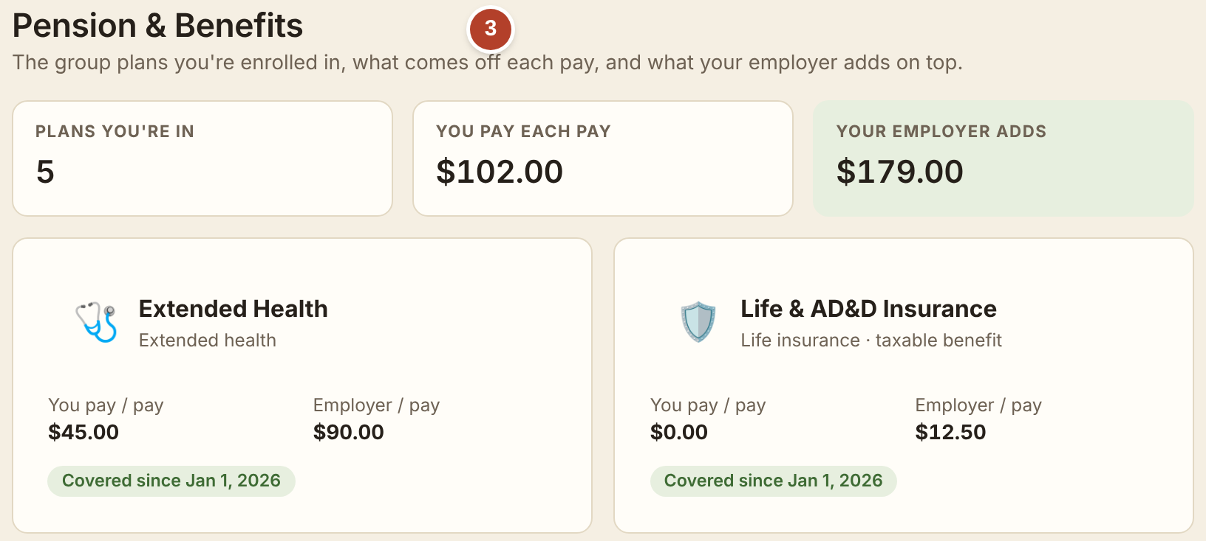
Staff check their own pay, job details and benefits
1
Employment details
Start date, position, location and who they report to.
2
Pay details
Pay rate, pay schedule and every pay statement, the moment it is ready.
3
Pension and benefits
The plans they are in, what comes off each pay and what the employer adds.
The answer is instant, at any time. Each person sees only their own record, and HR answers fewer routine questions.
Screens: My Profile › Employment and Pension & Benefits.
Notes:
Self-service. Every employee has My Profile and My Pay. One: employment details. Two: pay details and every pay statement as soon as it is ready. Three: pension and benefits: the plans, what comes off each pay and what the employer adds. The answer is instant, each person sees only their own record, and HR spends less time on routine questions.

Slide 11
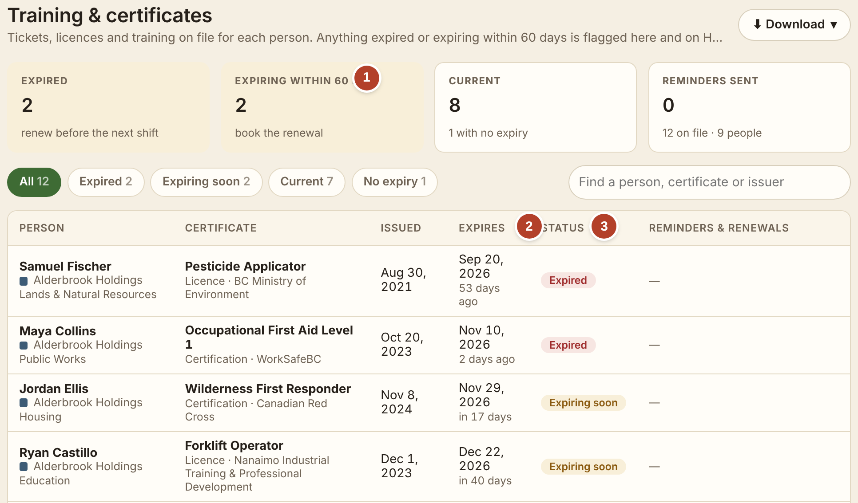
Certificates: expiry dates tracked for managers and HR
1
What needs attention
Expired, and expiring within 60 days.
2
The expiry date
With the days left for each one.
3
A clear status
Expired, expiring soon or current.
Nothing expires unnoticed. Managers see their own team. HR sees everyone, adds certificates and sends reminders.
Screen: People › Certificates, as a manager sees it.
Notes:
Certificates. The page lists the tickets, licences and training on file for each person. One: the boxes at the top show what has expired and what expires within 60 days. Two: each expiry date with the days left. Three: a clear status. Managers see their own team; HR sees everyone, adds certificates with the document itself and sends reminders with one click. Nothing expires unnoticed, which matters for safety and insurance.

Slide 12
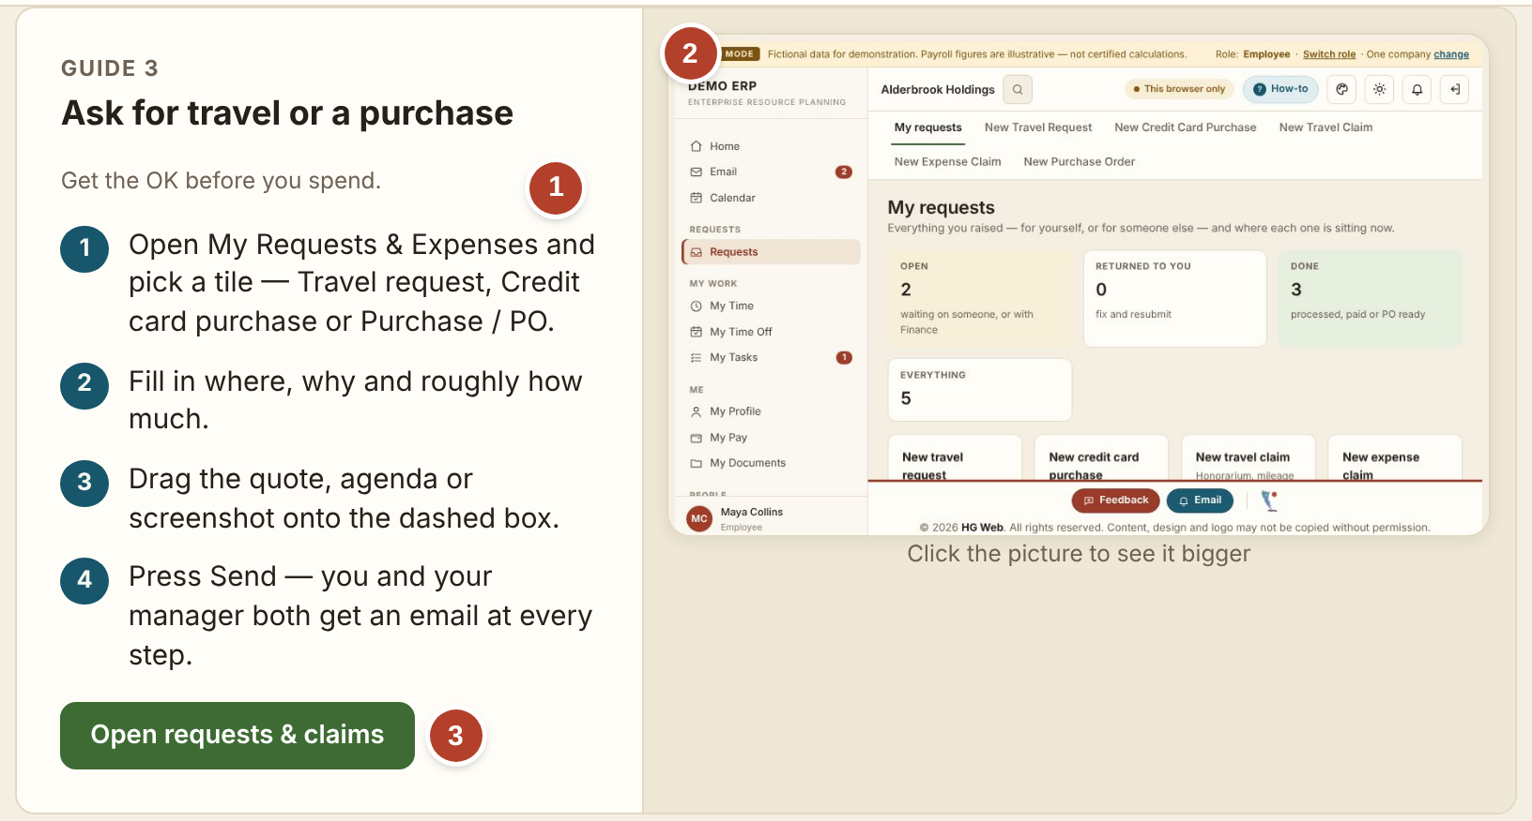
Built-in How-to guides: new staff ready in about 2 weeks
1
The proper procedure, step by step
Written in plain words, the same for everyone.
2
A picture of the real screen
So people know what to look for.
3
One button opens the page
Read the steps, then do the job.
New staff are ready in about 2 weeks. Guides are grouped by role: employee, manager, HR and more.
Screen: How-to guides. One guide, as a new employee sees it.
Notes:
Training. A How-to section is built in. Each guide covers one job with numbered steps in plain words, a picture of the real screen, and a button that opens the page. Guides are grouped by role. With one system and the guides inside it, we estimate a new employee is comfortable in about two weeks.

Slide 13
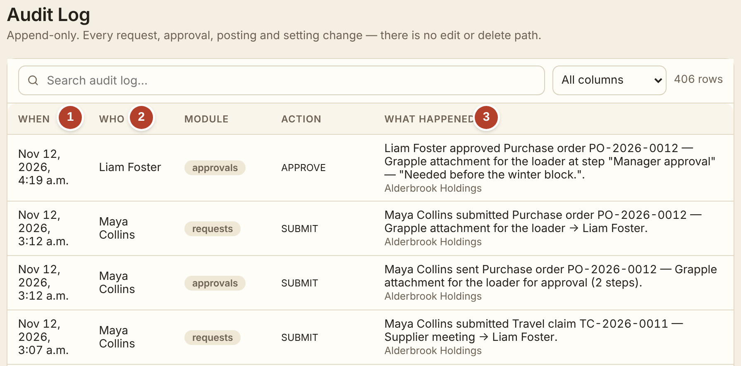
A proper audit trail, kept automatically
1
When
The date and time of every action, written the moment it happens.
2
Who
The person who did it, by name.
3
What happened
In plain words, with the request number, the step and any comment.
Screen: Administration › Audit log. One purchase order, step by step.
Nothing can be edited or deleted. One searchable record, ready for auditors and funders.
Notes:
The audit trail. Every action is written to this log the moment it happens. One: when. Two: who, by name. Three: what happened, in plain words. In the picture you can follow one purchase order from submission to approval. Nothing can be edited or deleted; a request can only be returned, declined or closed, and that is logged too. It is one searchable record, which is what auditors and funders ask for.

Slide 14
Admin time with the system: about 957 hours a year
Task | What it takes in the system | How many a year | Each | Hours a year
Timesheets | Type the hours, send; the supervisor approves on screen | 2,600 | 7 min | 303 h
Time-off requests | Pick the type and days, send; one click to approve | 400 | 5 min | 33 h
Requests and claims | Fill in, attach the receipt, approve, process | 600 | 30 min | 300 h
Purchase orders | Fill in, approve; the PO is produced with its number | 240 | 30 min | 120 h
Task updates | One click for progress, a short note for the manager | 2,400 | 5 min | 200 h
Total |  |  |  | 957 h
≈ 48 min
a month for each person, approvals included
≈ 18 h
a week across the whole organization
How this was estimated
about 100 staff (to be confirmed); a timesheet every two weeks; about 4 time-off requests, 6 requests or claims and 2–3 purchase orders a year per person; tasks updated about twice a month. Minutes include everyone who touches the item. All numbers can be changed in PowerPoint.
Notes:
This slide estimates how much admin time these tasks need with the system for about 100 staff (to be confirmed). Each row is one kind of task: what it takes in the system, how many there are in a year, the minutes for each one, counting everyone who touches it, and the hours a year. In total that is about 957 hours a year, or about 48 minutes a month for each person, approvals included. The counts are assumptions: a timesheet every two weeks, about four time-off requests, six requests or claims and two to three purchase orders a year per person, and task updates about twice a month. Replacing them with Old Massett Village Council's own counts gives the real figure.

Slide 15




Your system, your data, your people
Old Massett Village Council’s own data storage
No dependence on AI
Records are kept in one central database that Old Massett Village Council owns and controls, hosted on its own servers or with a host in Canada.
The system runs on fixed, ordinary rules that people set. It needs no AI service to work, and no information is sent to one.
Fully customizable
Local jobs, less outside dependence
Shaped to how the leadership team and employees work: the modules, the approval rules, the forms and the wording.
More HR work can be done in-house, and new positions can be created for local people with proper training.
Notes:
Four points that are not about minutes. First, Old Massett Village Council's own data storage: one central database it owns and controls, on its own servers or with a host in Canada. Second, no dependence on AI: the system follows fixed rules that people set and sends no information to an AI service. Third, it is fully customizable: the modules, approval rules, forms and wording follow how the leadership team and employees work. Fourth, more HR work can be done in-house, and new positions can be created for local people with proper training.

Slide 16
Pricing and timeline
MONTHLY PRICE
$2,000
a month
$24,000 a year once running
What the price includes
✓
The modules you choose
HR, Requests, Team and Operations; Finance customized to your finance team.
✓
Support within 48 hours
Questions and fixes answered within two working days.
✓
Fully customizable
Changed as the leadership team and employees need.
Monthly payments start only after the system is deployed to the whole organization.
✓
Your own data
Kept in one database Old Massett Village Council owns, hosted in Canada.
Weeks 1–2
Meetings with senior leaders, department managers and employees to gather requirements
Weeks 3–6
Implementation
Weeks 7–8
Trial in one or two departments
Then
Deployment to the whole organization. Monthly payments start here
Notes:
Pricing and timeline. The price is $2,000 a month, which is $24,000 a year once the system is running. It includes the modules Old Massett Village Council chooses, support within 48 hours, and changes to fit how the leadership team and employees work, and the data stays in a database Old Massett Village Council owns. The timeline is at the bottom. Weeks one and two: meetings with senior leaders, department managers and employees to gather requirements. Weeks three to six: implementation. Weeks seven and eight: a trial in one or two departments. Then the system is deployed to the whole organization, and the monthly payments start only at that point. Every number on this slide can be edited in PowerPoint.

Slide 17
Where we are, and what happens next
Today: a working prototype
Every screen in this briefing is real and can be tried in a browser, with fictional people and figures. A user manual comes with the demo link.
1
Try the demo
Pick the modules you need on the first page and follow the user manual.
2
Choose the modules
Decide which modules Old Massett Village Council needs first.
3
Meet to gather requirements
Senior leaders, department managers and employees, in weeks 1 and 2.
Time to go live
About 8 weeks: 2 weeks gathering requirements, 4 weeks of implementation, then a 2-week trial in one or two departments.
4
Trial, then go live
A trial in one or two departments, then the whole organization.
Notes:
To close. What exists today is a working prototype: every screen in this briefing is real and can be tried in a browser, with fictional people and figures, and a user manual comes with the demo link. Going live takes about eight weeks: two weeks gathering requirements, four weeks of implementation and a two-week trial in one or two departments. The next steps are on the right: try the demo, choose the modules Old Massett Village Council needs, meet to gather requirements, and then the trial and go-live.

