Slide 1

One place for requests, purchase orders, timesheets and tasks
DIGITAL OPERATIONS PROPOSAL
A working prototype and a phased digital operations proposal
Briefing for the CHN Executive Committee · November 2026
Prepared by Andalib Olee
Notes:
Opening. This is a briefing for CHN on a working prototype: one central system for requests, purchase orders, timesheets and tasks, with time off, onboarding and offboarding, self-service and certificates. The picture is the real Home page of the prototype; all names and figures in the screenshots are fictional.

Slide 2
This briefing
OVERVIEW
01
The proposal in one minute
What changes and the estimated effect
Slides 3
02
Timesheets, time off and people
Timesheets, time off, onboarding and offboarding
Slides 4–7
03
Requests and purchase orders
Five request types, approval routes and POs
Slides 8–12
04
Tasks, self-service and training
My Tasks, staff self-service, certificates, How-to guides
Slides 13–16
05
Control and governance
Admin time, audit trail, independence, security
Slides 17–20
06
Pricing, timeline and next steps
Costs, the path to a pilot and the decision
Slides 21–22
Notes:
The briefing has six parts: the proposal in one minute; timesheets, time off and people; requests and purchase orders; tasks, self-service and training; control and governance; and pricing, timeline and next steps.

Slide 3
The proposal in one minute
OVERVIEW
Today, requests, purchase orders and timesheets rely on paper and PDF forms, signatures, scans and email. Tasks have no shared workspace. The proposal brings all four into one system, with approvals and status recorded centrally.
≈ 1/3
≈ 1,400 h
≈ 8 weeks
One shared platform
of the admin task time: a request, purchase order or timesheet takes about one third of the time it takes today
estimated admin capacity recovered per year, per 100 staff
planning target from discovery through a controlled pilot; rollout is separate
for requests, purchase orders, timesheets and tasks
How these were estimated
Illustrative organization of 100 staff: 2,600 timesheets a year (one per employee every two weeks), about 600 requests and 240 purchase orders.
Assumed admin time today: a 90-minute midpoint for each request or purchase order and about 20 minutes for each timesheet. The proposed workflow is estimated at about one third of that time.
These volumes and processing times are planning assumptions. Validate CHN’s actual counts and baseline during discovery. Pricing is summarized on slide 21.
Notes:
The whole proposal on one page. Requests, purchase orders and timesheets rely today on paper and PDF forms, signatures, scans and email, and tasks have no shared workspace. The proposal brings all four into one system with approvals and status recorded centrally. A request, purchase order or timesheet is estimated to take about one third of today's admin time, which is roughly 1,400 hours a year for every 100 staff. The planning target from discovery through a controlled pilot is about eight weeks; rollout is a separate step. These are planning assumptions to validate with CHN’s own counts during discovery.

Slide 4
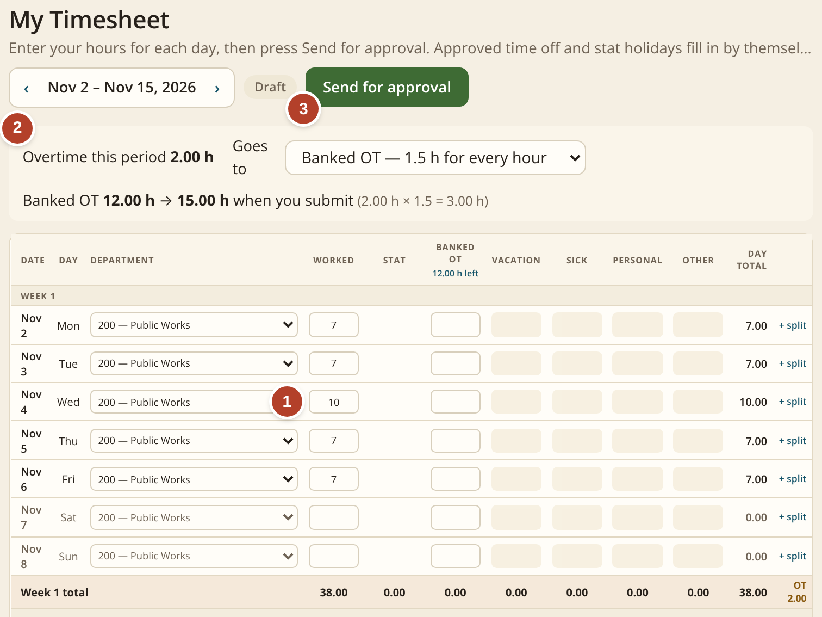
Timesheets: type the hours, the system does the math
TIMESHEETS, TIME OFF AND PEOPLE
1
Type the hours for each day
Here a 10-hour Wednesday among 7-hour days.
2
Overtime is worked out for you
Overtime uses CHN-approved rules. The banked-time balance updates automatically.
3
One button sends it for approval
The supervisor approves it on screen. No paper, no scan.
Overtime thresholds, multipliers and leave calculations must be configured to approved CHN policy and tested before launch.
Screen: My Timesheet, as an employee sees it.
Today: a paper or spreadsheet timesheet, signed, scanned and emailed. Overtime and banked time are counted by hand.
Notes:
The timesheet. One: the employee types the hours each day. Two: overtime is worked out using CHN-approved rules and the banked balance updates automatically. Three: one button sends it to the supervisor. Overtime and leave rules must be configured to approved CHN policy and tested before launch.

Slide 5
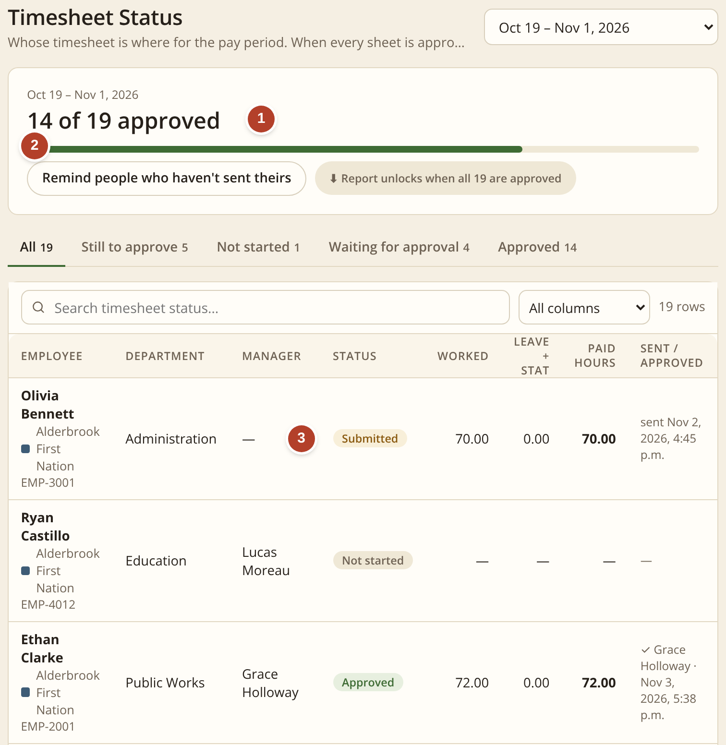
One page shows who has not sent a timesheet
TIMESHEETS, TIME OFF AND PEOPLE
1
Progress for the pay period
How many timesheets are approved.
2
One button reminds the rest
No chasing by email or phone.
3
Each person’s status
Not started, submitted or approved.
 | TODAY | NEW SYSTEM
Steps people do | 5 | 2
Time per timesheet | ≈ 20 min | ≈ 7 min
Overtime, banked time | by hand | automatic
Chasing late ones | one by one | one button
Screen: Time & Attendance › By pay period.
Estimates for an illustrative organization of 100 staff; how they were estimated is on slide 3.
Notes:
This page is for whoever collects timesheets each pay period: progress, one button to remind everyone who has not sent theirs, and each person's status.

Slide 6

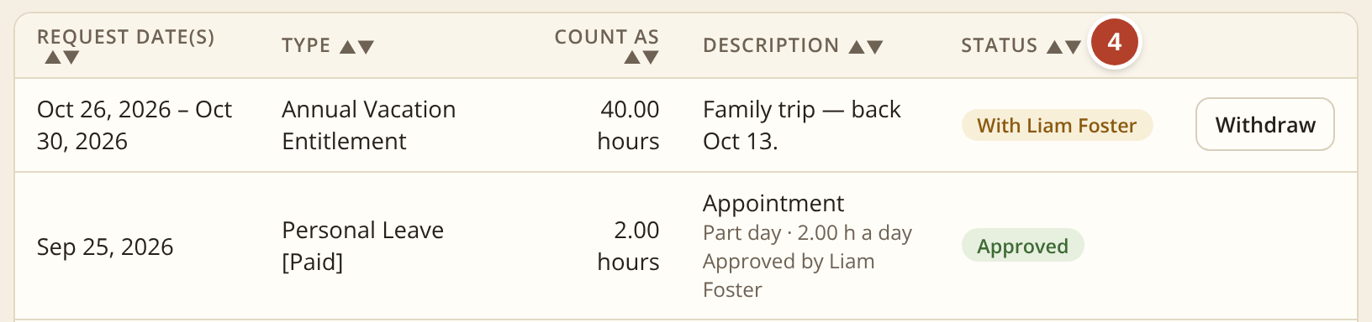
Time off: one short form instead of a PDF and an email
TIMESHEETS, TIME OFF AND PEOPLE
1
Pick the type and the days
The hours are worked out for you.
2
See what is left first
The balance after this request, before it is sent.
Today: a PDF form is filled in, signed and emailed, and the balance is checked by asking.
 | TODAY | NEW SYSTEM
How it is asked | PDF + email | one form
Balance left | ask HR | shown first
On the timesheet | typed again | fills itself
3
One button sends it
It goes straight to the supervisor.
4
Follow the status
Who has it, and when it is approved.
Screen: My Time Off.
Notes:
Time off. Pick the type and days, see the balance left before sending, send it to the supervisor with one button, and follow the status. Approved hours fill the timesheet automatically.

Slide 7
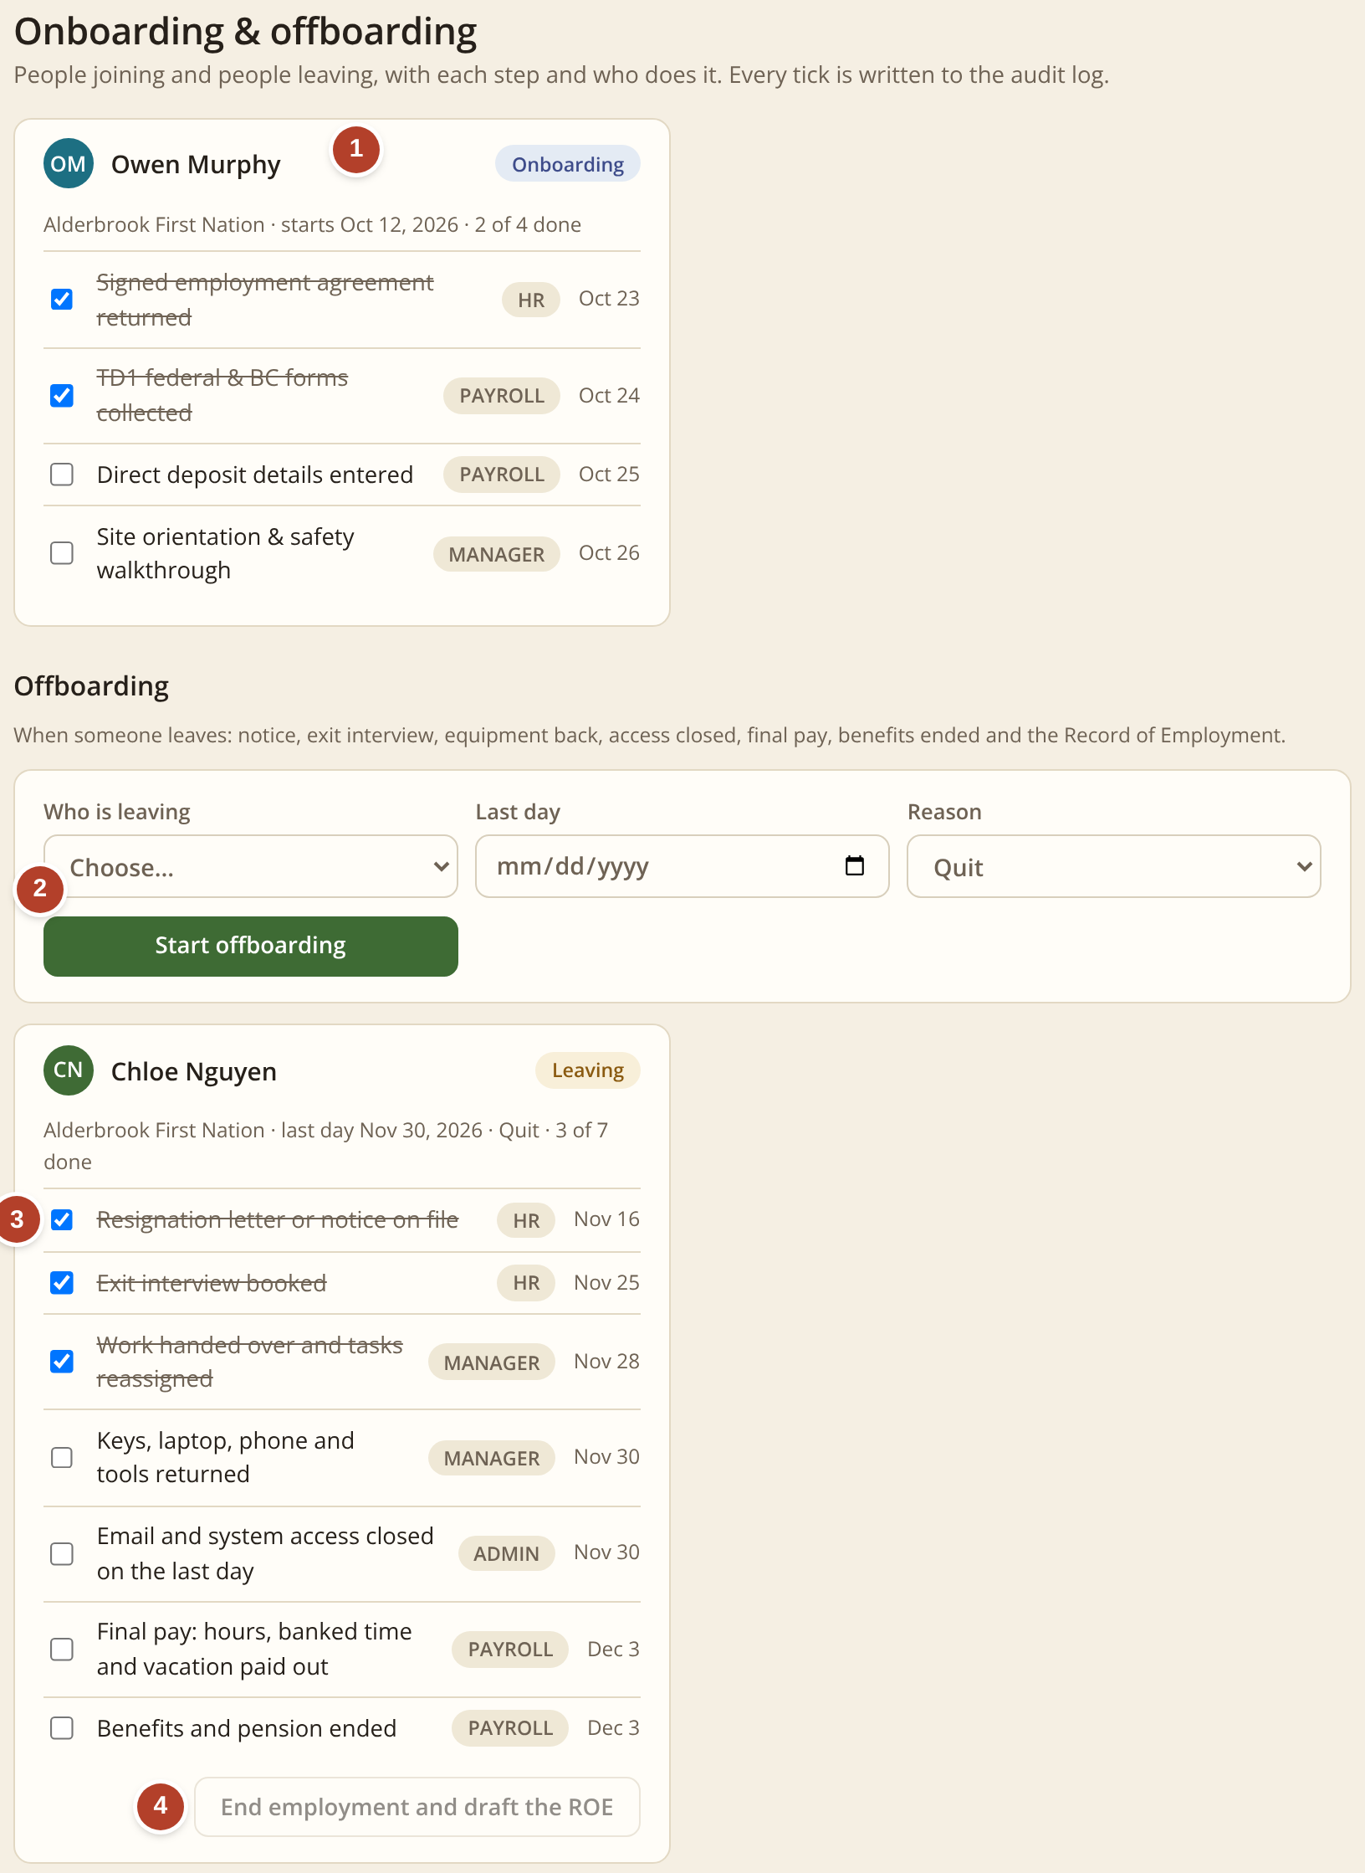
Onboarding and offboarding: every step, nothing missed
TIMESHEETS, TIME OFF AND PEOPLE
1
New starter checklist
Agreement, tax forms, direct deposit and orientation, each with who does it and when.
2
Start an offboarding
Pick the person, the last day and the reason. The checklist is assigned at once.
3
Leaving checklist
Notice, exit interview, work handed over, keys and equipment back, access closed, final pay, benefits ended.
4
Close the checklist
When every step is complete, HR reviews and closes the checklist. Payroll prepares and validates the Record of Employment through the approved process.
Today: paper checklists and emails between HR, the manager, IT and Payroll, and steps such as returning keys or closing access are easy to miss.
Screen: People › Onboarding & offboarding.
Notes:
Onboarding and offboarding. New starters get a checklist with owners and dates. When someone leaves, HR starts an offboarding and the leaving checklist is assigned at once. When every step is complete, HR reviews and closes the checklist, and Payroll prepares and validates the Record of Employment through the approved process.

Slide 8
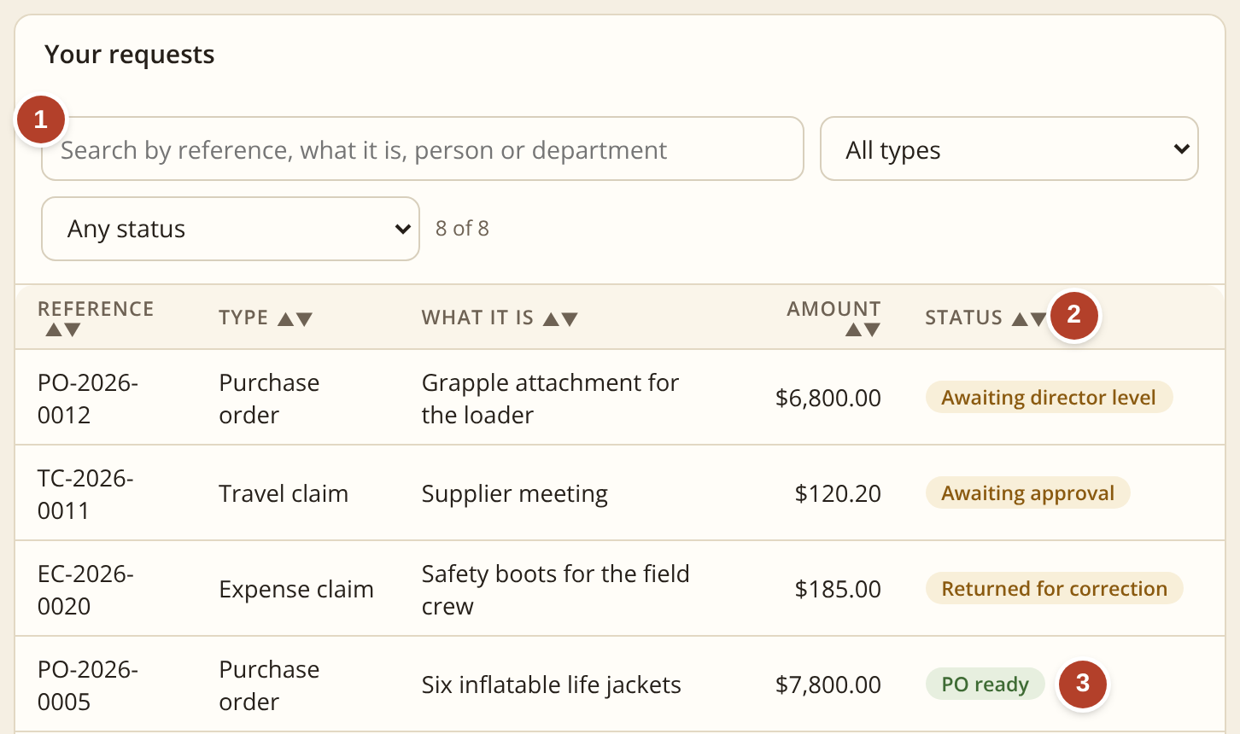
Requests: every type in one place, with its status
REQUESTS AND PURCHASE ORDERS
1
Find any request in seconds
Search by number, person, department or what it was for.
2
See where it stands right now
Awaiting approval, awaiting director level, returned to you, or ready.
3
A searchable record
Each request stays on a numbered list with its status and history, reducing the risk of forms being lost in inboxes or filing trays.
Five request types, one short form each: travel, credit card purchase, travel claim, expense claim and purchase order.
Screen: My requests, as an employee sees it.
Today: a paper or PDF form for each type, saved and passed on as an email attachment. To know where one is, you ask around.
Notes:
Requests. One searchable list with a plain-words status for every request, kept on a numbered record so forms are not lost in inboxes or filing trays.

Slide 9
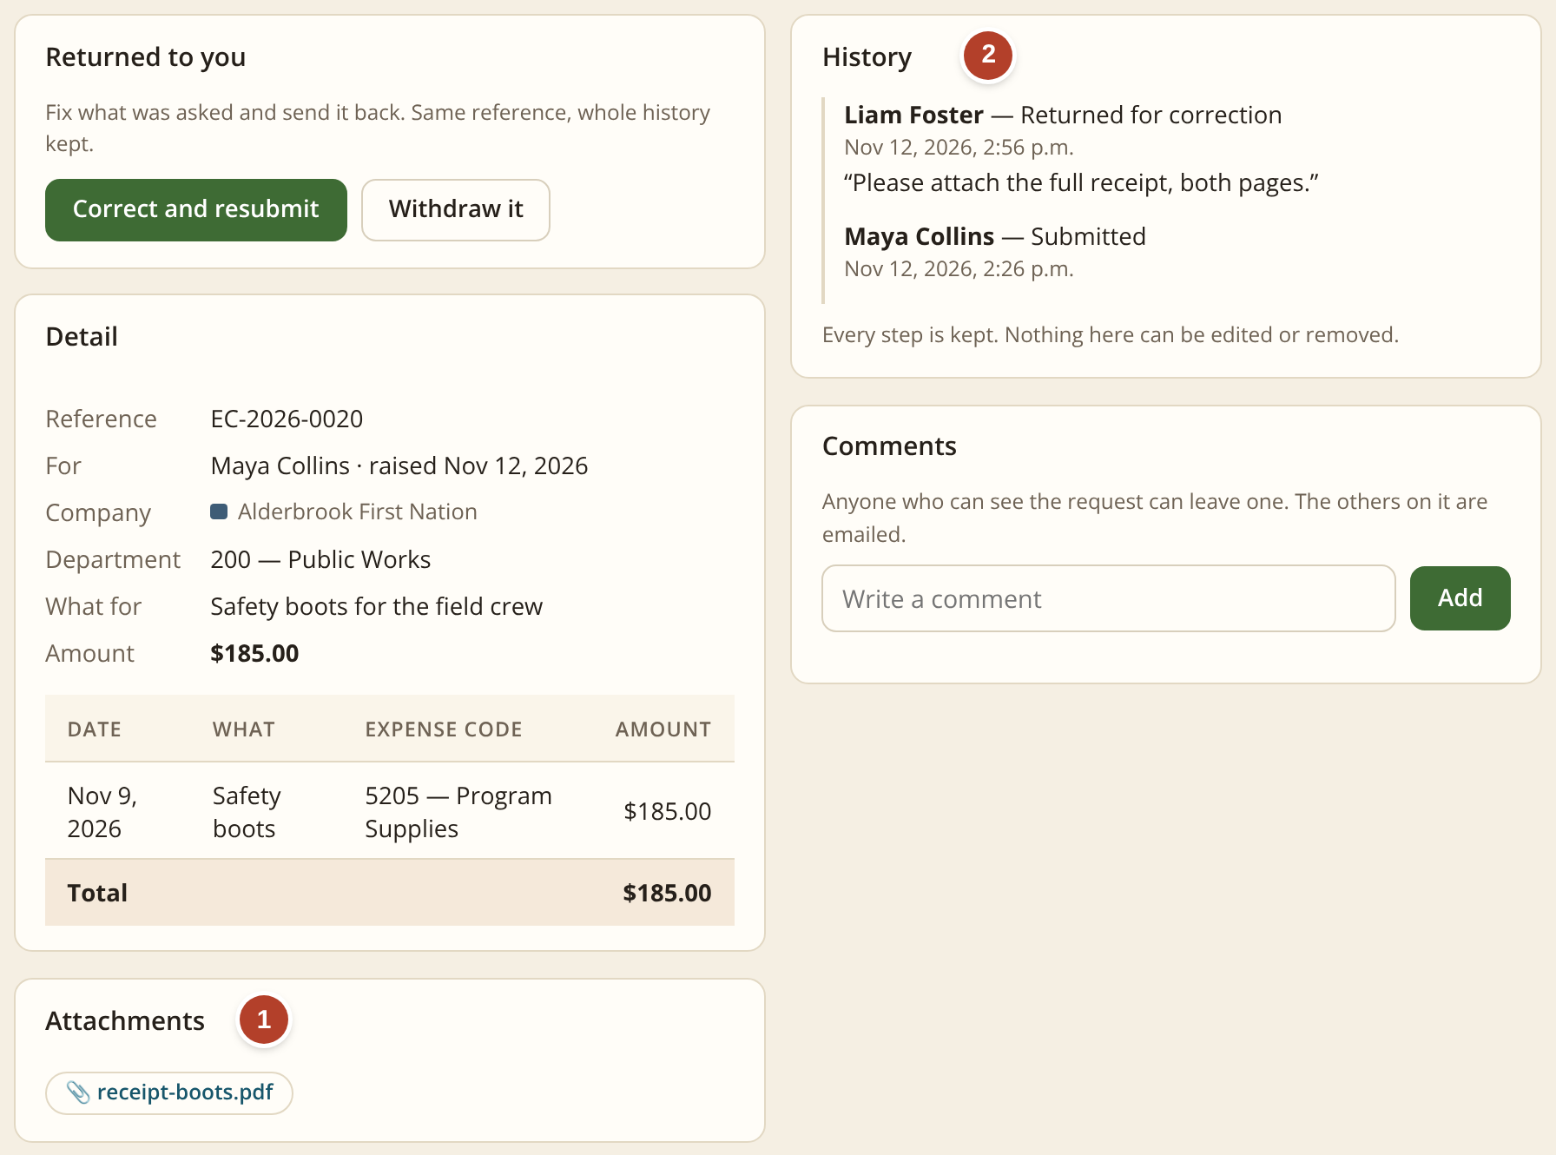
Five kinds of request, each with its files and its history
REQUESTS AND PURCHASE ORDERS
Travel request
Approval before a trip: where, when and the estimated cost.
1
Files attached
Receipts, quotes and other files are added while filling in the request. They stay with it.
Credit card purchase
Approval before buying something on the organization’s card.
2
Its own history
Who sent it, who approved or returned it, when, and any comment.
Travel claim
Mileage, meals and other costs after a trip.
Expense claim
Money spent out of pocket, with the receipt.
Screen: one expense claim opened.
Purchase order
Approval to order from a supplier.
A traceable record for every request. The request, attachments and approval events stay together under one number. Permitted corrections are captured as additional history, rather than silently overwriting the record.
Notes:
Five request types, each one short form. Files are attached while filling in the request and stay with it; each request has its own history. Permitted corrections are captured as additional history rather than overwriting the record.

Slide 10

A request moves in minutes, and everyone can see it
REQUESTS AND PURCHASE ORDERS
1
The route
Who has approved and who is next.
2
The history
Each step with name, date and comment.
3
The details
Department and expense code are required.
 | TODAY | NEW SYSTEM
Steps people do | 6 | 2
Emails written | ≈ 3 | 0
Time per request | 1–2 hours | ≈ 30 min
Signatures | hand or e-sign | one click
Screen: one request opened. The bar shows the route.
Estimates for an illustrative organization of 100 staff; how they were estimated is on slide 3.
Notes:
One request opened: the route across the top, the history with names, dates and comments, and the required details. About six steps on paper become two.

Slide 11
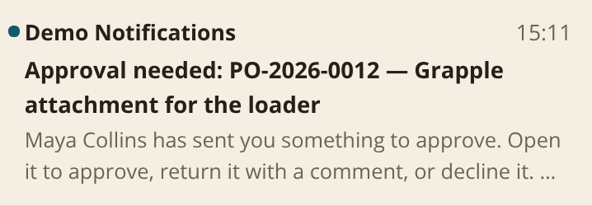
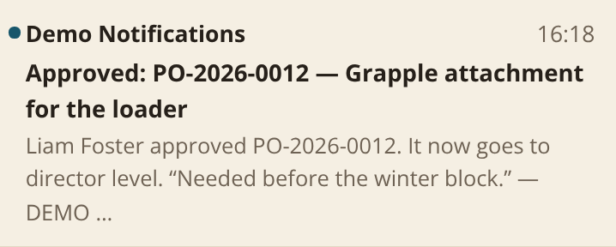
Today a purchase order travels by paper, scanner and email
REQUESTS AND PURCHASE ORDERS
TODAY: PAPER, SIGNATURES, SCANNER AND EMAIL
1 A paper PO form is filled in by hand
›
2 It is taken round for signatures
›
3 Someone scans it
›
4 The scan is sent to Finance; the department keeps one copy
›
5 Finance stores it on a computer
›
6 Later it has to be hunted for. Sometimes it is missing
WITH THE SYSTEM: ONE PLACE
1 It is filled in online
›
2 The supervisor approves with one click
›
3 Director level approves if it is over $5,000
›
4 The PO is numbered and stays on record
Pages printed
Missing purchase orders
Nobody writes an email. The system sends the notices itself:
about 3
→ 0
sometimes
→ risk reduced
The supervisor receives this
The employee receives this
Notes:
How a purchase order moves today: paper form, signatures, scan, email to Finance, stored on a computer, and later hunted for. In the system it is filled in online, approved with one click, director level above $5,000, and numbered on record. The system sends the notices itself.

Slide 12
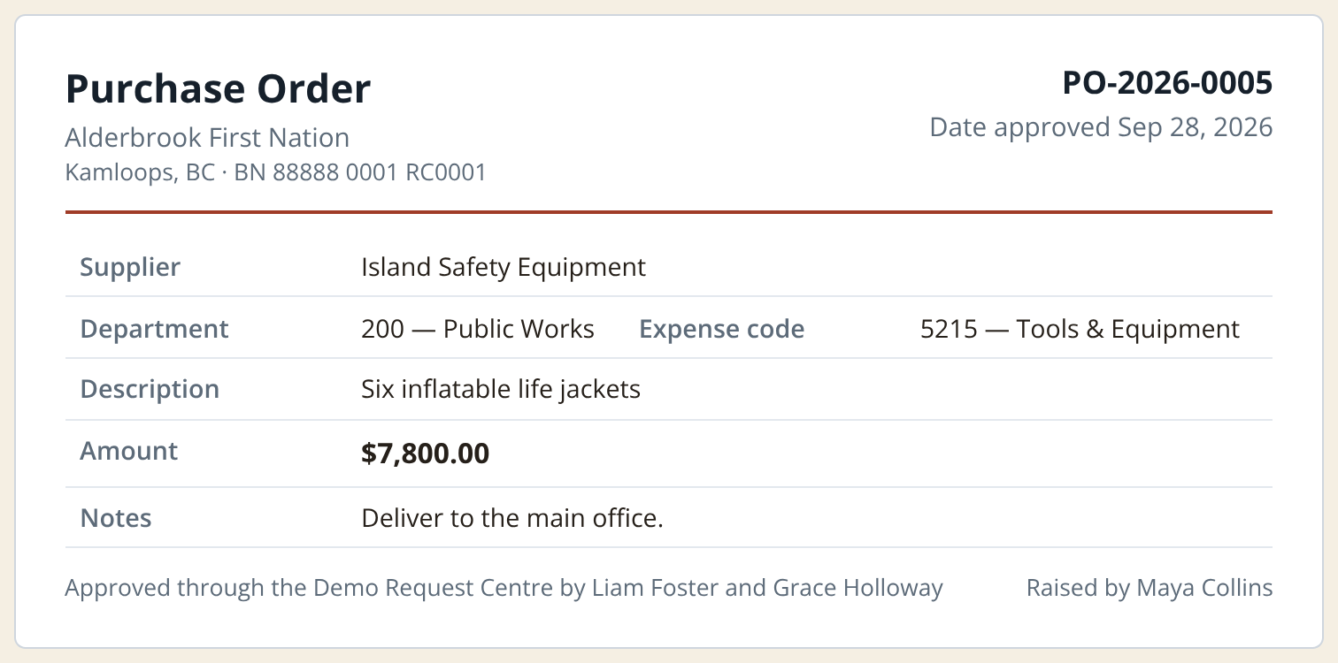
Purchase order approvals: controlled and traceable
REQUESTS AND PURCHASE ORDERS
What changes for one purchase order
 | TODAY | NEW SYSTEM
Steps people do | 8 | 3
Time per order | 1–2 hours | ≈ 30 min
Pages printed | ≈ 3 | 0 to 1
PO location | scattered | centralized
Screen: the one-page purchase order, ready to print or download as a PDF.
The workflow can enforce the configured approval sequence. Self-approval should be blocked, and approved delegation and exception rules must be defined, tested and recorded. The PO should show its approval history.
Employee asks
Supervisor approves
Director level if over $5,000
PO is ready, with its number
Estimates for an illustrative organization of 100 staff; how they were estimated is on slide 3.
Notes:
The approval path: employee, supervisor, director level above $5,000, then the PO with its number. The workflow can enforce the configured sequence; self-approval should be blocked and delegation and exception rules defined, tested and recorded.

Slide 13
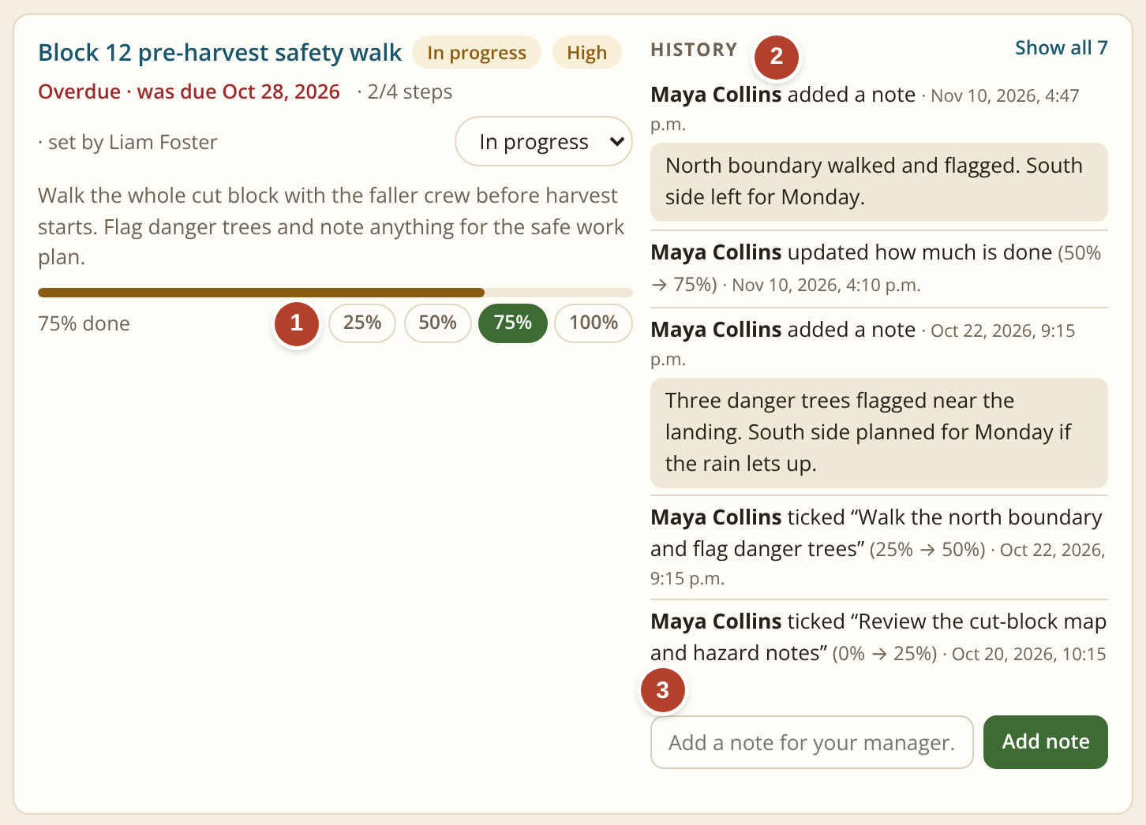
My Tasks: assigned, tracked and reported in one place
TASKS, SELF-SERVICE AND TRAINING
1
Progress with one click
25, 50, 75 or 100 percent.
2
The history
Who did what, and when.
3
A note for the manager
It replaces the status email.
Today: nothing like this. Tasks are given by email or in a meeting, and progress is found out by asking.
A streamlined workflow and more productive teams. Everyone sees what is assigned, what is late and what is done.
Screen: My Tasks. One task a manager assigned to an employee.
Notes:
My Tasks: progress with one click, the history of who did what, and a note for the manager that replaces the status email.

Slide 14
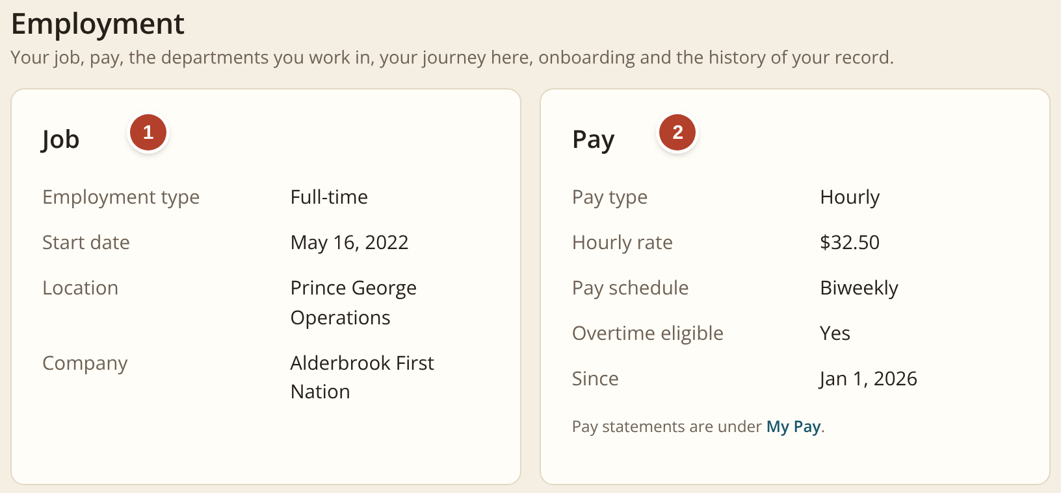

Staff check their own pay, job details and benefits
TASKS, SELF-SERVICE AND TRAINING
1
Employment details
Start date, position, location and who they report to.
2
Pay details
Pay rate, pay schedule and every pay statement, the moment it is ready.
3
Pension and benefits
The plans they are in, what comes off each pay and what the employer adds.
Today: an email to Finance or HR, then a wait for someone to look it up and reply.
With the system: employees can view the records permitted by their role once access rules and payroll/benefits data connections have been configured and tested.
Screens: My Profile › Employment and Pension & Benefits, as an employee sees them.
Notes:
Self-service: employment details, pay details and pension and benefits. Employees can view the records permitted by their role once access rules and payroll and benefits data connections have been configured and tested.

Slide 15
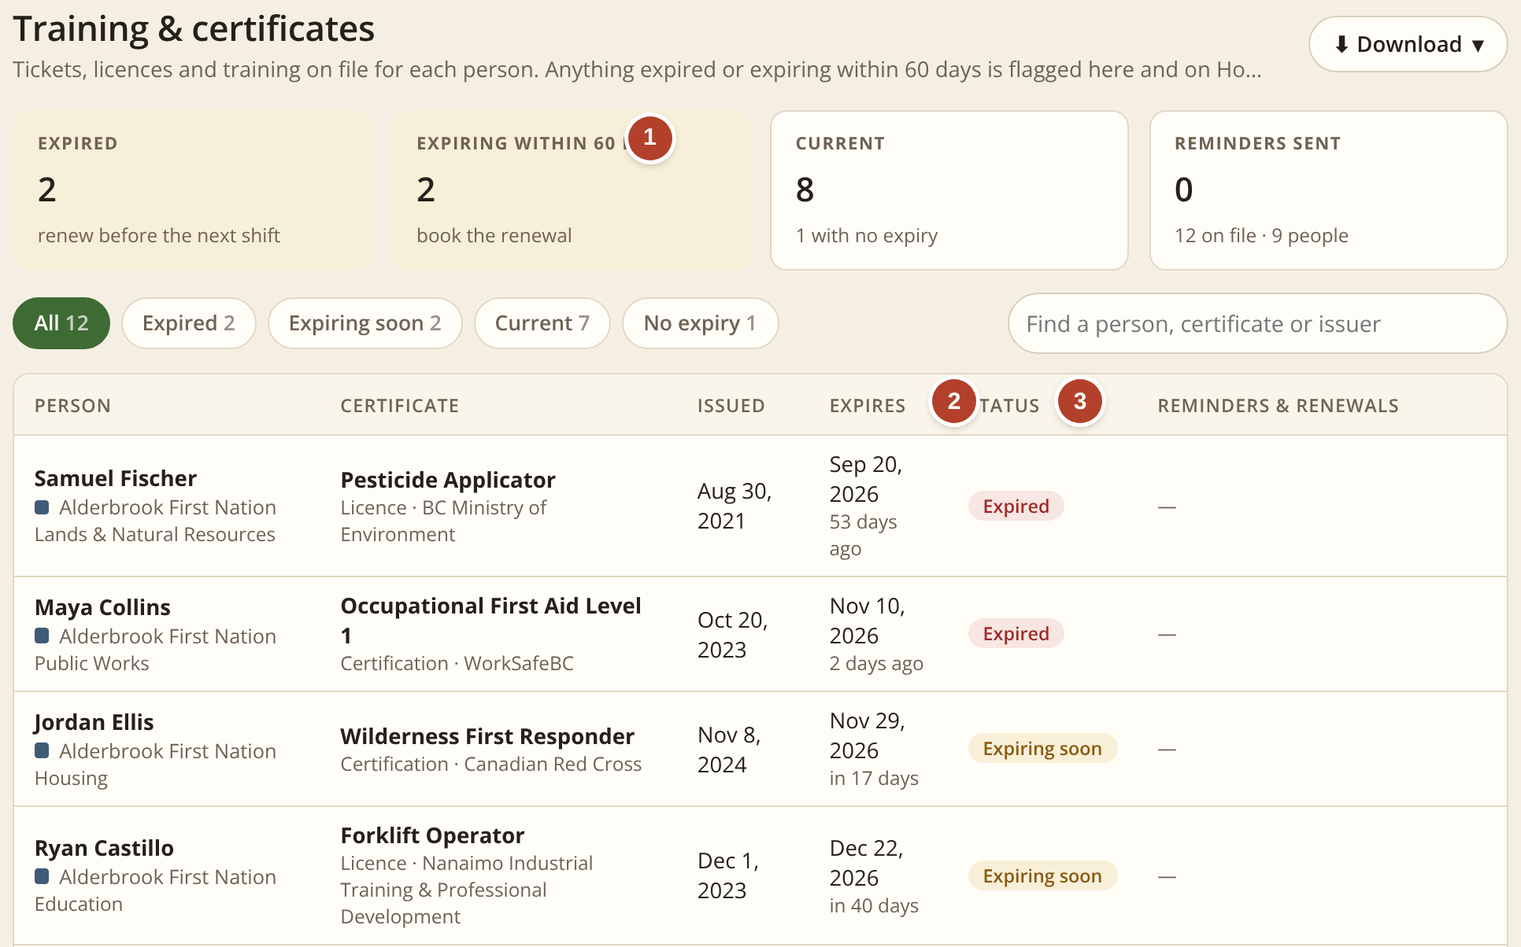
Certificates: expiry dates tracked for managers and HR
TASKS, SELF-SERVICE AND TRAINING
1
What needs attention
Expired, and expiring within 60 days.
2
The expiry date
With the days left for each one.
3
A clear status
Expired, expiring soon or current.
 | TODAY | NEW SYSTEM
Finding a date | look it up | one list
Early warning | none | 60 days
Reminders | by hand | one click
Screen: People › Certificates, as a manager sees it.
Managers see their own team. HR sees everyone, adds certificates and sends reminders.
Today: expiry dates sit in files and spreadsheets, and a lapsed certificate is often noticed only after it has expired.
Notes:
Certificates: what needs attention, each expiry date and a clear status. Managers see their own team; HR sees everyone and sends reminders.

Slide 16
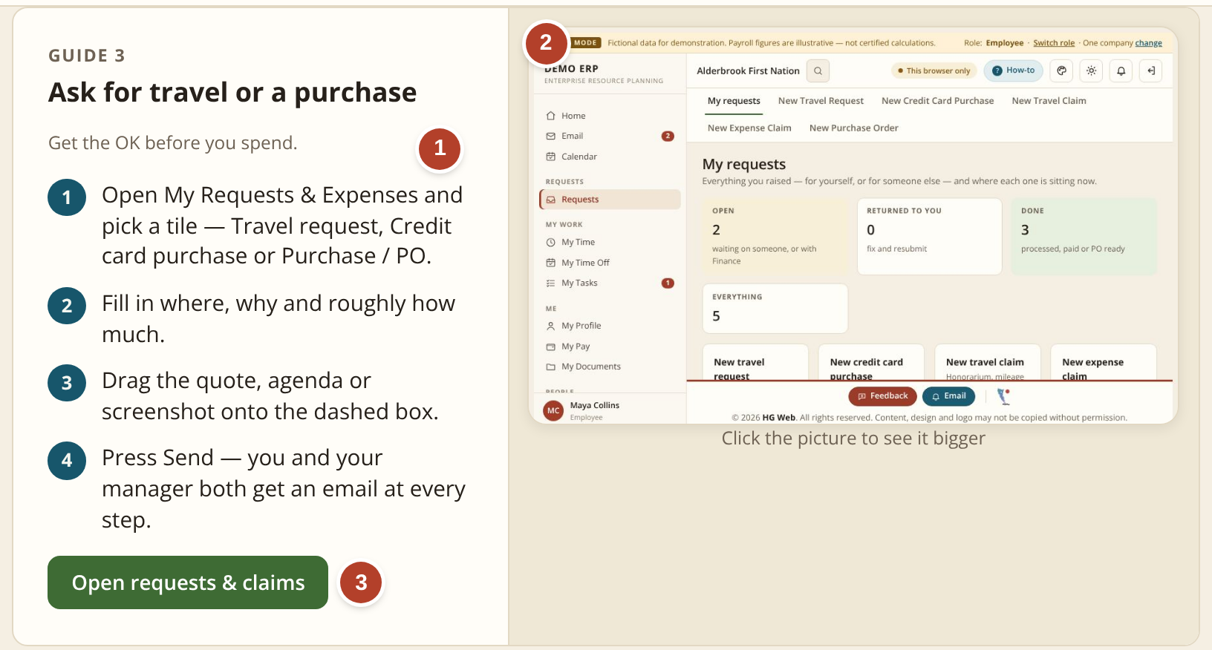
Built-in How-to guides: target faster staff onboarding
TASKS, SELF-SERVICE AND TRAINING
1
The proper procedure, step by step
Written in plain words, the same for everyone.
2
A picture of the real screen
So people know what to look for.
3
One button opens the page
Read the steps, then do the job.
 | TODAY | NEW SYSTEM
Training a new hire | 2–3 months | 2-week target
How people learn | ask around | follow guide
Guides by role | none | built in
Screen: How-to guides. One guide, as a new employee sees it.
Today: a new employee often learns forms and processes by asking colleagues; the current 2–3 month estimate should be validated with managers.
Training times are planning estimates; the two-week figure is a target to test during the pilot.
Notes:
How-to guides: the procedure step by step, a picture of the real screen, and a button that opens the page. The two-week training figure is a target to test during the pilot.

Slide 17
Illustrative administrative-time estimate: about one third
CONTROL AND GOVERNANCE
Where the time goes today
Filling in paper forms or editing PDFs, and collecting signatures.
Scanning and emailing the signed copy.
Hunting for a form or PO that cannot be found.
Counting overtime, banked time and leave by hand.
The system removes these four. It does not remove the decision: a person still approves every item.
Planning estimate for an illustrative 100-staff organization; validate against CHN baseline data during discovery.
Notes:
An illustrative estimate of admin minutes for one item, today and with the system. Validate against CHN baseline data during discovery.

Slide 18
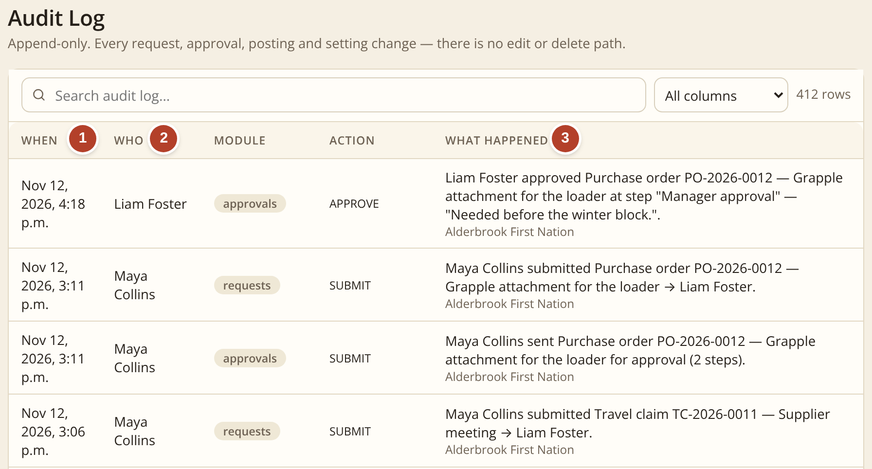
A proper audit trail, kept automatically
CONTROL AND GOVERNANCE
1
When
The date and time of every action, written the moment it happens.
2
Who
The person who did it, by name.
3
What happened
In plain words, with the request number, the step and any comment.
Audit history should retain submitted events. Permitted corrections must use controlled actions that create a traceable entry; retention, access and export rules are set with CHN.
Screen: Administration › Audit log. One purchase order, step by step.
Today: the trail is paper forms, scans and emails spread across folders and inboxes. If a PO is missing, so is the proof of its approval. With the system: one searchable record, ready for auditors and funders.
Notes:
The audit trail records when, who and what happened for every action. Submitted events are retained; permitted corrections use controlled actions that create a traceable entry; retention, access and export rules are set with CHN.

Slide 19




Beyond time saved: independence and less stress
CONTROL AND GOVERNANCE
Less dependence on outside apps
No dependence on AI
Requests, purchase orders, timesheets and tasks live in one system instead of separate tools, spreadsheets and paper forms. Fewer subscriptions, fewer logins.
The system runs on fixed, ordinary rules that people set. It needs no AI service to work, and no information is sent to one.
CHN-controlled data governance
Less paperwork, less stress
Hosting location, data ownership, export rights, backups, vendor access and retention terms will be agreed with CHN IT and leadership before implementation.
A shared view of status reduces avoidable follow-up, duplicate handling and time spent searching for paperwork.
Notes:
Four benefits beyond time: fewer outside apps, no dependence on AI, CHN-controlled data governance agreed with CHN IT and leadership before implementation, and less paperwork and stress.

Slide 20
Data security, privacy and IT governance
CONTROL AND GOVERNANCE
These are production-readiness requirements to confirm with CHN, not claims that every control is already complete in the prototype.
Identity and access
CHN-managed sign-in and multi-factor authentication
Role-based access for employees, managers, HR and Finance
Timely access changes when staff join, move or leave
Data protection and hosting
Encryption in transit and at rest
Confirm Canadian hosting and data-residency requirements
Encrypted backups with documented restore testing
Records and accountability
Defined retention, access and export rules
Traceable submissions, approvals and corrections
Controlled vendor access and clear responsibilities
Operational readiness
Patch, vulnerability and security monitoring
Incident response and support responsibilities
Recovery targets and tested continuity procedures
PILOT-READINESS GATE Before a pilot, CHN IT, privacy and records-management leads should review the requirements, assign owners and agree the evidence needed to accept each control.
Notes:
These are production-readiness requirements to confirm with CHN, not claims that every control is already complete in the prototype: identity and access, data protection and hosting, records and accountability, and operational readiness. Before a pilot, CHN IT, privacy and records-management leads review the requirements and agree the evidence needed for each control.

Slide 21
Pricing, financial exposure and timeline
PRICING, TIMELINE AND NEXT STEPS
Illustrative planning assumptions; confirm current contracts, vendor quotes and final implementation scope before any commitment.
CURRENT TOOLS · ESTIMATE
CAD $45,600–$48,000 / year
HR software: approximately $24,000/year
Adobe for all users: approximately $21,600–$24,000/year
External HR support is excluded.
PROPOSED SYSTEM · ESTIMATE
CAD $40,800–$42,000 / year
Recurring: $30,000 system (10 × $3,000) plus $10,800–$12,000 Adobe
One-time setup: $10,000
48-hour support target subject to contract.
FIRST YEAR
$50,800–$52,000
Proposed cost including setup; about $2,800–$6,400 above the current estimate.
THREE-YEAR VIEW
$132,400–$136,000
Proposed total including setup, versus $136,800–$144,000 for current tools.
EXCLUDED / TO VALIDATE
External HR and other costs
Hosting, migration, tax, internal staff time, price changes and any external HR costs are not included.
Illustrative 3-year difference: $800–$11,600 lower; not a guaranteed saving.
PROPOSED PATH TO A PILOT
WEEKS 1–2
Requirements, baseline and IT/privacy review
WEEKS 3–6
Configuration and implementation
WEEKS 7–8
Controlled pilot in one or two departments
GO / NO-GO
Evaluate results before production rollout
Notes:
Pricing and timeline. Current tools are estimated at $45,600 to $48,000 a year: HR software about $24,000 and Adobe for all users $21,600 to $24,000, with external HR support excluded. The proposed system is estimated at $40,800 to $42,000 a year: $30,000 for the system, ten months at $3,000 because payments start after deployment, plus Adobe for about half the users, $10,800 to $12,000; a one-time setup of $10,000; and a 48-hour support target subject to contract. The first year including setup is $50,800 to $52,000, about $2,800 to $6,400 above the current estimate; over three years the proposal is an illustrative $800 to $11,600 lower, not a guaranteed saving. Hosting, migration, tax, internal staff time, price changes and external HR costs are not included. The path to a pilot: weeks 1–2 requirements, baseline and IT and privacy review; weeks 3–6 configuration and implementation; weeks 7–8 a controlled pilot in one or two departments; then a go or no-go decision before production rollout.

Slide 22
Where we are, and what happens next
Today: a working prototype
Every screen in this briefing can be tried in a browser with fictional people and figures. It is not connected to real staff accounts or production email. Features and integrations will be confirmed during requirements and security review.
1
Validate requirements and baseline
Confirm CHN volumes, current processing times, forms, approval thresholds, overtime and leave rules, and user roles.
2
Complete IT and privacy review
Agree hosting, sign-in and MFA, permissions, backups, recovery, retention, vendor access and data ownership.
Proposed path to pilot
Planning target: 2 weeks discovery and governance review, 4 weeks configuration and build, then a 2-week pilot. Full production deployment follows a separate go/no-go decision.
3
Run a controlled pilot
Start with one or two departments and purchase orders and timesheets; train users and provide support.
4
Evaluate before production rollout
Measure processing time, approval completeness, record retrieval, user adoption and reliability. Bring results back for a rollout decision.
Decision requested: authorize requirements validation and pilot planning. Production rollout requires a separate approval.
Notes:
To close. Today there is a working prototype with fictional people and figures, not connected to real staff accounts or production email. The planning target is two weeks of discovery and governance review, four weeks of configuration and build, and a two-week pilot; full deployment follows a separate go or no-go decision. Next: validate CHN requirements and baseline, complete the IT and privacy review, run a controlled pilot, and evaluate before production rollout. The decision requested is to authorize requirements validation and pilot planning.

