Slide 1

One place for requests, purchase orders, timesheets and tasks
A working prototype, and what it would save
Briefing for the Executive Committee · November 2026
Prepared by Andalib Olee
Notes:
Opening. This is a short briefing on a working prototype: one central system for the four things that take the most back-and-forth today: requests, purchase orders, timesheets and tasks. The picture on the right is the real Home page of the prototype. All names and figures in the screenshots are fictional. I will show what each part looks like, how it compares with how we work today, and what it could save in time and cost.

Slide 2
The proposal in one minute
Today requests, purchase orders and timesheets run on paper and PDF forms, signatures, scans and email, and there is no shared place for tasks. One central system would handle all four, with every approval recorded automatically.
≈ 1/3
≈ 1,400 h
≈ $56,000
One centralized software
of the task time: a request, purchase order or timesheet takes about one third of the time it takes today
a year given back to real work, for every 100 staff
a year in staff time, at $40 an hour
instead of multiple websites and software
How these were estimated
An organization of 100 staff at $40 an hour: 2,600 timesheets a year (one every two weeks each), about 600 requests and 240 purchase orders.
Task time today: 1–2 hours for a request or purchase order (filling in or editing the PDF, signatures, scanning, emailing, following up) and about 20 minutes for a timesheet. In the system: about one third of that.
The yearly counts are assumptions; CHN’s own counts would give CHN’s figure. The cost to build and host the live system is not counted.
Notes:
The whole proposal on one page. Today requests, purchase orders and timesheets run on paper and PDF forms, signatures, scans and email, and there is nothing in place for tasks. In one system, each of these takes about one third of the task time it takes today, because nobody edits a PDF, walks a form round for signatures, scans it, emails it or goes looking for it. For every 100 staff that is roughly 1,400 hours a year, worth about $56,000 at $40 an hour. The fourth box is not about time: it is one centralized software instead of multiple websites and software, so everything is in one place and nothing goes missing. The bottom of the slide says how the figures were estimated: 100 staff, 2,600 timesheets, about 600 requests and 240 purchase orders a year; one to two hours today for a request or purchase order and about 20 minutes for a timesheet. These are estimates, and our own counts can replace them.

Slide 3
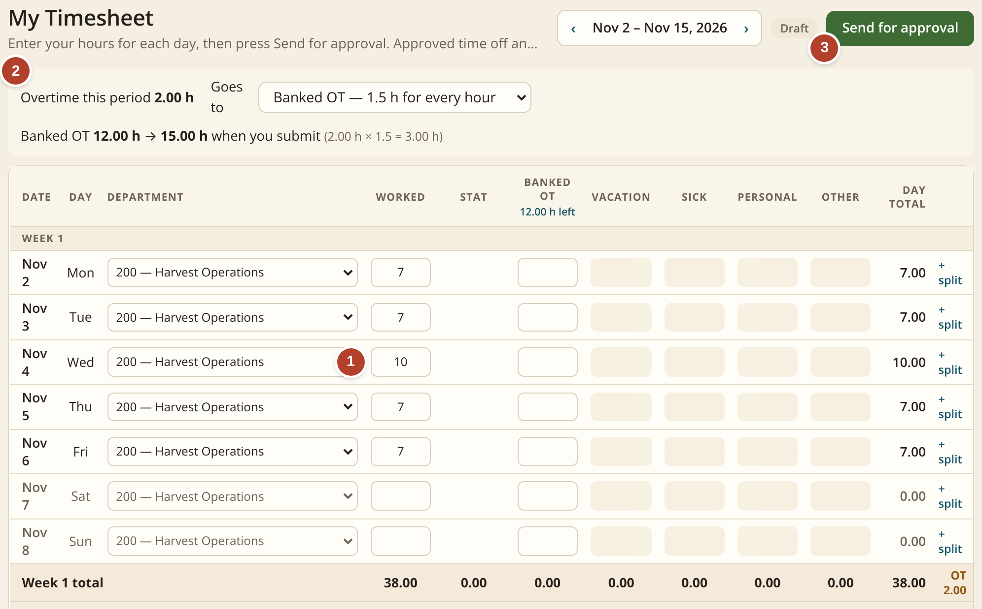
Timesheets: type the hours, the system does the math
1
Type the hours for each day
Here a 10-hour Wednesday among 7-hour days.
2
Overtime is worked out for you
Banked at 1.5 hours for every hour, or paid: the employee chooses. The balance updates at once.
3
One button sends it for approval
The supervisor approves it on screen. No paper, no scan.
Stat holidays and approved time off fill in by themselves.
Screen: My Timesheet, as an employee sees it.
Today: a paper or spreadsheet timesheet, signed, scanned and emailed. Overtime and banked time are counted by hand.
Notes:
The timesheet. One: the employee types the hours worked each day. In this example Wednesday is a 10-hour day. Two: the system works out the overtime by itself and shows it at the top: two hours of overtime, banked at one and a half times, so the banked balance goes from 12 to 15 hours. The employee can choose to bank it or have it paid. Three: one button sends the timesheet to the supervisor, who approves it on screen. Stat holidays and approved time off are already filled in, so nobody has to remember them. Today this is a paper or spreadsheet timesheet that is signed, scanned and emailed, and overtime and banked time are counted by hand.

Slide 4
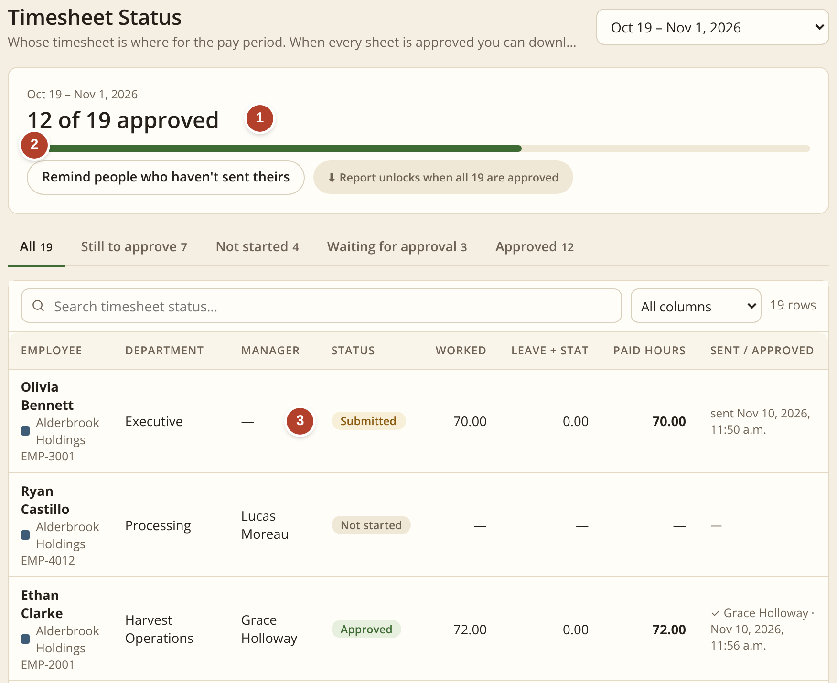
One page shows who has not sent a timesheet
1
Progress for the pay period
How many timesheets are approved.
2
One button reminds the rest
No chasing by email or phone.
3
Each person’s status
Not started, submitted or approved.
 | TODAY | NEW SYSTEM
Steps people do | 5 | 2
Time per timesheet | ≈ 20 min | ≈ 7 min
Overtime, banked time | by hand | automatic
Chasing late ones | one by one | one button
Estimates for an organization of 100 staff; how they were estimated is on slide 2.
Screen: Time & Attendance › By pay period.
Notes:
This page is for the person who collects the timesheets each pay period. One: the bar shows how many are approved, here 12 of 19. Two: one button sends a reminder to everyone who has not sent theirs, instead of chasing people one by one. Three: the list shows each person's status: not started, submitted or approved. Per timesheet, the time goes from about 20 minutes to about 7, because nothing is printed, signed, scanned or emailed, and overtime and banked time are worked out automatically. With 2,600 timesheets a year for 100 staff, the small saving on each one adds up.

Slide 5

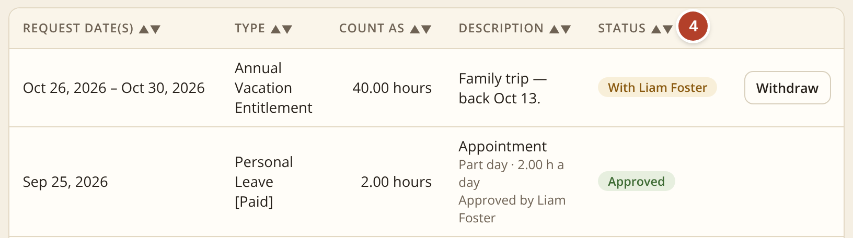
Time off: one short form instead of a PDF and an email
1
Pick the type and the days
The hours are worked out for you.
2
See what is left first
The balance after this request, before it is sent.
Today: a PDF form is filled in, signed and emailed, and the balance is checked by asking.
3
One button sends it
It goes straight to the supervisor.
 | TODAY | NEW SYSTEM
How it is asked | PDF + email | one form
Balance left | ask HR | shown first
On the timesheet | typed again | fills itself
4
Follow the status
Who has it, and when it is approved.
Screen: My Time Off.
Notes:
Time off. Today a person fills in a PDF form, signs it and emails it, and to know how many days they have left they ask HR. In the system it is one short form. One: pick the type of leave and the first and last day, and the hours are worked out automatically, leaving out weekends and stat holidays. Two: before anything is sent, the green box shows the balance and what will be left after this request. Three: one button sends it straight to the supervisor, who approves it on screen. A doctor's note or booking can be attached. Four: the list shows each request and its status: who has it now, and when it is approved. Once approved, the hours fill in on the timesheet by themselves, so nothing is typed twice, and the team calendar shows who is away.

Slide 6
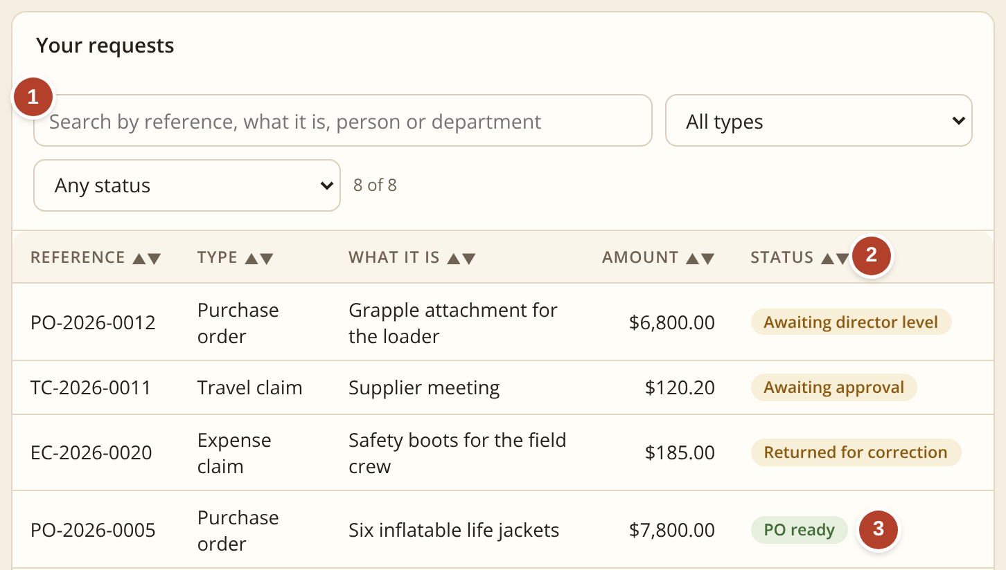
Requests: every type in one place, with its status
1
Find any request in seconds
Search by number, person, department or what it was for.
2
See where it stands right now
Awaiting approval, awaiting director level, returned to you, or ready.
3
Nothing goes missing
A finished request stays on the list with its number. It cannot be lost in an inbox or a filing tray.
Five request types, one short form each: travel, credit card purchase, travel claim, expense claim and purchase order.
Screen: My requests, as an employee sees it.
Today: a paper or PDF form for each type, saved and passed on as an email attachment. To know where one is, you ask around.
Notes:
This is what an employee sees under Requests. The red numbers on the picture match the three points on the right. One: a search box finds any request by number, person or department. Two: the Status column says in plain words where each request stands: awaiting approval, awaiting director level, returned to you with a comment, or ready. Three: finished requests stay on the list with their number, so nothing is lost. There are five kinds of request, each with one short form: travel, credit card purchase, travel claim, expense claim and purchase order. Today each of these is a paper or PDF form that is saved and passed on as an email attachment, and the only way to know where one is, is to ask around.

Slide 7
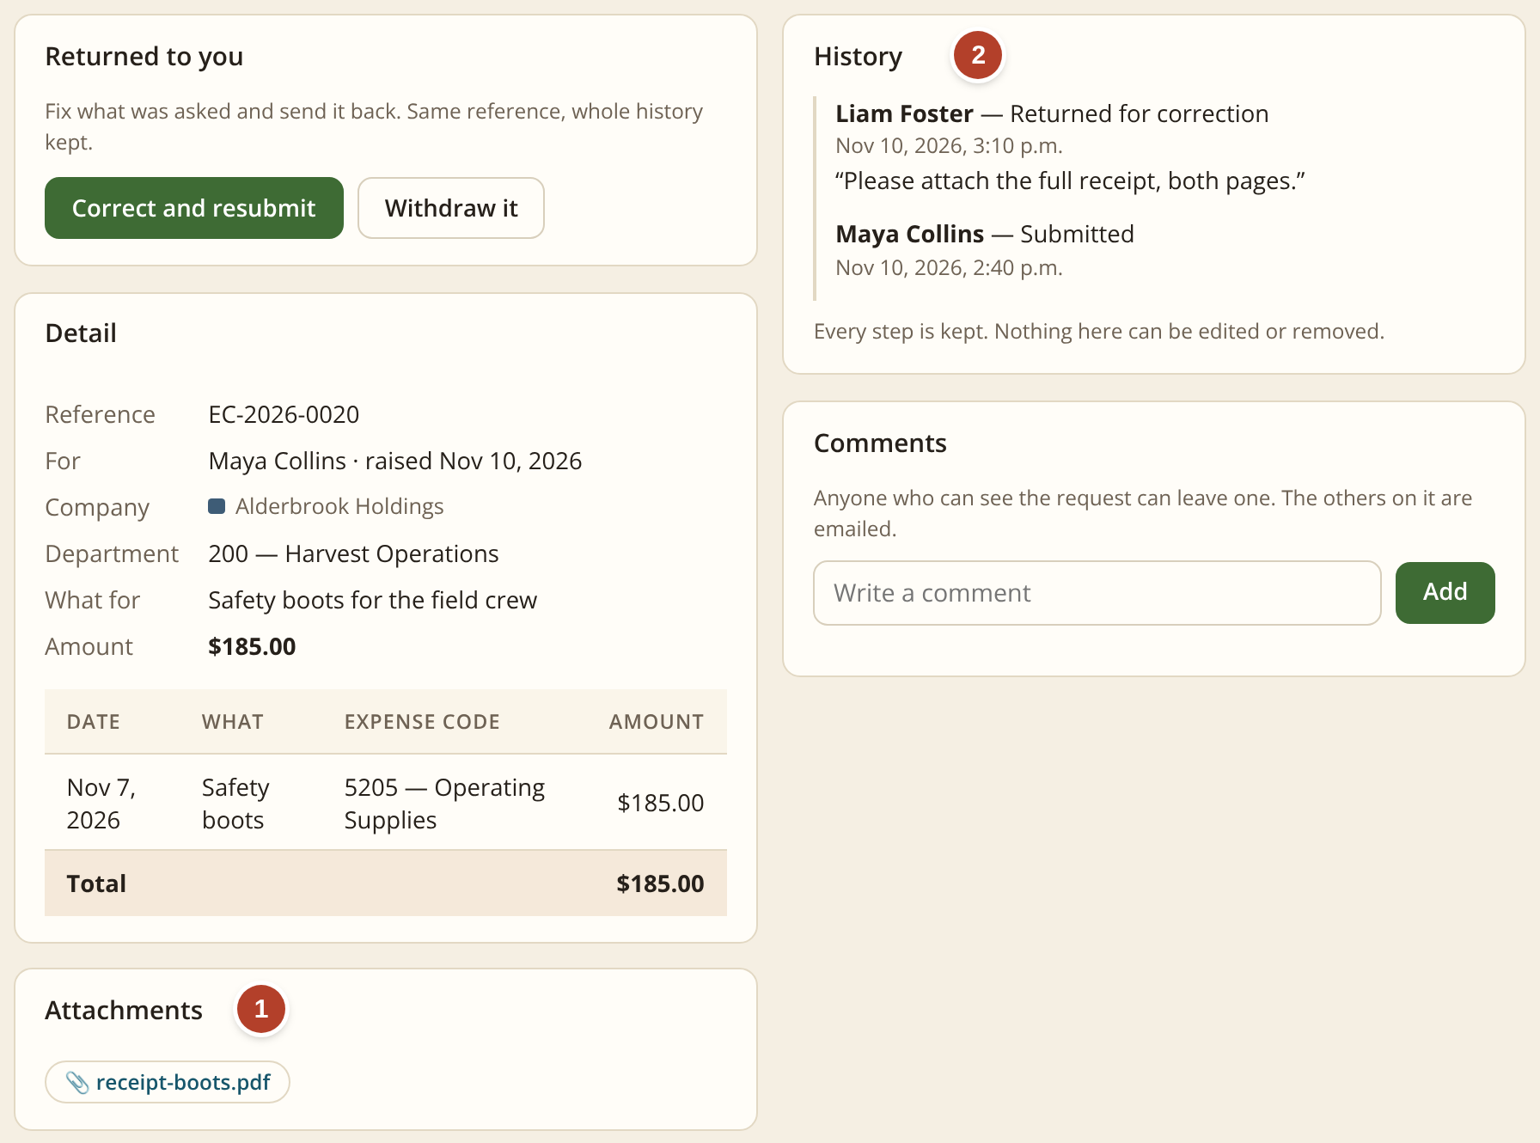
Five kinds of request, each with its files and its history
Travel request
Approval before a trip: where, when and the estimated cost.
1
Files attached
Receipts, quotes and other files are added while filling in the request. They stay with it.
Credit card purchase
Approval before buying something on the organization’s card.
2
Its own history
Who sent it, who approved or returned it, when, and any comment.
Travel claim
Mileage, meals and other costs after a trip.
Expense claim
Money spent out of pocket, with the receipt.
Screen: one expense claim opened.
Purchase order
Approval to order from a supplier.
A proper audit trail for every type. The request, its files and each approval are kept together under one number. Nothing can be edited or removed.
Notes:
These are the five kinds of request the system handles: a travel request before a trip, a credit card purchase, a travel claim after a trip, an expense claim for money spent out of pocket, and a purchase order. Each one is a short form. The picture is one expense claim opened. One: files can be attached while filling in the request, such as a receipt or a quote, and they stay with the request, so there is no separate email attachment to keep track of. Two: each request has its own history: who sent it, who approved or returned it, when, and any comment. Here the supervisor returned the claim asking for the full receipt. This is the audit trail: the request, its files and every approval are kept together under one number, and nothing can be edited or removed.

Slide 8
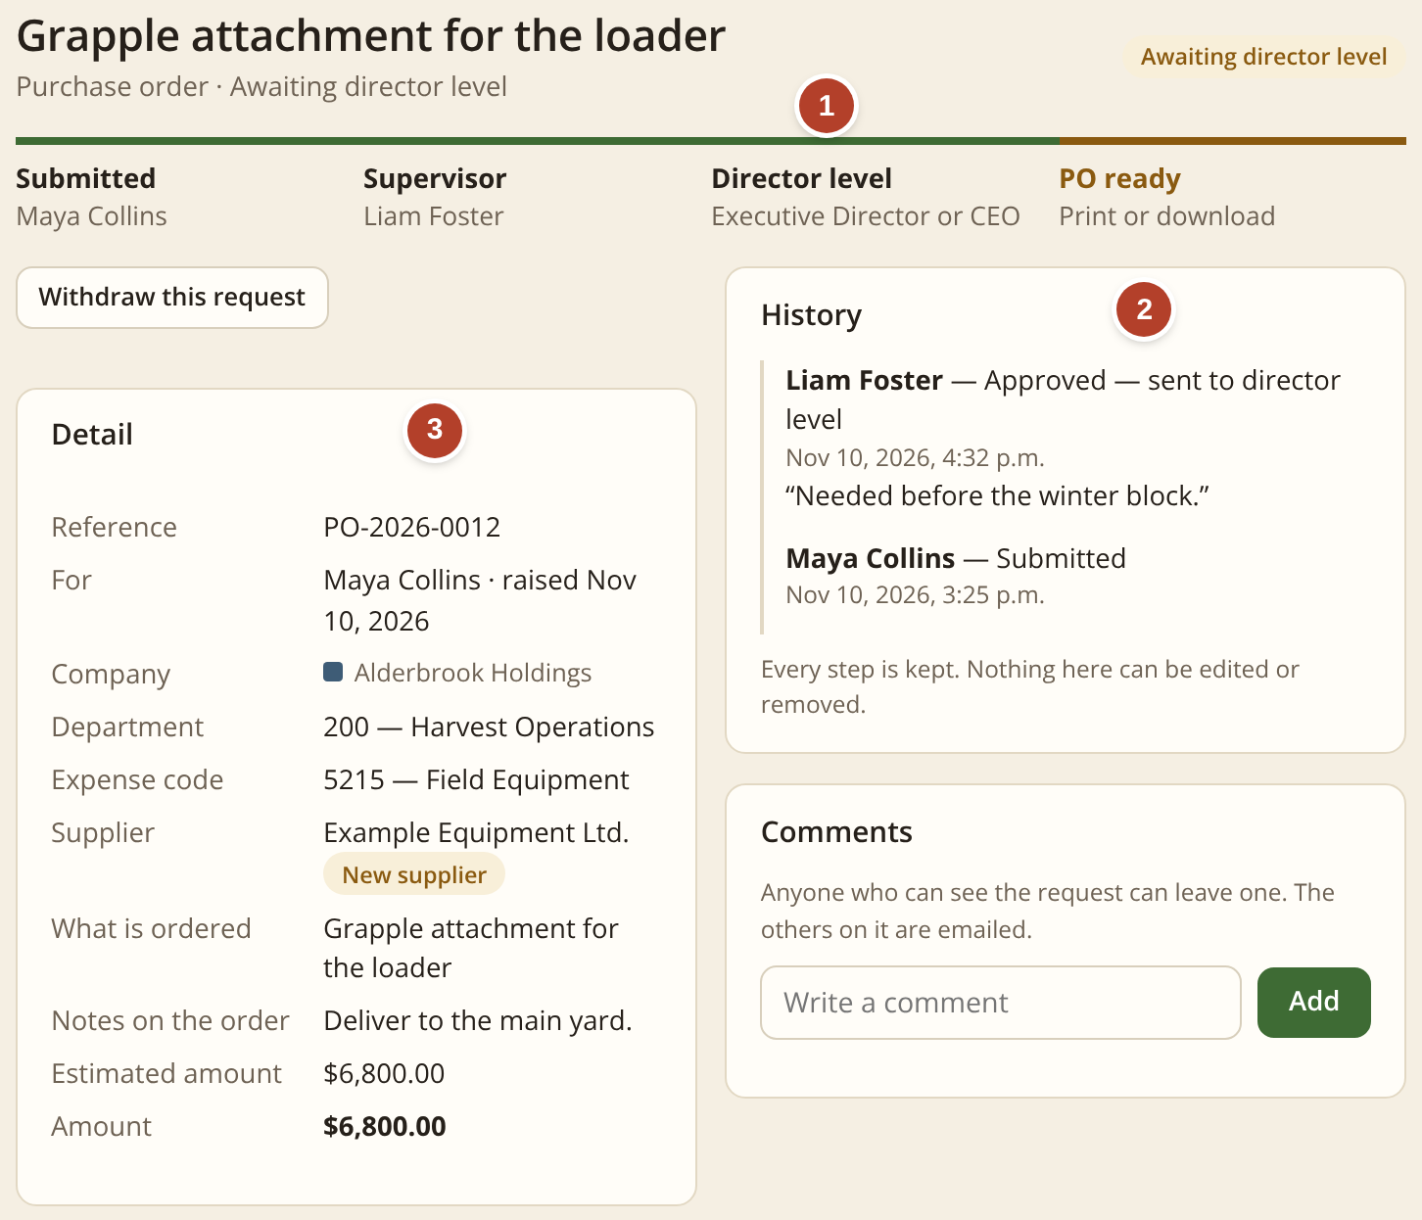
A request moves in minutes, and everyone can see it
1
The route
Who has approved and who is next.
2
The history
Each step with name, date and comment.
3
The details
Department and expense code are required.
 | TODAY | NEW SYSTEM
Steps people do | 6 | 2
Emails written | ≈ 3 | 0
Time per request | 1–2 hours | ≈ 30 min
Signatures | hand or e-sign | one click
Estimates for an organization of 100 staff; how they were estimated is on slide 2.
Screen: one request opened. The bar shows the route.
Notes:
Here one request is opened. One: the bar across the top is the route. It shows the request was submitted, the supervisor approved it, and it is now waiting at director level because it is over $5,000. Two: the history lists every step with the person's name, the date and any comment. Nothing there can be edited. Three: the details, including the department and expense code, which are required on every request. The table compares today with the system. Today it takes about 6 steps: fill in or edit the PDF form, print, collect signatures by hand or by e-sign, scan, email, then follow up, which adds up to one to two hours. In the system it is 2: submit and approve, about 30 minutes in all. If a supervisor is away on approved leave, the request also goes to the next person up, so it does not wait on someone's desk.

Slide 9
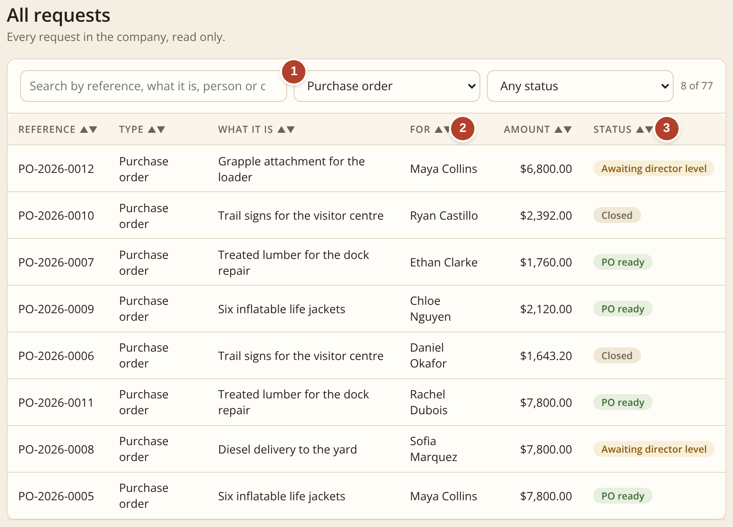
Purchase orders: one list shows where every order stands
1
Every purchase order in one list
Each has its own number. Pick “Purchase order” and they are all there.
2
Who asked for it
The person and what was ordered, with the amount.
3
Where it stands
Awaiting director level, PO ready, or closed.
Today: to find a PO, someone searches paper files, scans and inboxes, and sometimes it is not there.
Screen: Requests › All requests, showing purchase orders only.
Notes:
Purchase order tracking. Today the purchase order is a paper form. After it is signed and scanned, finding it again means searching paper files, scans and inboxes, and sometimes it is simply not there. Here every purchase order is in one list. One: choose Purchase order at the top and the list shows all of them, each with its own number. Two: the list shows who asked for it, what was ordered and the amount. Three: the Status column shows where each one stands: awaiting director level, PO ready, or closed. Nobody has to hunt, and nobody has to ask.

Slide 10
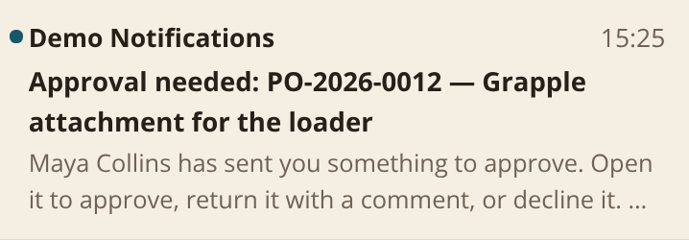
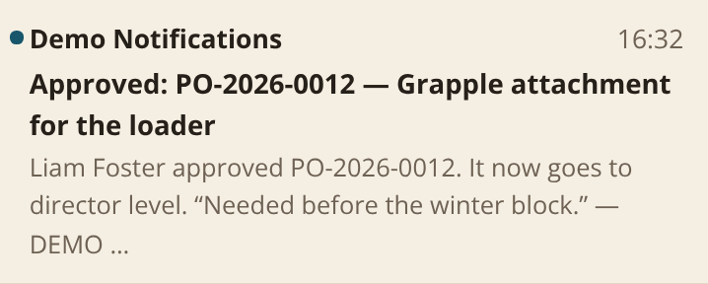
Today a purchase order travels by paper, scanner and email
TODAY: paper, signatures, scanner and email
1 A paper PO form is filled in by hand
›
2 It is taken round for signatures
›
3 Someone scans it
›
4 The scan is sent to Finance; the department keeps one copy
›
5 Finance stores it on a computer
›
6 Later it has to be hunted for. Sometimes it is missing
WITH THE SYSTEM: one place
1 It is filled in online
›
2 The supervisor approves with one click
›
3 Director level approves if it is over $5,000
›
4 The PO is numbered and stays on record
Pages printed
Missing purchase orders
Nobody writes an email. The system sends the notices itself:
about 3 → 0
sometimes → none
The supervisor receives this
The employee receives this
Notes:
This is how a purchase order moves today. It is completely on paper. Someone fills in the form by hand and takes it round for signatures. Then someone scans it and sends the scan to Finance, and the department keeps one copy. Finance stores it on a computer. Later, when the order is needed, somebody has to hunt for it, and sometimes it cannot be found. A missing PO also means the proof of approval is missing. In the system it is filled in online, the supervisor approves with one click, director level approves if it is over $5,000, and the purchase order gets its number and stays on record. No printing, no scanning and no hunting. Nobody writes an email either: the two small pictures at the bottom right are the notices the system sends by itself, one telling the supervisor that an approval is needed and one telling the employee it was approved. The same pattern applies to the other requests.

Slide 11
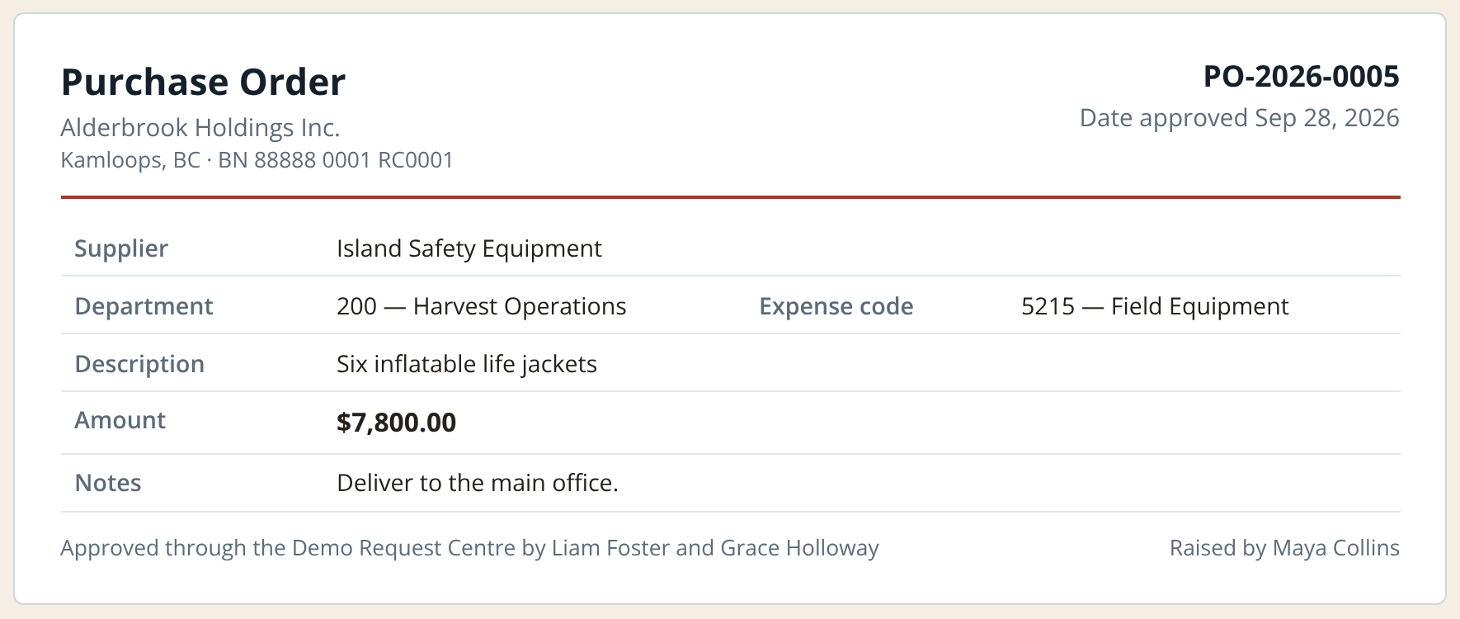
Proper approval every time, and no missing POs
What changes for one purchase order
 | TODAY | NEW SYSTEM
Steps people do | 8 | 3
Time per order | 1–2 hours | ≈ 30 min
Pages printed | ≈ 3 | 0 to 1
Missing POs | sometimes | none
Screen: the one-page purchase order, ready to print or download as a PDF.
The approval is always complete. Nobody approves their own order and no level can be skipped. The PO shows who approved it, so the printed order always matches what was approved.
Employee asks
Supervisor approves
Director level if over $5,000
PO is ready, with its number
Estimates for an organization of 100 staff; how they were estimated is on slide 2.
Notes:
How a purchase order is approved in the system. The row of boxes at the bottom is the path: the employee asks, the supervisor approves, and anything over $5,000 also needs director level. After the last approval the system produces the purchase order itself, with its number. The picture is that one-page order: the supplier, department, expense code, amount, and at the bottom the names of the people who approved it. Compare that with paper: about 8 steps become 3, and the time for one order drops from one to two hours to about 30 minutes. Two points matter most. First, a PO cannot go missing, because it only exists in the system. Second, the approval is always complete: nobody can approve their own order and no level can be skipped. The $5,000 limit is a setting an administrator can change.

Slide 12
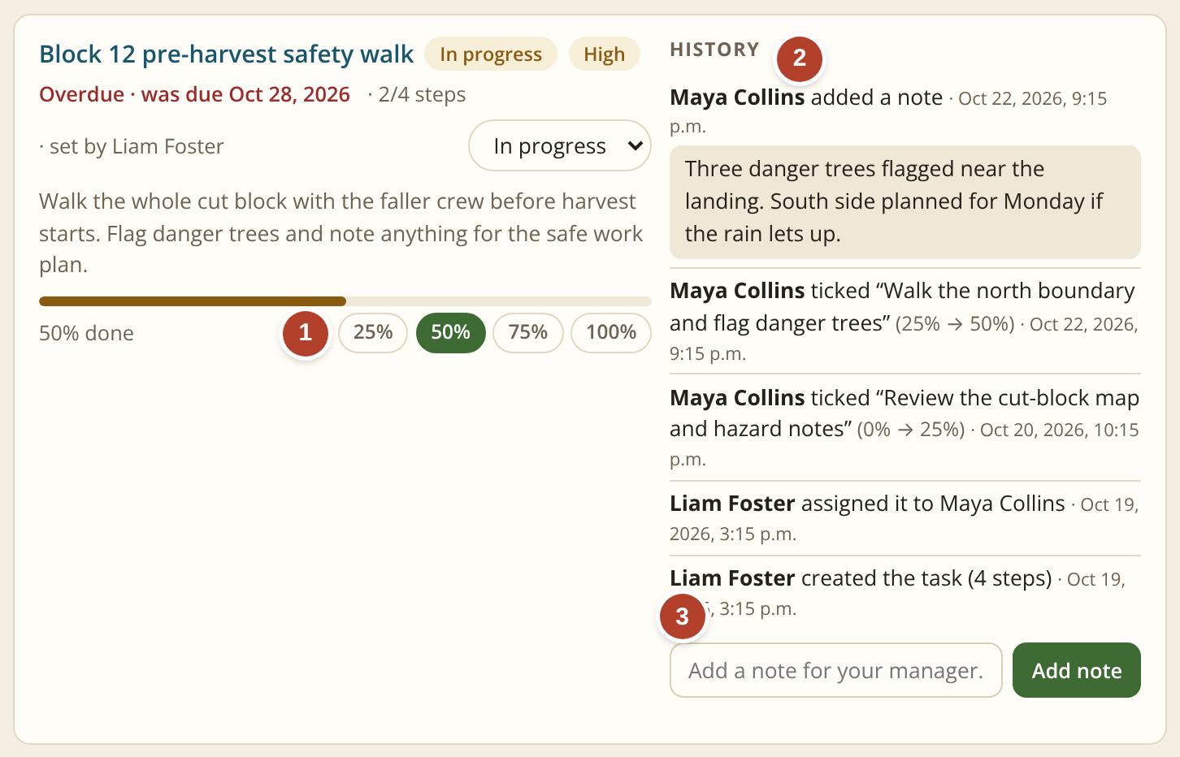
My Tasks: assigned, tracked and reported in one place
1
Progress with one click
25, 50, 75 or 100 percent.
2
The history
Who did what, and when.
3
A note for the manager
It replaces the status email.
Today: nothing like this. Tasks are given by email or in a meeting, and progress is found out by asking.
A streamlined workflow and more productive teams. Everyone sees what is assigned, what is late and what is done.
Screen: My Tasks. One task a manager assigned to an employee.
Notes:
My Tasks. Today there is nothing like this: tasks are given by email or in a meeting, and the manager finds out about progress by asking. Here a manager assigns a task with a due date and steps. One: the employee updates progress with one click. Two: the history on the right shows who created the task, who it was assigned to, each step ticked and each note, with dates. Three: a note box sends a message straight to the manager, which replaces the status email. Managers see their whole team's tasks on one page, with what is late or stuck. This streamlines the workflow and helps teams get more done, because nobody has to ask where things stand.

Slide 13
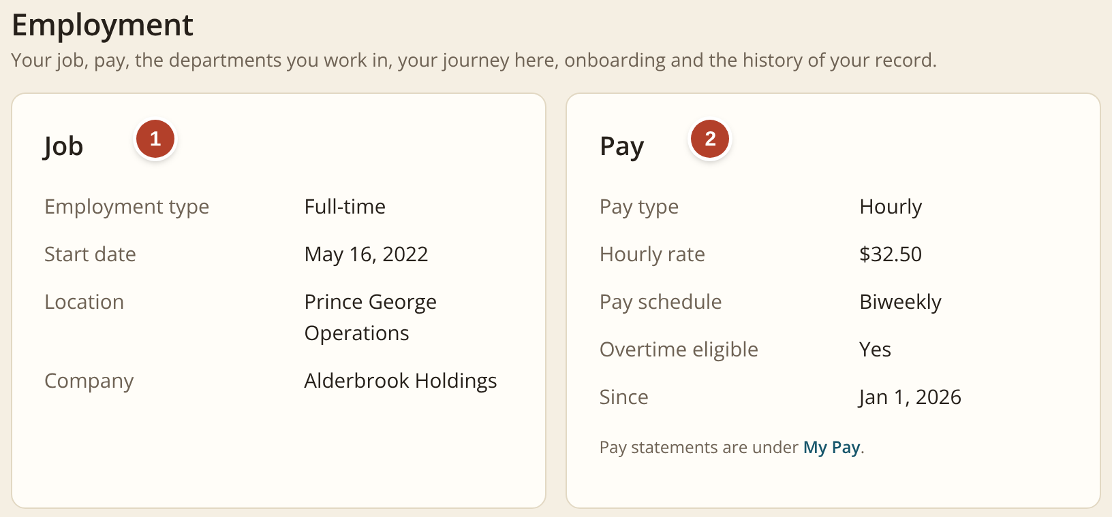

Staff check their own pay, job details and benefits
1
Employment details
Start date, position, location and who they report to.
2
Pay details
Pay rate, pay schedule and every pay statement, the moment it is ready.
3
Pension and benefits
The plans they are in, what comes off each pay and what the employer adds.
Today: an email to Finance or HR, then a wait for someone to look it up and reply.
With the system: the answer is instant. Each person sees only their own record, and Finance and HR answer fewer routine questions.
Screens: My Profile › Employment and Pension & Benefits, as an employee sees them.
Notes:
Self-service. Every employee has a My Profile and a My Pay page. One: employment details, such as start date, position, location and who they report to. Two: pay details: their pay rate, pay schedule and every pay statement as soon as it is ready. Three: pension and benefits: the plans they are enrolled in, what comes off each pay and what the employer adds on top. Today, to check any of these, a person emails Finance or HR and waits for someone to look it up and reply. In the system the answer is instant, at any time. Each person sees only their own record. It also means Finance and HR spend less time answering the same routine questions.

Slide 14
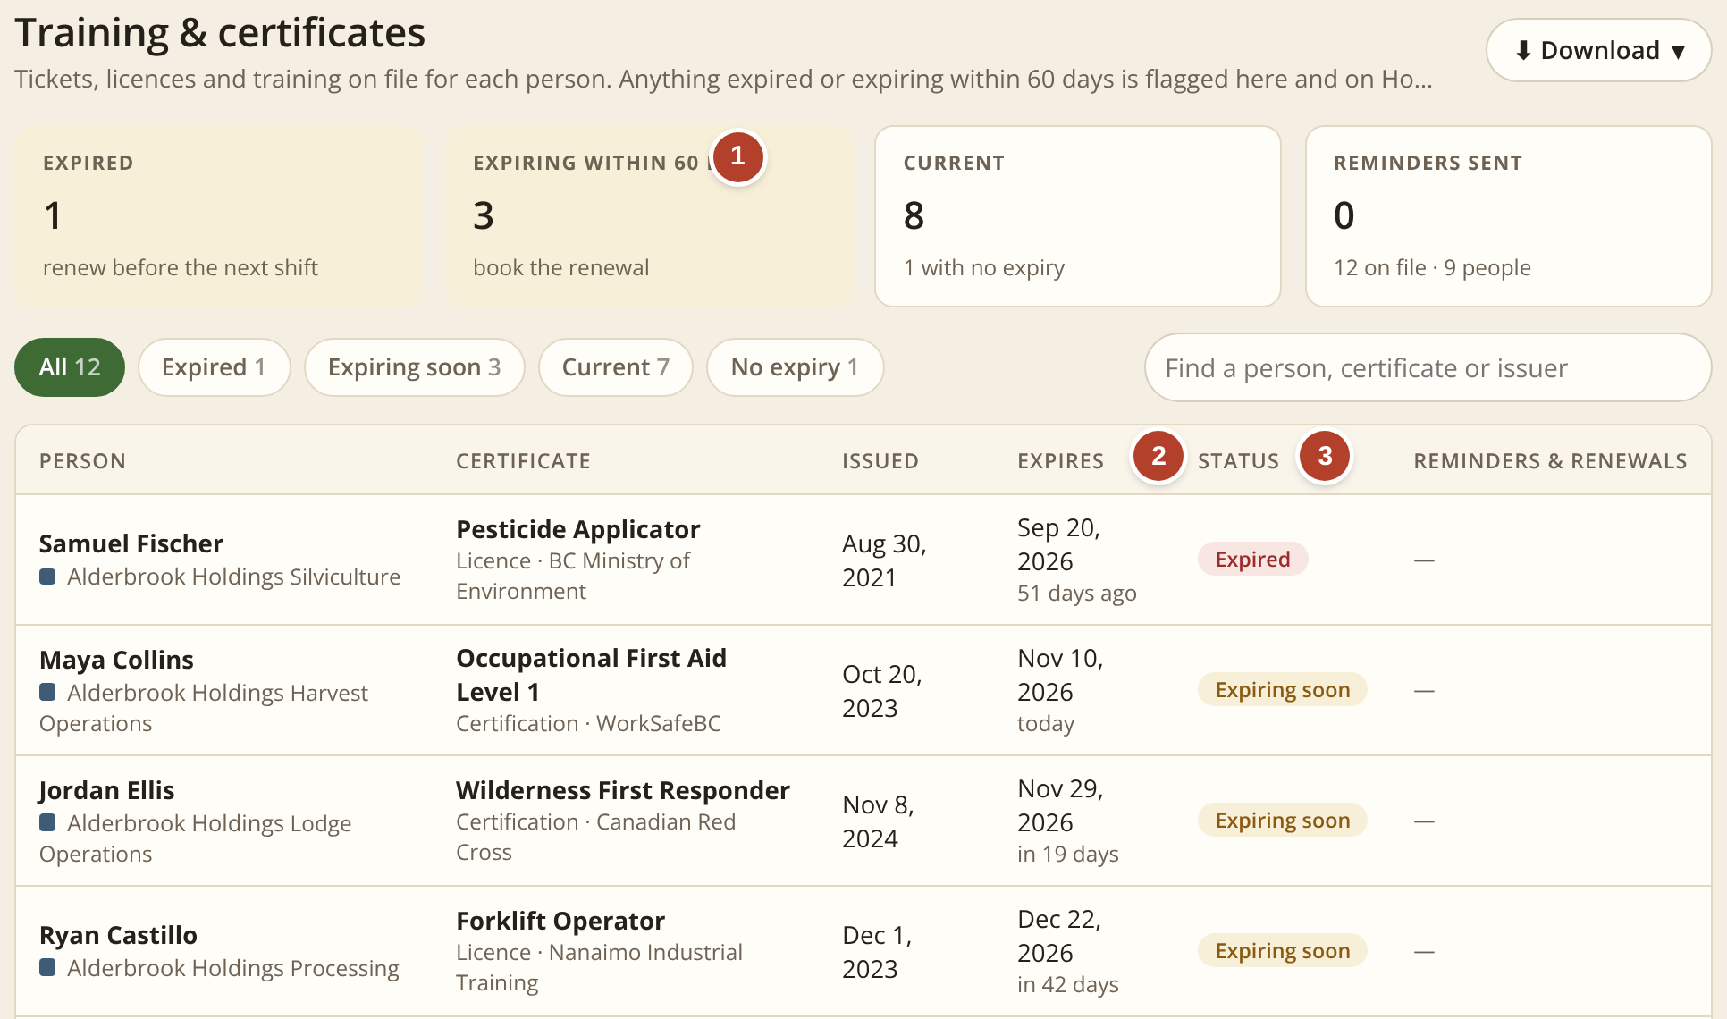
Certificates: expiry dates tracked for managers and HR
1
What needs attention
Expired, and expiring within 60 days.
2
The expiry date
With the days left for each one.
3
A clear status
Expired, expiring soon or current.
 | TODAY | NEW SYSTEM
Finding a date | look it up | one list
Early warning | none | 60 days
Reminders | by hand | one click
Screen: People › Certificates, as a manager sees it.
Managers see their own team. HR sees everyone, adds certificates and sends reminders.
Today: expiry dates sit in files and spreadsheets, and a lapsed certificate is often noticed only after it has expired.
Notes:
Certificates. This page lists the tickets, licences and training on file for each person, such as first aid or a forklift licence. One: the boxes at the top show what needs attention: how many have expired and how many expire within 60 days. Two: the list shows each expiry date and the days left. Three: a clear status: expired, expiring soon or current. Managers see the certificates of their own team. HR sees everyone, can add a certificate with the document itself, record a renewal and send a reminder with one click. Today these dates sit in files and spreadsheets, and a lapsed certificate is often noticed only after it has expired. Here nothing expires unnoticed, which matters for safety and for insurance.

Slide 15
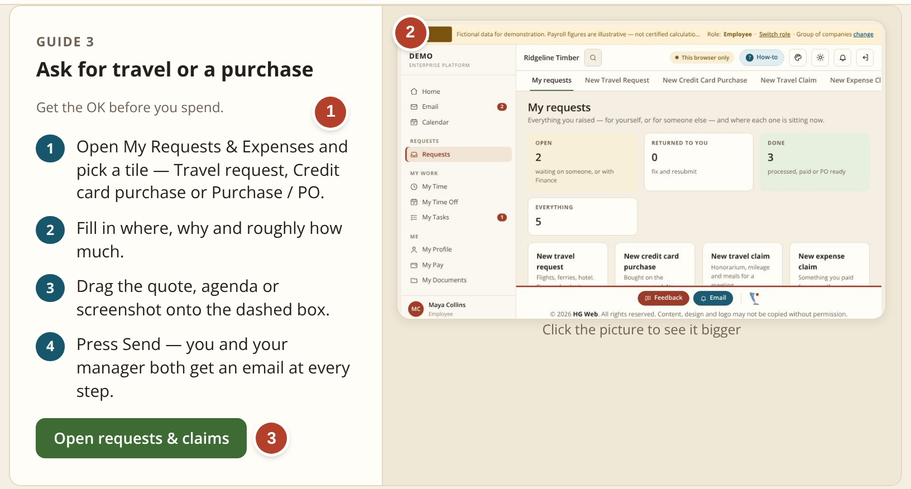
Built-in How-to guides: new staff ready in about 2 weeks
1
The proper procedure, step by step
Written in plain words, the same for everyone.
2
A picture of the real screen
So people know what to look for.
3
One button opens the page
Read the steps, then do the job.
 | TODAY | NEW SYSTEM
Training a new hire | 2–3 months | ≈ 2 weeks
How people learn | ask around | follow guide
Guides by role | none | built in
Screen: How-to guides. One guide, as a new employee sees it.
Today: a new employee learns each form and process by asking colleagues, over 2 to 3 months.
Training times are estimates.
Notes:
Training. The system has a How-to section built in. Each guide covers one job, such as asking for travel or a purchase, filling in a timesheet or approving a request. One: the proper procedure is written as numbered steps in plain words, so everyone follows the same steps. Two: beside the steps is a picture of the real screen, so a new person knows what to look for. Three: one button opens the page, so they can read the steps and then do the job. The guides are grouped by role: everyone, employee, manager and so on. Today a newly hired employee learns each form and process by asking colleagues, and it takes two to three months before they are comfortable. With one system and the guides inside it, we estimate that drops to about two weeks. It also takes less time from the colleagues who do the explaining today.

Slide 16
Task time drops to about one third
Where the time goes today
Filling in paper forms or editing PDFs, and collecting signatures.
Scanning and emailing the signed copy.
Hunting for a form or PO that cannot be found.
Counting overtime, banked time and leave by hand.
The system removes these four. It does not remove the decision: a person still approves every item.
Estimates for an organization of 100 staff; how they were estimated is on slide 2.
Notes:
This chart puts the three side by side. The red bars are minutes of task time today for one item; the green bars are the same item in the system. A request goes from about 90 minutes to about 30. A purchase order goes from about 90 minutes to about 30. A timesheet goes from about 20 minutes to about 7. Each takes about one third of the time it takes today. The time does not come from people working faster. It comes from removing four things: filling in paper forms or editing PDFs and collecting signatures, scanning and emailing, hunting for something that cannot be found, and counting overtime and leave by hand. People still make every approval decision.

Slide 17
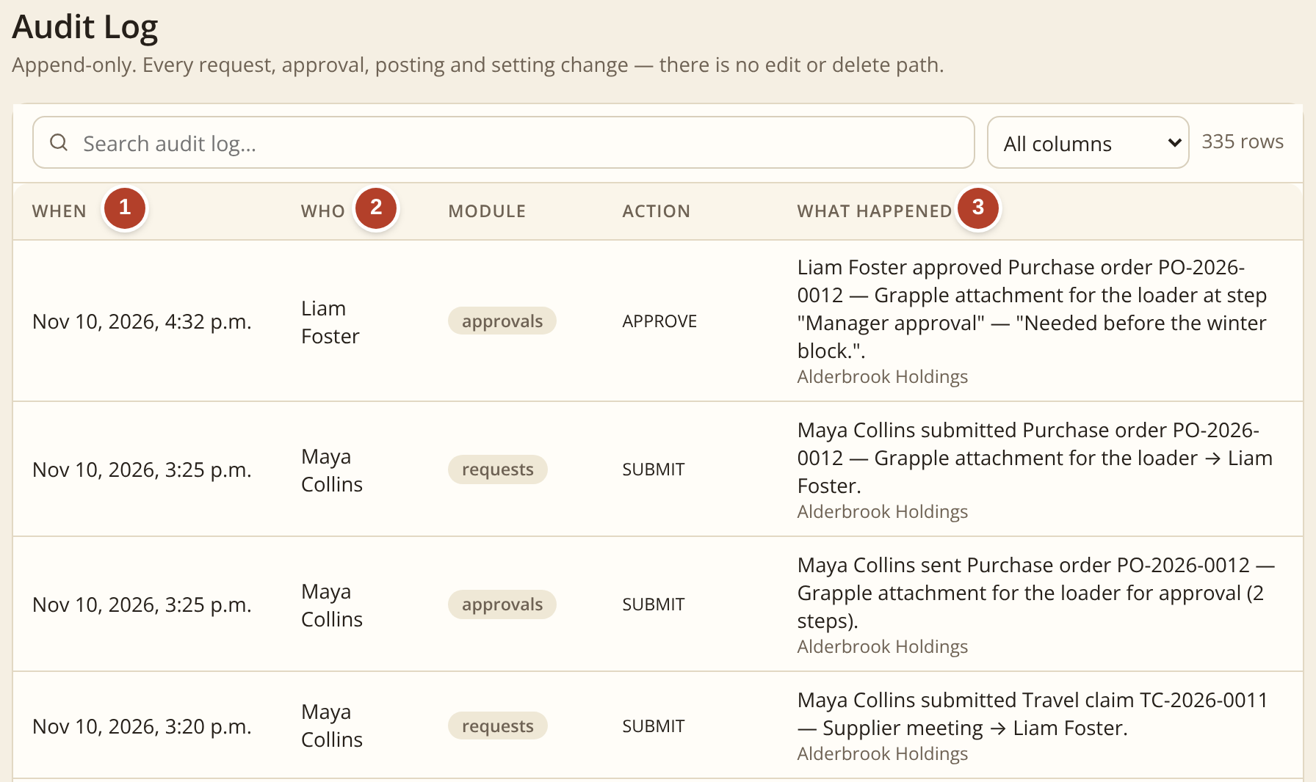
A proper audit trail, kept automatically
1
When
The date and time of every action, written the moment it happens.
2
Who
The person who did it, by name.
3
What happened
In plain words, with the request number, the step and any comment.
Nothing can be edited or deleted. A request can only be returned, declined or closed, and that is recorded too.
Screen: Administration › Audit log. One purchase order, step by step.
Today: the trail is paper forms, scans and emails spread across folders and inboxes. If a PO is missing, so is the proof of its approval. With the system: one searchable record, ready for auditors and funders.
Notes:
The audit trail. This matters as much as the time saved. Every action in the system is written to this log at the moment it happens. One: when. Two: who, by name. Three: what happened, in plain words. In the picture you can follow one purchase order: Maya submitted it, it was sent for approval in two steps, and Liam approved it with his comment. The log cannot be edited and nothing can be deleted. A request can only be returned, declined or closed, and that is logged as well. Today the trail is paper forms, scans and emails spread across folders and inboxes, and it depends on people keeping copies. If a purchase order is missing, the proof of its approval is missing too. Here it is one searchable record, which is what auditors and funders ask for. Each request also shows its own history on its own page.

Slide 18




Beyond time saved: independence and less stress
Less dependence on outside apps
No dependence on AI
Requests, purchase orders, timesheets and tasks live in one system instead of separate tools, spreadsheets and paper forms. Fewer subscriptions, fewer logins.
The system runs on fixed, ordinary rules that people set. It needs no AI service to work, and no information is sent to one.
CHN’s own data storage
Less paperwork, less stress
Records are kept in one central database that CHN owns and controls. CHN chooses where it is hosted: its own servers or a host in Canada.
No forms to print, sign and scan. No hunting for a missing PO. Everyone can see where things stand, so nothing is lost or forgotten.
Notes:
Four benefits that are not about minutes. First, less dependence on outside apps: the four jobs sit in one system instead of several tools, spreadsheets and paper forms, so there are fewer subscriptions and logins. Second, no dependence on AI: the system follows fixed rules that people set, such as who approves what and the $5,000 limit. It does not need any AI service to run and does not send information to one. Third, our own data storage: all records sit in one central database that CHN owns and controls, and CHN decides where it is hosted, on its own servers or with a host in Canada. Fourth, less paperwork and less stress: no printing, signing and scanning, no hunting for a missing purchase order, and everyone can see where things stand.

Slide 19
Where we are, and what happens next
Today: a working prototype
Every screen in this briefing is real and can be tried in a browser, with fictional people and figures. It is not yet connected to real staff accounts or email.
1
Confirm the numbers
Replace the estimates with CHN’s own counts of requests, purchase orders and timesheets.
2
Pilot with one or two departments
Start with purchase orders and timesheets, where paper causes the most trouble.
3
Decide hosting and sign-in with IT
CHN’s own servers or a host in Canada; staff use their existing work accounts.
Time to build the live system
About 1 to 2 months, in stages, with a small team. This is an early estimate, to be confirmed with IT.
4
Build in stages and test with real users
Go live after the pilot departments have used it for full pay periods.
Decision requested: approve steps 1 and 2.
Notes:
To close. What exists today is a working prototype: every screen you saw is real and can be tried in a browser, but it uses fictional people and figures and is not yet connected to real staff accounts or email. Building the live system is estimated at one to two months in stages; that is an early estimate and needs to be confirmed with IT. The four next steps are on the right. First, replace the estimates with our own counts. Second, pilot with one or two departments, starting with purchase orders and timesheets because that is where paper causes the most trouble. Third, decide with IT where it is hosted and how people sign in. Fourth, build in stages and only go live after the pilot departments have used it for full pay periods. The decision requested today is approval for the first two steps. A demonstration of the prototype can be arranged for anyone who would like to try it.

