Slide 1
PET SHOP

Slide 2
PENDAHULUAN
Dalam memasuki dunia globalisasi,manusia mengenal teknologi lebih maju untuk mempermudah melakukan berbagai kegiatan dalam kehidupan.Hadirnya website menimbulkan pemikiran baru demikian web site pet shop ini .Bisnis ini sangat prospektif ,terlebih diliat dari banyakya orang yang memiliki hewan kesayangan serta berdasarkan pengamatan pernah di lakukan.

Slide 3
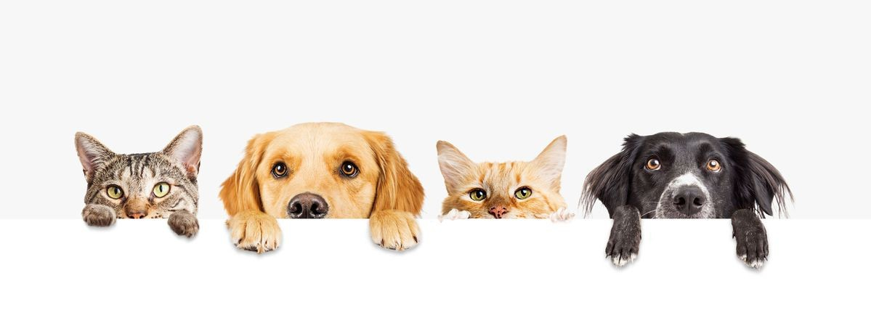
APA ITU
PET
SHOP?
PET SHOP adalah bisnis ritel yang menjual berbagai jenis hewan, menjual makanan hewan ,persediaan dan aksesoris hewan.

Slide 4
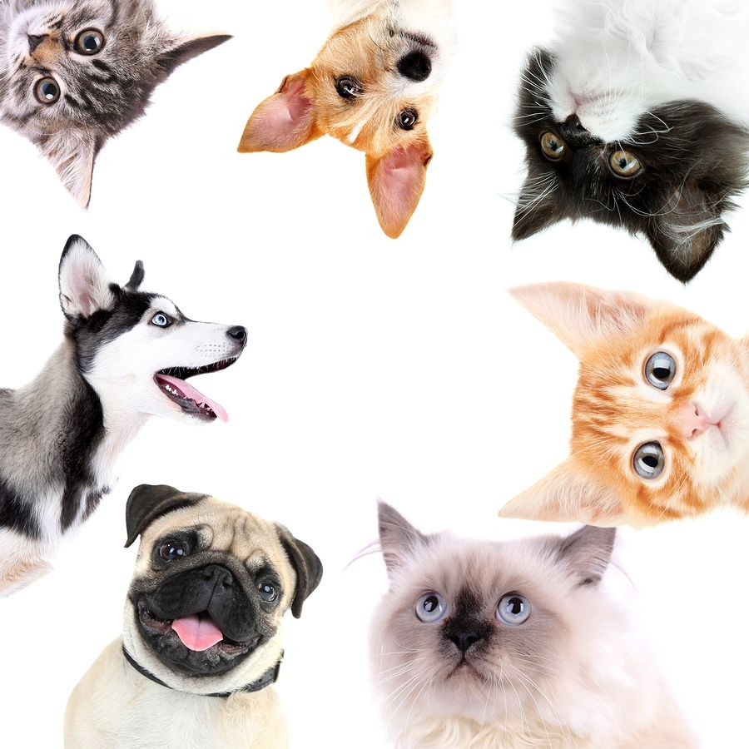
Tujuan membuat web site PET SHOP
Membuat sistem web site yang dapat mengelola data produK yang akan di jual & memfasilitasi masyarakat membeli peralatan kebutuhan dan aksesoris hewan peliharaan.
Dapat memprediksikan tingkah laku customer
melalui histori transaksi ,dapat menampilkan
rekomendasi produk yang di beli.

Slide 5
MANFAAT
Manfaat untuk Pet Shop
Dapat meningkatkan penjualan
2. Bentuk peningkatan pelayanan
Manfaat untuk pengguna/masyarakat
Dengan adanya web site ini membantu pemilik hewan peliharaan Dapat menemukan kebutuhan hewannya berupaaksesoris,mainan,makanan Maupun tempat penitipan
Dapat membantu pemilik hewan dalam memilih tempat penitipan hewan,Maupun petshop yang terbaik.

Slide 6
Mitra
Write here your important notes
Write here your important notes
Write here your important notes

Slide 7
Ruang Lingkup PROYEK

Slide 8

Laporan ke Uangan Proyek

Slide 9
Persyaratan Fungsional
1
2
3

Slide 10
Jadwal/Target
Hour | Monday | Tuesday | Wednesday | Thursday | Friday
8:00 / 9:00 | Lesson 1 |  | Lesson 3 |  | Lesson 5
9:00 / 10:00 | Lesson 1 | Lesson 2 | Lesson 3 |  | Lesson 5
10:00 / 11:00 |  | Activities | Lesson 3 | Lesson 4 | Review
11:00 / 12:00 | Activities | Activities |  | Activities
12:00 / 13:00 |  | Activities |  |  | Exam
13:00 / 14:00
Notes
Make a quiz game as a review activity

Slide 11
ASUMSI
Lesson 1
Lesson 2
Enter information about the lesson here
Enter information about the lesson here
Enter information about the lesson here
Enter information about the lesson here
Enter information about the lesson here
Enter information about the lesson here
Enter information about the lesson here
Enter information about the lesson here

Slide 12
A Timeline Always Works Well
Day 1
Day 3
Despite being red, Mars is a cold place
Jupiter is the biggest planet of them all
Day 2
Day 4
Mercury is the closest planet to the Sun
Saturn is a gas giant and has rings

Slide 13
98,300
Big numbers catch your audience’s attention

Slide 14
33.4%
54%
12.6%
Mercury is the closest planet to the Sun
Despite being red, Mars is actually a cold place
Jupiter is the biggest planet in the Solar System

Slide 15
Review of Concepts
Mercury
Venus
Mars
Jupiter
Saturn
Neptune
Mercury is the closest planet to the Sun
Venus is the second planet from the Sun
Despite being red, Mars is actually a cold place
Jupiter is the biggest planet in the Solar System
Saturn is the ringed one and a gas giant
Neptune is the farthest planet from the Sun

Slide 16
Monthly Calendar
sun
mon
tue
wed
thu
fri
sat

Slide 17
Alternative Resources: Planning Elements

Slide 18
Alternative Resources: Planning Elements

Slide 19
Resources
Did you like the resources on this template? Get them for free at our other websites.
PHOTOS:
Casual girl surfing laptop at home
Boy doing homework with laptop
Side view of a businesswoman writing schedule in diary at workplace
Flat lay pink workplace arrangement with copy space
Side view of woman looking at tablet and smiling
Long view man using his laptop indoors
VECTORS:
Cute colorful calendar
Planning elements sample

