Slide 1
State
Design pattern

Slide 2
Info
Intent
Allows an object to alter its behavior when its internal state changes. The object wil appear to change its class. (Change its type at run-time)
State is used when:
The state pattern is useful when creating object-oriented state machines, where the functionality of an object change fundamentally according to its state.
Behavioural Design pattern:
Define manners of communication between classes and object at run-time.

Slide 3
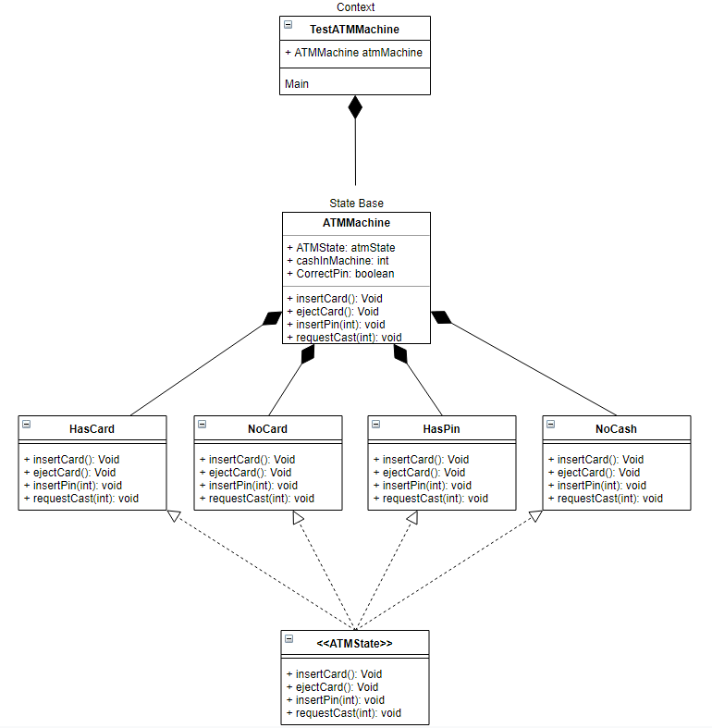
Code
Context (main)
StateBase (ATMMachine)
ConcreteStates (HasCard, NoCard, HasPin, NoCash)

