Slide 1
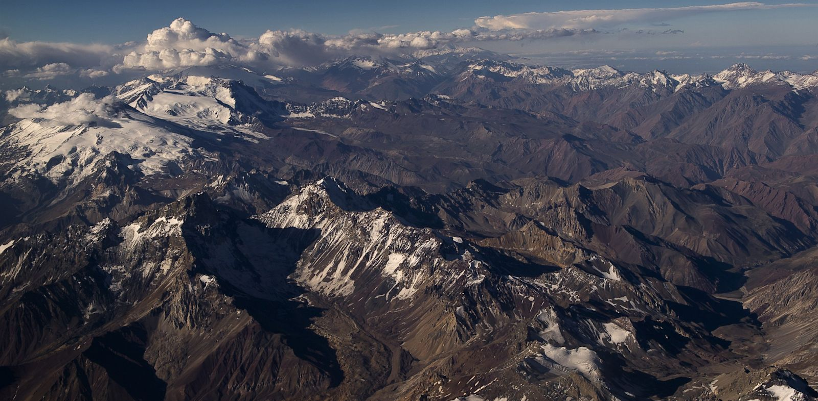
Andean ROAD
Jaime E. Forero-Romero
je.forero@uniandes.edu.co
Universidad de los Andes
Bogotá, Colombia
PABLO PORCIUNCULA/AFP/Getty Images

Slide 2
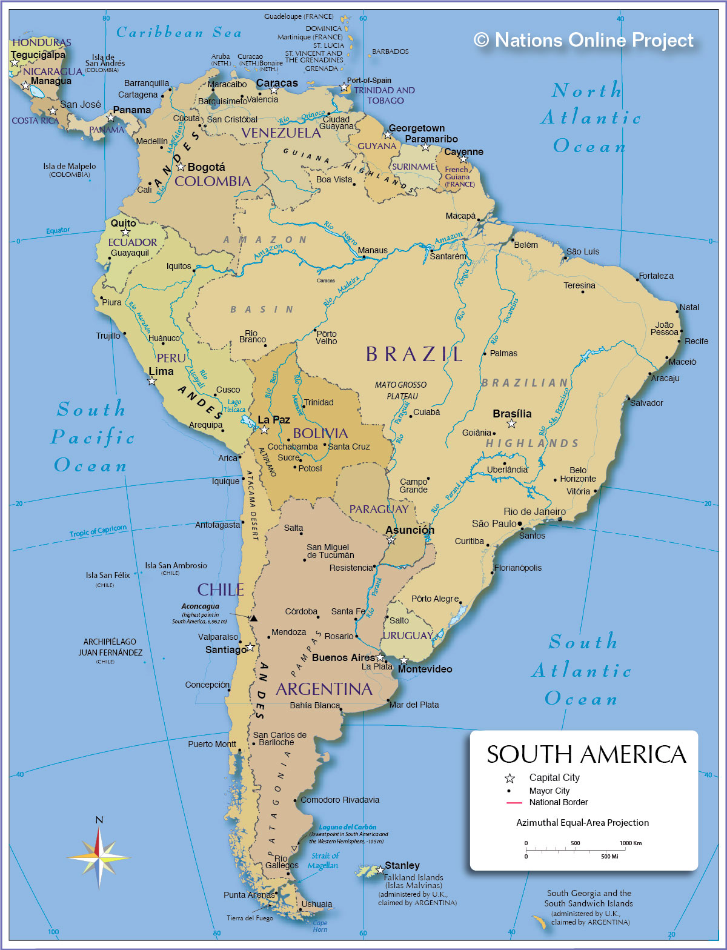
What countries are in the Andean ROAD?

Slide 3
How many millions of people do we have in the region?
48
30
15
30
10
17

Slide 4
How many (tenured) professional astronomers do we have in the region?
30
10
5
10
3
100

Slide 5
How many institutions do we have in the ROAD?
2
11
2
2
1
“1”+1

Slide 6
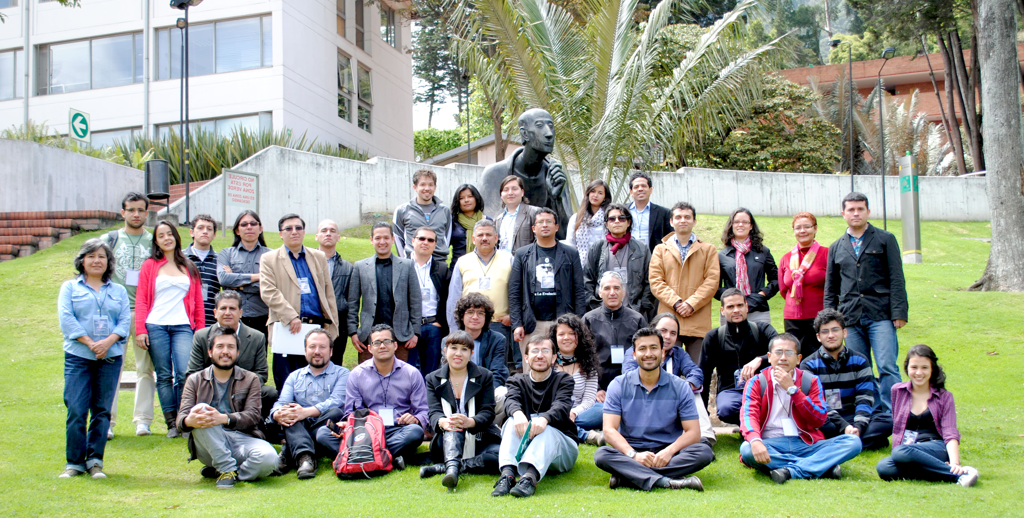
First Workshop Astronomía en los Andes (2013) - Bogotá

Slide 7
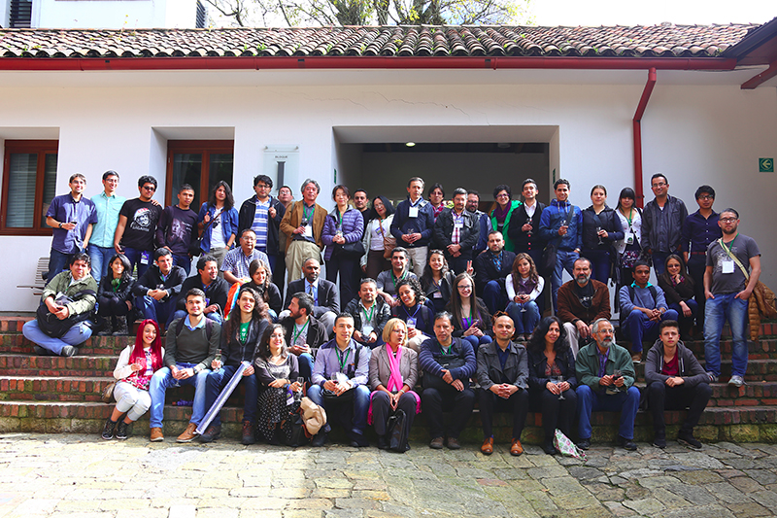
Second Workshop Astronomía en los Andes (2015) - Bogotá

Slide 8
We work towards a decentralized structure
TF2. Angela Pérez
(Medellín, Colombia)
TF1. Germán Chaparro
(Bogotá, Colombia)
TF3. Farid Char
(Antofagasta, Chile)

Slide 9
TF2
TF1
ALL
TF3

Slide 10
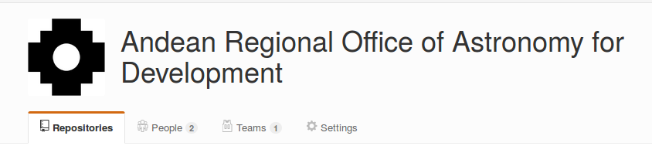
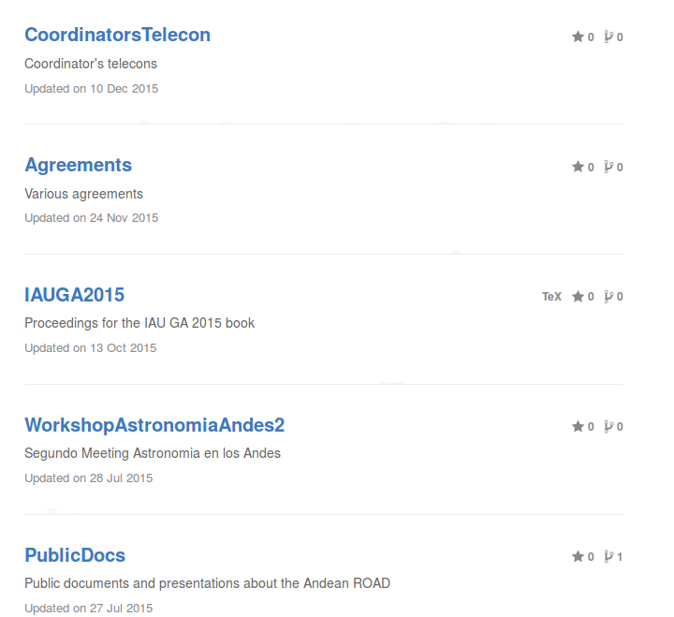
Public document repository (github)+ google groups + monthly telecons
ALL
https://github.com/AndeanROAD

Slide 11

Latin American Regional IAU Meeting (2016) - Cartagena
ALL

Slide 12
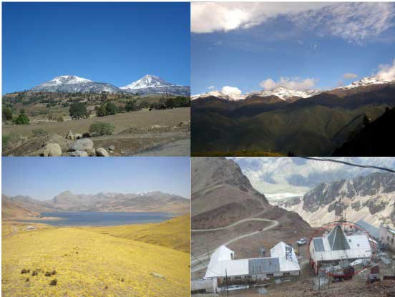
Working group on Astroparticle Physics
Contact: Luis Núñez (Colombia) – Hernán Asorey (Argentina)
TF1
http://www.aps.org/units/fip/newsletters/201202/lago.cfm

Slide 13
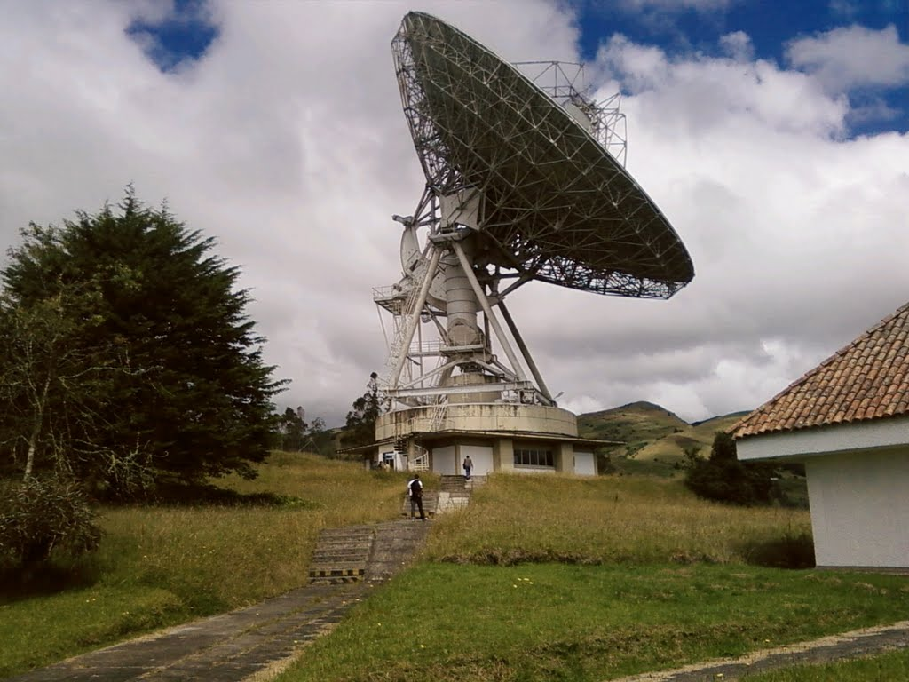
Working group on Radioastronomy
Contact: Oscar Restrepo (Colombia) – Jose Ishitsuka (Perú)
TF1
http://www.panoramio.com/photo/44704551

Slide 14
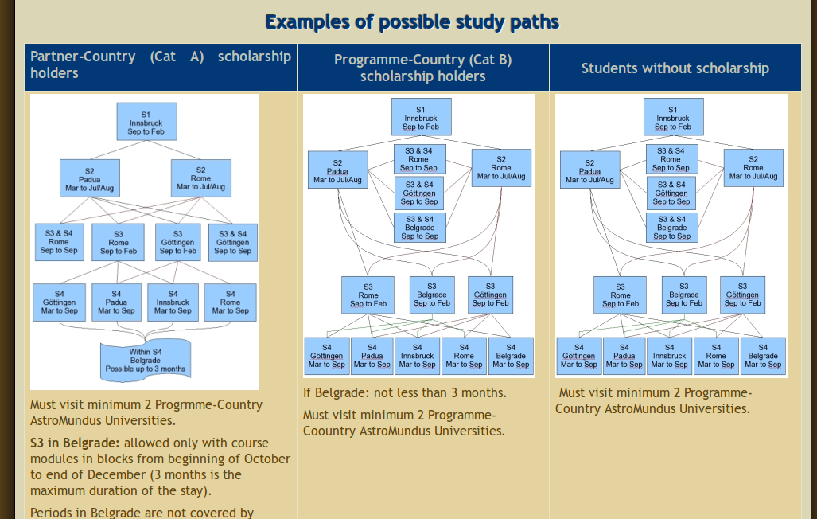
Andean Master's program
Contacts: Jaime Forero (Colombia) / Eduardo Unda-Sanzana (Chile)
TF1
http://www.astromundus.eu/

Slide 15
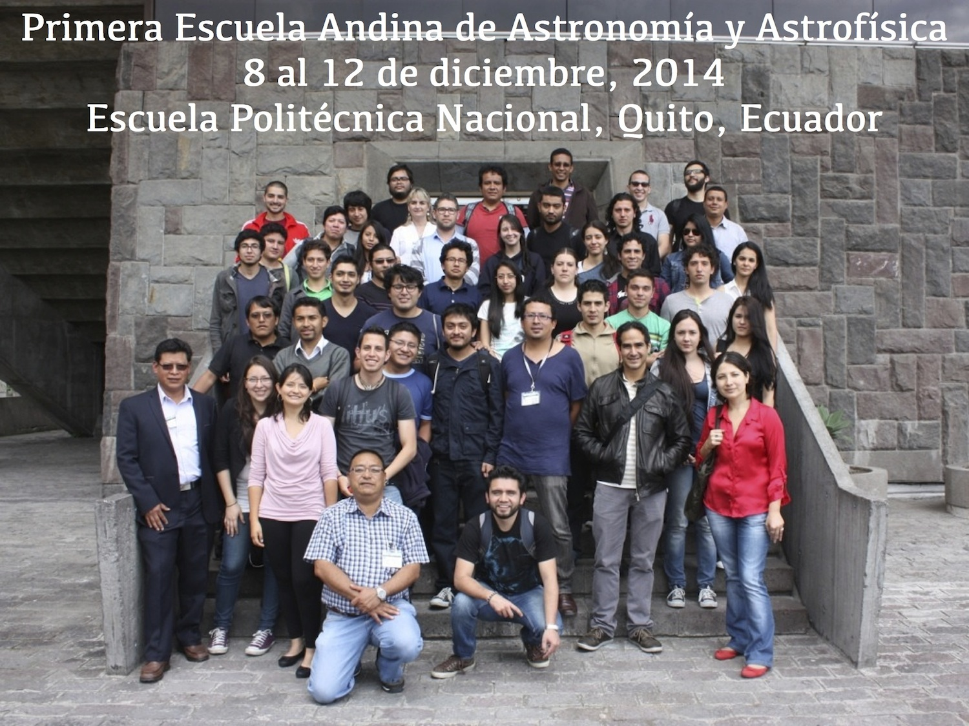
Andean Schools of Astronomy and Astrophysics (Ecuador 2014)
TF1

Slide 16
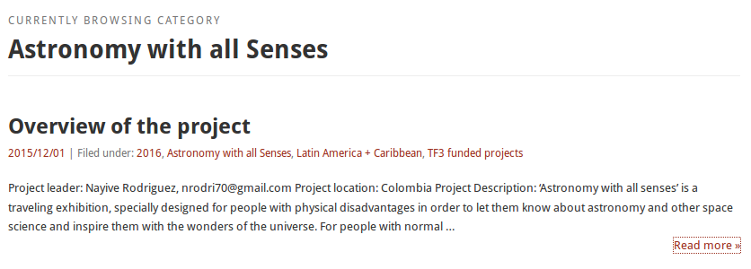
Astronomy for people with physical disadvantages
TF2
TF3

Slide 17

Communicating Astronomy with the Public (2016) - Medellin
TF2
TF3

Slide 18
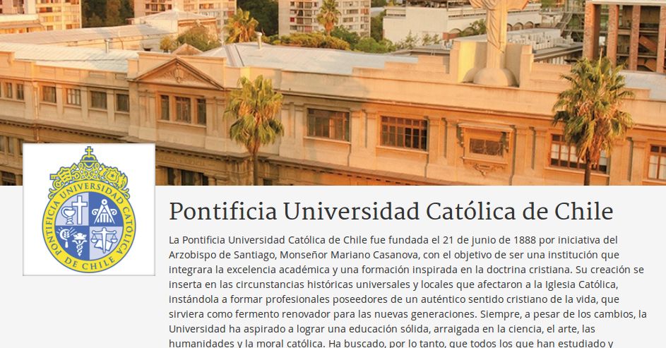

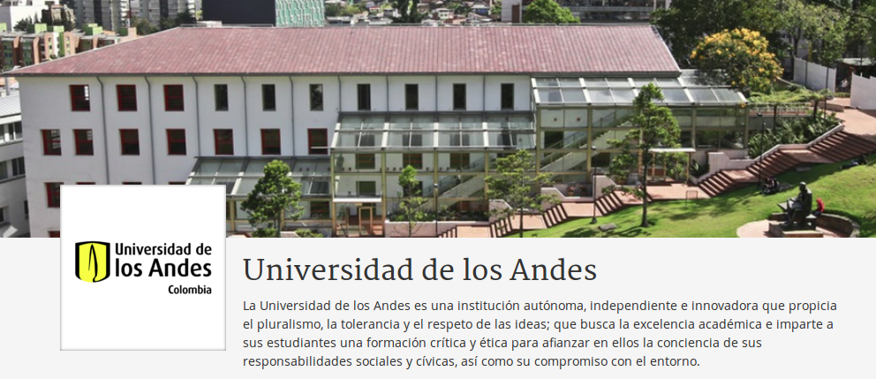
Massive Open Online Courses
TF1
TF3

Slide 19
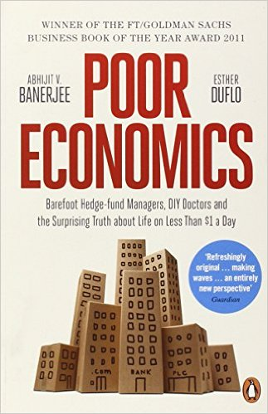
Now we can start to focus on development
We have modern & scientific methods

Slide 20

What do we mean by development?
We have post-colonial mainstream answers

Slide 21

What do we mean by development?
We have post-development alternative answers

Slide 22

What do we mean by development?
We have post-colonial and
(almost) post-development alternative questions

Slide 23
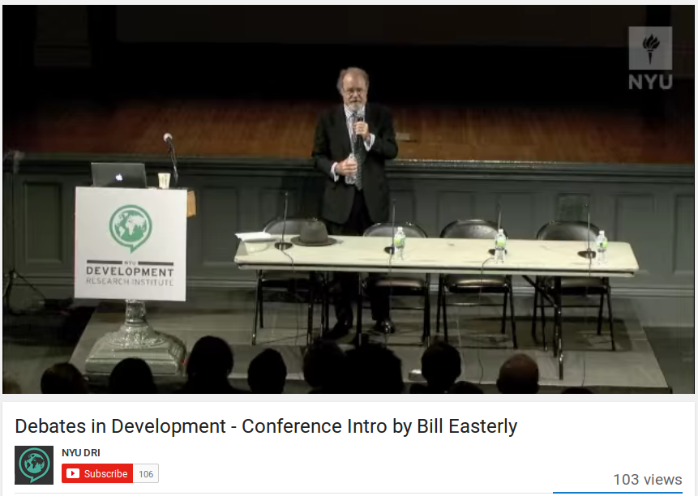
Use dumb solution finding systems and not smart scientific solutions

Slide 24
How do we bring about change?
Human
Non-material
Material
Non-human

Slide 25
How do we bring about change?
Human
Voluntarism
Non-material
Material
Non-human

Slide 26
How do we bring about change?
Human
Voluntarism
Non-material
Material
Structuralism
Non-human

Slide 27
How do we bring about change?
Human
Subjectivism
Voluntarism
Non-material
Material
Structuralism
Non-human

Slide 28
How do we bring about change?
Human
Subjectivism
Voluntarism
Non-material
Material
Theurgy
Structuralism
Non-human

Slide 29
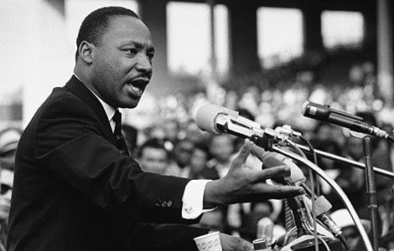
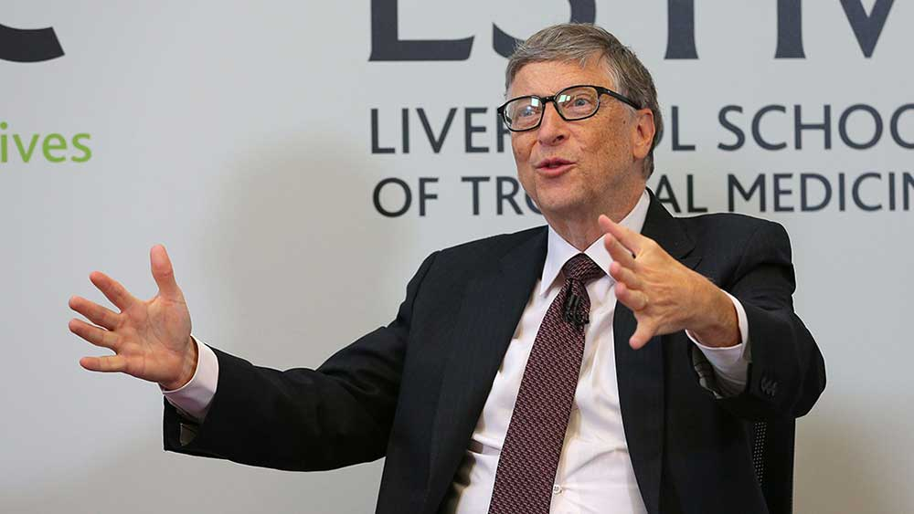
What is our metaphysical theoretical basis? How do we find a balance?
http://www.huffingtonpost.com/peter-dreier/martin-luther-king-was-a-democratic-socialist_b_9008990.html
http://www.investors.com/news/apple-microsofts-bill-gates-in-this-weeks-top-insider-trades/

