Slide 1


Advanced modeling of manufacturing recipes in the context of Industry 4.0 Graduate student: Andela Tosic

Slide 2
Introduction
This thesis implements a library inspired by the Regionalized Value State Dependence Graphs (RVSDGs) used in software compilers designed to manipulate production processes.
DDGs (Demand-based dependece graphs) such as the RVSDGs, are intermediate representations (IRs) well suited for a wide range of program transformations.
They explicitly model the flow of data and state, and only implicitly represent a restricted form of control flow.
Notes:
I this thesis I have implemented a library that uses intermedial rappresentation, in specific, the Regionalized Value State Depedence Graph. This is Demand-based dependece graphs, well suited for a wide range of program trasformations – (Si tratta di grafici di dipendenza basati sulla domanda, adatti a un'ampia gamma di trasformazioni del programma.)
Implicitly it represent some kinf od restricted form of control flow and explicitly it models the flow of data and state.

Slide 3
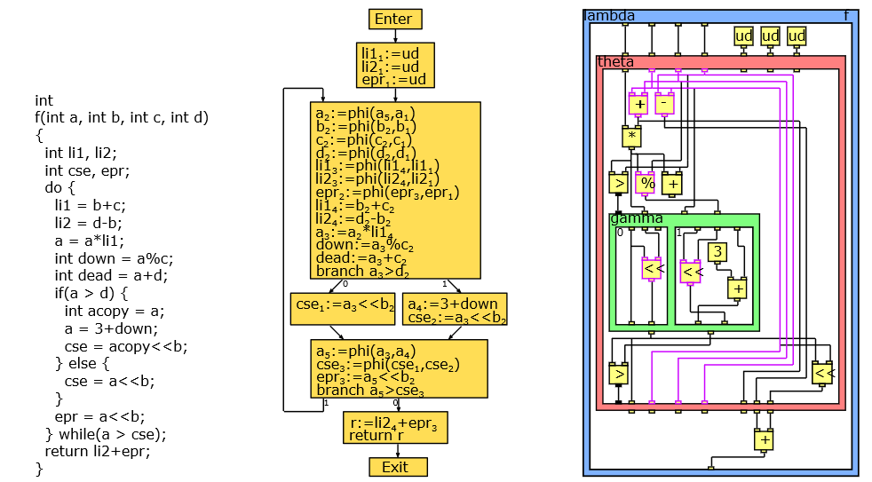
Introduction
The RVSDG is a dataflow centric IR where:
Nodes represent computations
Edges represent computational dependencies
Regions capture the hierarchical structure of programs
Notes:
In this intermedian rappresentation, we have three main elements, wchihc are nodes, edges and regions. We have nodes that are modeling computations that are suppoted by the librery implemented. There are also edges that represent computational dependencies. Edges connect node outputs or region arguments to a node input or region result
We can see regions are also nodes

Slide 4
Motivation
In last year’s, the BP Model and Notation (BPMN) has become a de-facto standard for modeling processes. However:
This standard does not incorporate explicitly the Problem-Solving (PS) knowledge in the Process Modeling (PM) results. Thus, such knowledge cannot be shared or reused.
BPMN models can be complex and difficult to read.
BPMN workflows are designed to be rigid, not adaptable to change, and not conducive to decision making and collaboration.

Slide 5
Motivation
The RVSDG represents programs in demand-dependence form, implicitly supports structured control flow, and models entire programs within a single IR.
The proposed library allows manipulating production processes and defining complex process transformations by composing a set of nodes (i.e., regions), hiding the internal details.
Unlike current recipe modeling techniques, such as BPMN (Business Process Model and Notation), the implemented library brings greater flexibility, focusing on the data flow, enabling automated reasoning over production processes.

Slide 6
Implementation
Simple nodes model primitive operations
Edges connect node outputs or region arguments to a node input or region result, or state typed.
Regions capture the hierarchical structure of programs
RVSDG
Expression
Using
DataDeclaration
Using
Type
Using
Exception

Slide 7
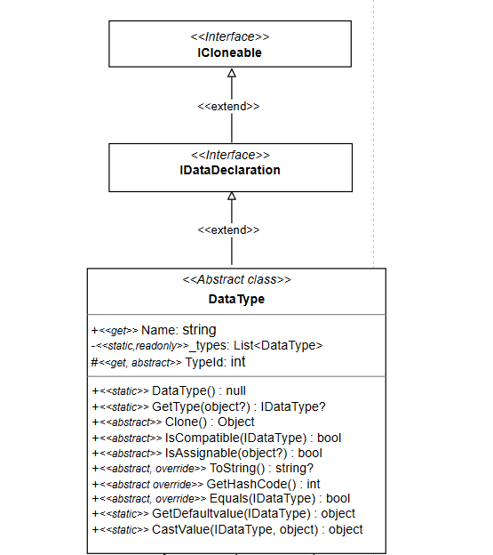
Implementation

Slide 8
Implementation
IsCompatible – Method used to perform arithmetic and logical operations correctly by checking whether the types of input values are compatible with the type of output passed as a parameter.
IsAssignable - Method used when DD is instantiated without explicitly indicating the value type. It allows checking whether the value type is supported by the library;
CastValue - Method that explicitly performs conversion of types that are supported by the library;

Slide 9
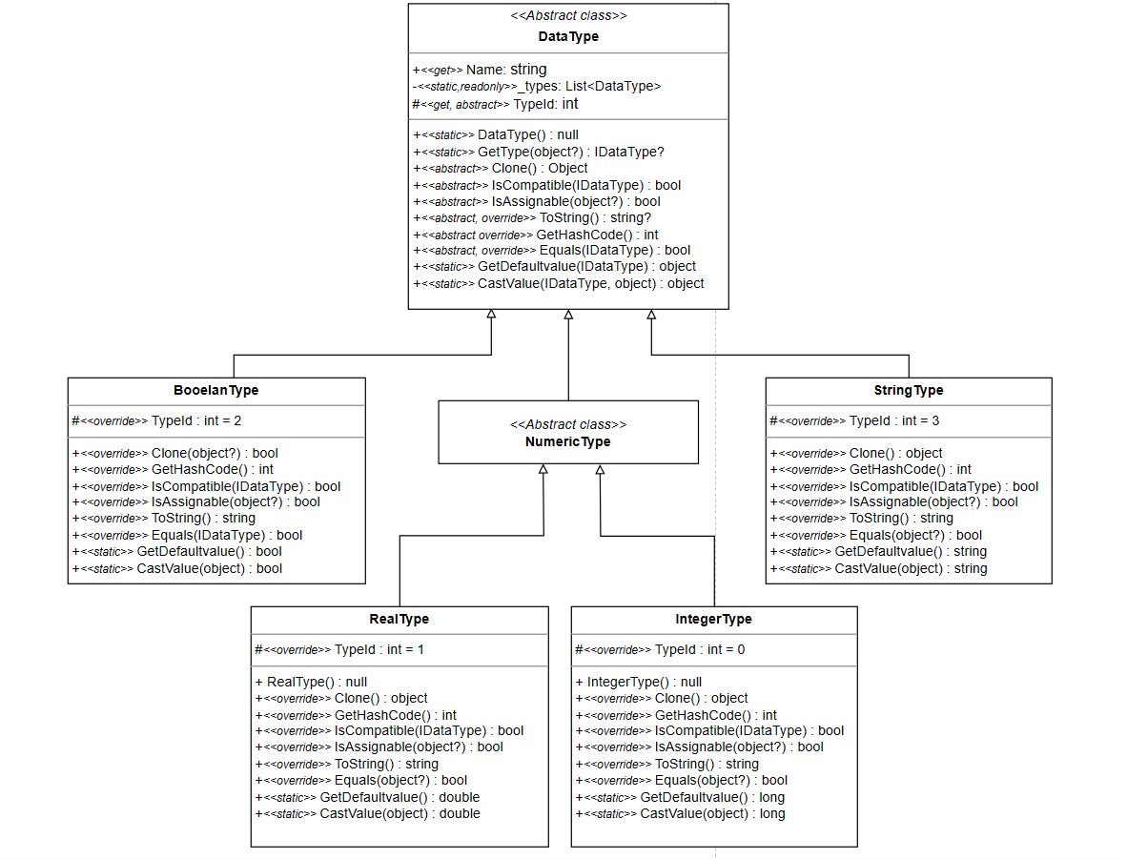
Implementation

Slide 10
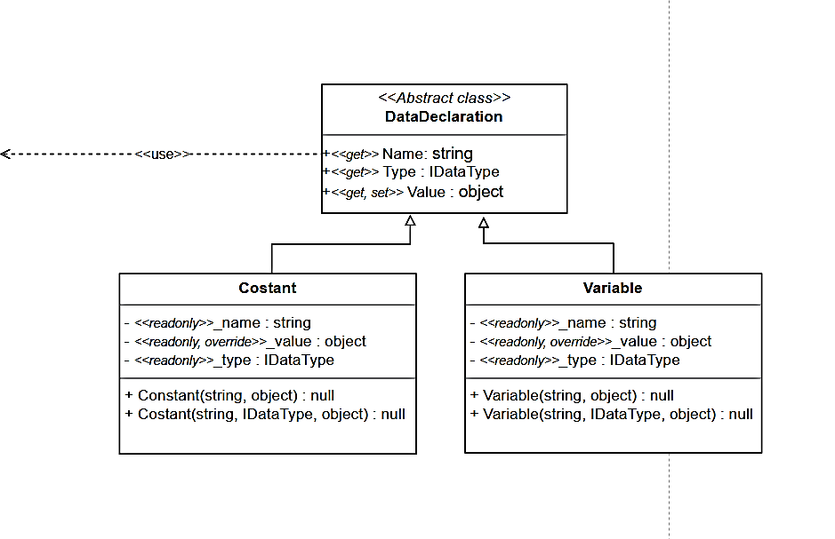
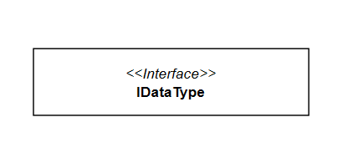
Implementation
Client:DataDaclaration requires supplier:IDataType for its own specification or implementation

Slide 11
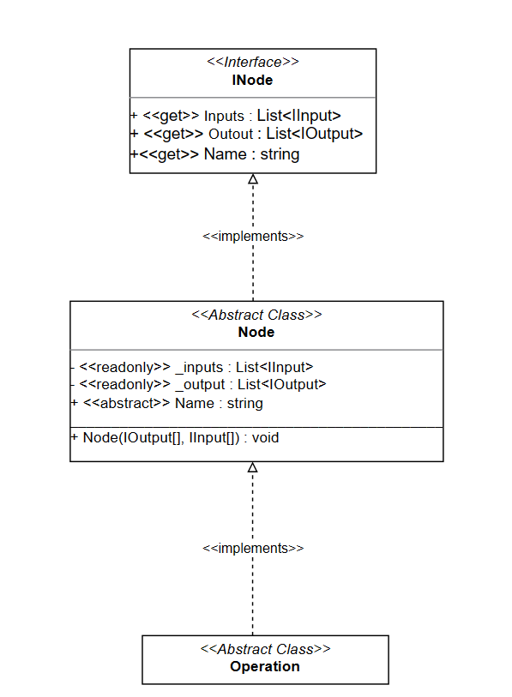
Implementation
Nodes have an operator associated with them.
A node’s signature must correspond to the signature of its operator.

Slide 12
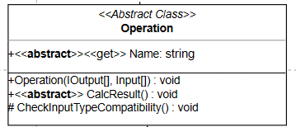
Implementation
Nodes have an operator associated with them
A node’s signature must correspond to the signature of its operator
Simple nodes map their input value tuple to their output value tuple by evaluating their operator with the inputs as arguments, and associating the results with their outputs.

Slide 13
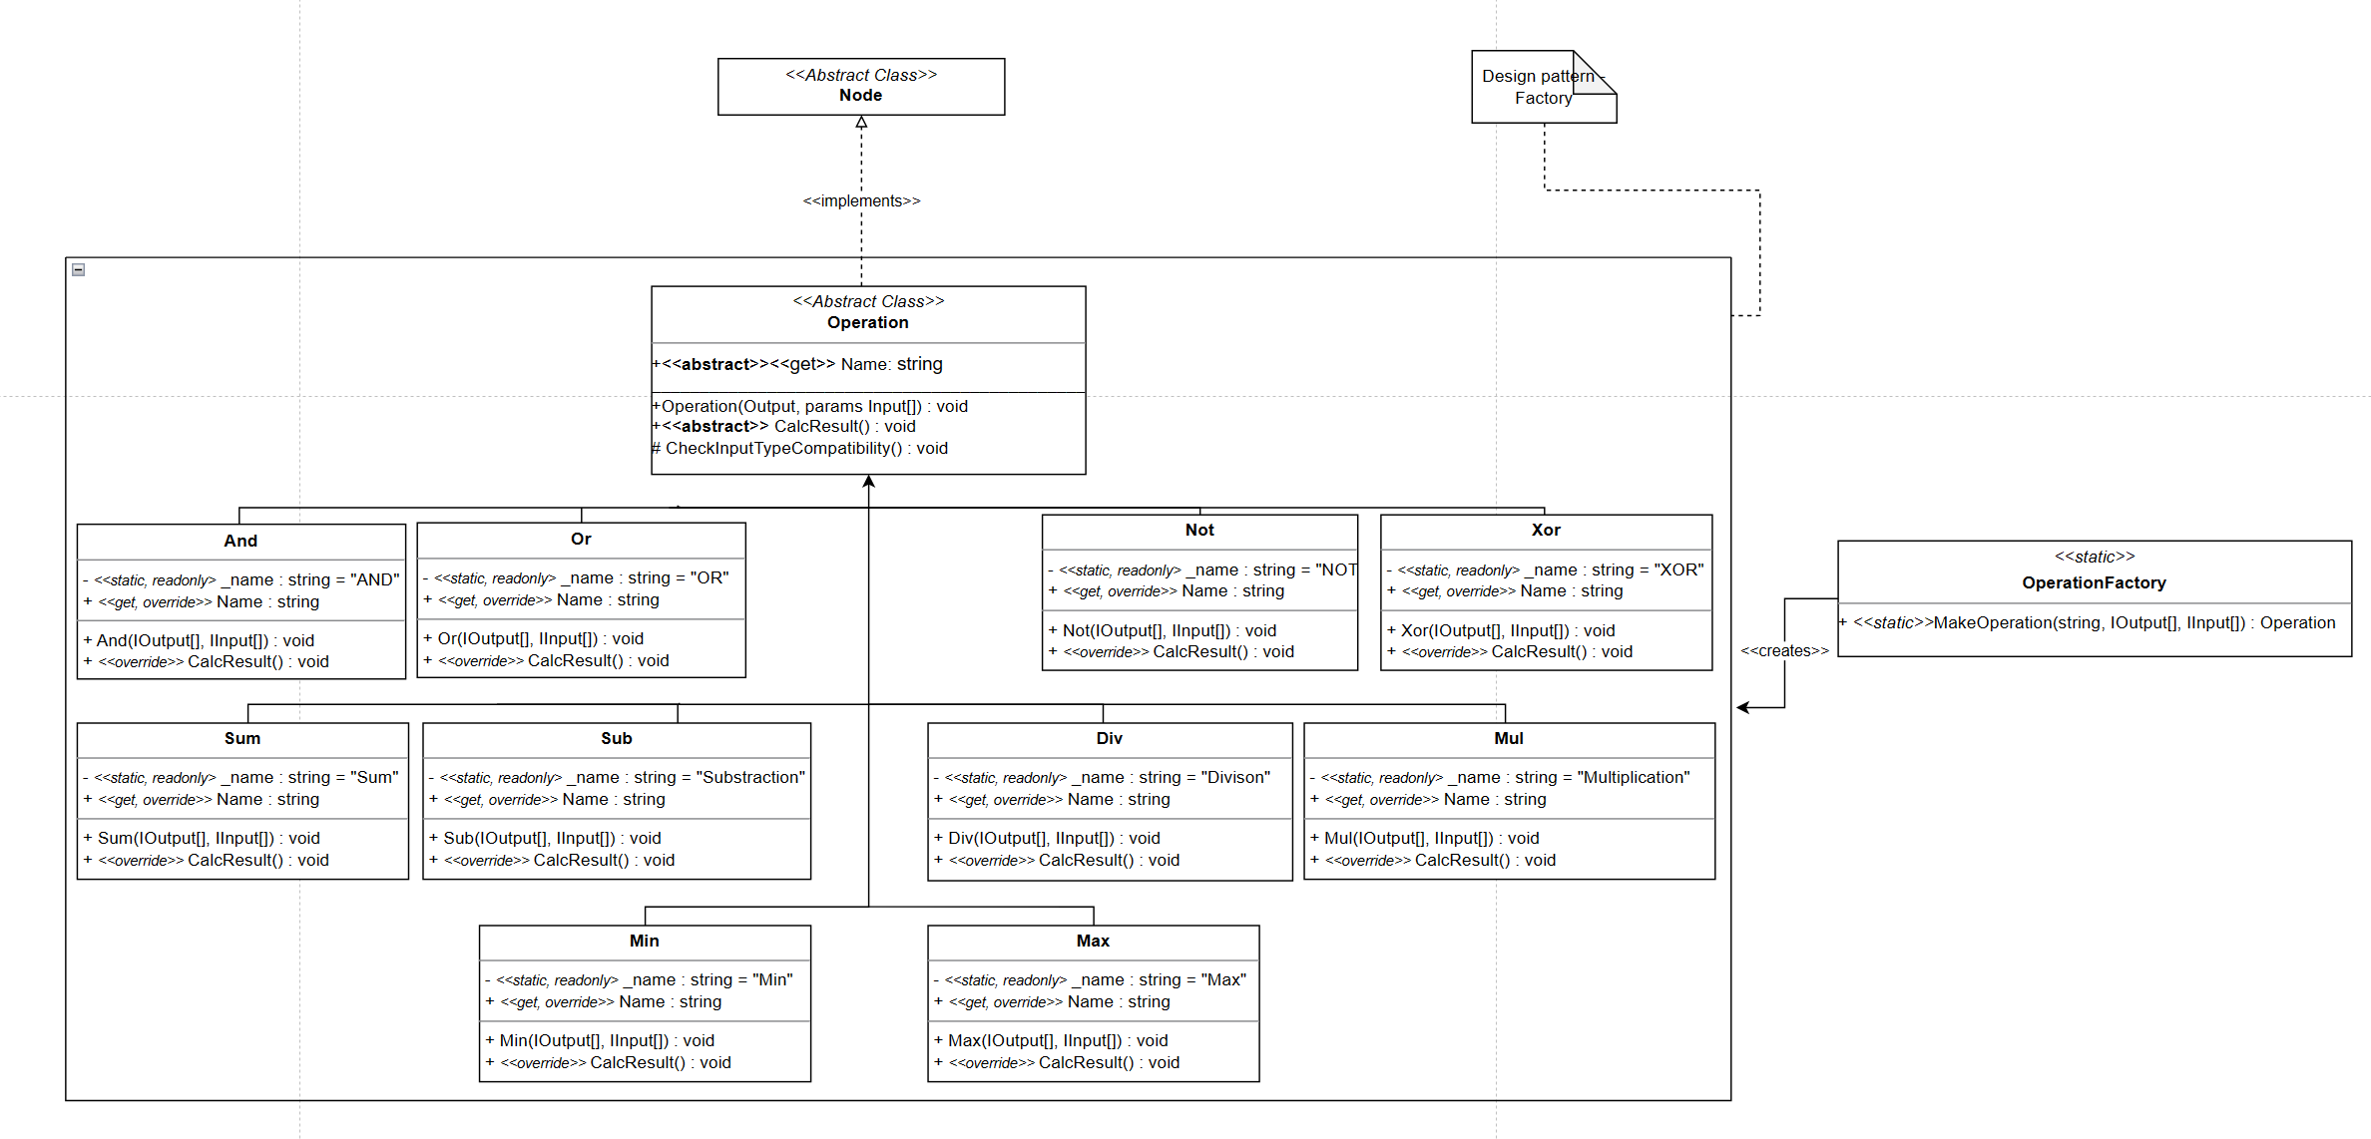
Implementation
CheckInputTypeCompatibility calls IsCompatible() method implemented by the subclasses of the DataType class.

Slide 14
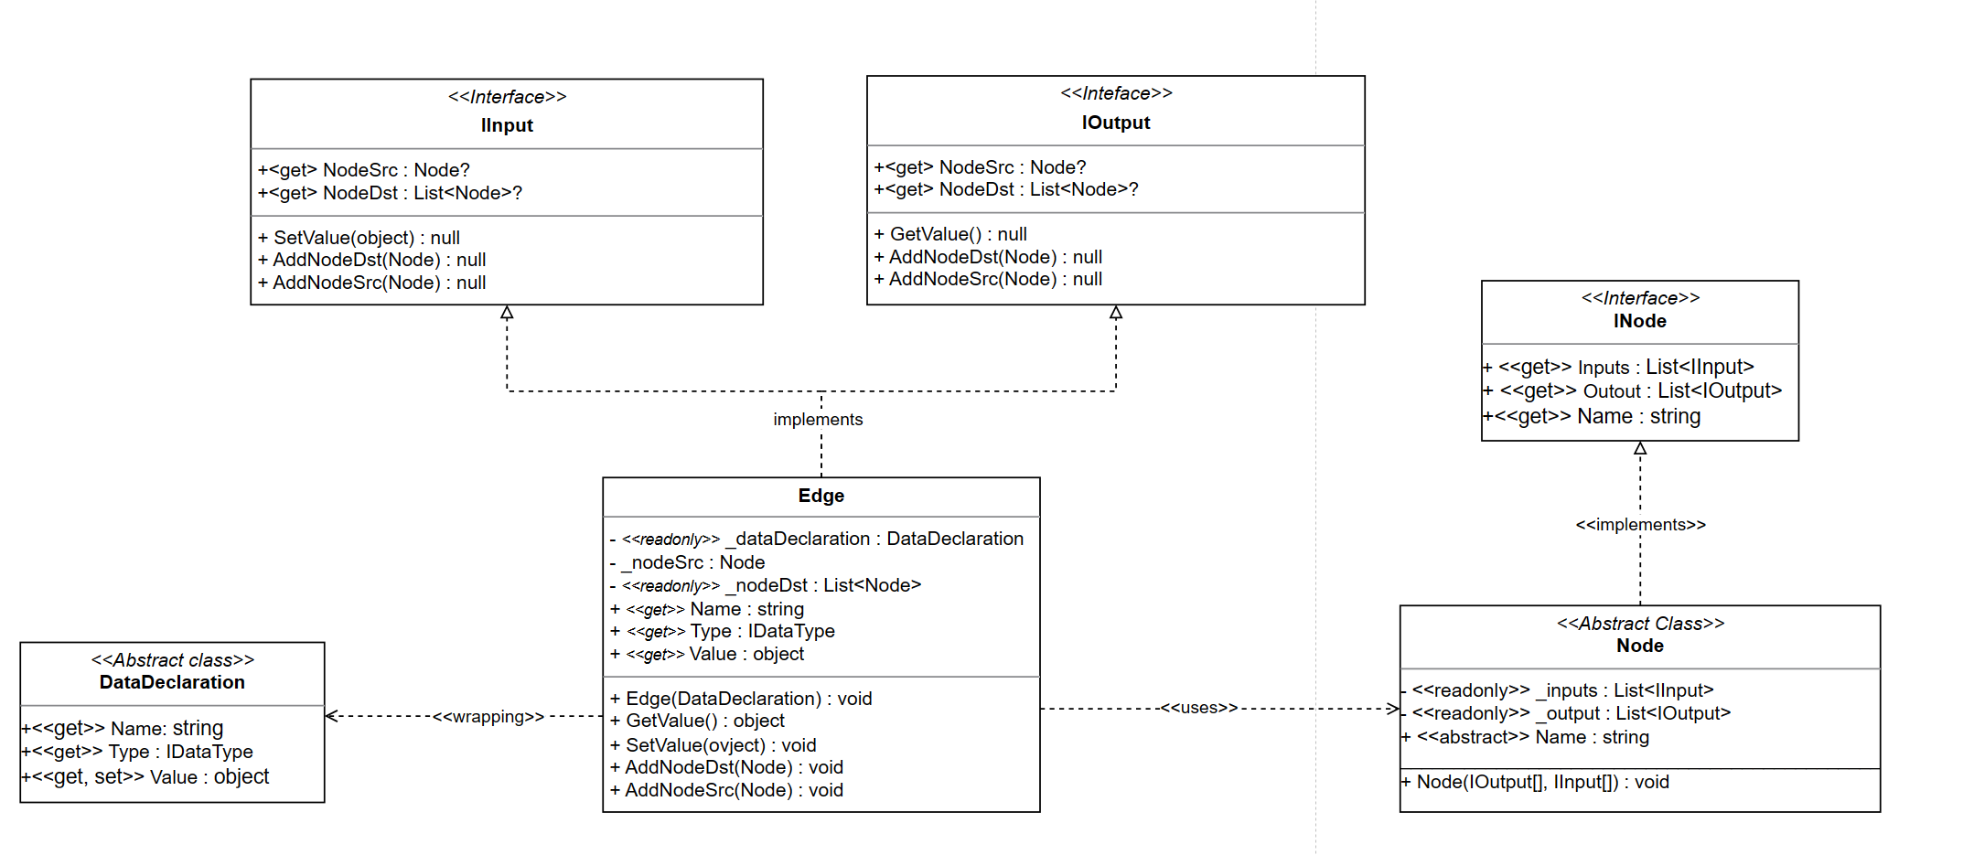
Implementation
Edges connect node outputs or region arguments to a node input or region result, and are either value typed, i.e., represent the flow of data between computations, or state typed, i.e., impose an ordering on operations with side-effects.

Slide 15
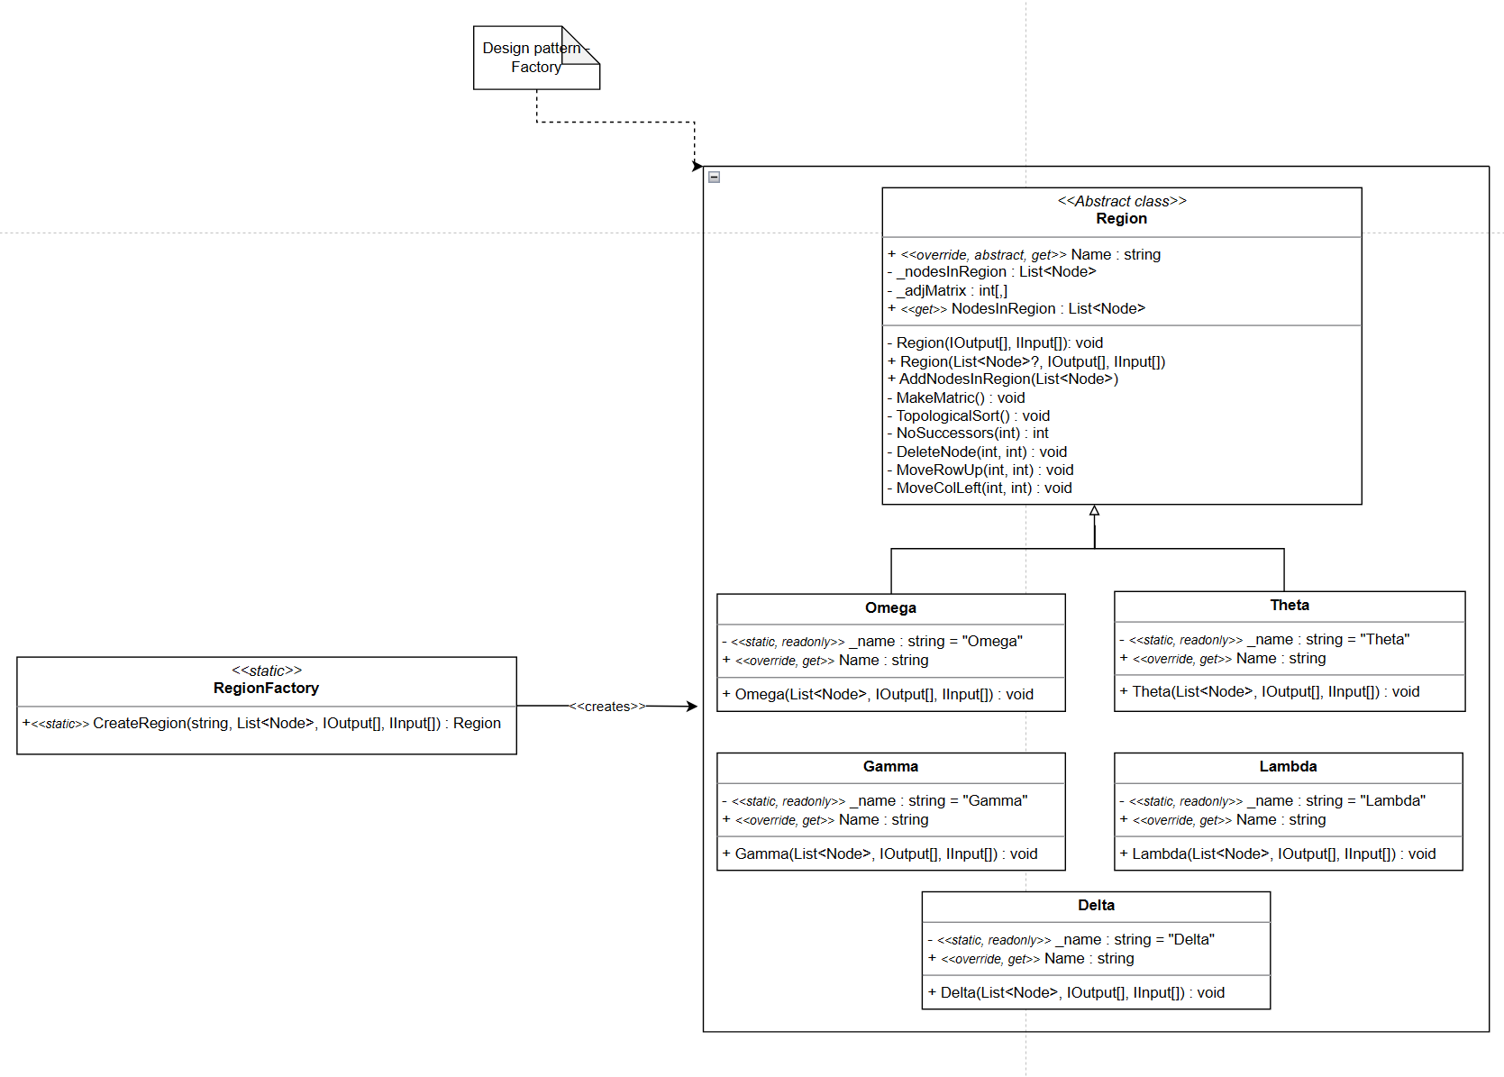
Implementation
Omega Region is the root region of RVSDG.
Other regions are an extension of this one.
Topological order

Slide 16
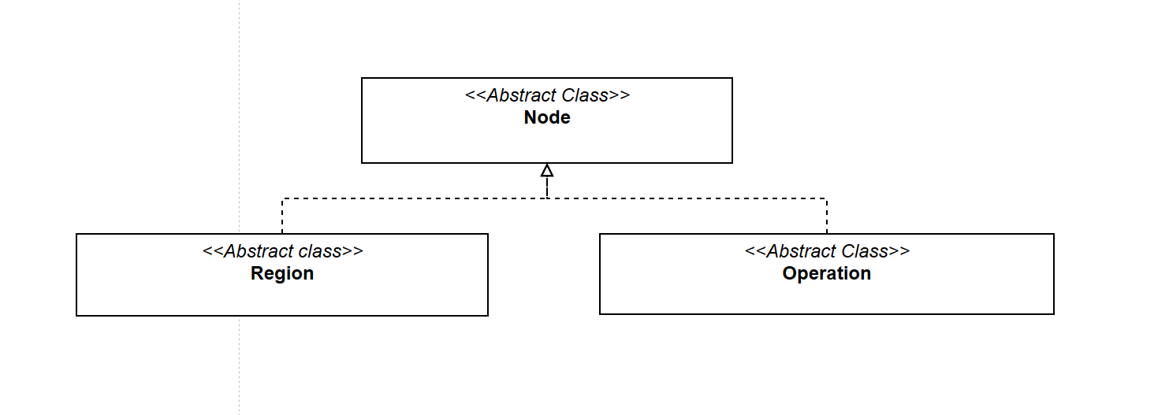
Implementation
An 𝜔-node models a translation unit. It is the top-level node of an RVSDG and has no inputs or outputs.
A 𝜃 -node models a tail-controlled loop. It contains one region that represents the loop body.
A 𝛾-node models a decision point and contains regions R0, ..., R𝑘 | 𝑘 > 0 of matching signature.

Slide 17
Conclusions
Although RVSDG is used for compiler optimization, in this thesis, it has been successfully ported to the manufacturing domain.
The result is the library that enables advanced modeling of manufacturing recipes in the context of Industry 4.0. that through the use of RVSDG:
Enables manipulation of production processes
Defines complex process transformations
Implicitly supports structured control flow

Slide 18
Conclusions
Unlike current recipe modeling techniques, the implemented library:
Allows explicit data flow and state modeling
Brings greater flexibility
Enables automated reasoning over production processes
This project:
Contribute to the increase in the optimization level due to the data structure used
Enriches the existing functionalities
Enables the implementation of more specific functionalities
Provides maximum simplicity in use

Slide 19
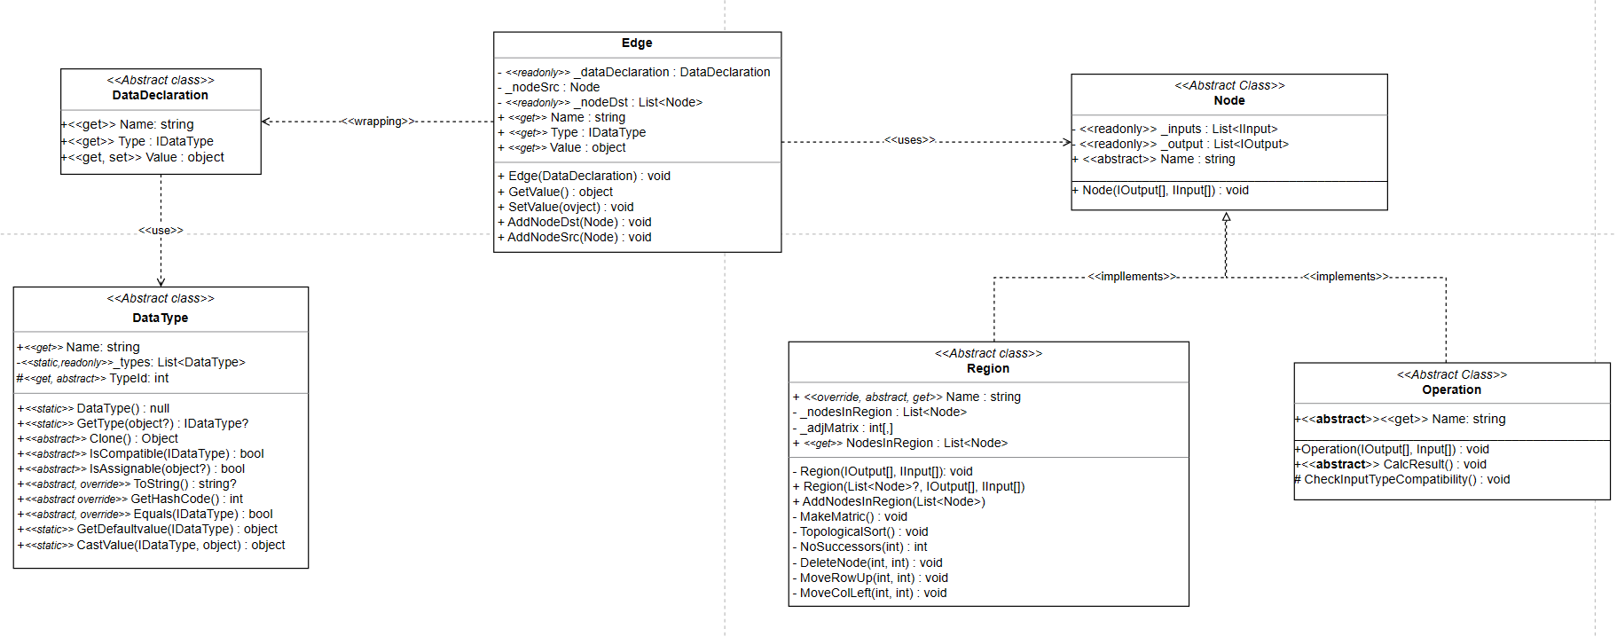
Global View

