Slide 1
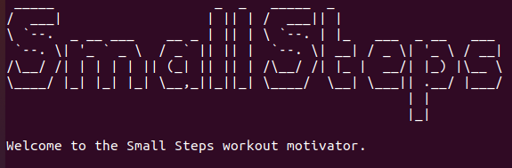
Small Steps – your exercise habit helper

Slide 2
Why this app?
There are a lot of people (like myself) who want to start exercising
It can be hard to just commit to doing even a few exercises a day

Slide 3
Why this app?
Small Steps allows a user to:
- choose a few exercises,
- set their target repetitions for each exercise,
- track their workouts over the week
- check their results VS their goals

Slide 4
The app needed to:
Allow the user to choose exercises and target repetitions
Allow the user to enter data for days they worked out
Remember the user’s data (write to and read from files)
Display the results for the week in a table

Slide 5
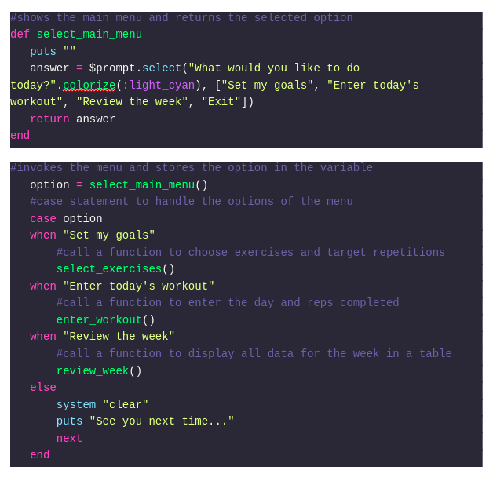
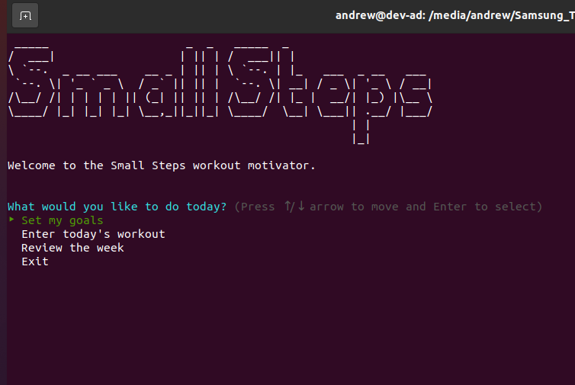
Features: main menu

Slide 6
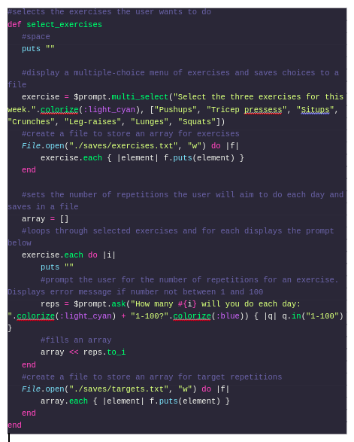
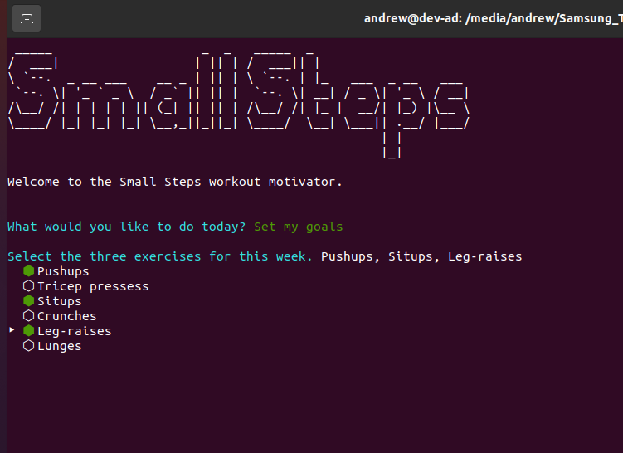
Feature: input your goals

Slide 7
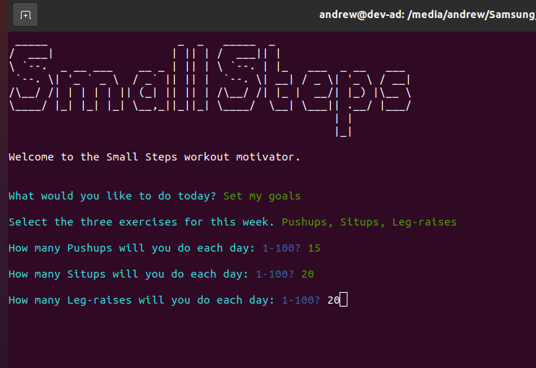
Feature: input your goals

Slide 8
Feature: input your goals

Slide 9
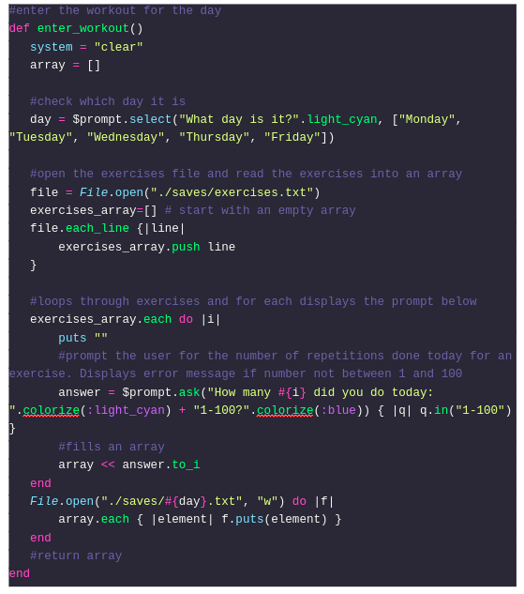
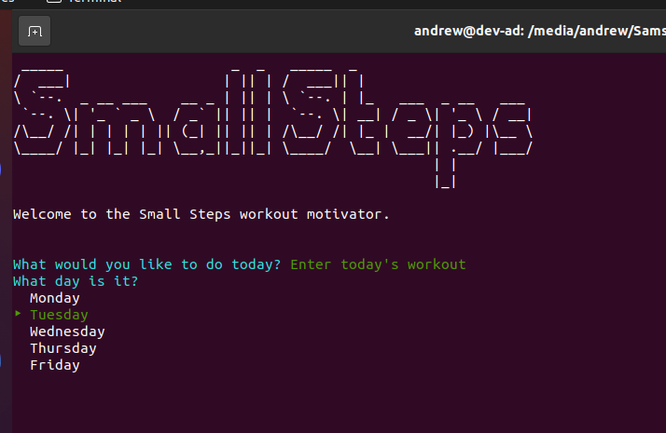
Feature: input a workout

Slide 10
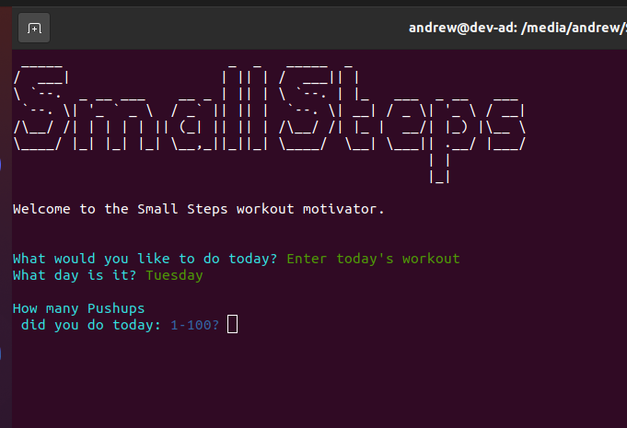
Feature: input a workout

Slide 11


Handling an input error
If the user doesn’t enter an integer in range:
Fix: prompt asks user to enter a number between 1 and 100 until they do.

Slide 12
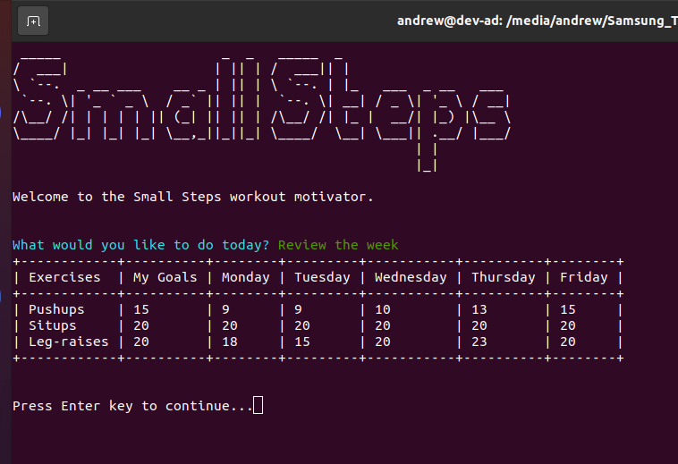
Feature: display results
Work in Progress
Needs to read data from all saved files (goals and each workout day)
Put the data into hashes inside an array
Can then be output into the table shown

Slide 13
Challenges
How to input and store data: arrays, hashes, or classes?
- arrays were my first go-to
- hashes seem a little more logical (and would have helped with the final table!)
- rspec testing seems easier with classes (and they can store the data logically)

Slide 14

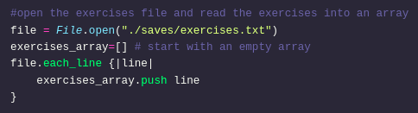
Challenges
Data persistence: needing to read and write to files
- It makes sense that the app can be closed and keep the data input each time

Slide 15
Ethical Issues
None for the application purpose
Use of code searched online:
- when I use code from Stackexchange, etc. I acknowledge its source if it is significant
- 1 example of this in my code for the table

Slide 16
Favourite Parts
Creating my flow diagrams (some of them)
Solving the file I/O
Reducing excess code down
moving most operations into the functions which reduced redundancy (and all of the arrays I started with!)
Seeing things work!

Slide 17
Demonstration
Allow me to demonstrate Small Steps in action

Slide 18
The End
Any questions?

