Slide 1
Tech Bytes: All About APIs
Josh Kimmel
MSCS/MBA ‘21

Slide 2
Today’s Agenda
What actually is an API?
I’m not an engineer, why do I care?
Real world example of API’s in action!
Good old-fashioned Q&A/AMA

Slide 3
What is an API?

Slide 4
Application Programming Interface
Amazon Website
Order “Cracking the PM interview” with credit card
A way for software entities to pass
information according to a specific format
API
Tinder iOS app
Jon sees Chelsea and swipes right
Sports Blog
A table with latest NBA results
Google Maps
Shows Uber Pricing
Amazon Servers
Receives Order
Send request to charge credit card
If transaction is successful, ship order
API
API
API
API
Tinder Server
Chelsea swiped right before so match notification sent back to Tinder app on Jon’s phone
ESPN Servers
Uber Servers
Credit Card Processing Solution
Charges credit card and returns status of transaction
Notes:
The key word is “interface”. An API is a contract that a particular software application offers to the rest of the world (other programmers). At a high-level this contract specifies:
How can other programmers “talk” to this application.
What kinds of messages can programmers send when talking to this application. What will these messages cause to happen?
For each kind of message, what specifically should that message look like?
The slide shows many different examples of specific contexts:
Client ⬄ Server
App 1 ⬄ App 2
Conversations can be (and likely are) chained!

Slide 5




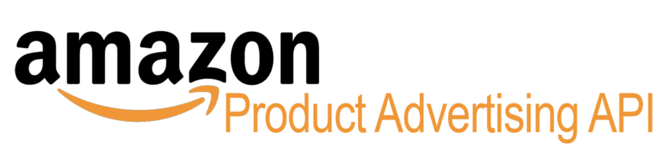

APIs are everywhere…
Notes:
It’s no surprise that a programmer would want the outside world to be able to talk to his/her application. Hence, you’ll find these things everywhere!
Note that this notion of “for developers” points to the difference between public and private API’s (more on this later…). You don’t need to be a developer to interact with them. In fact, you’re interacting with them all the time every day! The bigger takeaway is that essentially any software application you can think of uses API’s.

Slide 6
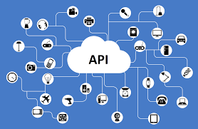
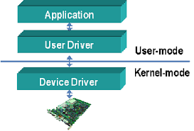
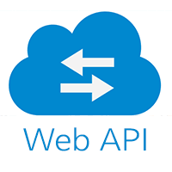


…and exist in many contexts
Gateway to Hardware
Across Local Apps
Over the Internet
Monetized vs. Free
Public vs. Private
Notes:
We’ve alluded to some different contexts earlier. But let’s enumerate the high-level ones explicitly:
Some contracts specify that communication occurs over the Internet (or at least should be structured as such…). These are referred to as “web API’s”.
Take the Tinder example earlier. The app on your phone (client) tells the Tinder backend (server) that you swiped left.
Link
Some contracts specify that communication occurs locally (on the same computer or a local network) and thus doesn’t need to adhere to the message format of the Internet.
Take a Slack plug-in in Chrome. These are two local applications that talk to each other.
Link
Some contracts allow users to control physical devices (albeit indirectly).
Device drivers are the common term.
Link
Some contracts come with documentation that is public. Others don’t. If documentation is available, the API is considered public. If it’s private, that doesn’t necessarily mean you can’t use it. Security through obscurity…
Link
Some contracts are gated by authentication/tracking mechanisms. Others are less constrained. Gating/tracking mechanisms enable various monetization mechanisms:
Must pay for a license or can’t authenticate
Pay as you use
Free, but throttled if you abuse the resource
Etc.

Slide 7
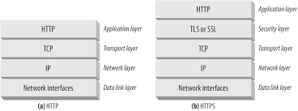
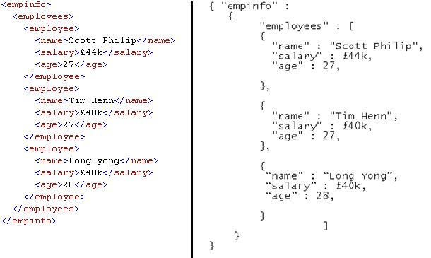
Web API’s
How Communication Should Occur
What Messages Look Like
Notes:
For the rest of today, we’ll focus specifically on web API’s. They are quite common given how much we use the Internet.
A web API has specific implications on the communication mechanism and message format. Communication is assumed to be based on the HTTP protocol, with TCP/IP likely lurking below. A quick summary:
HTTP = Hypertext Transfer Protocol => the high-level formatting of the message. Includes a method type, a destination, some metadata, and a body.
“S” => HTTP over TLS => enables message encryption for security
TCP = Transport Control Protocol => ensures the message reliably makes it to its destination over an unreliable medium (the constituents of the Internet). Adds special metadata to do so.
IP = Internet Protocol => deals with the path of each component of the message (“packet”) over the Internet such that it can (in theory) make it to its destination. Adds more special metadata to do so.
This stack of protocols goes deeper, but I’ll spare you from here on out.
Web API’s also have some minor implications for what the message body should like in general. Typically, there is a well-defined message body format specified in one of those header fields of HTTP. The most common body formats: JSON, XML, URL-encoded
JSON = JavaScript Object Notation => looks like JavaScript, easily ports to JavaScript
XML = Extensible Markup Language => older, accomplishes the same thing as JSON
However, below the granularity of high-level message body format, it is up to the API creator to specify what information should/can be included!

Slide 8
Why should I care?

Slide 9
So What
API’s are a bridge between your company’s application and the outside world!
PM
Define the contract
Define API Calls
Define data needed from requester
Define data to provide in return
PMM
Present the contract
Create API documentation to educate the public how to interact with your system
Finance & Strategy
Monetize based on the contract
Determine usage policies, pricing tiers, throttles, expansion opportunities & more
Physical Contract
World of API’s
Notes:
PM => you might be in charge of defining the contract! Your engineers implement what you define based on what your users would find useful.
What should messages look like? What data is coming in? What data is going out?
PMM => you might be in charge of how the finished contract is presented to your customers! Is it public or private?
Create API documentation that is easy to understand and consume
Finance/Strategy => you might be tasked with assessing the feasibility of API monetization!
What kind of licensing models? Tiers? Throttle limits?
Many more scenarios in which you might be involved?

Slide 10
Python: A Quick Aside

Slide 11


Python
Programming language equipped with an interpreter
Syntax is human-readable and intuitive*
Very rich ecosystem of open-source/built-in libraries
Quality of Life Automation
High-Performance Apps
Notes:
The way I see it:
Python is great for quality of life apps – i.e., not necessarily the driver of your core business, but a supporter
DevOps is a great example of a context in which Python is SUPER useful
Python might not be good enough for apps that require high-performance – i.e., the SW component of your business that must scale arbitrarily
Interpretation on the fly adds considerable overhead
Depends on the app – modern HW is *really* fast – maybe you can afford to pay that overhead

Slide 12
Getting Started with Python
Download/Install Python (supported on all major OS’s)
Officially-sanctioned Python tutorial
Hack away! It really is that simple…
*Disclaimer: Be careful about the difference between Python 3 vs. Python 2. Both are still supported, but programs that work in one are very likely to fail in the other. Unix-based systems typically come with Python 2 installed by default.

Slide 13
API’s in Action

Slide 14

Stock Market Wizard
I’m an MBA student, so I should be up on the stock market.
But it’s spring quarter and the Tour de Strand is only 1 month away – I must spend all of my time and effort to prepare.
Let’s use API’s and Python to reconcile these diametrically opposing initiatives!
The Tools:
Python 3
Yahoo! Finance Web API
Gmail Web API
https://github.com/AnderTechClub/stock-market-wizard

Slide 15
Stock Market Wizard - Takeaways
We managed to:
Use Python to automate something that improves our quality of life
Use Yahoo! Finance’s (private, free) Web API to retrieve desired financial data
Use Gmail’s (public, gated) web API to send an email report of interesting financial data
Go us! 1 hour of work so we don’t miss the next GameStop, all while still keeping up with our strict training regimen

Slide 16
Conclusion

Slide 17
Key Takeaways
API’s are just a contract – something business-oriented folk can and should understand well!
There are standard parameters for these contracts that make defining them easier.
There are programmatic tools (ex: Python) that make working with API’s possible and, dare I even say, easy?

Slide 18



Key Takeaways
API’s are just contracts at heart – not too scary!
Standard parameters make API definitions simpler
Programmatic tools can streamline definition/consumption of API’s further

Slide 19
Q&A + AMA

Slide 20
Thank you!

