Slide 1


Slide 2
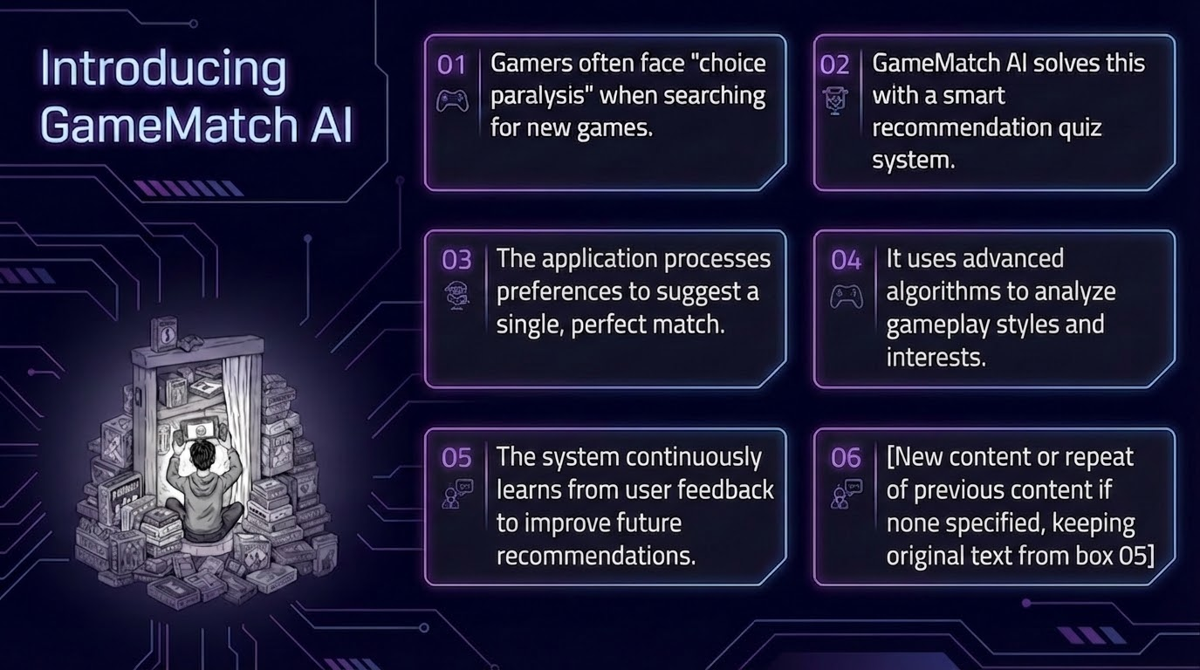

Slide 3


Slide 4
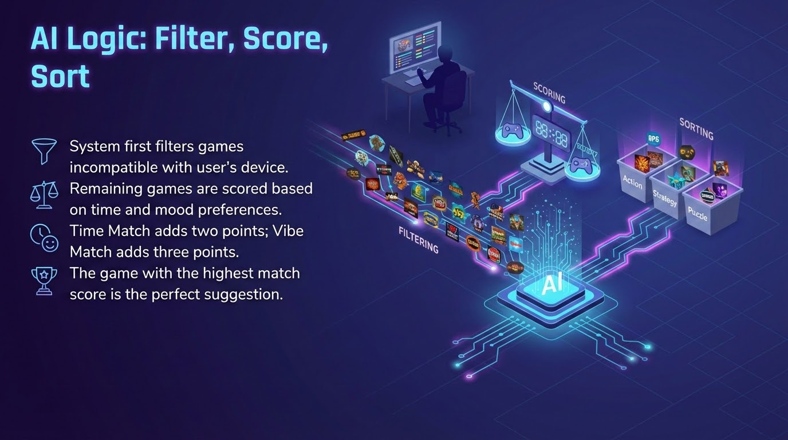

Slide 5


Slide 6
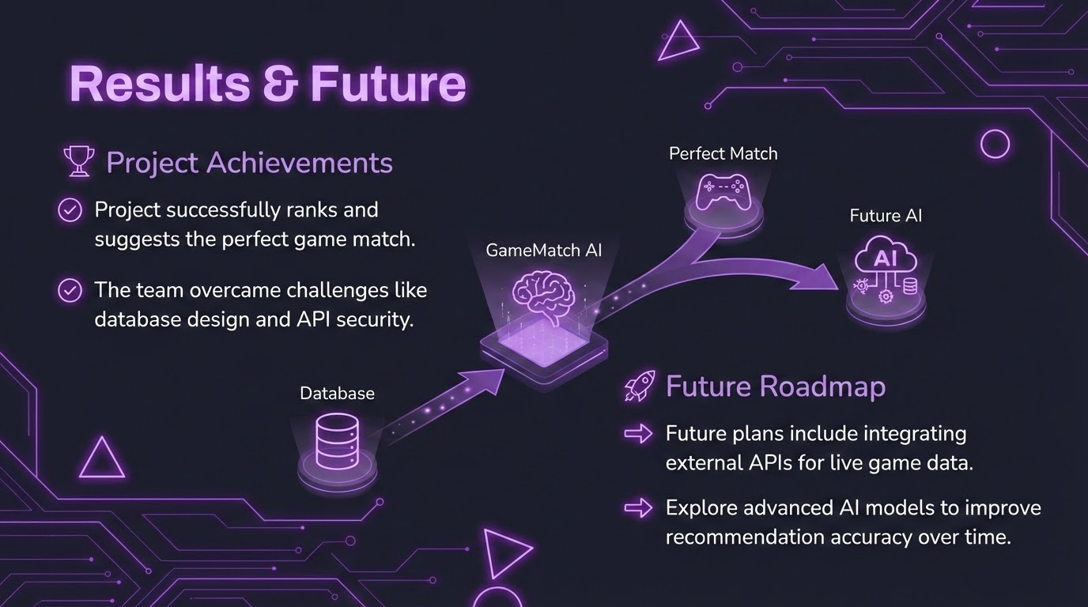

Slide 7
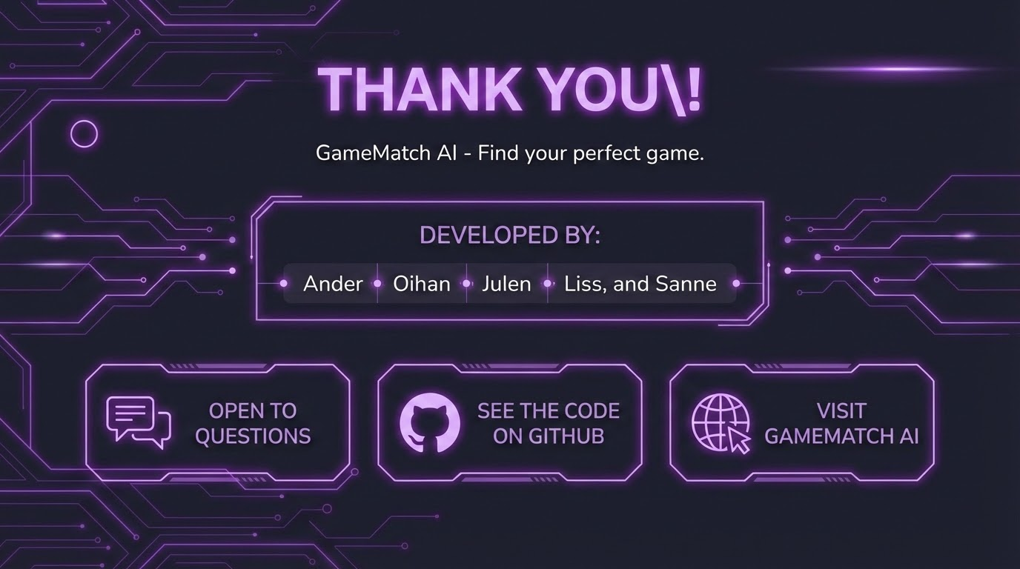

Slide 8
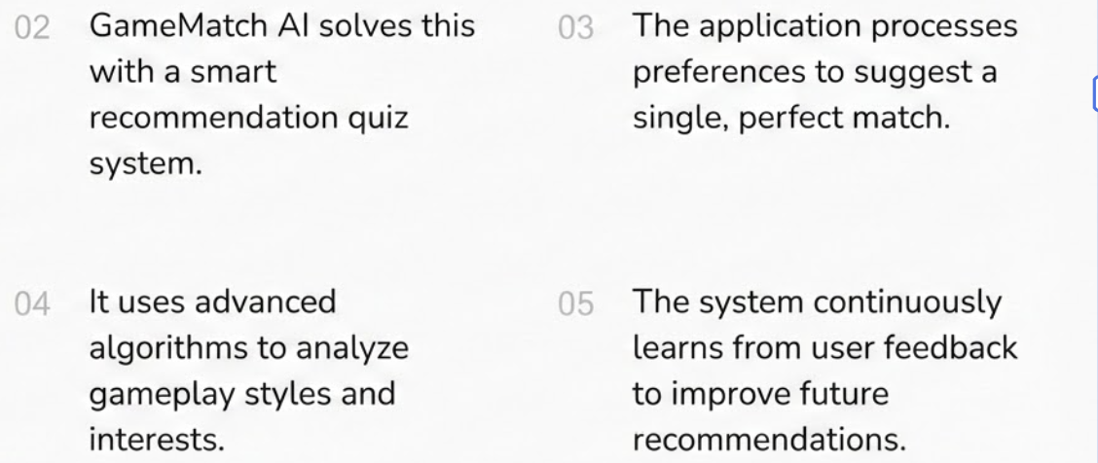

Introducing GameMatch AI
Gamers often face "choice paralysis" when searching for new games.
GameMatch AI solves this with a smart recommendation quiz system.
The application processes preferences to suggest a single, perfect match.
GameMatch AI solves this this with a smart recommendation quiz

Slide 9

Backend Architecture Overview
MySQL database with nearly 600 curated games
Relational tables organize users, games, genres, and platforms
PHP PDO is used to securely connect to the database
Prepared statements prevent SQL injection and enhance security

Slide 10

AI Logic: Filter, Score, Sort
System first filters games incompatible with user's device.
Remaining games are scored based on time and mood preferences.
Time Match adds two points; Vibe Match adds three points.
The game with the highest match score is the perfect suggestion.

Slide 11

UI/UX Design Stack
The visual design uses a dark mode 'Gamer' aesthetic
A dark Slate 900 palette with Violet 500 neon accents creates the theme
Vanilla CSS handles modular styling, responsive grids, and effects
JavaScript manages state and non-reloading smooth quiz transitions

Slide 12

Thank You!
Visit GameMatch AI to find your perfect game.
Developed by Ander, Oihan, Julen, Liss, and Sanne.
Thank you for your time, we are open to questions.
Please connect with us and see the code on GitHub.

