Slide 1
Route Session 4
Course : COMP6681 – Web Programming
Effective Period : September 2021

Slide 2
Learning Outcomes
LO1: Describe concept of web programming
LO2: Design web-based applications with structured approach

Slide 3
Outline
Definition of Routing
Create a Route
Route Parameters
Route Redirect
Route Group
Fallback route
Route Priority
Writing URL Route
View the Route List

Slide 4
Definition of Routing
Routing or Routing acts as a liaison between the user and the entire framework. In Laravel, every web address that we type in the web browser will pass the route first.
It is the route that determines where the process will be taken, whether to the Controller or to the View.

Slide 5
Definition of Routing
Fig 1. MVC Diagram + Routing

Slide 6
Definition of Routing
Laravel Default Routes
By default, Laravel already includes 1 default route. When we type the address http://localhost:8000 and press the Enter key, a Laravel route program code will be called to process the address.
This program code is in the routes/web.php file. Please open this file:

Slide 7
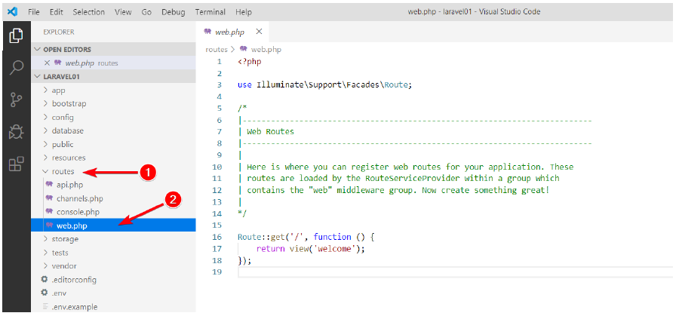
Definition of Routing
Laravel Default Routes
Fig 2. File routes/web.php

Slide 8
Definition of Routing
Laravel Default Routes
By default, the routes/web.php file already contains a few lines of program code, as shown in Figure 2.
In line 3 there is a command to import the Route facade. In simple terms, facade is Laravel's term for auxiliary classes.
Under normal use, the command in line 3 does not need to be modified.

Slide 9
Definition of Routing
Laravel Default Routes
On lines of code 16-18 is the program code that will be called to process the address http://localhost:8000.
return view('welcome'); is the Command that will run a View named 'welcome'. This view is basically a php file.

Slide 10
Create a Route
To create a route, simply write a new Route static method call into the routes/web.php file. For example, write the following code under Laravel's default route:
If it is written as above, then a route with the address http://localhost:8000/hello can be accessed. Here are the results:
Route::get('/hello', function () {
return 'Hello World';
});

Slide 11
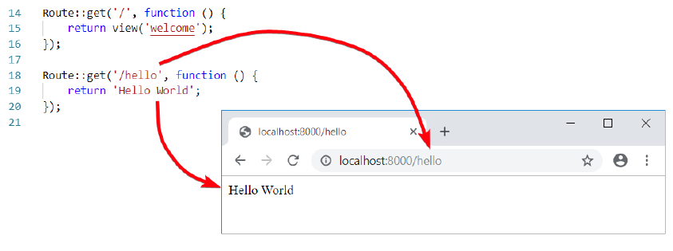
Create a Route
Fig 3. Display result from http://localhost:8000/hello

Slide 12
Create a Route
The contents of this anonymous function can also be in the form of ordinary PHP code, it doesn't have to be a return command. As a second example, we will add a new route for the address http://localhost:8000/belajar:
Route::get('/belajar', function () {
echo '<h1>Hello World</h1>';
echo '<p>Sedang belajar Laravel</p>';
});

Slide 13
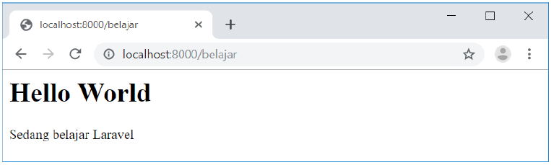
Create a Route
Fig 4. Display result from http://localhost:8000/belajar

Slide 14
Route Parameter
In certain situations, sometimes we want to retrieve the value that is in the URL address. Using basic PHP, this can be done with a query string. For example, if the URL address is written as http://localhost/mahasiswa.php?nama=Rani.
Then the value of 'Rani' can be taken from the variable $_GET['name'] in the student.php page.
routes/web.php
Route::get('/mahasiswa/{nama}', function ($nama) {
return "Tampilkan data mahasiswa bernama $nama";
});

Slide 15
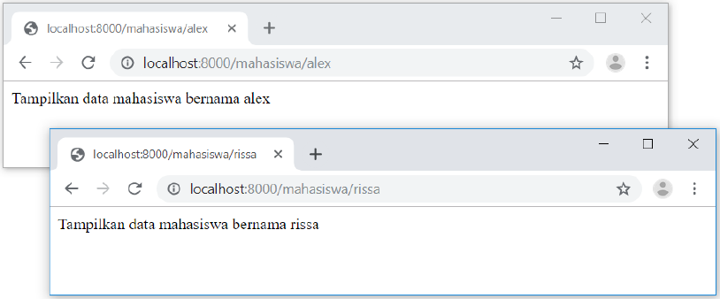
Route Parameter
Fig 5. Display result from route parameter

Slide 16
Route Redirect
Laravel also provides a feature to redirect between routes. To do this, use the Route::redirect method as in the following example:
There are 2 routes here. The routes in lines 1 – 3 are normal routes for the address localhost:8000/contact-us. In line 5 there is code to create a redirect. So that when the address is accessed localhost:8000/contact-us, the page is immediately redirected to localhost:8000/hubungi-kami.
routes/web.php
1 Route::get('/hubungi-kami', function () {
2 return '<h1>Hubungi Kami</h1>';
3 });
4
5 Route::redirect('/contact-us', '/hubungi-kami');

Slide 17
Route Group
If we have several routes that we want to process as a group, we can use route groups. By using a route group, several routes can be processed as a single unit.
We will learn what can be processed for this route group in stages, for example later being able to run certain middleware, use certain namespaces, or access certain subdomains.
As a simple example, we can use the Route::prefix() method to add a prefix to each member of the route. Pay attention to the following 3 routes:
routes/web.php
Route::get('/admin/mahasiswa', function () {
return "<h1>Daftar Mahasiswa</h1>";
});
Route::get('/admin/dosen', function () {
return "<h1>Daftar Dosen</h1>";
});
Route::get('/admin/karyawan', function () {
return "<h1>Daftar Karyawan</h1>";
});

Slide 18
Route Group
There is nothing wrong with this method. However, since all routes use the same segment prefix, namely 'admin/', we can take advantage of the route group with the addition of the Route::prefix() method:
routes/web.php
Route::prefix('/admin')->group(function () {
Route::get('/mahasiswa', function () {
echo "<h1>Daftar Mahasiswa</h1>";
});
Route::get('/dosen', function () {
echo "<h1>Daftar Dosen</h1>";
});
Route::get('/karyawan', function () {
echo "<h1>Daftar Karyawan</h1>";
});
});

Slide 19
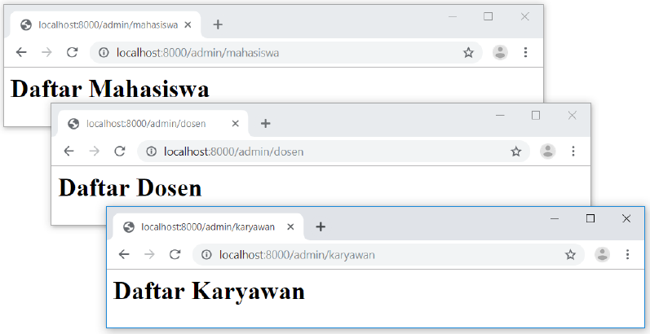
Route Group
This method will add the '/admin' prefix to all routes in the group. This makes it easier for us if we want to change '/admin' to another prefix because we only need to edit in the group, no need to change routes one by one.
Fig 6. Route with prefix '/admin'

Slide 20
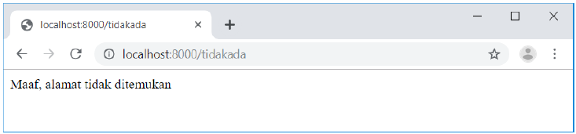
Route Fallback
Laravel provides a special route that will be executed if no route is found for a URL address. By default, laravel will show a 404 page | Not Found, but we can override it using the Route::fallback() method.
routes/web.php
Route::fallback(function () {
return "Maaf, alamat tidak ditemukan";
});
Fig 7. Display Route Fallback

Slide 21
Route Priority
The order in which the routes are written has a different priority effect depending on the route type. If we use a regular route (without parameters), then if there is more than 1 routewith the same address, the last route to run:
Here we wrote 3 routes which all contain the same URL address, namely '/book/1'. When the address http://localhost:8000/buku/1 is accessed, what will appear in the web browser is “Buku kita ke-1", which is the result of the route on lines 9 – 11.
1 Route::get('/buku/1', function () {
2 return "Buku ke-1";
3 });
4
5 Route::get('/buku/1', function () {
6 return "Buku saya ke-1";
7 });
8
9 Route::get('/buku/1', function () {
10 return "Buku kita ke-1";
11 });

Slide 22
Route Priority
But when using the route parameter, the result is different:
When accessing http://localhost:8000/buku/1, what appears is “Buku ke-1", which is the result of the route in lines 1 – 3.
1 Route::get('/buku/{a}', function ({a}) {
2 return "Buku ke-{a}";
3 });
4
5 Route::get('/buku/{b}', function ({b}) {
6 return "Buku saya ke-{b}";
7 });
8
9 Route::get('/buku/{c}', function ({c}) {
10 return "Buku kita ke-{c}";
11 });

Slide 23
Writing URL Route
In some references, route writing can also be prefixed without a forward slash, as follows:
This writing is no different from:
Both routes both refer to the URL address localhost:8000/mahasiswa/andi. The addition of a '/' sign at the beginning of writing the route is just "optional".
Route::get('mahasiswa/andi', function () {
echo "Halaman mahasiswa andi";
});
Route::get('/mahasiswa/andi', function () {
echo "Halaman mahasiswa andi";
});

Slide 24
View the Route List
When our project is big enough, the routes/web.php file will contain many routes. In addition, there will also be several commands that indirectly run certain routes (we will discuss them in a separate section). So Laravel provides the php artisan command to see all the available routes.
Artisan itself is a built-in Laravel cmd command that can be used to do many things.
How to display a list of routes using the artisan command. Please open a new cmd (the cmd running php artisan serve is left alone). Then go into the folder that was created, then type the command php artisan route:list

Slide 25
References
Lukmanul Hakim. (2020). Konsep & implementasi Pemrograman LARAVEL 7 Edisi BEST PRACTICE. CV. LOKOMEDIA. Yogyakarta. ISBN: 978-602-6231-25. Chapter 4.
Andre Pratama. (2019). Laravel Uncover. DuniaIlkom.
https://www.youtube.com/watch?app=desktop&v=dxHTkqSpz-w

Slide 26
Excercise
Create a navbar and content item that has click feature that will navigate to detail page and make sure to utilize route feature Laravel
Utilize two feature route from Laravel outside this presentation

Slide 27
Thank You

