Slide 1

DevSecOps
or...maintaining high velocity and still wearing a seatbelt ☺
Additional content here →
https://msandbu.org/securing-azure-kubernetes-services/

Slide 2

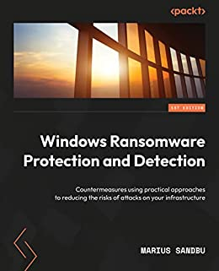
WHOAMI$
Cloud Evangelist – Sopra Steria
Focus areas: Cloud & Security
«Hobbies»
Microsoft Cloud Security User Group
Cloudfirst Podcast
Tech influencer msandbu.org
Also an author sometimes

Slide 3
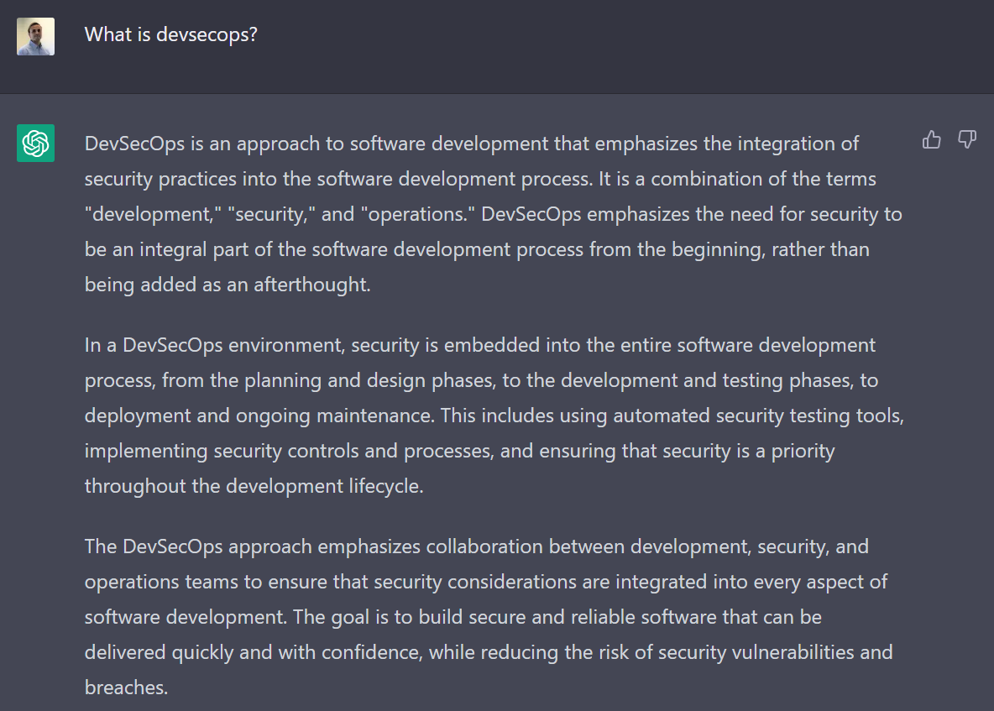

Slide 4
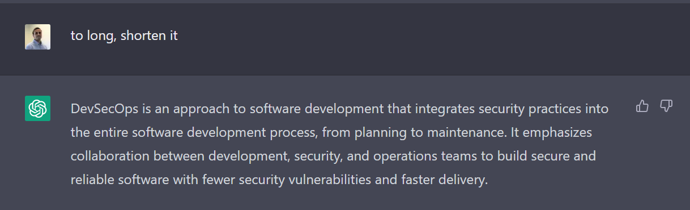

Slide 5
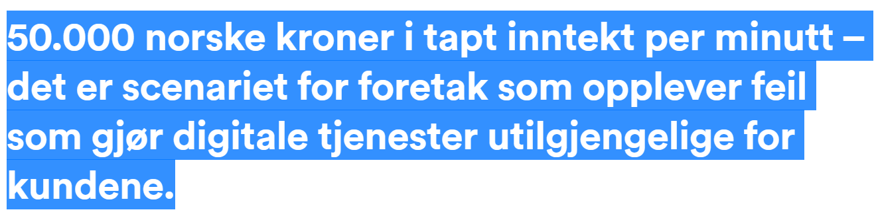
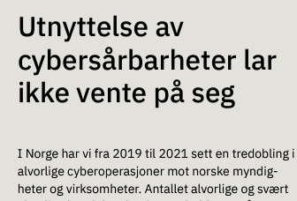
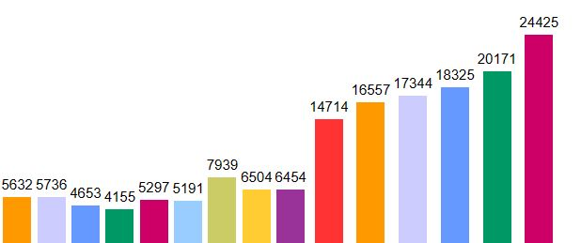
From the NSM Risk report 2023
The number of vulnerabilities from 2008 – 2022

Slide 6
Attack vectors
Vulnerabilities
Vulnerabilities in external services
Misconfigured Services
Public exposed services
IT
DDoS-/DoS-attacks
TCP SYN Flood / HTTP GET/POST Flood
Plexserver
Collaboration
Physical access
Email
Web
User information hijacked
Credential Stuffing – MFA Fatigue
Phishing
Qbot / Icedid
Drive-by download
RedLineStealer / Vidar
Developers

Slide 7
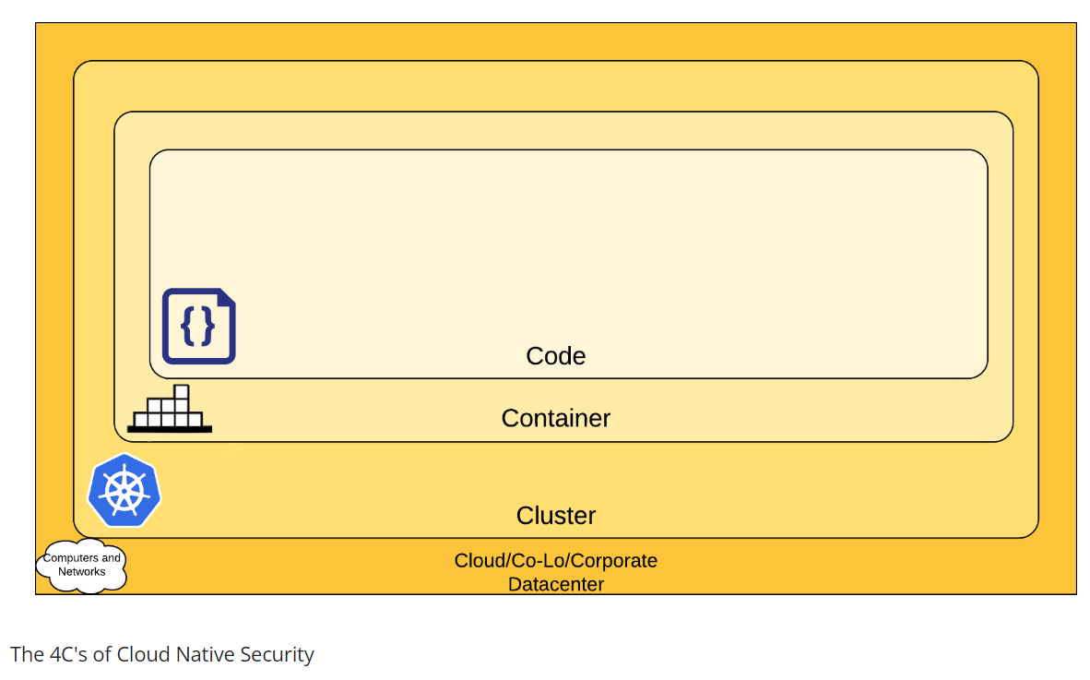
Risks in a Cloud-native landscape?
Unauthorized access to Kube API
Vulnerabilities in Kubernetes
Container applications
Unauthorized access to CI/CD and sourcecode
Container Escape
Vulnerabilities in Container Image or source code
WTF is going on inside here?!
Supply-chain vulnerabilities
Limited to none network «segmentation» policies
Limited network insight
Harvested user credentials/tokens/SPNs
Limited security control of container registry
Credentials stored in plaintext in container
Limited RBAC
Tactics - Threat Matrix for Kubernetes https://microsoft.github.io/Threat-Matrix-for-Kubernetes/

Slide 8
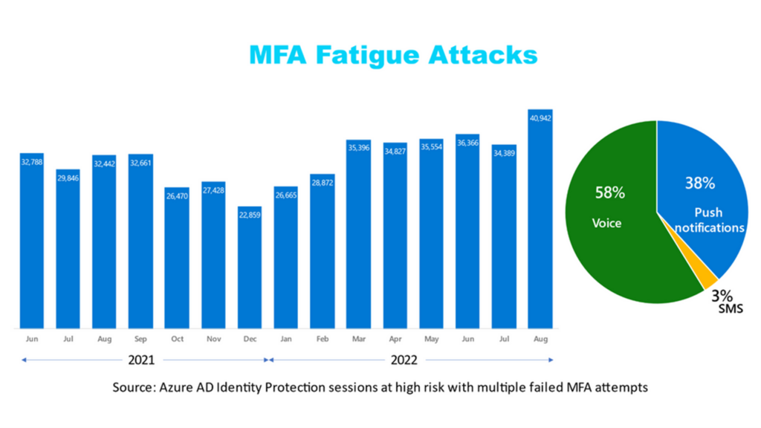
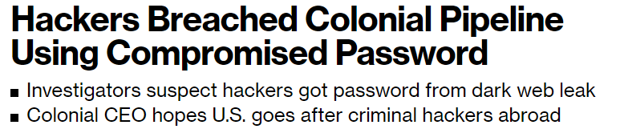
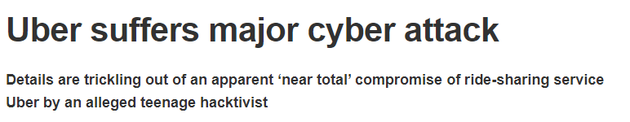
Identity also a much bigger challenge
300% Increase in identity-based attacks the last years
Reusing username and passwords on different sites
Phishing attacks and credential harvesting
MFA Fatigue attacks

Slide 9
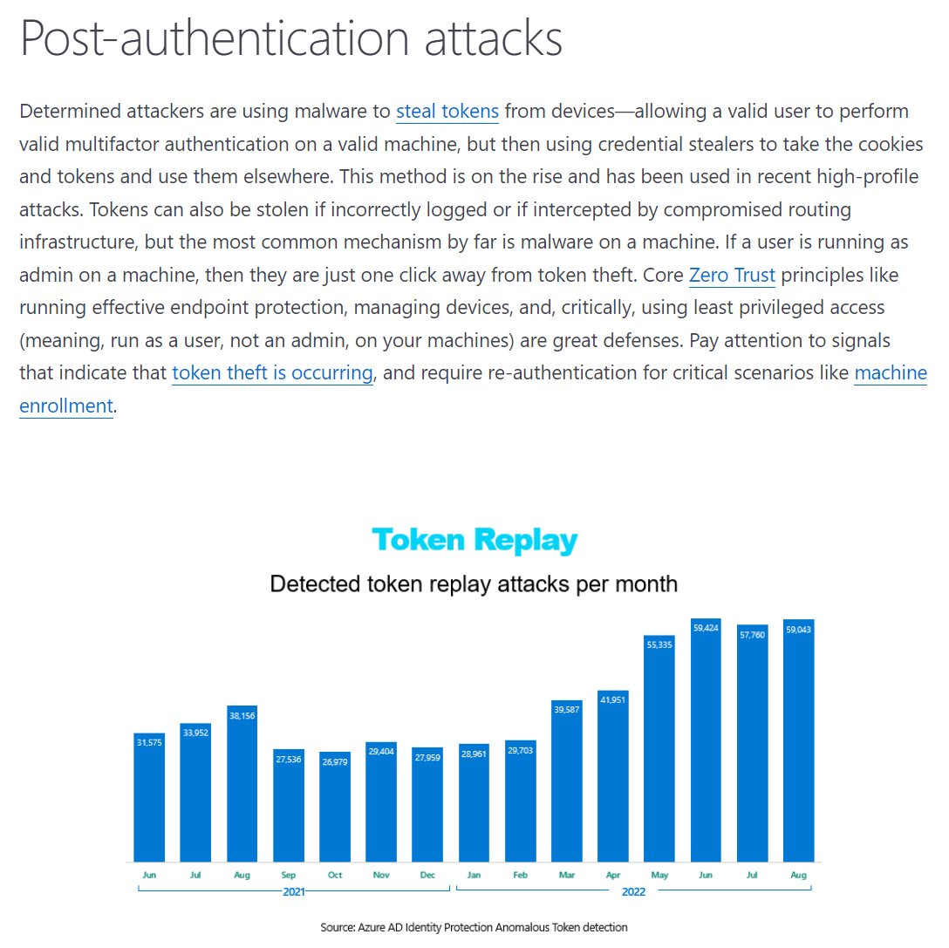
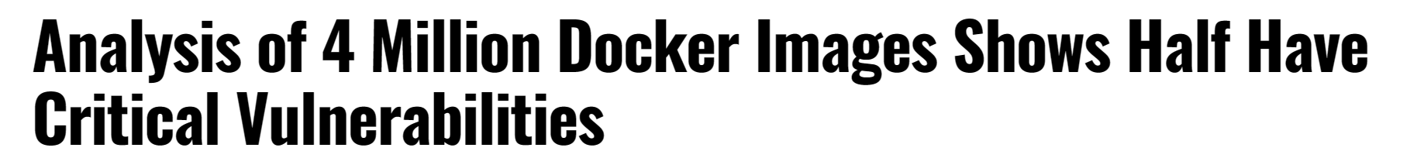
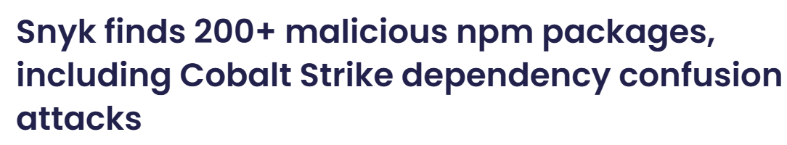
What other security threats?
State of Kubernetes Security Report 2022
State of Open Source Security Report 2022

Slide 10
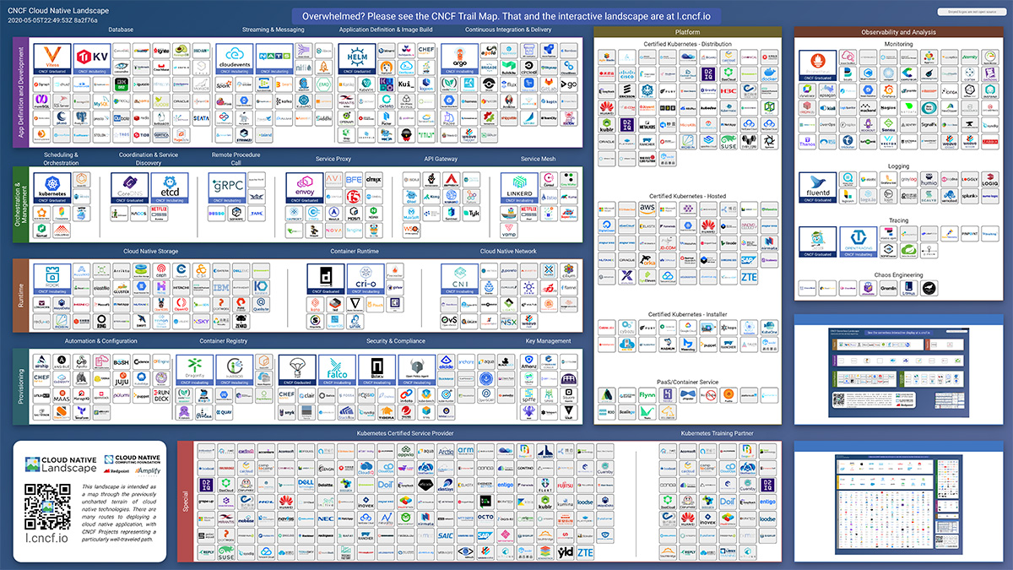
So.. How should we secure this?

Slide 11
Kubernetes (k8s) Architecture
Integrations will differ
CSI = Storage and Secrets
Cloud Controller Manager = API integration to cloud providers
Load Balancer and Ingress
Windows and Linux nodes
A huge ecosystem with oppurtunities
Often many security mechanisms available from the providers
Network uses an integration called CNI
Example: Cilium, VMware NSX, Azure CNI
Kubernetes Platform
Code
Build
Deploy
Run

Slide 12
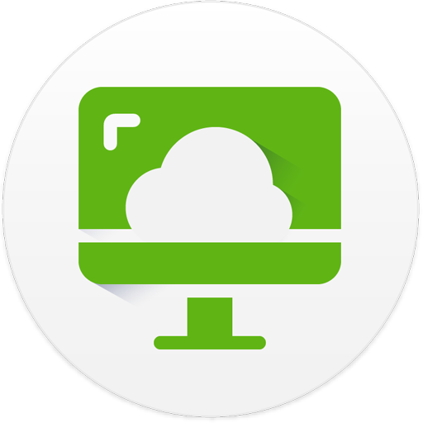
Real-life scenario on how you shouldn’t do it
Username and password + Azure MFA
Access internal services using VDI
Username and password
+ RSA MFA
NO healthcheck of device
Multiple agents and MFA services
Developers
No MFA on the github account (at that time)
Github Account

Slide 13
Not all attacks are that critical (but they can be!)
Kubernetes with Kubeflow
Kubeflow Pipeline
Using Kubeflow to trigger Tensor flow jobs
New pipeline→ Docker Images from Docker Hub
Kubeflow dashboard open to internet
XMRig for CPU Mining
Ethminer for GPU mining

Slide 14
Compromised Git pipeline
Developer X got his access token from Github stolen
Collected all enviroment variables in git and sent it to a digital ocean VPS
Tried to logon to Azure Portal using harvested credentials
Day 3 03:23 (sunday)
Day 1 04:20
04:37
01
02
03
04
05
06
Day 1 05:34 (Friday)
04:21
Attacker modified Actions workflow
Accessed storage account in Azure
Was able to collect «some» data

Slide 15
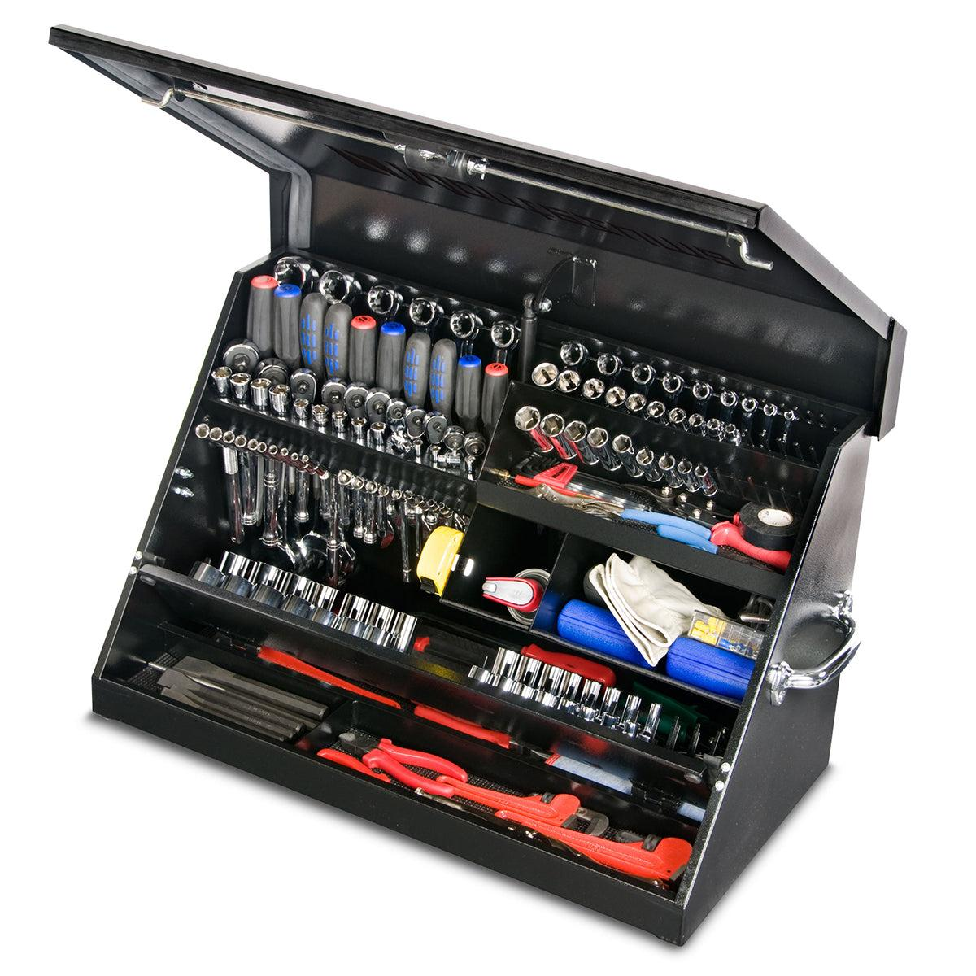
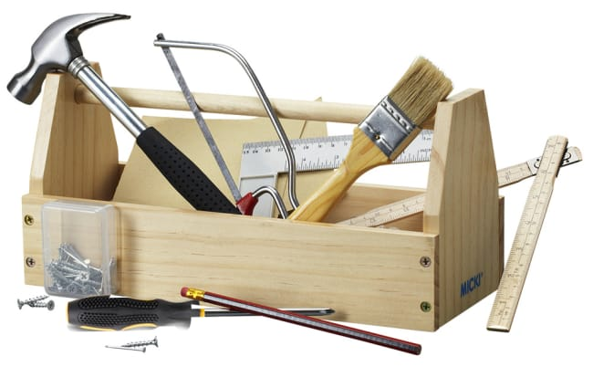
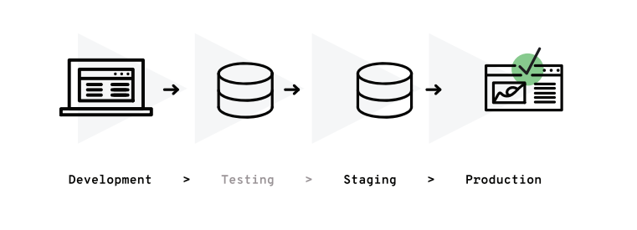
What kind of countermeasures can we implement?
Not one size fits all – Some mechanisms are entirely depedant on use-case and security requirements of an organization

Slide 16
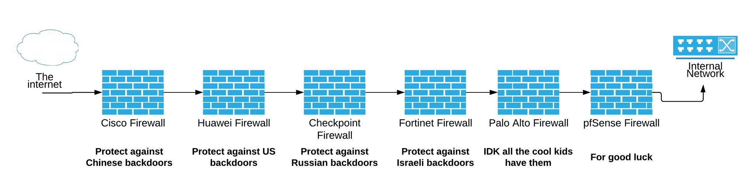
Securing the developer experience

Slide 17
Zero-Trust Network Access
Identity Posture
Never Trust Always Verify
Device Posture
ZTNA Magic
SaaS
TCP/UDP
Web Apps
Windows Apps
File Storage
Jumphost
End-user
Condition based access
Lokasjon
Tidspunkt
Data
Session

Slide 18
Microsoft’s approach
Azure Active Directory
Azure AD SaaS apps
SaaS
Azure Bastion
Jumphost
Azure Application Proxy
Intern Web
Azure Virtual Desktop / W365
VDI
Conditional Access
Azure VPN with Azure AD
TCP/UDP
Intune & Defender
Azure Arc
SSH/K8s
Microsoft Tunnel
TCP/UDP

Slide 19
Cloudflare Zero-Trust
Support for Many IDP’s
SaaS
Magic Tunnel
Warp
Cloudflared
TCP/UDP
Support for Many MDM/EDR
Jumphost

Slide 20
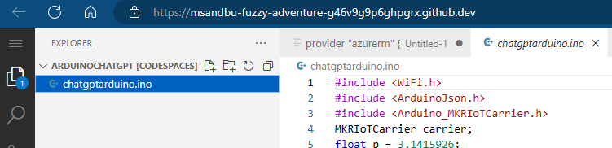
Securing the developer workbench
VS Code – Local development
GitPod
Github Codespaces
Provide non-persistent container, web-based IDE
Deployed as isolated pod
As SaaS service can integrate with CASB
Allow use of central iDP
Virtual Desktop (AVD)
For workloads not supported in web-IDE
Example: Hardware development (Custom drivers)
Provide secure virtual desktop with locked down OS

Slide 21
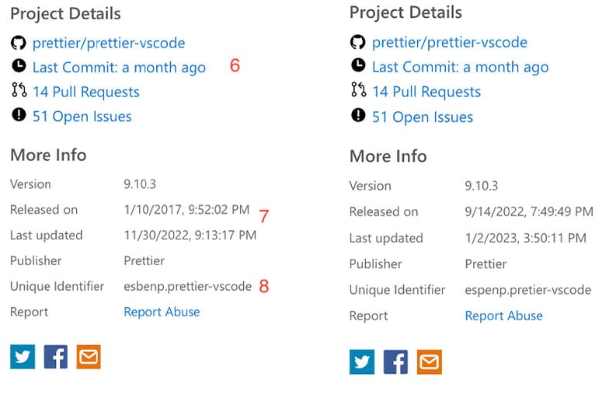
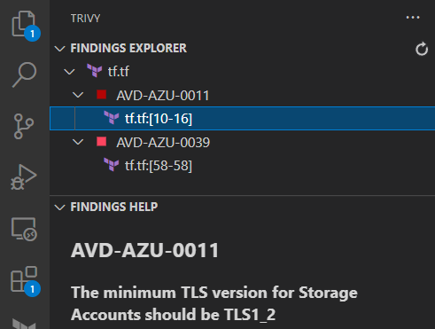
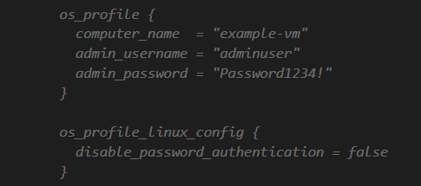
Securing the developer workbench – Extensions!
Be Careful of which extenions you use!
Double check publisher
Double check released date
Some useful extensions for code analysis
Checkov (Palo Alto – Requires Prism Cloud API)
Trivy (Requires API access to Aqua Security)
Tfsec (Full open source)
Snyk (Requires API access to Snyk.io)
Can you spot the fake one?
Also be careful with Copilot

Slide 22
Security mechanisms for GitHub
SCIM – User provisioning from central iDP
SSO and access management using SAML/OAuth
Self-hosted runners and private repositories
Provide the ability to control and restrict the traffic flow
TFSec = Inspect security issues in Terraform code
Trivy = Inspect security issues in TF Code and Container images
Microsoft Defender for DevOps
Git Signed Commit
Github Advanced Security
Secret scanning = Free feature
Manage programatic access
Use of fine-grained personal access tokens
Can be defined as by default on organization level
Microsoft Defender for DevOps uses:
Bandit
BinSkim
Eslint
Terrascan
Trivy
Github Advanced Security: (features for private repositories)
Code scanning
Secret Scanning
Depedency Review

Slide 23
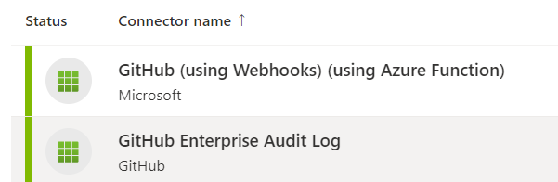
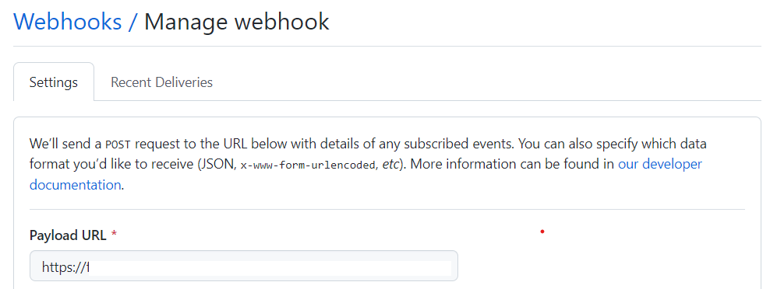
Security mechanisms for GitHub
Security Monitoring with Azure Sentinel
Github with Webhooks (Collects logs from Actions, Forks, Code Scanning) sends to an Azure Function)
Github Enterprise Audit Log (Collects information about use admin activity and nothing related to Actions)

Slide 24
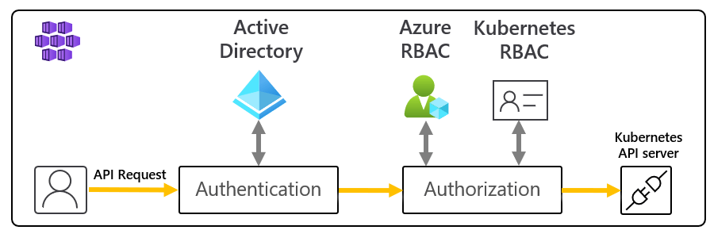
IAM mechanisms and RBAC
dexidp/dex or pinniped
Accessing Kuberneretes API trough
Token, Sertifikat or authentication proxy
Built-in Certificate in Kubernetes cannot be revoked
No standard LDAP integration
Example: Azure AD, Google or OpenID Connect
RBAC is only to add permissions no deny mechanism
Roles can be defined on namespace level or cluster
RBAC and API Objects All permissions can be delegated(CRUD)
apiVersion: rbac.authorization.k8s.io/v1 kind: Role metadata: namespace: default name: pod-reader rules: - apiGroups: [""] # "" resources: ["pods"] verbs: ["get", "watch", "list"]
apiVersion: rbac.authorization.k8s.io/v1 kind: RoleBinding metadata: name: read-pods namespace: default subjects: - kind: User name: minikube apiGroup: rbac.authorization.k8s.io roleRef: kind: Role name: pod-reader apiGroup: rbac.authorization.k8s.io
Role
Rolebinding
Namespace
ClusterRole
ClusterRoleBinding
sighupio/permission-manager

Slide 25

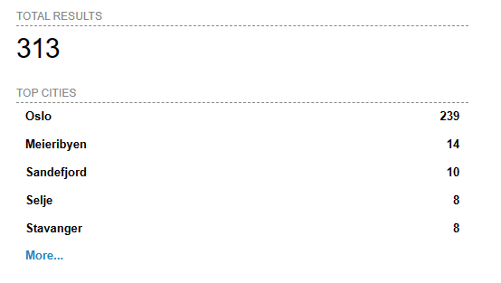
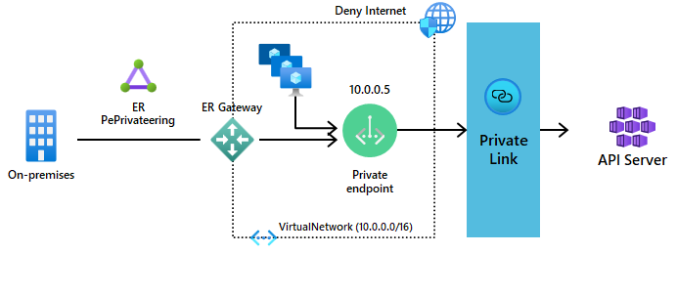
Private Cluster
No limit on authentiction requests
Mostly an issue on Kubernetes in Public Cloud
Redusere abuse of tokens or other credentials against KubeAPI
A few vulnerabilites here the last years (example: CVE-2022-3172)
.....or atleast define authorized IP addresses for Kube-API proxy
Will often require a redeployment of the cluster
Microsoft supports use of multiple private endpoints

Slide 26
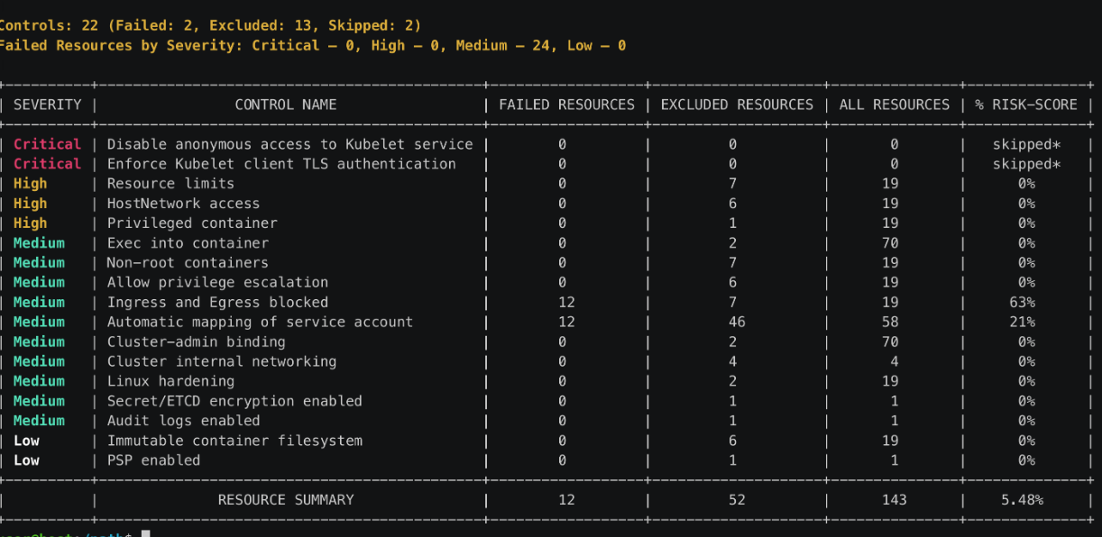
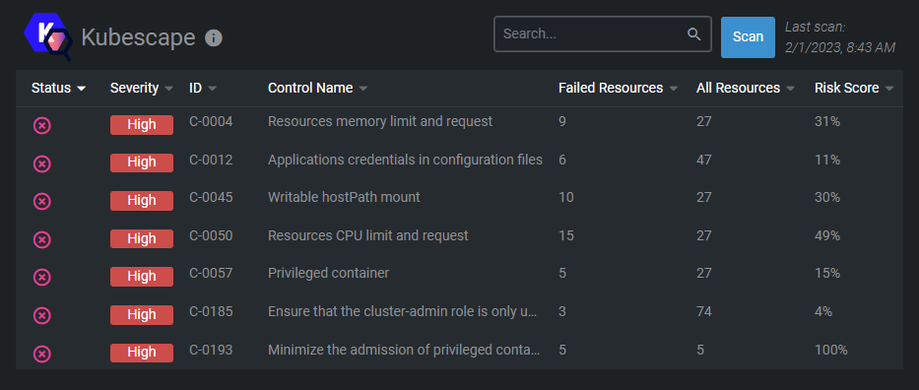
Is it according to best pratices?
Kubebench – Scans enviroment according to CIS
Kubescape – Scans enviroment according to NSA-CISA and CIS
Both understand limitations when running in Microsoft Azure
Kubescape can also run using Github Actions or CLI
YAML or JSON based reporting
Kubescape extension for Lens / Openlens

Slide 27
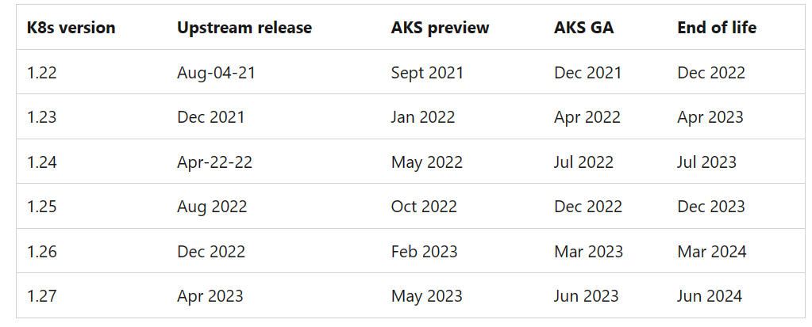
Upgrades and patching
1 year support on a minor release
Version now 1.26.1 (major.minor.patch)
Maintance for 14 months
Some different standards on what is supported
Depending on vendor
Kubernetes patches come weekly
Some patches requires node restart
A bit dependent on underlying OS
Example: VMware - Photon, Microsoft – Mariner
NOTE: limited supports for Microsoft tools on Mariner yet….
Kured (Kubernetes Reboot Daemon)
Look after /var/run/reboot-required and reboot if required
Node image oppgradering
Get warning about unsupported API’s
FairwindsOps/pluto

Slide 28
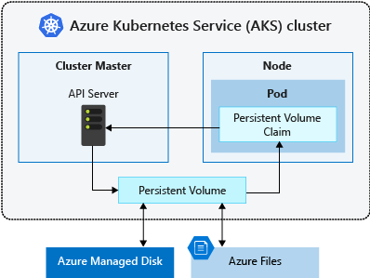
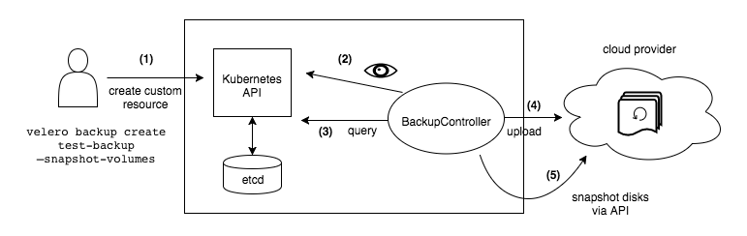
Backup and data protection
For services that require persistent storage
Provisions using built-in CSI (storage interface)
Cloud platforms, Dell, HP, NetApp, IBM etc
For data storage that requires read/write by multiple pods.
Backup is something that needs to be deployed seperately
Use of tools like Velero, Kasten or Portvorx Backup
Or native AKS backup in preview (Velero in-disguise)
Kubestr can be used to benchmark CSI drivers
Back up Azure Kubernetes Service (AKS) using Azure Backup - Azure Backup | Microsoft Learn

Slide 29
Pod Security Admission (PSA)
Better default isolation on containers
Can define different levels
Three built-in levels
Example: Privileged gives no limits
Can be defined on namespace level
warn
audit
enforce
Policy Modes
Namespace
kubectl label --overwrite ns test-privileged pod-security.kubernetes.io/enforce=privileged pod-security.kubernetes.io/warn=privileged
kubectl label --overwrite ns test-restricted pod-security.kubernetes.io/enforce=restricted pod-security.kubernetes.io/warn=restricted
Pod Security Standards
restricted
privileged
baseline

Slide 30
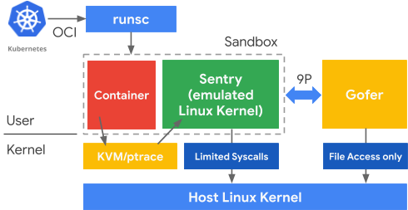
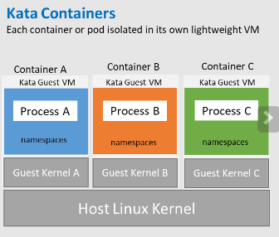
Encryption and Container Isolation
gVisor - emulates OS-Kernel calls to reduce the risk of container escape
Confidental Computing Available in Azure
Kata VM’s (preview on AKS)
Not supported in AKS... Yet..
Uses Hardware technology from AMD to encrypt everything in runtime
Each container its own lightweight VM (in preview AKS)

Slide 31
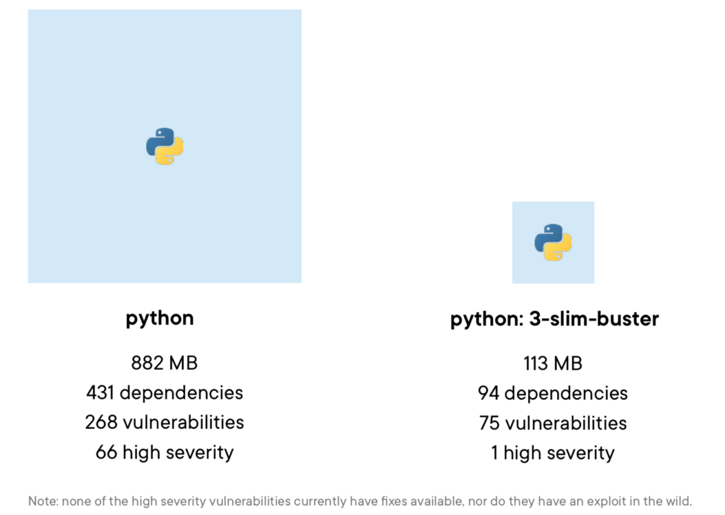
Container Registry
Many are using base image with heavy footprint
Small changes required such as just changing to slim
Private vs Public Image repository
Same principles apply in regard to access control
Only allow «approved» images
Image scanning mechanisms to detect vulnerabilities
Azure Defender for Containers

Slide 32
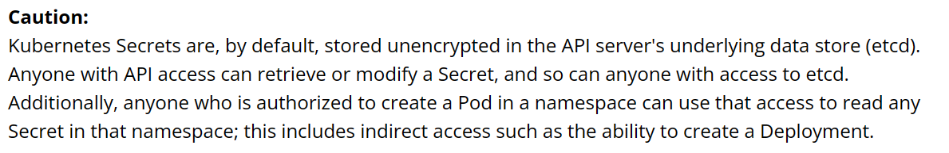
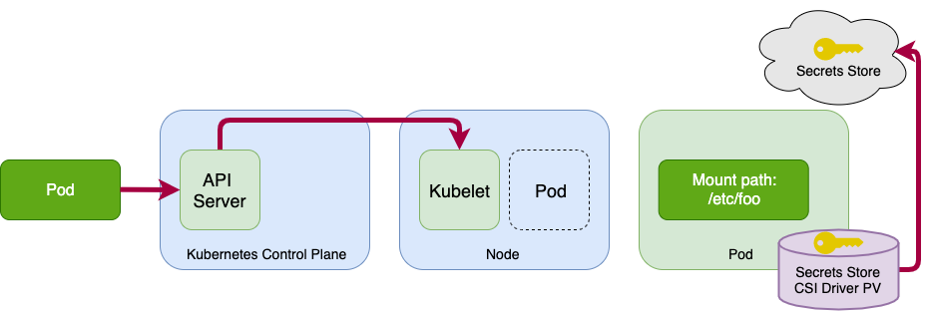
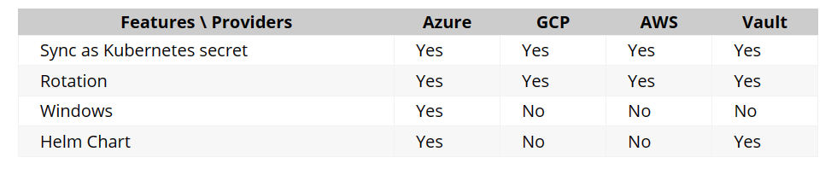
Secret Management
Database access
Filesystem
Cloud enviroment
Service Accounts
Certificates
Etcd has no built-in versioning or backup
Data is not encrypted at rest by default
Recommendation is external Kubernetes Secret Operator
Move secrets out of Kubernetes and the containers
Secret CSI driver for storing credentials for containers
Supported for Secret Store CSI

Slide 33
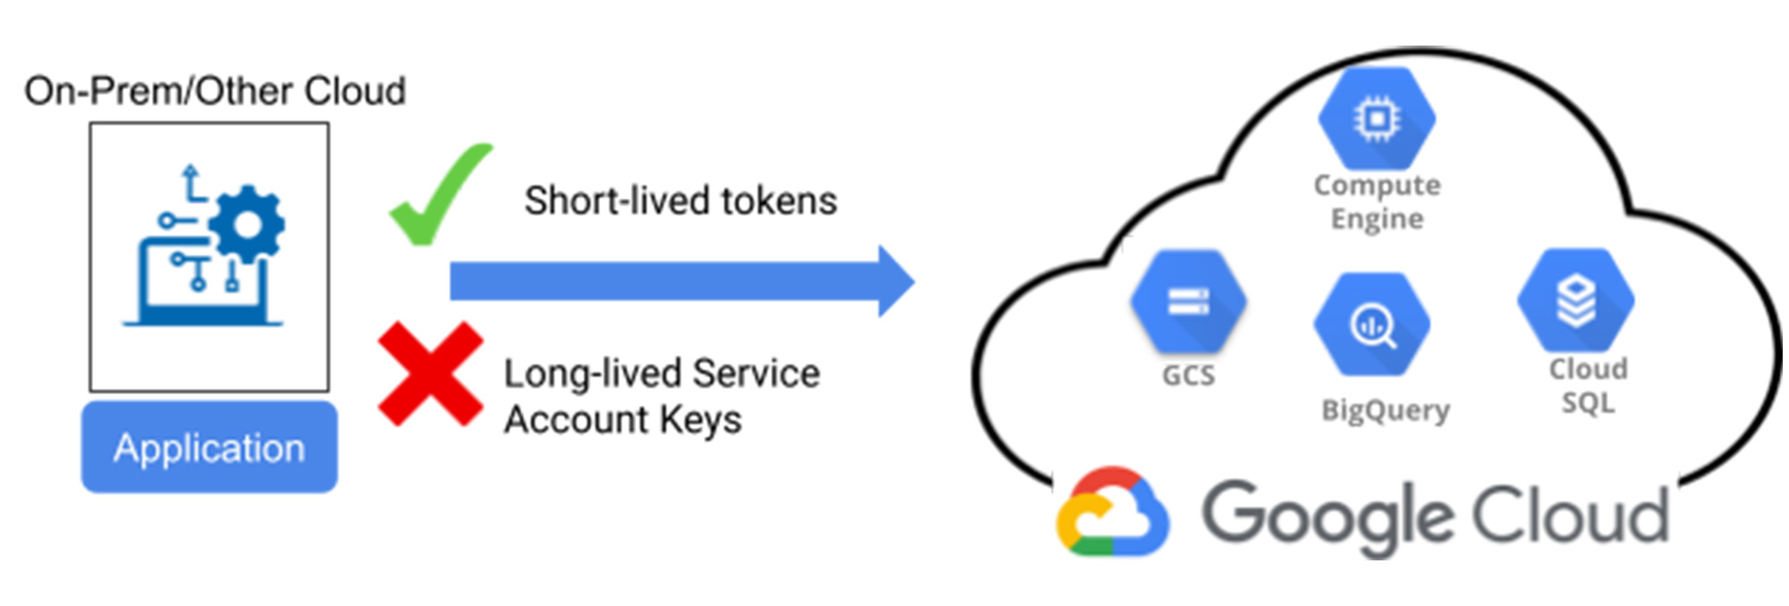
Workload Identity + Trusted Access (Preview)
Safe authentication between container to PaaS services
Supported by Google and Microsoft
Federate authentication trough OpenID Connect
Avoid use of keys at all!
Trusted Access in preview -
Azure Services to authenticate securely to AKS based services

Slide 34
Kubernetes Nettverk - some acronyms
CNI = Network integration between Kubernetes and the underlying network
CRD = Custom Resource Definition (Utvidelse med ressurser I Kubernetes APIet)
Network Policies = Lag ¾ Firewall mechanisms – Controlled via CNI
Services = Exposing of a service in a pod
Ingress / Gateway API = Entry to the different services (trough layer 7)
IP Tables = packet filter in the OS kernel and controls much of the network logic in k8s
eBFP = Mini applications running as a sandbox package in the OS kernel

Slide 35
Network Policies
apiVersion: networking.k8s.io/v1
kind: NetworkPolicy
metadata:
name: frontend-to-sqldatabase
namespace: default
spec:
podSelector:
matchLabels:
app: sqldatabase
policyTypes:
- Ingress
- Egress
ingress:
- from:
- ipBlock:
cidr: 172.17.0.0/16
- namespaceSelector:
matchLabels:
project: myproject
- podSelector:
matchLabels:
role: frontend
egress:
- to:
- ipBlock:
cidr: 10.0.0.0/24
ports:
- protocol: TCP
port: 5978
Traffic control on layer ¾
IP, Port, Protocol, Pod label
By default everything in Kubernetes is open
Require a CNI that can control traffic
Calico, WeaveNet, Azure CNI, GKE CNI, Cilium (eBFP)
Flannel (does not support Network Policies)
Traffic flow controlled via YAML configuration
Target
Source IP
Source
Some free tools to visualize flow https://orca.tufin.io/netpol/
https://artturik.github.io/network-policy-viewer/
Target IP og Port

Slide 36
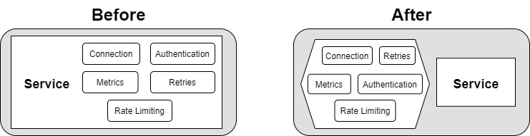
Service Mesh
Allows us to provide the following features in the platform
Visibilty (L7)
Security (L7)
Traffic shaping
Moving this functionality out of the application layer and into the platform

Slide 37
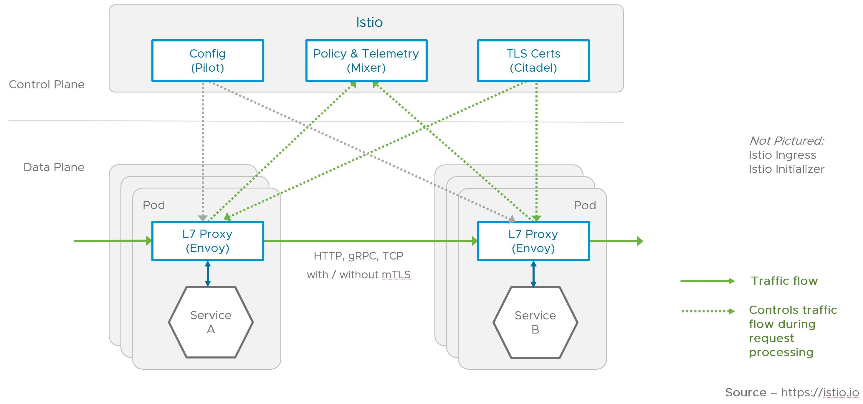
Service Mesh - Architecture
Different features and architecture depending on vendor
Sidecar proxy or use of eBFP
Cilium use eBFP
Istio use iptables
Provides for instance mTLS on service-to-service
Provides visibility into the network tier
Layer 7 network policies
Service Mesh architecture will soon be replaced with a new architecture
Architecture based upon Isitio which uses Envoy as a sidecar proxy

Slide 38
Some Service Mesh alternatives
Features | Istio | Linkerd | Hashicorp Consul | Traefik Mesh | Kuma (fra Kong) | Open Service Mesh | VMware Tanzu
Proxy component | Envoy | Linkerd2-proxy | Envoy | Egen | Envoy | Envoy | Envoy
Sidecar Proxy | Yes | Yes | Yes | No | Yes | Yes | Yes
Container-VM | Yes | No | Yes | No | Yes | No | No
MultiCluster | Yes | Yes | Yes | No | Yes |  | Yes
BYO Ingress | Gateway | Yes | Yes | Wel.. | Yes | Yes | Yes
Dashboard | Kiali | Yes | Yes | Traefik Hub |  | Azure Monitor | Tanzu Mission Control
mTLS | Yes | Yes | Yes | Yes | Yes | Yes | Yes
Traffic Kontroll | Yes | Yes | Yes | Yes | Yes | Yes | Yes
HTTP/3 | Yes | No | Yes | Yes | Yes | Yes | Yes
https://linkerd.devstats.cncf.io/

Slide 39
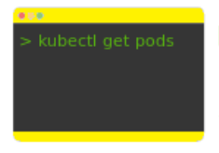
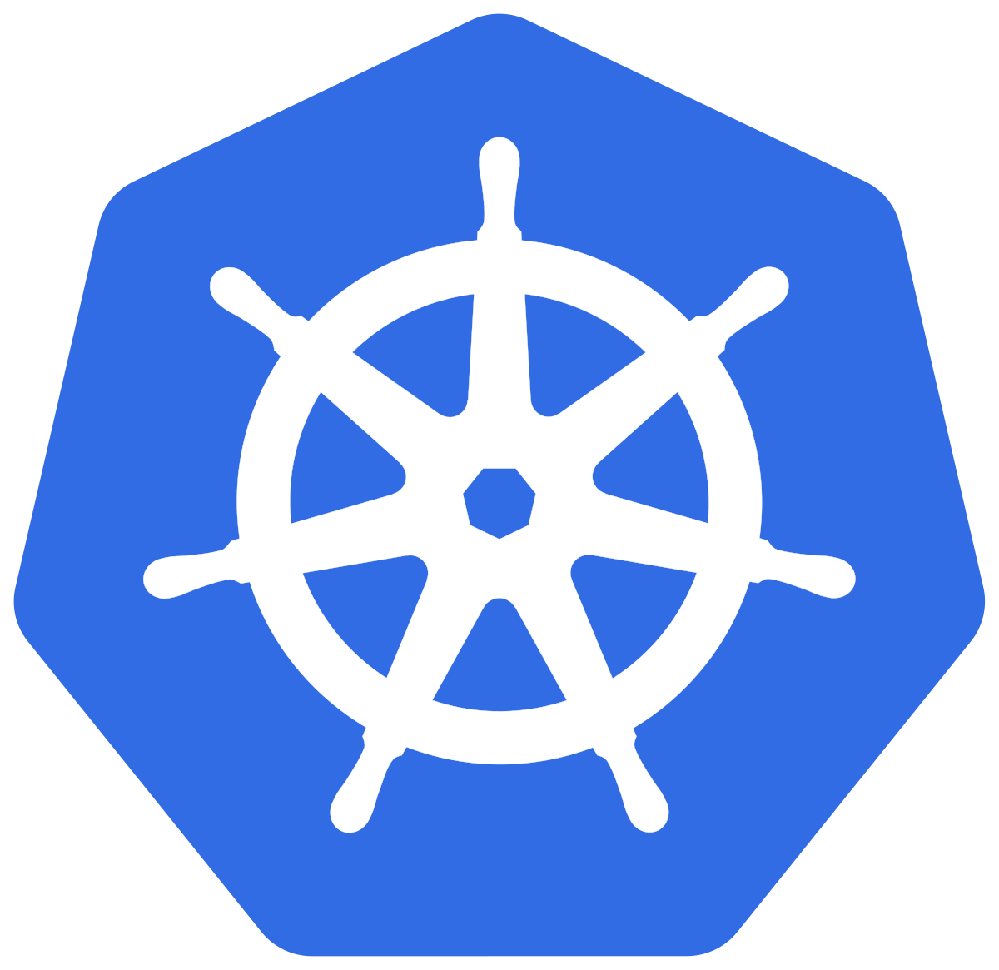
Security Monitoring of Kubernetes
Kubernetes API monitoring
Kubectl apply -f
DNS Logs from CoreDNS
Kubernetes Audit Policy
Host logs
Audit Level
apiVersion: audit.k8s.io/v1 kind: Policy omitStages: - "RequestReceived" rules: - level: RequestResponse resources: - group: "" resources: ["pods"] - level: Metadata resources: - group: "" resources: ["pods/log", "pods/status"]
None
Metadata
Request
RequestResponse
Log service
CNI logs
Splunk
Sentinel
ELK
Loki
Customize Azure Kubernetes Service Diagnostics for Azure Log Analytics - msandbu.org

Slide 40
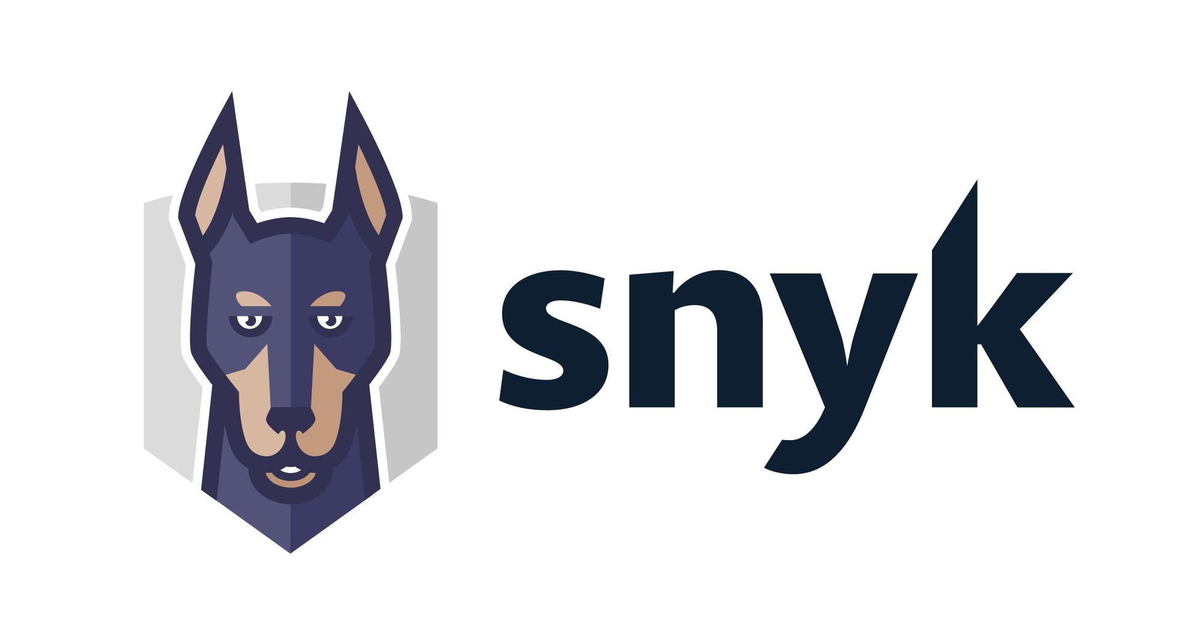

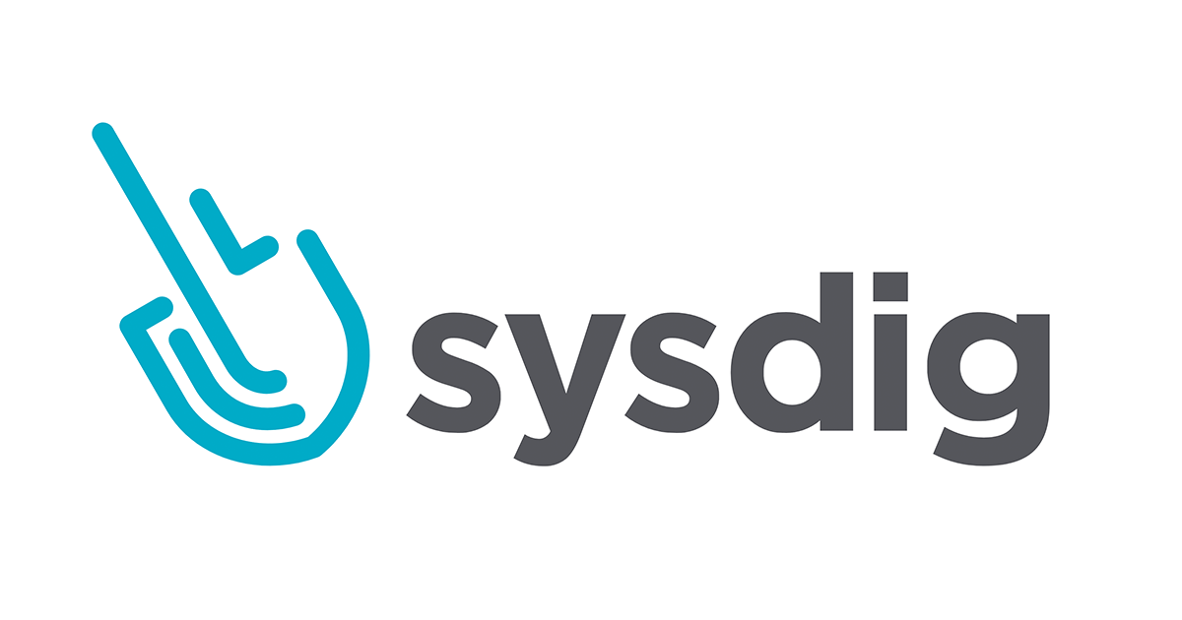

Enterprise products
Secure Code development
Securing dependencies
Container Image Scanning
Secure IaC
Secure Code Development
Secure IaC
Cloud and Kubernetes Security Posture
Secure Code Development
Securing Pipelines
Secure IaC
Vulnerability Management
Cloud and Kubernetes Security Posture
Secure Code Development
Securing Pipelines
Secure IaC
Vulnerability Management

Slide 41
So where to start?
Basic Mechanisms
Next level of maturity
Per use-case
Private Cluster
Identity based access
Security scanning for vulnerabilities and dependencies
Simple network Policies
Control of versioning
Workload Identity
Security Monitoring
External Secret Management
Proper Network Policies based upon Zero-trust principles
GitOps
Identity control using SCIM
Service Mesh
Backup
Kubebench (CIS, NIST validering)
Confidential Computing or Kata VM
Use of enterprise commersial producuts
Falco/Tetragon
Build understanding
Train the developers
Start with simple achiveable goals

