Slide 2
Who, why and how?​

Slide 3
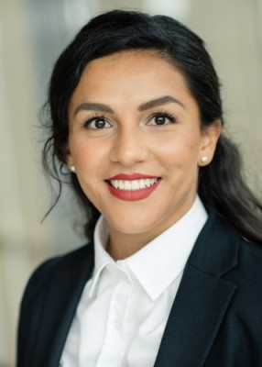
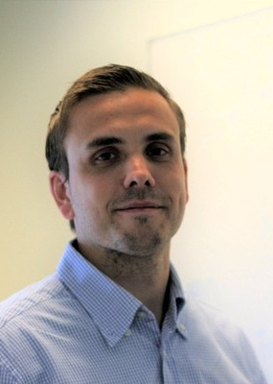
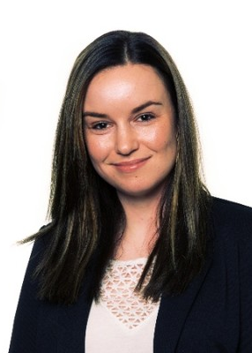
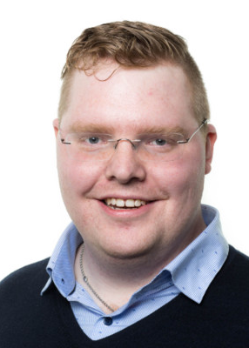
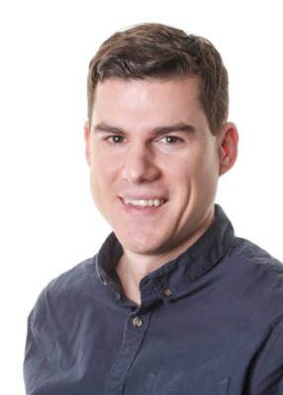
Who we are and what we do
Sanna Diana Tomren
Marius Sandbu
Linda Andersen
Haflidi Fridthjofsson
Craig Forshaw

Slide 4
Why
Have fun​
Build network ​
Share knowledge ​
Learn from each other ​
Giving power to the community​
Develop technology for a secure and sustainable future​

Slide 5
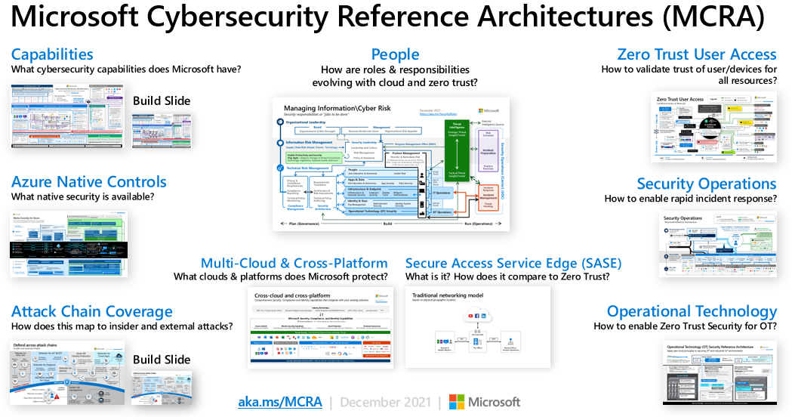
Microsoft Security, where to start?

Slide 6
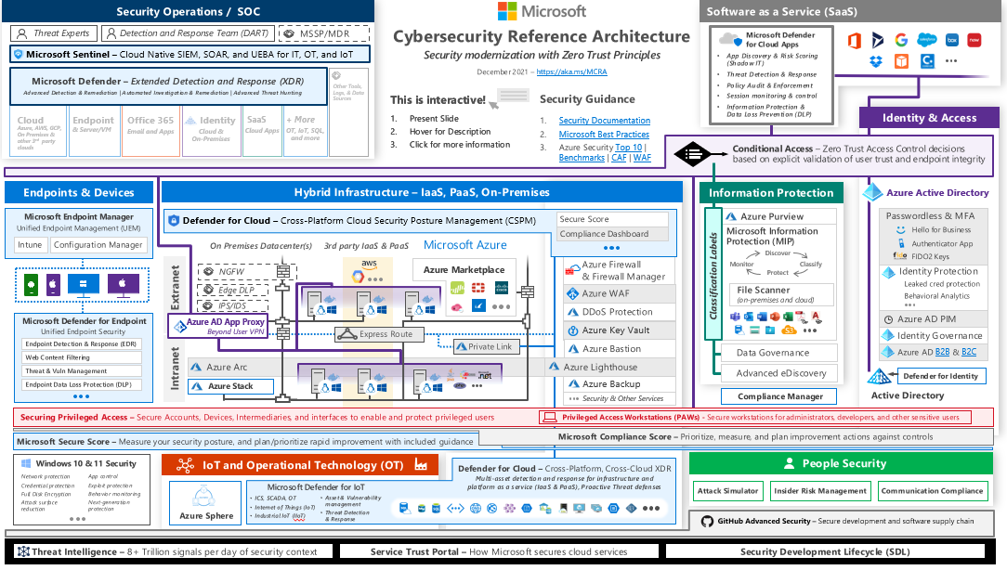

Slide 7
How

Slide 8

Jan 2023
Container Security
Dec 2022
Networksecurity
DES
JAN
NOV
FEB
Mar 2023
EDR
OKT
MAR
Oct 2022
Secure IaC
SEPT
ÅRSHJUL
2022/23
APR
AUG
MAI
20. april 2022
Kickoff MSUG
JUL
JUN
Sep 2022
SIEM & SOAR
Ferie
Juni 2022
Identity in hybrid cloud environment

Slide 9
Menti

Slide 10
Thank you!

