Slide 1

Context- awareness
29-05-2018
Anders Pedersen
201508308
3. Machine learning basics for context inference

Slide 2


Agenda
Context- awareness
29-05-2018
Anders Pedersen
201508308
“Smart” ringetone justering
Accelerometer, mikrofon, gps
Widget arkitektur, J48 træ
Motivation
Ulrich cykeltur til uni: misset opkald
Træls at justere ringetone hele tiden
Context- awareness
29-05-2018
Anders Pedersen
201508308
3. Machine learning basics for context inference.
Projektet

Slide 3
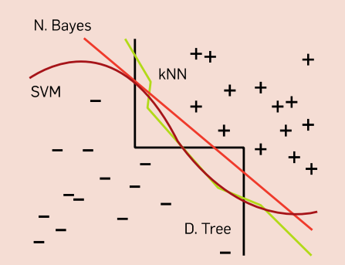
Agenda
Context- awareness
29-05-2018
Anders Pedersen
201508308
Context- awareness
29-05-2018
Anders Pedersen
201508308
3. Machine learning basics for context inference.
Supervised Machine Learning
- Unknown target function f(x)
- Labeled dataset D = {(x1,y1),…,(xn,yn)}
Goal :
Find hypothesis g which approximate f well (g ≈ f) (using D)
hope g generalize well outside D !!! (Eout ≈ Ein)
If successful : Predict mostly correct on future input

Slide 4
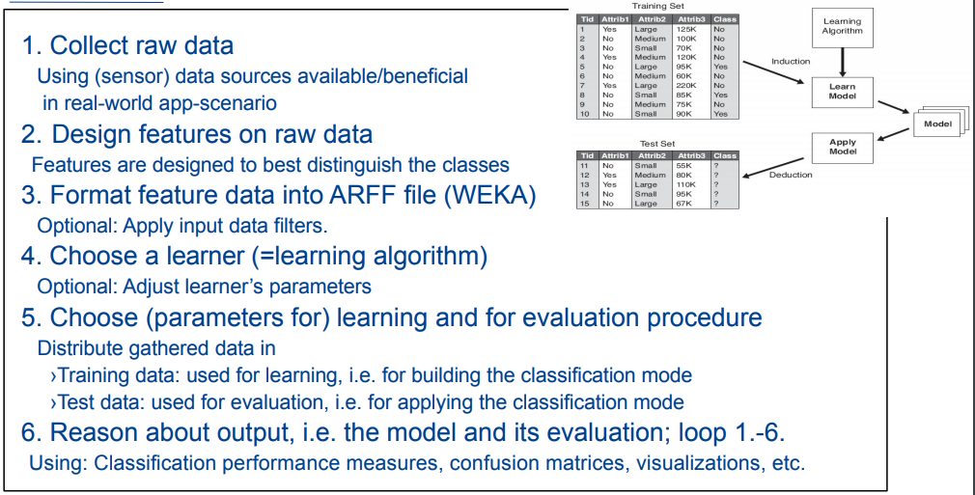
Agenda
Context- awareness
29-05-2018
Anders Pedersen
201508308
Context- awareness
29-05-2018
Anders Pedersen
201508308
3. Machine learning basics for context inference.
Typical workflow building classifier

Slide 5
Agenda
Context- awareness
29-05-2018
Anders Pedersen
201508308
Context- awareness
29-05-2018
Anders Pedersen
201508308
3. Machine learning basics for context inference.
Context inference using ML
Infer :
- Transportation mode (gps,…)
- Activity (microphone, accelerometer, gps,…)
- Gestures (accelerometer, camera)
- ...

Slide 6

Agenda
Context- awareness
29-05-2018
Anders Pedersen
201508308
Context- awareness
29-05-2018
Anders Pedersen
201508308
3. Machine learning basics for context inference.
Context inference using ML

Slide 7
Agenda
Context- awareness
29-05-2018
Anders Pedersen
201508308
Context- awareness
29-05-2018
Anders Pedersen
201508308
3. Machine learning basics for context inference.
Context inference using ML
Raw sensor data
Extracted feature
(Lat,Long) | avgSpeed
Acceleration force (x,y,z) | MinAcc, MaxAcc stDevAcc
Mic amplitude | avgMicAmplitude
GPS
GPS
Accelerometer
Microphone

Slide 8
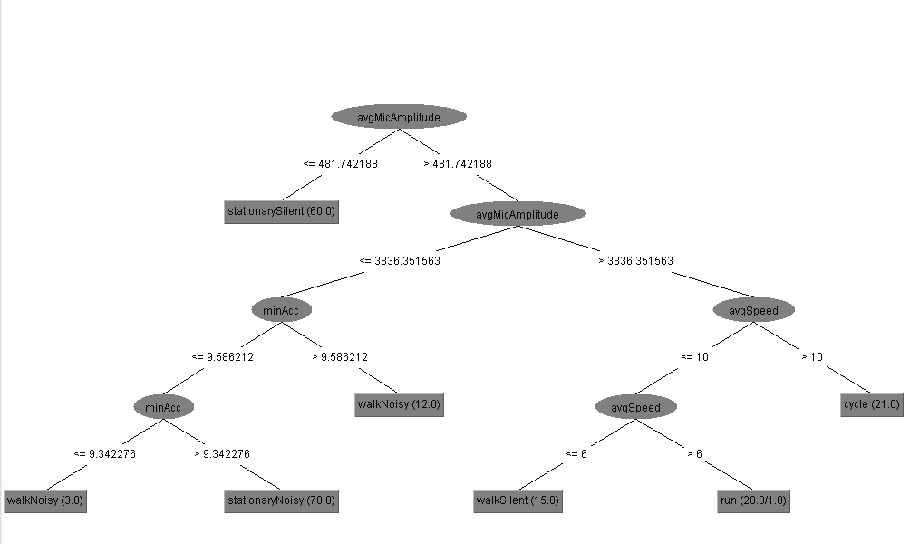
Agenda
Context- awareness
29-05-2018
Anders Pedersen
201508308
Context- awareness
29-05-2018
Anders Pedersen
201508308
3. Machine learning basics for context inference.
Decision tree

