Slide 1

Context- awareness
29-05-2018
Anders Pedersen
201508308
6. Grand challenges and newer context aware applications.

Slide 2


Agenda
Context- awareness
29-05-2018
Anders Pedersen
201508308
“Smart” ringetone justering
Accelerometer, mikrofon, gps
Widget arkitektur, J48 træ
Motivation
Ulrich cykeltur til uni: misset opkald
Træls at justere ringetone hele tiden
Context- awareness
29-05-2018
Anders Pedersen
201508308
6. Grand challenges and newer context aware applications
Projektet

Slide 3
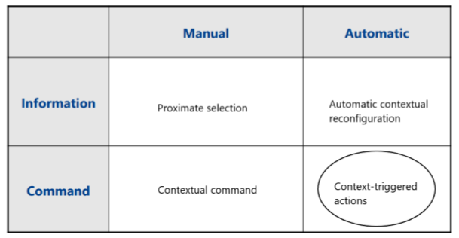
Agenda
Context- awareness
29-05-2018
Anders Pedersen
201508308
Context- awareness
29-05-2018
Anders Pedersen
201508308
6. Grand challenges and newer context aware applications
Context-awareness
Context-awareness : … software that adapts according to its location of use, the collection of nearby people and objects, as well as changes to those objects over time.
[Schilit, Theimer, 1994]
Contextual Sensing
Contextual Adaptation
Contextual Resource Discovery
Contextual Augmentation
Taksonomi: Klasser
[Schilit, Theimer, 1994]
Taksonomi: Features
[Pascoe, 1998]
(projekt)

Slide 4
Agenda
Context- awareness
29-05-2018
Anders Pedersen
201508308
Context- awareness
29-05-2018
Anders Pedersen
201508308
6. Grand challenges and newer context aware applications
Challenges with mobile sensor based applications
- Sensor biases
Low cost sensors, poor calibration
Might get worse over time
- Sampling rate heterogeneity
Devices and sensors have different max sample rates
- Sampling rate instability
Caused by heavy multitasking and I/O load

Slide 5
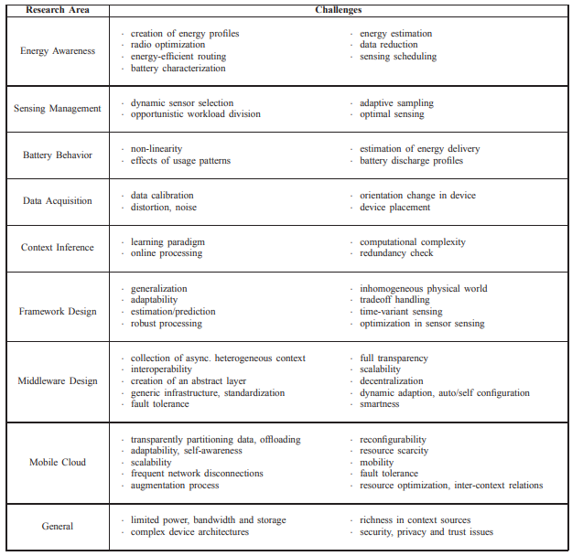
Agenda
Context- awareness
29-05-2018
Anders Pedersen
201508308
Context- awareness
29-05-2018
Anders Pedersen
201508308
6. Grand challenges and newer context aware applications
Future challenges

Slide 6
Agenda
Context- awareness
29-05-2018
Anders Pedersen
201508308
Context- awareness
29-05-2018
Anders Pedersen
201508308
6. Grand challenges and newer context aware applications
Energi awareness
- Sensors use alot of power
Especially true for continuous sensing
- Battery life halved (tested with constant sensor usage)
Possible solutions
- Duty cycling
- Data reduction
- Better algorithms (less power consumption)
- Better devices

Slide 7
Agenda
Context- awareness
29-05-2018
Anders Pedersen
201508308
Context- awareness
29-05-2018
Anders Pedersen
201508308
6. Grand challenges and newer context aware applications
Security & Privacy
Context information can be misused
Mostly relevant in situations where data is shared (Group/Community sensing)

Slide 8
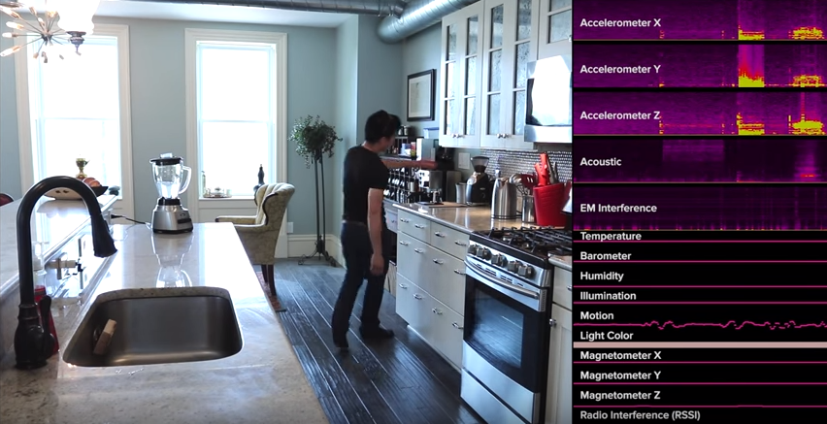
Agenda
Context- awareness
29-05-2018
Anders Pedersen
201508308
Context- awareness
29-05-2018
Anders Pedersen
201508308
6. Grand challenges and newer context aware applications
Newer Context-Aware apps
Synthetic sensors

