Slide 1

Context- awareness
29-05-2018
Anders Pedersen
201508308
4. Sensing technology and mobile sensing concepts .

Slide 2


Agenda
Context- awareness
29-05-2018
Anders Pedersen
201508308
“Smart” ringetone justering
Accelerometer, mikrofon, gps
Widget arkitektur, J48 træ
Motivation
Ulrich cykeltur til uni: misset opkald
Træls at justere ringetone hele tiden
Context- awareness
29-05-2018
Anders Pedersen
201508308
5. Sensing technology and mobile sensing concepts
Projektet

Slide 3
Agenda
Context- awareness
29-05-2018
Anders Pedersen
201508308
Context- awareness
29-05-2018
Anders Pedersen
201508308
5. Sensing technology and mobile sensing concepts
Mobile phone sensing : a field of research
‘...little to no advancements in the field until recently (2010)’
Advances in technology :
- Cheaper sensors and more of them
- Phones are open and programmable (low entry barrier)
- Easy to distribute : App store / Google play
- Mobile computing cloud : Large scale sensor data
(Lane et al, 2010)

Slide 4
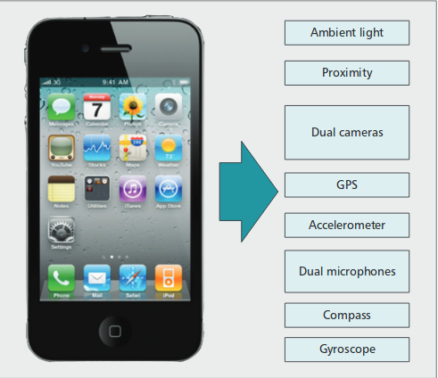
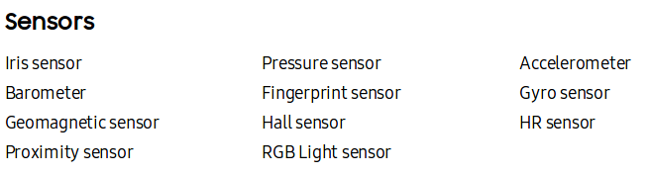
Agenda
Context- awareness
29-05-2018
Anders Pedersen
201508308
Context- awareness
29-05-2018
Anders Pedersen
201508308
5. Sensing technology and mobile sensing concepts
Sensors in phones
IPhone 4 – 2010 (Lane et al.)
Galaxy s8 (2017)

Slide 5
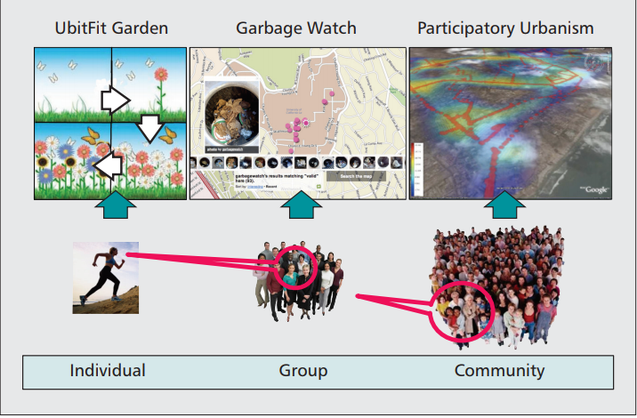
Agenda
Context- awareness
29-05-2018
Anders Pedersen
201508308
Context- awareness
29-05-2018
Anders Pedersen
201508308
5. Sensing technology and mobile sensing concepts
Sensing paradigms and scale
- Participatory sensing
- Opportunistic sensing
- Individual sensing
- Group activity sensing
- Community sensing
(ongoing research areas)
(Lane et al, 2010)

Slide 6
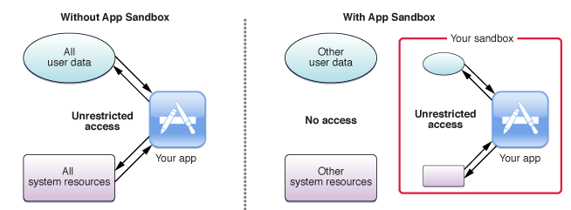
Agenda
Context- awareness
29-05-2018
Anders Pedersen
201508308
Context- awareness
29-05-2018
Anders Pedersen
201508308
5. Sensing technology and mobile sensing concepts
Mobile phone as a sensor
Context problems
- Mobile phone is general purpose machine.
- Lots of other tasks than sensing !
- Limited ressourses. Cant do continous sensing. (got other stuff to do).
(Lane et al, 2010)

Slide 7
Agenda
Context- awareness
29-05-2018
Anders Pedersen
201508308
Context- awareness
29-05-2018
Anders Pedersen
201508308
5. Sensing technology and mobile sensing concepts
Context-Aware applications based on mobile sensing.
- Infer activity : running, walking etc.
- Infer mode of transportation : bus, car, cycle etc.
- Infer users environment : concert, lecture etc.
- Infer emotional state : sad, happy etc.

Slide 8
Agenda
Context- awareness
29-05-2018
Anders Pedersen
201508308
Context- awareness
29-05-2018
Anders Pedersen
201508308
5. Sensing technology and mobile sensing concepts
Context-Aware applications based on mobile sensing.
- Infer activity : running, walking etc.
- Infer mode of transportation : bus, car, cycle etc.
- Infer users environment : concert, lecture etc.
- Infer emotional state : sad, happy etc.
- Infer context : what situation is user in
How to do it?

Slide 9
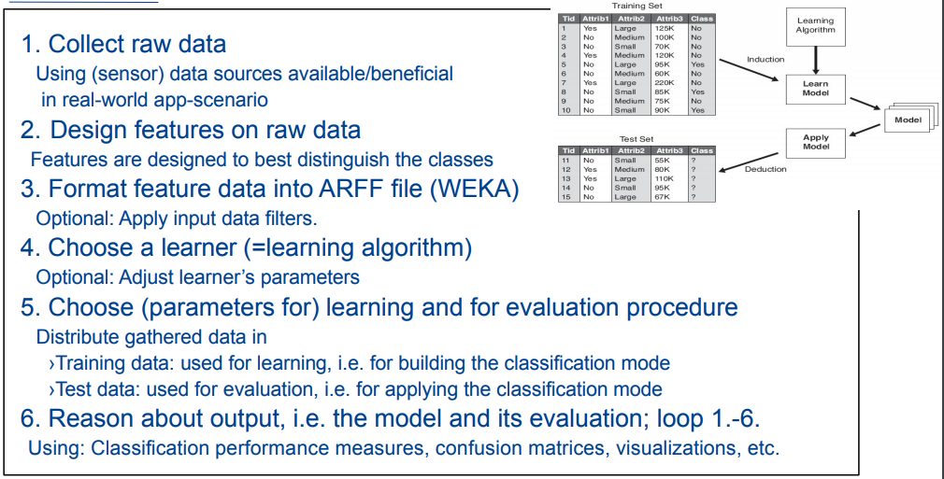
Agenda
Context- awareness
29-05-2018
Anders Pedersen
201508308
Context- awareness
29-05-2018
Anders Pedersen
201508308
5. Sensing technology and mobile sensing concepts
Context-Aware applications based on mobile sensing.
- Infer activity : running, walking etc.
- Infer mode of transportation : bus, car, cycle etc.
- Infer users environment : concert, lecture etc.
- Infer emotional state : sad, happy etc.
- Infer context : what situation is user in
How to do it?

Slide 10
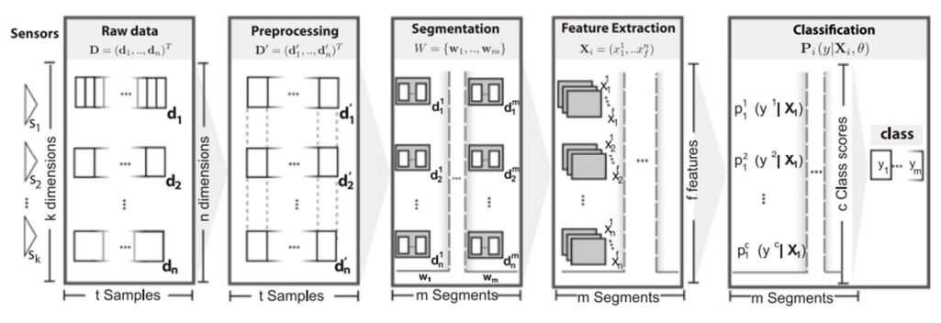
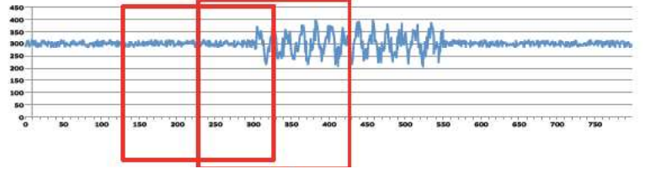
Agenda
Context- awareness
29-05-2018
Anders Pedersen
201508308
Context- awareness
29-05-2018
Anders Pedersen
201508308
5. Sensing technology and mobile sensing concepts
Handling the sensor data
- Expensive !
- Duty cycling can help (sometimes)
Continuous sensing

