Slide 1

Context- awareness
29-05-2018
Anders Pedersen
201508308
1. Context, context-awareness; history and evolution of context-aware computing applications.

Slide 2


Agenda
Context- awareness
29-05-2018
Anders Pedersen
201508308
“Smart” ringetone justering
Accelerometer, mikrofon, gps
Widget arkitektur, J48 træ
Motivation
Ulrich cykeltur til uni: misset opkald
Træls at justere ringetone hele tiden
Context- awareness
29-05-2018
Anders Pedersen
201508308
1. Context, context-awareness; history and evolution of context-aware computing applications.
Projektet

Slide 3
Agenda
Context- awareness
29-05-2018
Anders Pedersen
201508308
Context- awareness
29-05-2018
Anders Pedersen
201508308
1. Context, context-awareness; history and evolution of context-aware computing applications.
Context
Context : ...any information that can be used to characterize the situation of an entity. An entity is a person, place or object that is considered relevant to the interaction between a user and an application, including the user and application themselves.
[Dey, Abowd, 2000]
Alt relevant information i forhold til interaktion mellem system og bruger..
- Internal
- External
- Inferred
(projekt)

Slide 4
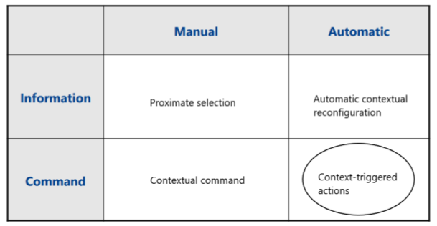
Agenda
Context- awareness
29-05-2018
Anders Pedersen
201508308
Context- awareness
29-05-2018
Anders Pedersen
201508308
1. Context, context-awareness; history and evolution of context-aware computing applications.
Context-awareness
Context-awareness : … software that adapts according to its location of use, the collection of nearby people and objects, as well as changes to those objects over time.
[Schilit, Theimer, 1994]
Contextual Sensing
Contextual Adaptation
Contextual Resource Discovery
Contextual Augmentation
Taksonomi: Klasser
[Schilit, Theimer, 1994]
Taksonomi: Features
[Pascoe, 1998]
(projekt)

Slide 5
Agenda
Context- awareness
29-05-2018
Anders Pedersen
201508308
Often used while not in focus : Maturity
Context- awareness
29-05-2018
Anders Pedersen
201508308
1. Context, context-awareness; history and evolution of context-aware computing applications.
History and evolution
Active Badge (Want et al., 1992)
Determine location of users -> forward calls to most likely location of recepient
Context : Location
Applied to many domains. Extensively in :
- Tour guides
- Reminder systems
- Environmental control
Mobile phones !
(projekt)

Slide 6
Agenda
Context- awareness
29-05-2018
Anders Pedersen
201508308
Context- awareness
29-05-2018
Anders Pedersen
201508308
1. Context, context-awareness; history and evolution of context-aware computing applications.
Problems
Context aware apps detect a small subset of the users true context
Spying a newsrack, Tom pulls his rented car to the side of the street and hops out to grab a paper. The car, recognizing the door has just closed and the engine is running, locks its doors.
“What a cretin,” Roger mutters as the CEO finishes his presentation, unaware, for the moment, that the high-tech speaker phone in the table’s center has triangulated on his whisper and upped its gain to broadcast his remark to the meeting’s remote audience.
… ’common sense is difficult to implement’
(Erikson 2002)
(projekt)
(projekt)

Slide 7
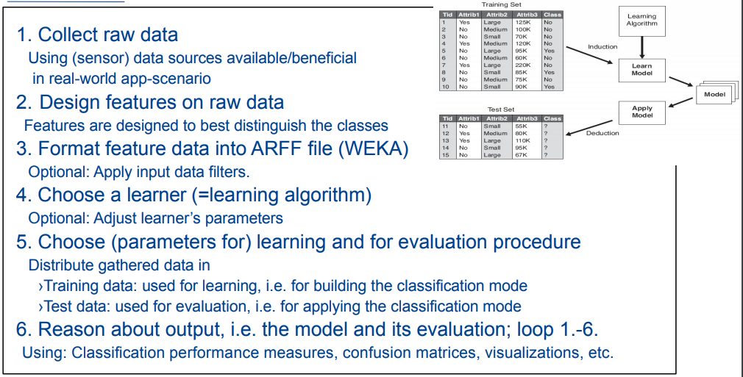
Agenda
Context- awareness
29-05-2018
Anders Pedersen
201508308
Context- awareness
29-05-2018
Anders Pedersen
201508308
1. Context, context-awareness; history and evolution of context-aware computing applications.
Context-Awareness using ML

