Slide 1
MotoButtons 2 User’s Guide
September 27, 2024

Slide 2
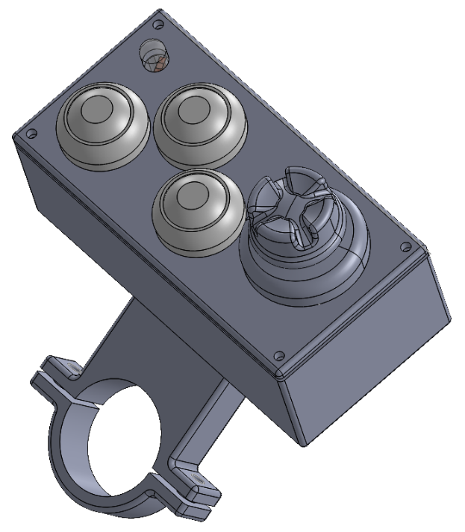
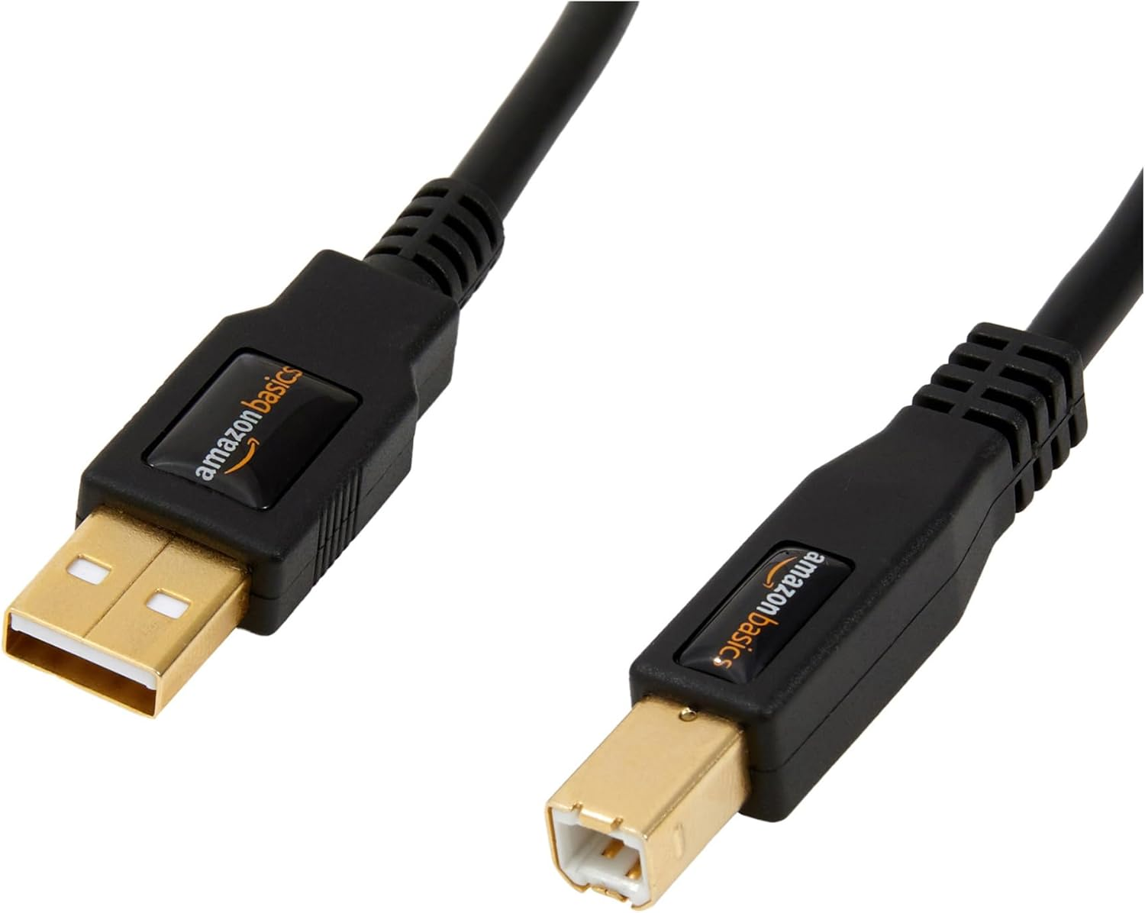
Device Overview
LED Interpretation
Color | Meaning
Red | 1. Initial power on 2. Virtual button activated 3. (Flashing) Controller orientation changed at power on
White | Power on completed Keypress (optional)
Blue | Solid: Bluetooth enabled Flashing: Bluetooth searching for connection
Green | Mouse mode
Yellow | DMD2 Mode
Cyan | MyRouteApp mode
Magenta | Media player mode
Color (RGB) mode, action and state indicator LED
Long press “C” to activate additional “virtual button”
A
B
4-way or 5-way (center button) joystick
C
5V DC power (from USB cable)
All buttons (except joystick directional input) activate when released, not when pressed!

Slide 3
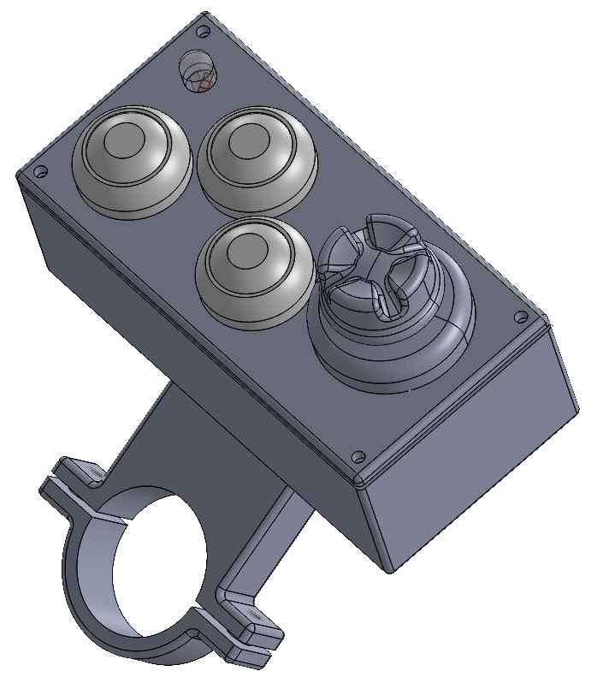
Changing the Installation Orientation
Depending on how you choose to install the unit, you may need to set the orientation of the device. This way, “up” on the joystick will be “up” on your phone or tablet.
Setting the orientation
Hold the joystick UP before applying power. Release once the LED flashes RED.
The setting will be stored for future power cycles.

Slide 4
Changing the Mode
You can change the mode at any time by long pressing two buttons.
Changing the mode
Holding both the A and B buttons for 1 second. When the mode changes, the LED will cycle to the next color.
The device remembers the mode during power cycles.
Hold both buttons (A and B) for 1 second
A
B
C
DMD2
Mouse
MyRouteApp
Media Player

Slide 5
Activating the Virtual Button (4-way joysticks)
To accommodate controllers with only a 4-way joystick (no center press), button C can be held down (long press) to simulate the center click of the joystick.
Virtual joystick center press
Hold down Button C for 1 second. The LED will turn RED, then release the button.
Hold “C” down for 1 second to simulate joystick center press
A
B
C

Slide 6
Mouse Mode
Joystick Hold up, down, left, right to move cursor. Press center for mouse or finger press (5-way only). Holding longer than half a second moves cursor rapidly.
Button C Mouse or finger press (necessary for 4-way joysticks).
Press for finger tap (click)
A
B
C
Move pointer

Slide 7
DMD2 Mode
Joystick Press for enter or change direction/page.
Button A F6 key
Button B F7 key
Button C Enter Long press: F5 key
F6
F7
A
B
Enter (F5 long press)
Enter
C
Direction/ page

Slide 8
Media Player Mode
Play or pause music
Joystick Up/down: increase/decrease music volume Left/right: previous/next track Center press: mute music
Button A Play or pause music
Button B Stop music
Button C Increase display brightness Long press: Mute music
Stop music
Increase brightness (mute long press)
A
B
Mute
C
Change track
Adjust volume

Slide 9
MyRouteApp Mode
Joystick Pan map or change field. Center press: operate compass
Button A Zoom in
Button B Zoom out
Button C Open menu Long press: start navigation
Zoom in
Zoom out
Enter (start navigation long press)
A
B
Operate compass
C
Direction/ pan map

Slide 10
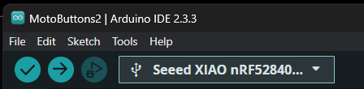
Reprogramming the Firmware
Hold buttons A and B for 10 seconds (until LED goes out)
Due to a bug in the Seeed XIAO microcontroller (MCU), a special button combination is necessary to put the MCU in firmware upload mode. This is known as “DFU” mode.
Entering DFU mode
Connect the USB-C port on the MCU to a computer.
Simultaneously hold down buttons A and B for 10 seconds until the LED goes out.
The MCU enters DFU mode. Select the other / new COM (serial) port in the Arduino IDE and click the upload firmware button.
A
B
C
3. Click upload button
2. Select the other COM port for firmware upload

Slide 11
Issues, Suggestions or Questions?
If you encounter issues, have suggestions or other questions, please submit an “issue” in the GitHub repository page. https://github.com/joncox123/MotoButtons2/issues
Alternatively, you may ask the community for help on the ADV Rider forum. However, bugs or issues must be submitted to the GitHub issue tracker.
ADV Rider MotoButtons Forum
Unfortunately, the author cannot respond directly to e-mails.

