Slide 1
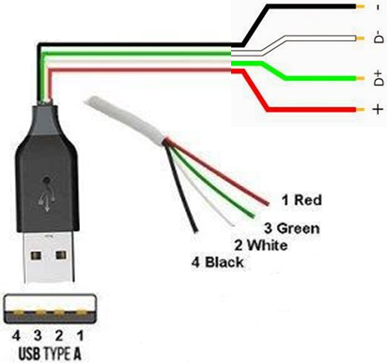
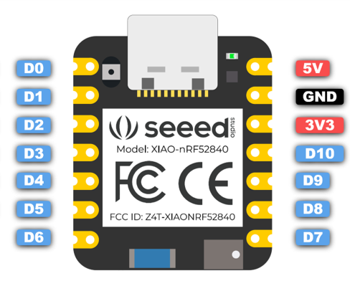
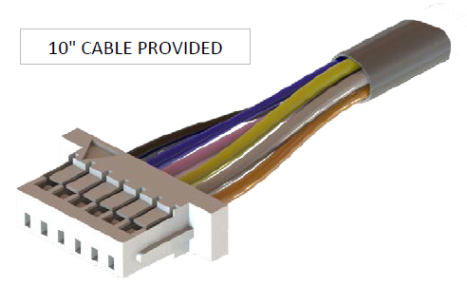
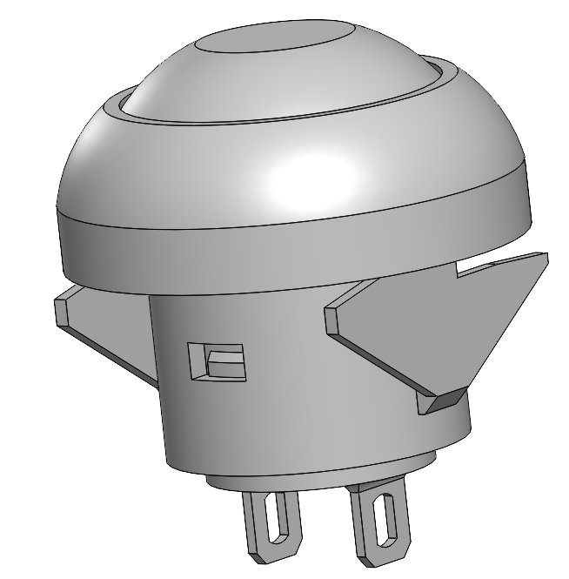
MotoButtons2 Wiring Diagram
5V Power
(e.g. USB Cable)
Ground Wiring
RGB LED
https://github.com/joncox123/MotoButtons2
D0: Joystick RIGHT (X+ / Blue) D1: Joystick CENTER/TOP (5-way / Orange*) D2: Joystick UP (Y+ / Yellow) D3: Joystick LEFT (X- / Pink) D4: Joystick DOWN (Y- / Grey) D5: Button A D6: Button B D7: Button C D8: RGB LED RED D9: RGB LED BLUE D10: RGB LED GREEN
Ruffy HS1 Joystick
Connector
A
B
C
3.3V (NOT 5V !)
*5-way / Center wire is optional

Slide 2
BLUE
RED
GREEN
GROUND

