Slide 1





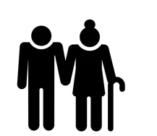




Fitness tracking
Subset of the data of life
Media consumption
Communication
App usage
Purchasing behavior
Time management
Work and productivity
Purchasing behavior
Social interactions
Location
https://takeout.google.com/
02808

Slide 2
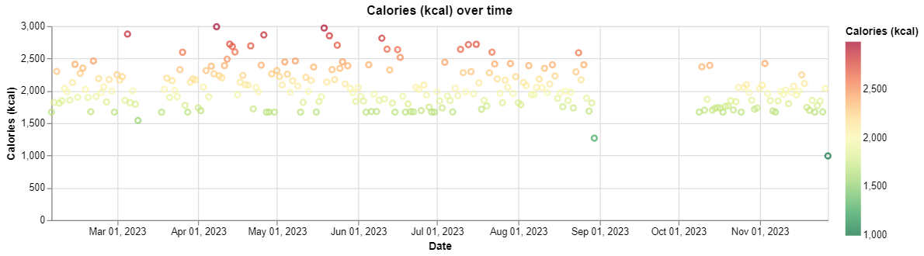
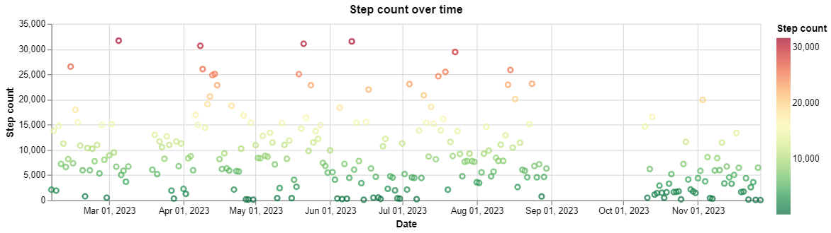
Google fit data
22 Features, of which 13 are interpretable and real values.
Identifying trends amongst the features.
Does it make sense to present both these plots?
02808

Slide 3
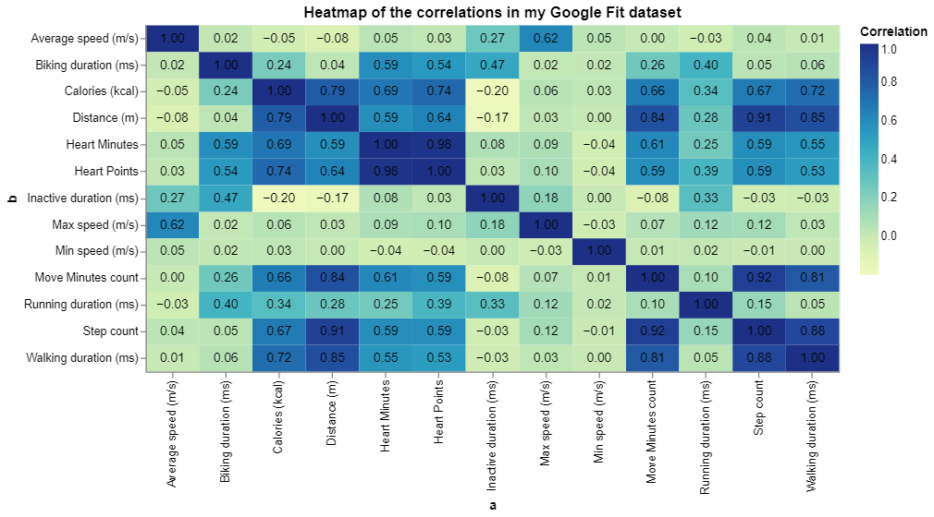
Evaluating ‘individually important’ features
Examples of takeaways
Impactful features, without
too large of a correlation with
other features.
Feature with almost no correlation
with other features. In this specific
example; Min Speed does not
mean much.
Two highly correlated features.
As well as very similar correlation
with other features.
02808

