Slide 1
A-linjen, 2. semester
Joachim, Frederik, Anders

Slide 2
Projekt
Aarhus Universitet, Miljøvidenskab i Risø

Slide 3
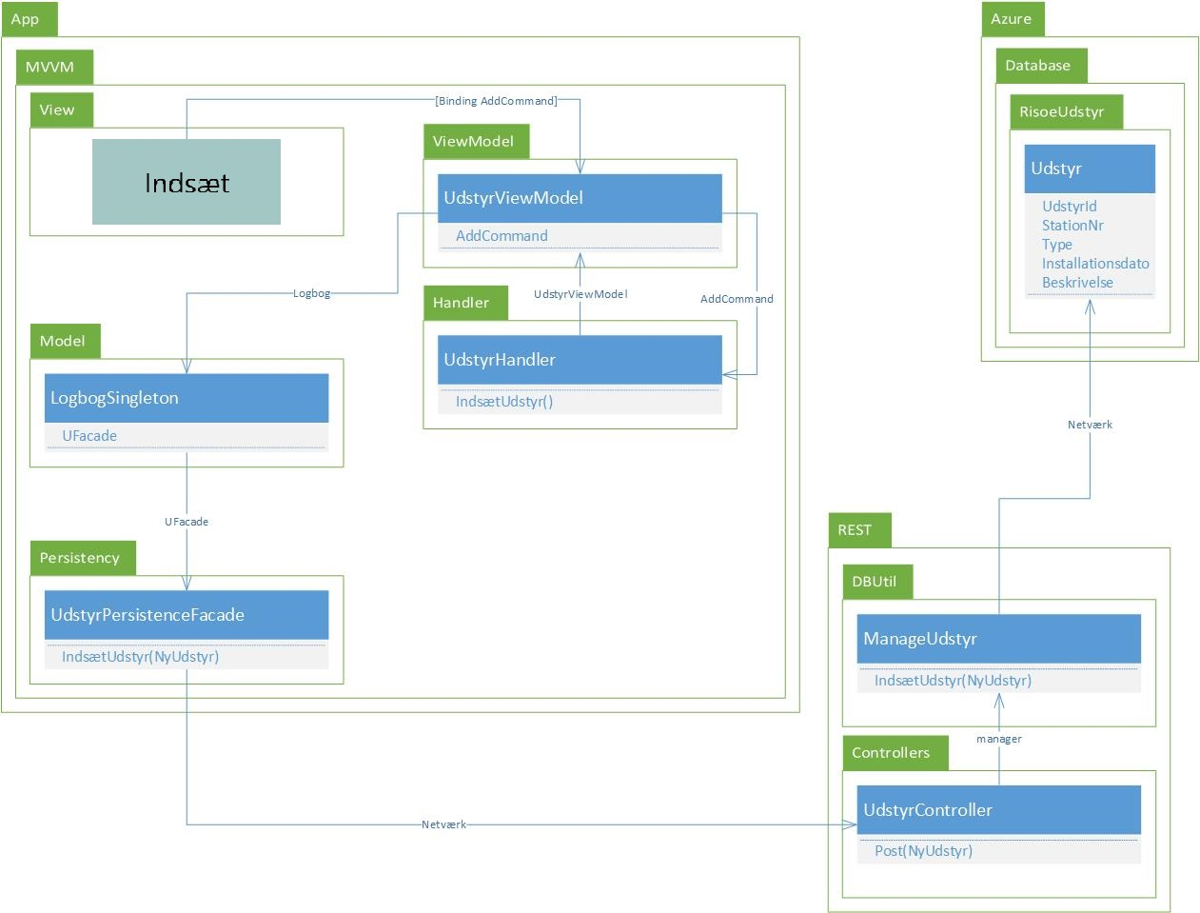

Slide 4
Emne – Bruger

Slide 5
Emne – GUI / Heuristikker
Tidlige tanker:
2. Match between system and the real world
Sprog
5. Error prevention
Knapper / dropdown

Slide 6
Emne – GUI / Heuristikker
Senere tanker:
6. Recognition rather than recall
Tooltips / Help ikon
9. Help users recognize, diagnose, and recover from errors
Fejlbeskeder (MessageDialogHandler)

Slide 7
Emne – Test

