Slide 1
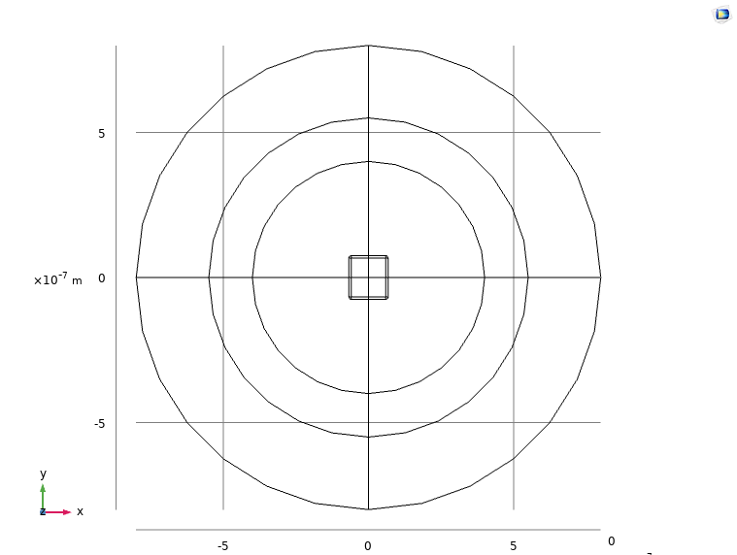
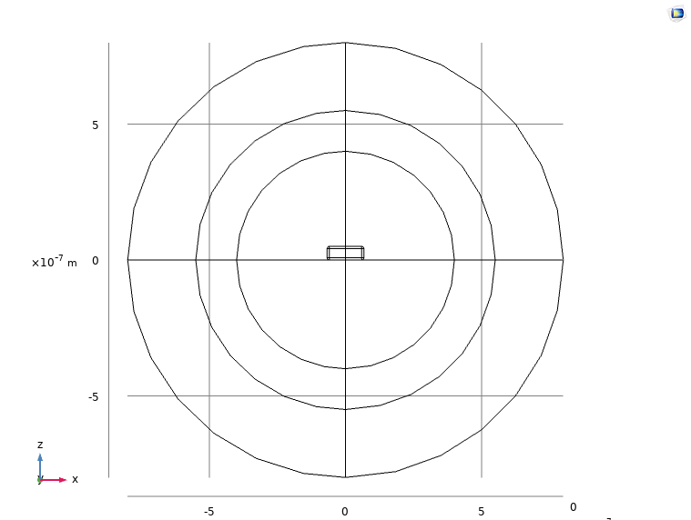
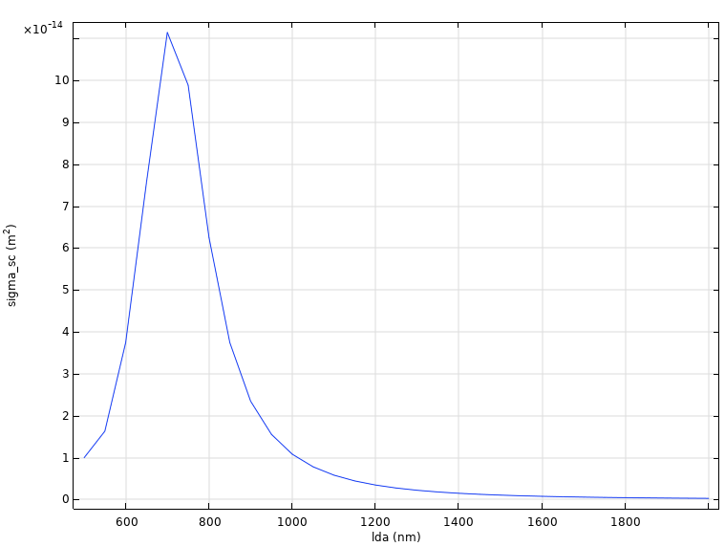
PML
Scattering sphere
135nm*150nm*50nm Au block on glass substrate
Incident light has E field polarized along x direction and k vector along z (TE polarization)
Electric field amplitude of 613V/m

Slide 2
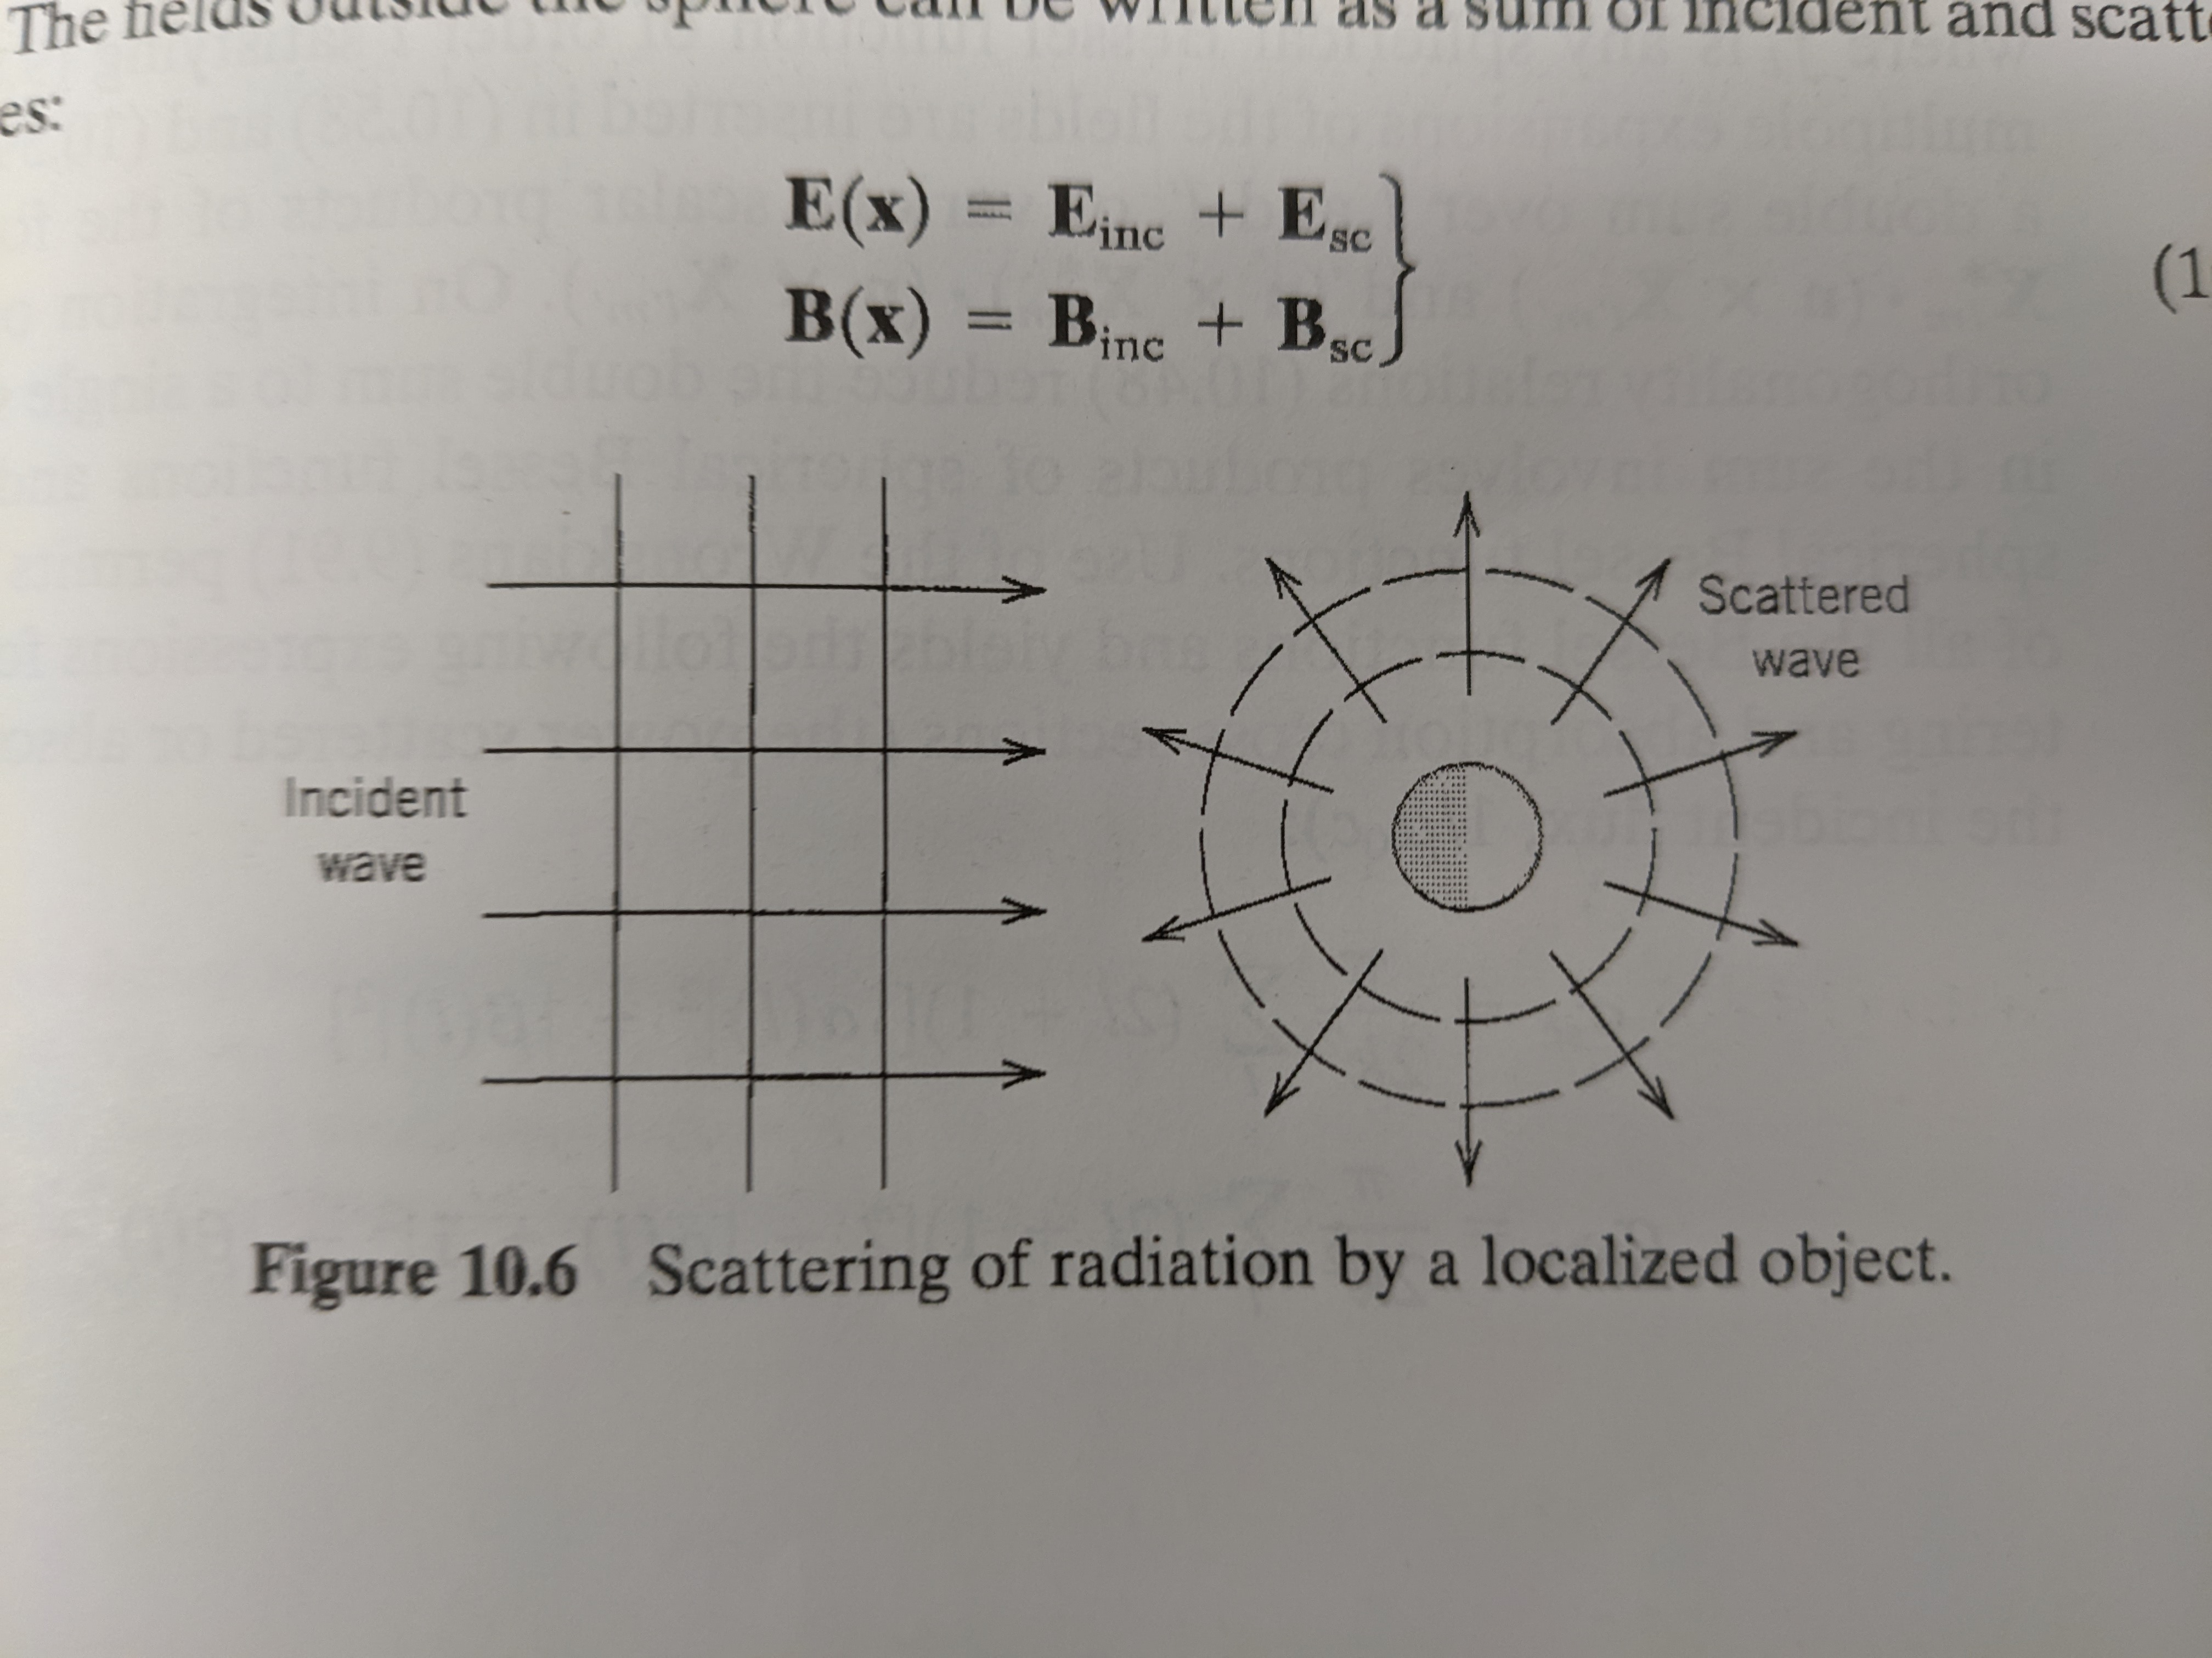
Scattering of Electromagnetic Waves by a Sphere
(Jackson Chapter 10.4)
Sphere of radius a and infinite conductivity
Incoming plane wave and outgoing sphereical waves

Slide 3
How to Think About Scattering and Diffraction
(Jackson Chapter 10)
When system size is small compared to wavelength:
  Describe using lowest order induced multipoles
System Size
Wavelength
When system size is comprable to wavelength:
  More systematic treatment with multipole fields is required
System Size
Wavelength

Slide 4
Scattered and Absorbed Power
Scattered power is the outward component of the Poynting vector
Integration Surface
Absorbed power is the inward component of the Poynting vector

Slide 5
Nano Particle
1 length = 1.5 #150 nm
2 width = 1.35 #135 nm
3 height = .5 #50 nm
4
5 nano_particle = mp.Block(size=)
Length: 150nm
Width: 135 nm
Height:50 nm
Material: Au

Slide 6

Differential Cross Section
Incident flux in the direction n_0 and polarization epsilon_0
The power radiated in the direction n with polarization epsilon

Slide 7
Installing Meep on Research Computing
mkdir /projects/$USER/install
mkdir /projects/$USER/build
mkdir /projects/$USER/.local
ssh scompile
module load gcc/10.2.0
module load openmpi szip
module load git autotools cmake python
prefix="/projects/$USER"
build="$prefix/build"
install="$prefix/install"
export PKG_CONFIG_PATH="$install/lib/pkgconfig:$install/lib64/pkgconfg:$PKG_CONFIG_PATH"
export LD_LIBRARY_PATH="$install/lib:$install/lib64:$LD_LIBRARY_PATH"
export PYTHONUSERBAS="$prefix/.local"
export PATH="$install/bin:$prefix/.local/bin:$PATH"
MY_LDFLAGS="-L${install}/lib -Wl,-rpath,${install}/lib -L${install}/lib64 -Wl,-rpath,${install}/lib64"
MY_CPPFLAGS="-I${install}/include"
This step is just to prep our environment with the needed tools
using gcc since intel’s compiler fails when building guile. Guile is apparently good at finding compiler bugs, so it could just be a bug. Regardless, I’m using gcc since I don’t have time to debug. The error for intel is something like ‘single argument version of static_assert not available in this mode.’

Slide 8
Meep Dependency libctl
libctl ← Guile ←{GNU MP,GNU Unistring, bdw-gc}
libctl is a control file library. It is used to help pass around parameters for large computations.
Unfortunately we have to install libctl from source, which requires us to install child dependencies
I’ve made a script you can download here

Slide 9
Meep: Install Guile
cd $HOME
curl -LO https://github.com/Andersen98/nano_particle_glass_substrate/blob/cde109e798f097a6c40532f5043b422c9955207e/scripts/install_guile.sh
chmod +x install_guile.sh
./install_guile.sh -b /projects/$USER/build -i /projects/$USER/install
... #press enter until you hit lines below
...
echo "Enter 1 for gmp, 2 for libunistring 3 for bdwgc 4 for guile 5 to build all" [ENTER]
echo "Enter 6 to clean build or 7 to clean install." [ENTER]
read -r target [ENTER]
5 #this builds guile and its deps
Guile is a plugin language developed by GNU. It has several dependencies (all of which are not available on the cluster), so I wrote an install script to automate the guile install here.
Notes:
OUTPUT
Libraries have been installed in:
/home/etan5063/install/lib
If you ever happen to want to link against installed libraries
in a given directory, LIBDIR, you must either use libtool, and
specify the full pathname of the library, or use the '-LLIBDIR'
flag during linking and do at least one of the following:
- add LIBDIR to the 'LD_LIBRARY_PATH' environment variable
during execution
- add LIBDIR to the 'LD_RUN_PATH' environment variable
during linking
- use the '-Wl,-rpath -Wl,LIBDIR' linker flag
- have your system administrator add LIBDIR to '/etc/ld.so.conf'
See any operating system documentation about shared libraries for
more information, such as the ld(1) and ld.so(8) manual pages.

Slide 10
libctl
curl -LO https://github.com/NanoComp/libctl/releases/download/v4.5.1/libctl-4.5.1.tar.gz
tar -vxf libctl-*.tar.gz
cd libctl-*/
install=/projects/${USER}/install
export PATH=${install}/bin:$PATH
./configure \
LDFLAGS=-L${install}/lib -L${install}/lib64\
CPPFLAGS=-I${install}/include
--prefix=${install}
libctl build from source instructions here

Slide 11
hdf5
cd $
deps:
3.1. Zlib
3.2 Szip (optional)
3.3. MPI and MPI-IO
Annoyed that meep couldn’t find hdf5 module. Installing from source.
Notes:
SUMMARY OF THE HDF5 CONFIGURATION
=================================
General Information:
-------------------
HDF5 Version: 1.13.3
Configured on: Tue Nov 15 21:02:04 MST 2022
Configured by: etan5063@shas0136
Host system: x86_64-unknown-linux-gnu
Uname information: Linux shas0136 3.10.0-957.21.3.el7.x86_64 #1 SMP Fri Jun 14 02:54:29 EDT 2019 x86_64 x86_64 x86_64 GNU/Linux
Byte sex: little-endian
Installation point: /projects/etan5063/install
Compiling Options:
------------------
Build Mode: production
Debugging Symbols: no
Asserts: no
Profiling: no
Optimization Level: high
Linking Options:
----------------
Libraries: static, shared
Statically Linked Executables:
LDFLAGS:
H5_LDFLAGS:
AM_LDFLAGS:
Extra libraries: -lz -ldl -lm
Archiver: ar
AR_FLAGS: cr
Ranlib: ranlib
Languages:
----------
C: yes
C Compiler: /curc/sw/openmpi/4.0.5/gcc/10.2.0/bin/mpicc ( built with gcc version 10.2.0 (GCC))
CPPFLAGS:
H5_CPPFLAGS: -D_GNU_SOURCE -D_POSIX_C_SOURCE=200809L -DNDEBUG -UH5_DEBUG_API
AM_CPPFLAGS: -I/projects/etan5063/build/hdf5-hdf5-1_13_3/src/H5FDsubfiling
C Flags:
H5 C Flags: -std=c99 -Wall -Wcast-qual -Wconversion -Wextra -Wfloat-equal -Wformat=2 -Winit-self -Winvalid-pch -Wmissing-include-dirs -Wshadow -Wundef -Wwrite-strings -pedantic -Wno-c++-compat -Wlarger-than=2560 -Wlogical-op -Wframe-larger-than=16384 -Wpacked-bitfield-compat -Wsync-nand -Wno-unsuffixed-float-constants -Wdouble-promotion -Wtrampolines -Wstack-usage=8192 -Wmaybe-uninitialized -Wdate-time -Warray-bounds=2 -Wc99-c11-compat -Wduplicated-cond -Whsa -Wnormalized -Wnull-dereference -Wunused-const-variable -Walloca -Walloc-zero -Wduplicated-branches -Wformat-overflow=2 -Wformat-truncation=1 -Wattribute-alias -Wcast-align=strict -Wshift-overflow=2 -Wattribute-alias=2 -Wmissing-profile -Wc11-c2x-compat -fstdarg-opt -fdiagnostics-urls=never -fno-diagnostics-color -s -Wbad-function-cast -Wcast-align -Wformat -Wimplicit-function-declaration -Wint-to-pointer-cast -Wmissing-declarations -Wmissing-prototypes -Wnested-externs -Wold-style-definition -Wpacked -Wpointer-sign -Wpointer-to-int-cast -Wredundant-decls -Wstrict-prototypes -Wswitch -Wunused-but-set-variable -Wunused-variable -Wunused-function -Wunused-parameter -Wincompatible-pointer-types -Wint-conversion -Wshadow -Wrestrict -Wcast-function-type -Wmaybe-uninitialized -Wno-aggregate-return -Wno-inline -Wno-missing-format-attribute -Wno-missing-noreturn -Wno-overlength-strings -Wno-jump-misses-init -Wstrict-overflow=2 -Wno-suggest-attribute=const -Wno-suggest-attribute=noreturn -Wno-suggest-attribute=pure -Wno-suggest-attribute=format -Wno-suggest-attribute=cold -Wno-suggest-attribute=malloc -O3
AM C Flags:
Shared C Library: yes
Static C Library: yes
Fortran: no
C++: no
Java: no
Features:
---------
Parallel HDF5: no
Parallel Filtered Dataset Writes: no
Large Parallel I/O: no
High-level library: yes
Dimension scales w/ new references: no
Build HDF5 Tests: yes
Build HDF5 Tools: yes
Threadsafety: no
Default API mapping: v114
With deprecated public symbols: yes
I/O filters (external): deflate(zlib)
MPE: no
Map (H5M) API: no
Direct VFD: no
Mirror VFD: no
Subfiling VFD: no
(Read-Only) S3 VFD: no
(Read-Only) HDFS VFD: no
dmalloc: no
Packages w/ extra debug output: none
API tracing: no
Using memory checker: no
Memory allocation sanity checks: no
Function stack tracing: no
Use file locking: best-effort
Strict file format checks: no
Optimization instrumentation: no
[etan5063@shas0136 hdf5-hdf5-1_13_3]$

Slide 12
meep
cd "/projects/$USER/build"
curl -LO https://github.com/NanoComp/meep/releases/download/v1.24.0/meep-1.24.0.tar.gz
tar -vxf meep-*.tar.gz
cd meep-*/
export PKG_CONFIG_PATH=$install/lib/pkgconfig:$install/lib64/pkgconfg:$PKG_CONFIG_PATH

Slide 13
PART 1: Simple waveguide

Slide 14
Straight waveguide example
(set! geometry (list
(make block (center 0 0) (size infinity 1 infinity)
(material (make medium (epsilon 12))))))
We first define the computational cell. We put a source on one end and then we watch it propagate down to the other.
We make the cell 16 micrometers in the x-direction. We make the cell 8 micrometers in the y direction so the boundaries don’t affect the waveguide mode.

Slide 15
Straight waveguide example
(set! sources (list
(make source
(src (make continuous-src (frequency 0.15)))
(component Ez)
(center -7 0))))
Next we specify current source objects using the `sources` object. The simplest source is just a single point source Jz.
`continuous-source` is just a fixed frequency sinusoid exp(-iwt)

Slide 16
Straight waveguide example
(set! sources (list
(make source
(src (make continuous-src (frequency 0.15)))
(component Ez)
(center -7 0))))
Units?
`freqency` is specified in units of 2pi*c/a, where `a` is the unit length and `c` is the speed of light
`wavelength` is specified in units

Slide 17
Straight waveguide sources
(set! sources (list
(make source
(src (make continuous-src (frequency 0.15)))
(component Ez)
(center -7 0))))
Units?
`freqency` is specified in units of 2pi*c/a, where `a` is the unit length and `c` is the speed of light
`wavelength` is specified in units of inverse frequency, so if a=1micrometer, then 0.15 corresponds to a vacuum wavelength of 1/0.15 ~6.67mivrometers. If epsilon=12, it would be about 2micrometers.

Slide 18
Straight waveguide perfectly matched layers
(set! pml-layers (list (make pml (thickness 1.0))))
How do you choose thickness?
`pml` are the absorbing boundaries in meep. A good rule of thumb is to make is ½ the largest wavelength in the simulation. If that doesn’t work, double the thickness.
Note that a frequency of 0.15 has a wavelength of about 2 in the waveguide (where epsilon=12 in the waveguide). Thus a pml of thickness=1 should be a good starting value.

Slide 19
Straight waveguide resolution
(set! resolution 10)
How do you choose resolution?
`resolution` is the number of pixels per unit distance for our simulation. A good rule of thumb is 8 pixels per wavelength in the highest dielectric.
Note: The above resolution of 10px/micrometer corresponds to 60px/wavelength in epsilon=1, and 20px/wavelength in epsilon=12.

Slide 20
Straight waveguide run-until
(run-until 200
(at-beginning output-epsilon)
(at-end output-efield-z))
`run-until` specifies the time to run for as well as other subsiquent args that specify some analysis at each step.
The output should have the form eps-000000.00.h5 and ez-000200.00.h5 (or tutorial-eps-000000.00.h5 and tutorial-ez-000200.00.h5 if we ran from a file called tutorial.ctl).

Slide 21
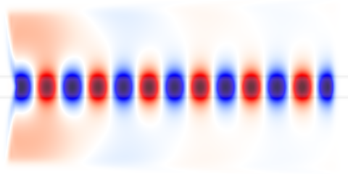
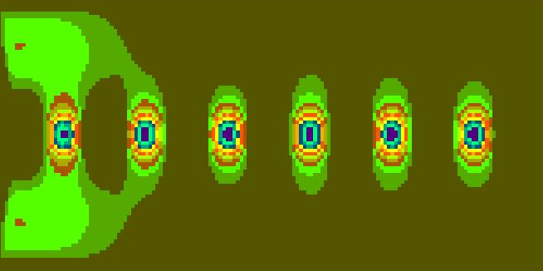
Straight waveguide Analysis/Visualization
unix% h5topng -S3 -Zc dkbluered -a yarg -A eps-000000.00.h5 ez-000200.00.h5
#this is a lie, I used octave
`h5tpng` is a tool to visualize the meep hdf5 field outputs. Here we overlay the field on top of the dielectric image.

Slide 22
Straight waveguide full code
;; From the Meep tutorial: plotting permittivity and fields of a straight waveguide
(set! geometry-lattice (make lattice (size 16 8 no-size)))
(set! geometry (list
(make block (center 0 0) (size infinity 1 infinity)
(material (make medium (epsilon 12))))))
(set! sources (list
(make source
(src (make continuous-src (frequency 0.15)))
(component Ez)
(center -7 0))))
(set! pml-layers (list (make pml (thickness 1.0))))
(set! resolution 10)
(run-until 200
(at-beginning output-epsilon)
(at-end output-efield-z))

Slide 23
Part 2: Transmittance/Scattering Spectra
Incident Field
Scattered fields
Surface that we integrate over to get the transmitted power.

Slide 24
transmitted
i
j
scattered
During each time step dt, each point on the plane accumulates it’s own local Fourier transforms E_w(x) and H_w(x) For each segment,
incident

Slide 25
i
j

Slide 26
APPENDIX: Guile Notes - GNU MP
cd /projects/$USER/builds
curl -LO https://gmplib.org/download/gmp/gmp-6.2.1.tar.xz
tar -vxf gmp-6.2.1.tar.xz
cd gmp-6.2.1
./configure --prefix=/projects/$USER/install
make -j
make check
make install
make clean
MP install instructions are here https://gmplib.org/manual/Installing-GMP
We don’t have root access, so we need to pass the ‘--prefix=$HOME/install’ to the configure script
see slide notes for ld flags
Notes:
OUTPUT
Libraries have been installed in:
/home/etan5063/install/lib
If you ever happen to want to link against installed libraries
in a given directory, LIBDIR, you must either use libtool, and
specify the full pathname of the library, or use the '-LLIBDIR'
flag during linking and do at least one of the following:
- add LIBDIR to the 'LD_LIBRARY_PATH' environment variable
during execution
- add LIBDIR to the 'LD_RUN_PATH' environment variable
during linking
- use the '-Wl,-rpath -Wl,LIBDIR' linker flag
- have your system administrator add LIBDIR to '/etc/ld.so.conf'
See any operating system documentation about shared libraries for
more information, such as the ld(1) and ld.so(8) manual pages.

Slide 27
APPENDIX: Guile Notes - GNU Unistring
cd /projects/$USER/builds
curl -LO https://ftp.gnu.org/gnu/libunistring/libunistring-1.1.tar.gz
tar -vxf libunistring-1.1.tar.gz
cd libunistring-1.1
./configure --prefix=/projects/$USER/install
make -j
make check
make install
make clean
MP install instructions are here https://gmplib.org/manual/Installing-GMP
We don’t have root access, so we need to pass the ‘--prefix=$HOME/install’ to the configure script
see slide notes for ld flags
Notes:
OUTPUT
Libraries have been installed in:
/home/etan5063/install/lib
If you ever happen to want to link against installed libraries
in a given directory, LIBDIR, you must either use libtool, and
specify the full pathname of the library, or use the '-LLIBDIR'
flag during linking and do at least one of the following:
- add LIBDIR to the 'LD_LIBRARY_PATH' environment variable
during execution
- add LIBDIR to the 'LD_RUN_PATH' environment variable
during linking
- use the '-Wl,-rpath -Wl,LIBDIR' linker flag
- have your system administrator add LIBDIR to '/etc/ld.so.conf'
See any operating system documentation about shared libraries for
more information, such as the ld(1) and ld.so(8) manual pages.

Slide 28
Appendix: Guile Notes -
Boehm-Demers-Weiser Garbage Collector
cd /projects/$USER/builds
git clone https://github.com/ivmai/bdwgc
cd bdwgc
git clone https://github.com/ivmai/libatomic_ops
mkdir build && cd build
cmake \
-DCMAKE_INSTALL_PREFIX:PATH=/projects/$USER/install\
-Dbuild_tests=ON ..
make all -j
./atomicopstest &&\
./disclaimtest &&\
./hugetest &&\
./leaktest &&\
./realloctest &&\
./staticrootstest &&\
./threadkeytest &&\
./weakmaptest &&\
./cordtest &&\
Using cmake since it generates the pkg-config file (see CMakelists.txt)
Set cmake prefix as per this
Notes:
OUTPUT
Libraries have been installed in:
/home/etan5063/install/lib
If you ever happen to want to link against installed libraries
in a given directory, LIBDIR, you must either use libtool, and
specify the full pathname of the library, or use the '-LLIBDIR'
flag during linking and do at least one of the following:
- add LIBDIR to the 'LD_LIBRARY_PATH' environment variable
during execution
- add LIBDIR to the 'LD_RUN_PATH' environment variable
during linking
- use the '-Wl,-rpath -Wl,LIBDIR' linker flag
- have your system administrator add LIBDIR to '/etc/ld.so.conf'
See any operating system documentation about shared libraries for
more information, such as the ld(1) and ld.so(8) manual pages.

Slide 29
Appendix: Guile - main install and linking to deps
cd /projects/$USER/builds
curl -LO ftp://ftp.gnu.org/gnu/guile/guile-3.0.8.tar.gz
zcat guile-3.0.8.tar.gz | tar xf -
cd guile-3.0.8
export PKG_CONFIG_PATH="/projects/$USER/install/lib64/pkgconfig:$PKG_CONFIG_PATH"
export PKG_CONFIG_PATH=”/projects/$USER/install/lib/pkgconfig:$PKG_CONFIG_PATH”
./configure --prefix=/projects/$USER/install \
LDFLAGS="-L/projects/$USER/install/lib -L/projects/$USER/install/lib64 -Wl,-rpath -Wl,/projects/$USER/install/lib -Wl,-rpath -Wl,/projects/$USER/install/lib64"\
--cache-file=config.cache
make -j64 #see side note
make check
make install
make clean
Guile has an install tutorial here
using the make -j option may create too many child processes (systemd has a max process limit). See here. In this case run `make -j64` to
This takes a long time to build

Slide 30
Making an install script
see slide notes for script
Notes:
#!/bin/bash
trap '$(read -p "[$BASH_SOURCE:$LINENO]] $BASH_COMMAND")' DEBUG
set -euo pipefail
max_threads=128
die() {
printf '%s\n' "$1" >&2
exit 1
}
# Initialize all the option variables.
# This ensures we are not contaminated by variables from the environment.
build=
install=
while [ ${#@} -ne 0 ] ; do #number of args left is greater than 0.
case $1 in
-h|-\?|--help)
show_help # Display a usage synopsis.
exit
;;
-b|--build) # Takes an option argument; ensure it has been specified.
if [ -d "$2" ]; then
build=$2
shift
else
die 'ERROR: "--build" requires a non-empty option argument.'
fi
;;
--build=?*)
if [ -d "${1#*=}" ]; then
build=${1#*=} # Delete everything up to "=" and assign the remainder.
else
die 'ERROR: "--build" requires a non-empty option argument (directory with read/write permission).'
fi
;;
--build=) # Handle the case of an empty --file=
die 'ERROR: "--build" requires a non-empty option argument.'
;;
-i|--install) #takes option argument; ensure it is specified.
if [ -d "$2" ]; then
install=$2
shift
else
die 'ERROR: "--install" requires path to an existing directory.'
fi
;;
--install=?*)
if [ -d "${1#*=}" ]; then
install=${1#*=} #delete everything up to = sign.
else
die 'ERROR: "--install" requires a directory (should also have read write permission).'
fi
;;
--) # End of all options.
shift
break
;;
-?*)
printf 'WARN: Unknown option (ignored): %s\n' "$1" >&2
;;
*) # Default case: No more options, so break out of the loop.
break
esac
shift
done
gmp(){
cd "$build"
curl -LO https://gmplib.org/download/gmp/gmp-6.2.1.tar.xz
tar -vxf gmp-6.2.1.tar.xz
cd gmp-6.2.1
./configure --prefix="$install"
make -j
make install
make clean
}
libunistring(){
cd "$build"
curl -LO https://ftp.gnu.org/gnu/libunistring/libunistring-1.1.tar.gz
cd libunistring-1.1
./configure --prefix="$install"
make -j
make check
make install
make clean
}
bdwgc(){
cd "$build"
git clone https://github.com/ivmai/bdwgc
cd bdwgc
git clone https://github.com/ivmai/libatomic_ops
mkdir build && cd build
cmake \
-DCMAKE_INSTALL_PREFIX:PATH="$install"\
-Dbuild_tests=ON ..
make all -j
./atomicopstest &&\
./disclaimtest &&\
./hugetest &&\
./leaktest &&\
./realloctest &&\
./staticrootstest &&\
./threadkeytest &&\
./weakmaptest &&\
./cordtest &&\
./gctest &&\
./initfromthreadtest &&\
./middletest &&\
./smashtest &&\
./subthreadcreatetest &&\
./threadleaktest
make install
make clean
}
guile(){
cd "$build"
curl -LO ftp://ftp.gnu.org/gnu/guile/guile-3.0.8.tar.gz
zcat guile-3.0.8.tar.gz | tar xf -
cd guile-3.0.8
env PKG_CONFIG_PATH="${install}/lib64/pkgconfig:${install}/lib/pkgconfig:$PKG_CONFIG_PATH" \
./configure --prefix="$install" \
LDFLAGS="-L${install}/lib -L${install}/lib64 -Wl,-rpath -Wl,${install}/lib -Wl,-rpath -Wl, ${install}/lib64"
make -j"$max_threads" #see side note
make check
make install
make clean
}
echo -n "Enter 1 for gmp, 2 for libunistring 3 for bdwgc 4 for guile or 5 for all"
read -r target
case $target in
1)
gmp
;;
2)
libunistring
;;
3)
bdwgc
;;
4)
guile
;;
5)
gmp && libunistring && bdwgc && guile
;;
*)
die 'Error, must select something to install. Exiting.'
;;
esac

