Slide 1
Wild Isolate lifespan and healthspan estimates
Anthony Fouad, Julia Hayden, Joyce Xu, and Chris Fang-Yen

Slide 2
Recent changes in data acquisition & analysis
The imaging robot (formerly CHARISMA, now WormWatcher) has a larger mirror box and field of view.
No threshold is applied to pixel differences¹. Instead, all differences are summed over time, but noise floor for each well is subtracted².
For this dataset, the noise floor is defined as the mean activity before stimulation in the last few sessions.
We found that a fixed threshold is not robust to the varying signal-to-noise ratio across different robots or even different different wells within a plate on one robot.
For this reason it’s possible for an activity measurement to be negative, especially for noisier wells/images. The cumsum(Activity) calculation for T85/T99 is therefore now cummax(cumsum(Activity)) to prevent decreases in cumulative activity.

Slide 3
Noise-floor-subtracted activity curves
Noise floor

Slide 4
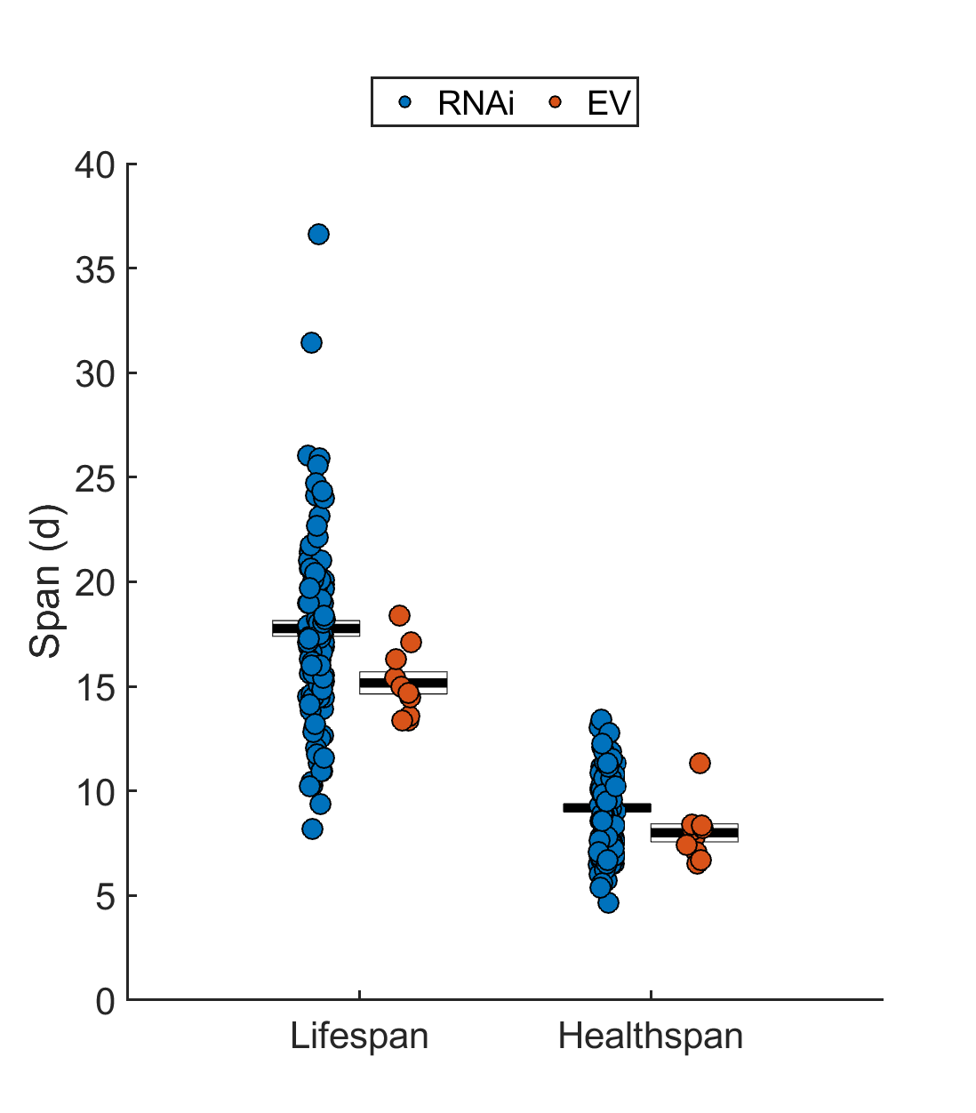
Results overview (all pooled)
6x 24 well plates
12 replicates of each strain, less wells that were excluded as starved or contaminated
WI
N2

Slide 5
Results overview (all pooled)
Fraction of wells

Slide 6
Results overview (all pooled) – lifespan estimate vs healthspan estimate

Slide 7
Pooled lifespan/healthspan estimates by strain
One point = 1 replicate, most strains have 12 replicates
Error bars are Mean +/- SEM

