Slide 1



Paul Anderson, Ph.D.
Department of Computer Science &
Software Engineering
California Polytechnic State University

Slide 2
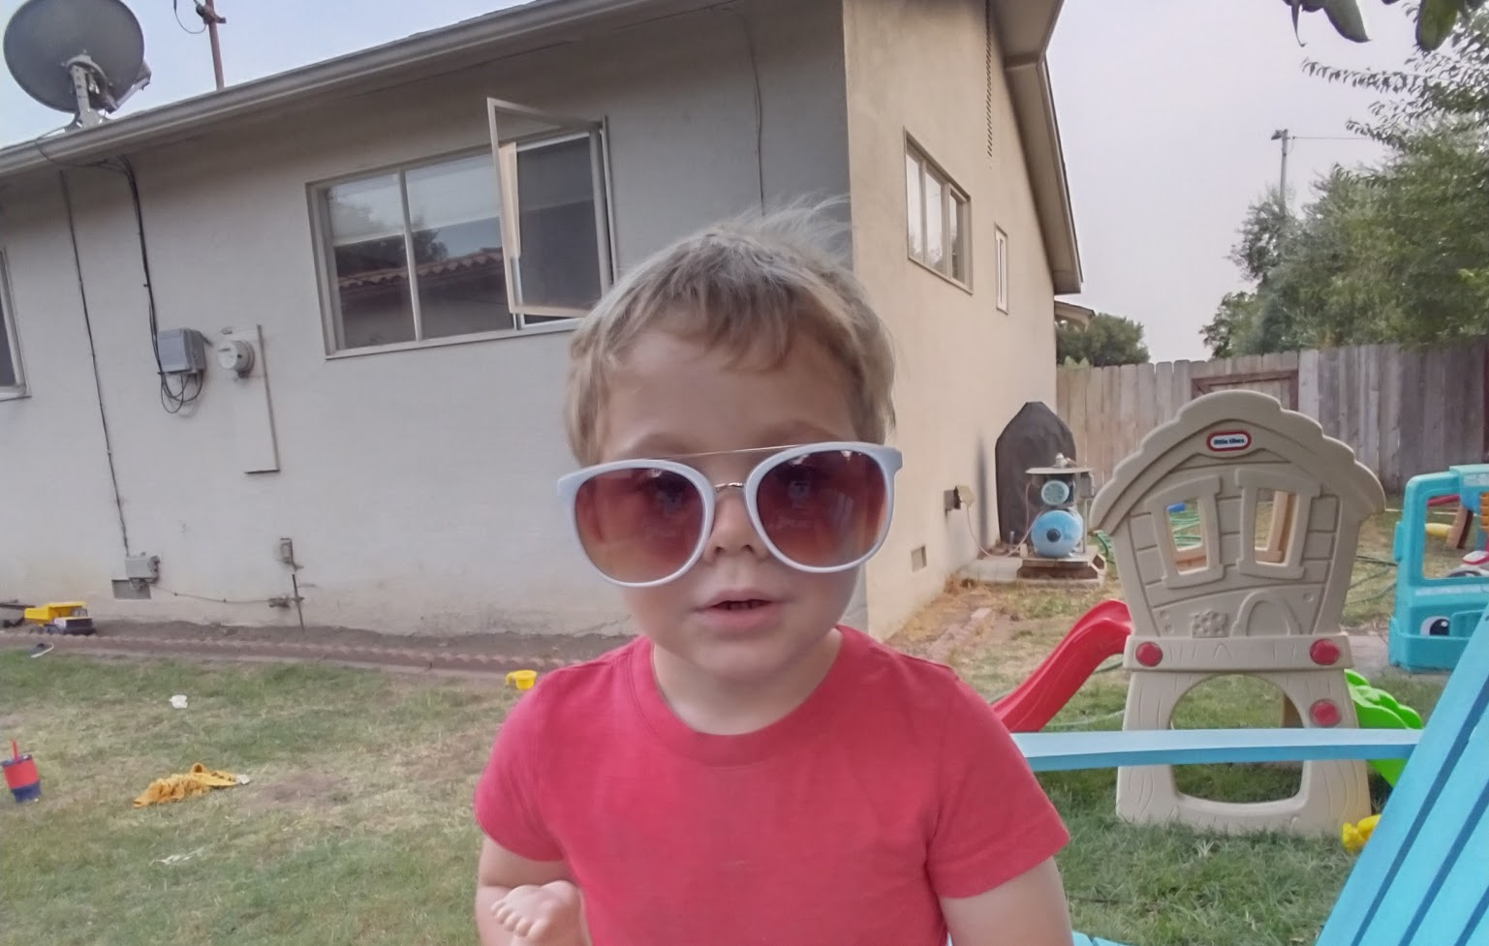

Slide 3
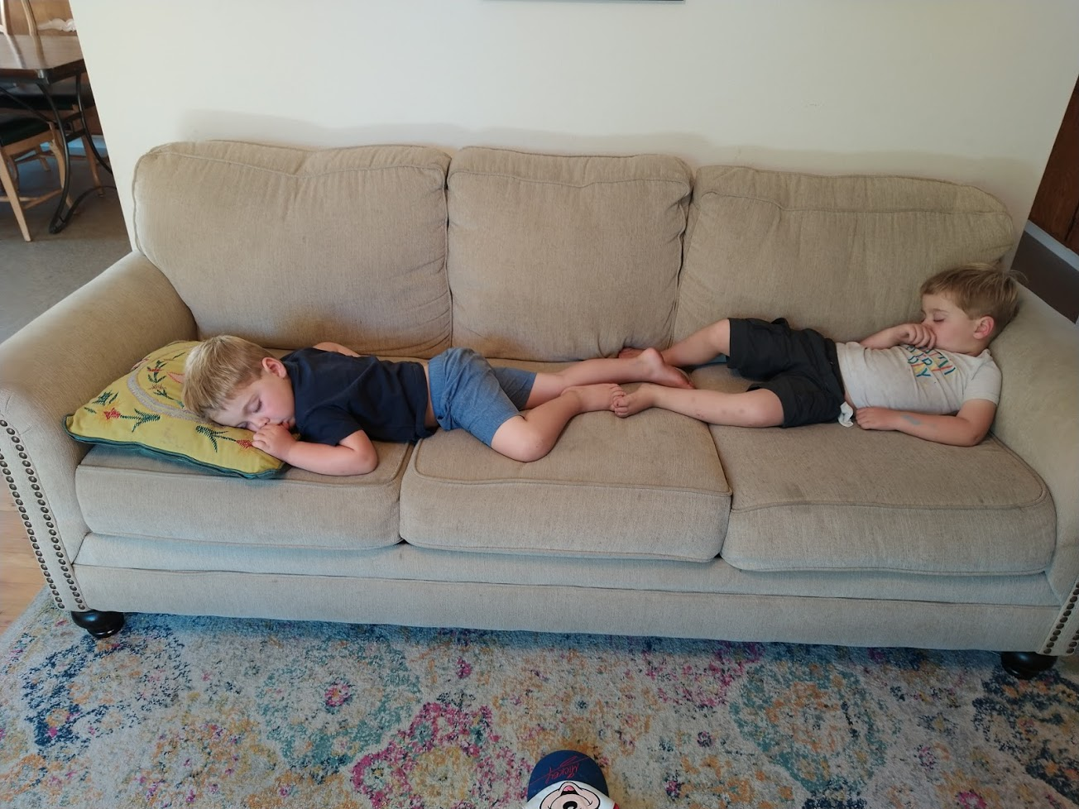

Slide 4


Slide 5
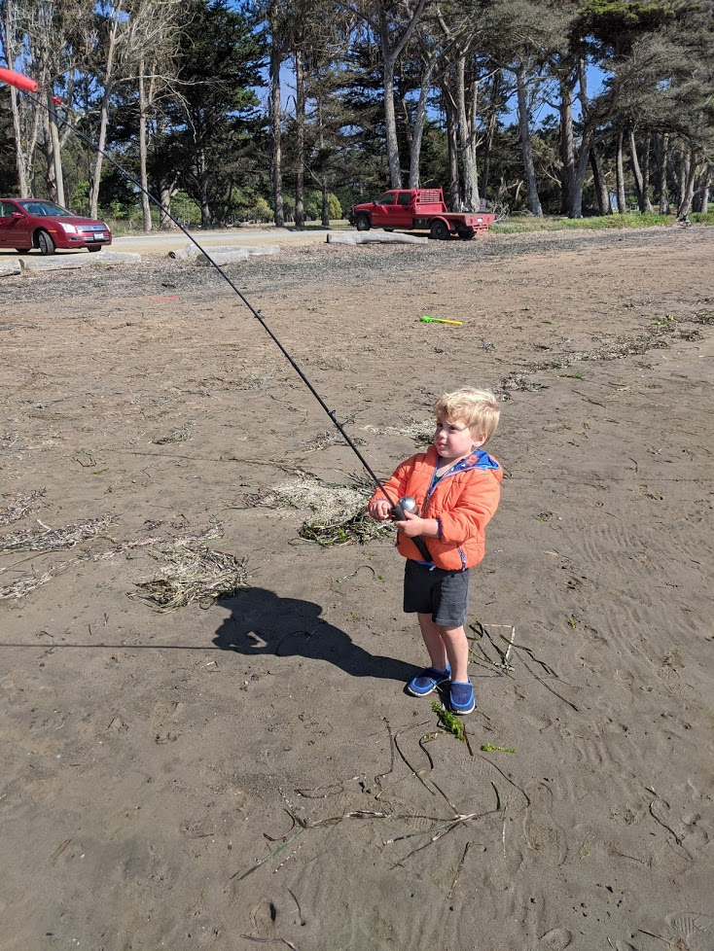

Slide 6
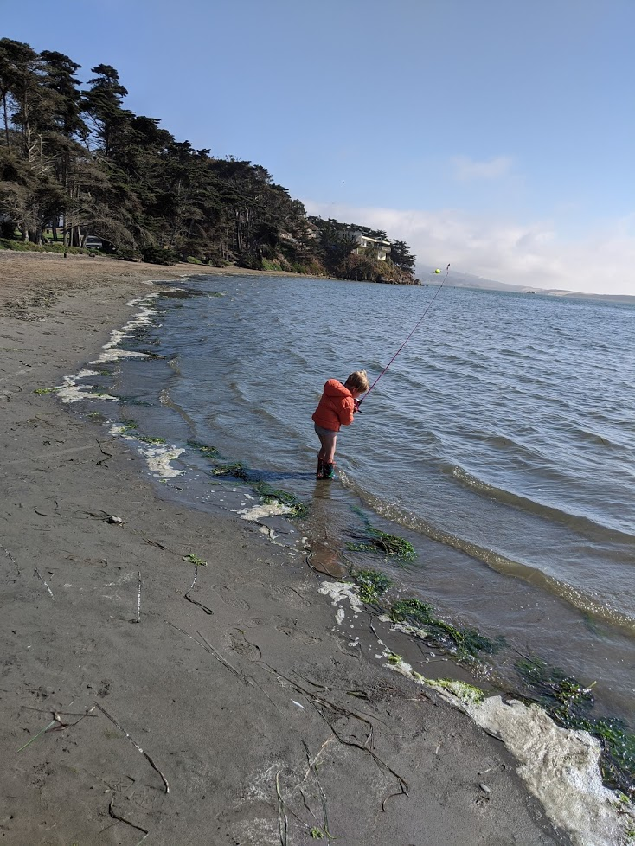

Slide 7


Slide 8
