Slide 1
Principal Component Analysis
Paul Anderson

Slide 2

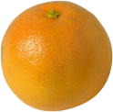
The Problem with Apples and Oranges
High dimensionality
Can’t “see”
If had only one, two, or three features, could represent graphically
But 4 or more…
 | Weight | Diameter | Redness | Orangeness
Ex1 | 0.26 | 3.10 | 2.92 | 7.78
Ex2 | 0.35 | 2.51 | 1.91 | 5.34
Ex3 | 0.30 | 2.33 | 2.05 | 11.49
Ex4 | 0.21 | 3.67 | 10.82 | 1.79
Ex5 | 0.28 | 2.13 | 3.11 | 9.02
Ex6 | 0.28 | 3.83 | 8.80 | 2.04
Ex7 | 0.10 | 3.96 | 7.30 | 2.81
Ex8 | 0.32 | 3.40 | 1.16 | 12.01
Ex9 | 0.19 | 3.89 | 2.75 | 9.45
Ex10 | 0.22 | 2.46 | 1.71 | 10.98
Ex11 | 0.33 | 3.95 | 7.88 | 2.67
Ex12 | 0.43 | 2.99 | 1.03 | 10.16
Ex13 | 0.21 | 5.29 | 11.44 | 1.44
Ex14 | 0.30 | 3.35 | 9.99 | 1.51
Ex15 | 0.26 | 3.04 | 4.48 | 1.46
Ex16 | 0.27 | 4.38 | 6.48 | 1.55
Ex17 | 0.46 | 2.90 | 1.86 | 7.79
Ex18 | 0.29 | 2.92 | 11.88 | 1.66
Ex19 | 0.24 | 3.50 | 9.09 | 1.75
Ex20 | 0.40 | 3.24 | 2.00 | 11.16

Slide 3
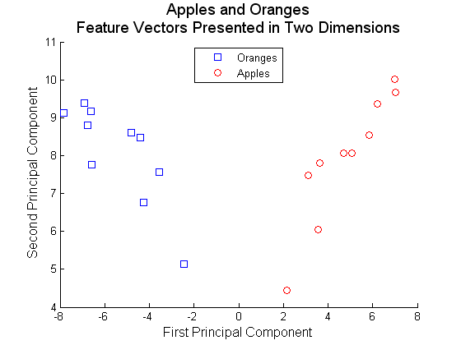
If Could Compress Into 2 Dimensions
Apples and oranges: feature vectors
Axis of greatest variance

Slide 4
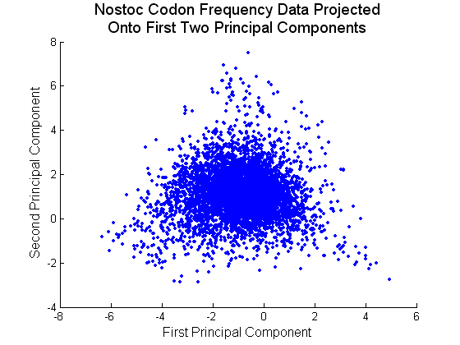
Real World Example
59 dimensions
3500 genes
Very useful in exploratory data analysis
Sometimes useful as a direct tool (MCU)

Slide 5
But We’re Not Scared of the Details
Given
  Data matrix M (feature vectors for all examples)
Generate
  covariance matrix for M (Σ)
  Eigenvectors (principal components) from covariance matrix
M
Σ
Eigenvectors

Slide 6
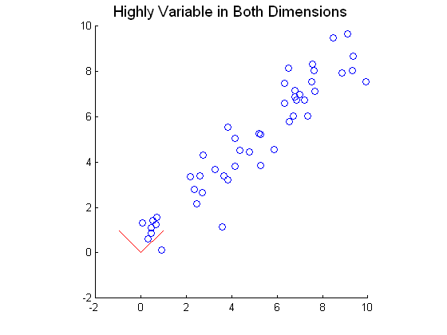
Eigenvectors and Eigenvalues
Each Eigenvector is accompanied with an Eigenvalue
The Eigenvector with the greatest Eigenvalue points along the axis of greatest variance

Slide 7
Eigenvectors and Eigenvalues
If use only first principal component very little degradation of data
Have reduced dimensions from 2 to 1

Slide 8
Project data onto new axes
Once have Eigenvectors can project data onto new axis
Eigenvectors are unit vectors, so simple dot product produces the desired effect
M
Σ
Eigenvectors
Project Data

Slide 9
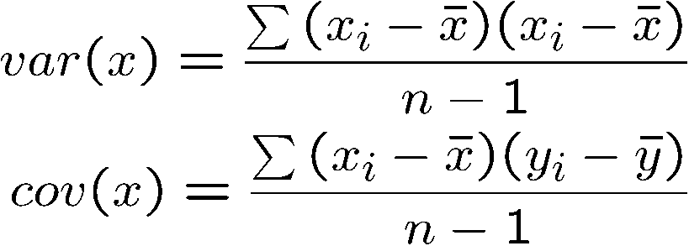
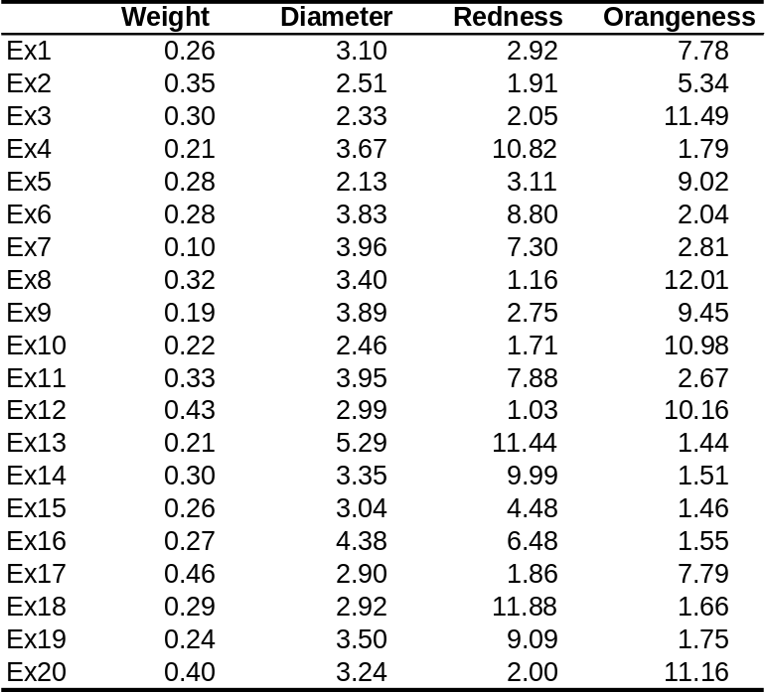
Covariance Matrix
M
Σ
Eigenvectors
Project Data
1,1 | 1,2 | 1,3 | 1,4
2,1 | 2,2 | 2,3 | 2,4
3,1 | 3,2 | 3,3 | 3,4
4,1 | 4,2 | 4,3 | 4,4

Slide 10
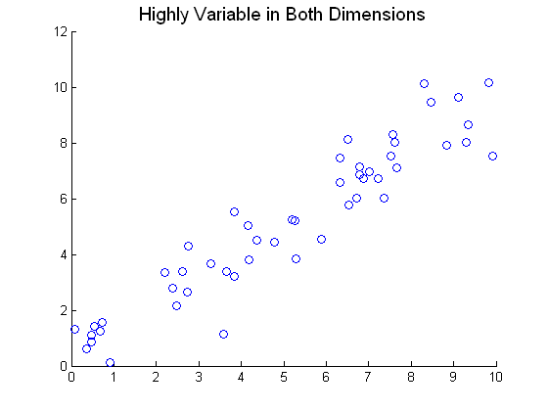
Covariance Matrix
8.3949 | 7.5958
7.5958 | 7.7130

Slide 11
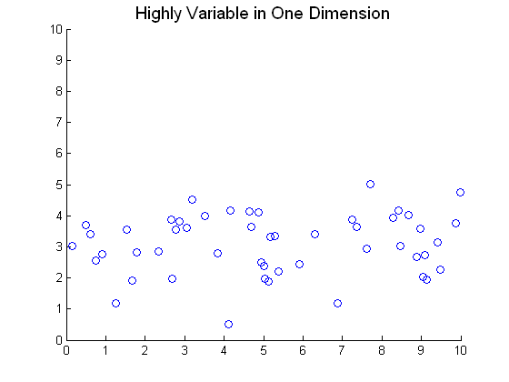
Covariance Matrix
8.7951 | 0.3299
0.3299 | 0.9200

Slide 12
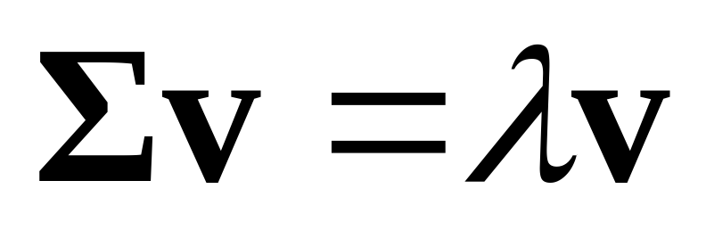
Eigenvector
M
Σ
Eigenvectors
Project Data
Eigenvector
  Linear transform of the Eigenvector using Σ as the transformation matrix resulting in a parallel vector

Slide 13
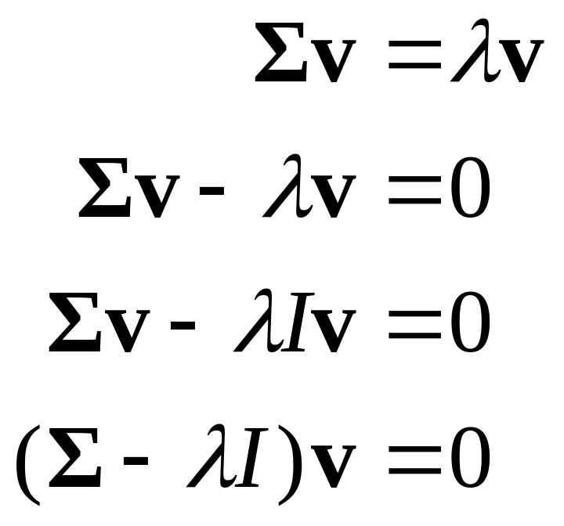
Eigenvector
How to find
  Σ is an nxn matrix
  There will be n Eigenvectors
  Eigenvectors ≠ 0
  Eigenvalues ≠ 0

Slide 14
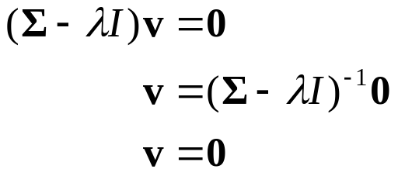
Eigenvector
A is invertible if and only if det(A) ≠ 0
If (A-λv) is invertible then:
But it is given that v ≠ 0 so must not be invertible
Not invertible so det(A-λv) = 0

Slide 15
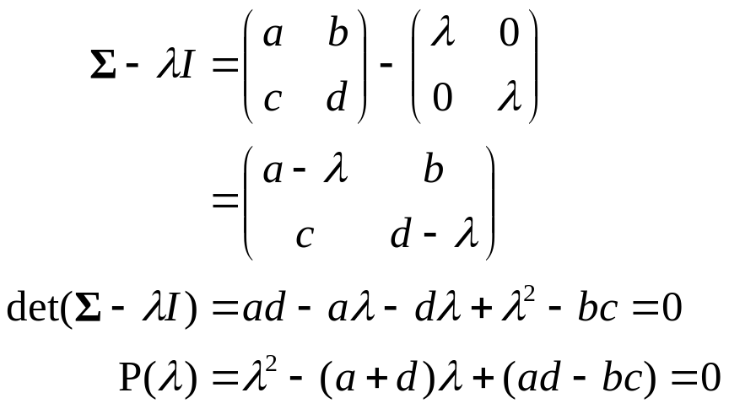
Eigenvector
First, solve for the λ by performing the following operations:
If solve for λ will get 2 roots, λ₁ and λ₂.

Slide 16
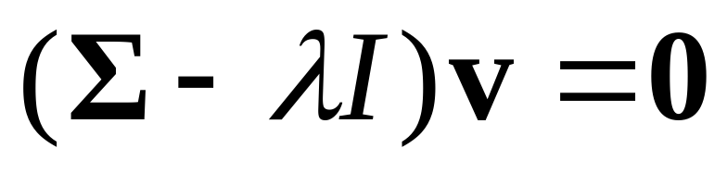
Eigenvector
Now that the Eigenvalues have been acquired we can solve for the Eigenvector (v below).
Know Σ, know λ, know I, so becomes homogeneous system of equations (equal to 0) with the entries of v as the variables
Already know that there is no unique solution
  The only way there is a unique solution is if the trivial solution is only solution.
  If this were the case it would be invertible

Slide 17
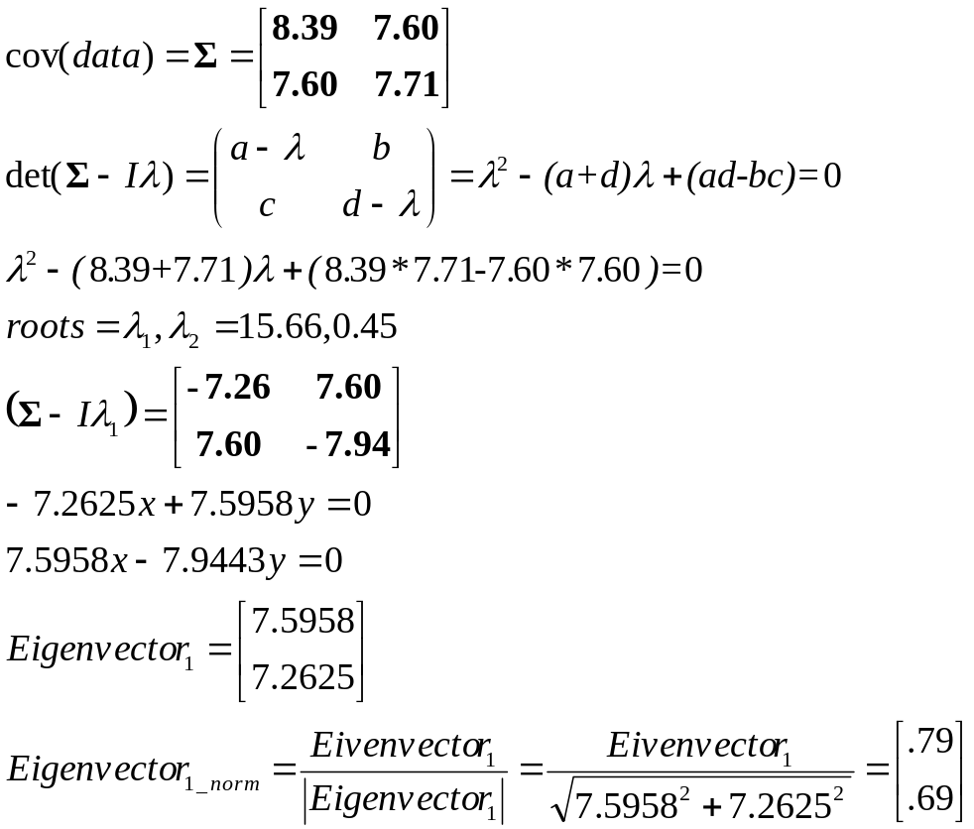
Back to the example
0.72

Slide 18
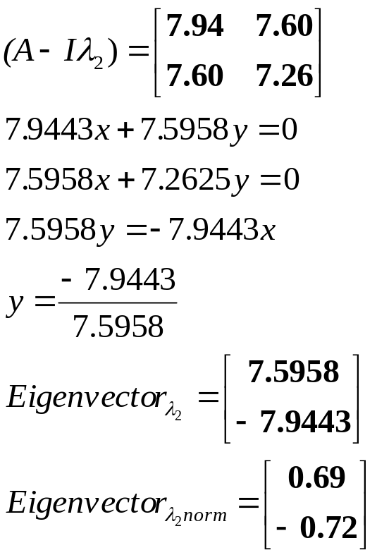
Back to the example

Slide 19
Eigenvectors (Summary)
M
Σ
Eigenvectors
Project Data
P(λ)
λ’s
Eigenvectors
Find characteristic polynomial using determinant
Solve for Eigenvalues (λ’s)
Solve for Eigenvectors

Slide 20
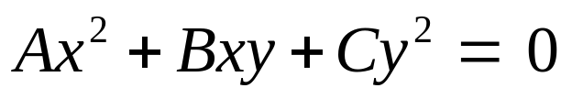
Axis of Greatest Variance?
Equation for an ellipse
D, E, and F have to do with translation
A and C related to the ellipse’s spread along the X and Y axes, respectively
B has to do with rotation

Slide 21
Axis of Greatest Variance
Mathematicians discovered that any ellipse can be exactly captured by a symmetric matrix
Covariance matrix is symmetric
The Eigenvectors of the said matrix point along the principal axes of the ellipse
Origin of the name (principal components analysis)
A | B/2
B/2 | C
Related to spread along x axis (variance of data along x axis)
Related to spread along y axis
Related to rotation (covariance)

Slide 22
Principal Axis Theorem
Principal axis theorem holds for quadratic forms (conic sections) in higher dimensional spaces

Slide 23
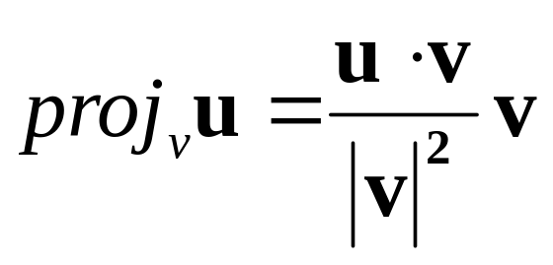
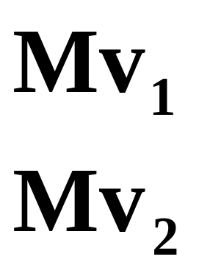
Project Data Onto Principal Components
M
Σ
Eigenvectors
Project Data
Eigenvectors are unit vectors

Slide 24
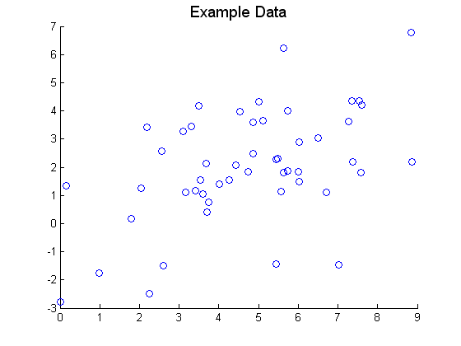
Practice
Covariance matrix
4.3703 | 2.0668
2.0668 | 4.0295
4.3703 | 2.0668
2.0668 | 4.0295
4 | 2
2 | 4

Slide 25
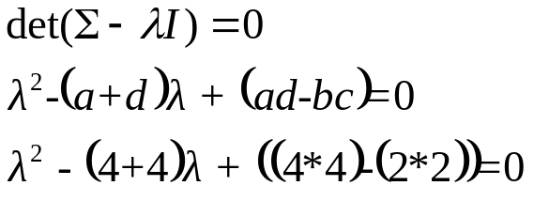
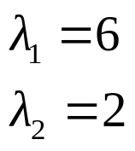
Practice
M
Σ
Eigenvectors
Project Data
P(λ)
λ’s
Eigenvectors
4 | 2
2 | 4

Slide 26
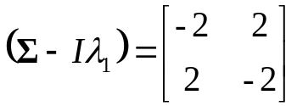
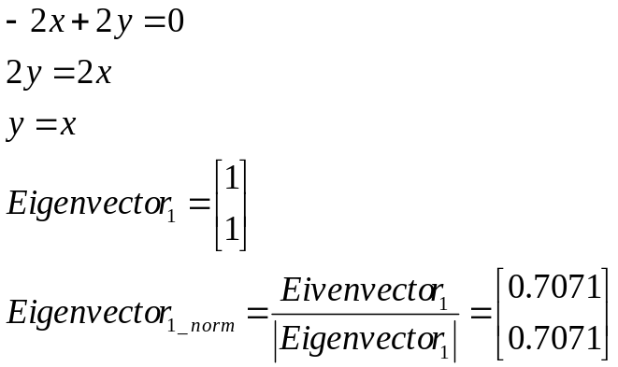
Practice
M
Σ
Eigenvectors
Project Data
P(λ)
λ’s
Eigenvectors
4 | 2
2 | 4

Slide 27
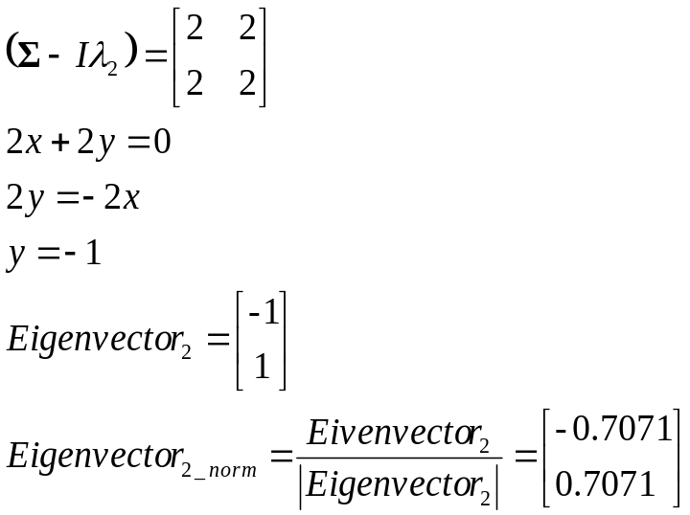
Practice
M
Σ
Eigenvectors
Project Data
P(λ)
λ’s
Eigenvectors
4 | 2
2 | 4

