Slide 1
K-means
DATA 301
Paul Anderson

Slide 2
https://www.google.com/url?sa=i&source=images&cd=&ved=2ahUKEwi1-cfJ6vTlAhXEIDQIHVuLAB0QjRx6BAgBEAQ&url=https%3A%2F%2Fwww.researchgate.net%2Ffigure%2FSupervised-and-unsupervised-machine-learning_fig2_325867536&psig=AOvVaw3u2Dr8SKrMEPc5XbqNOEbz&ust=1574203325663897

Slide 3
K-Means Example

Slide 4
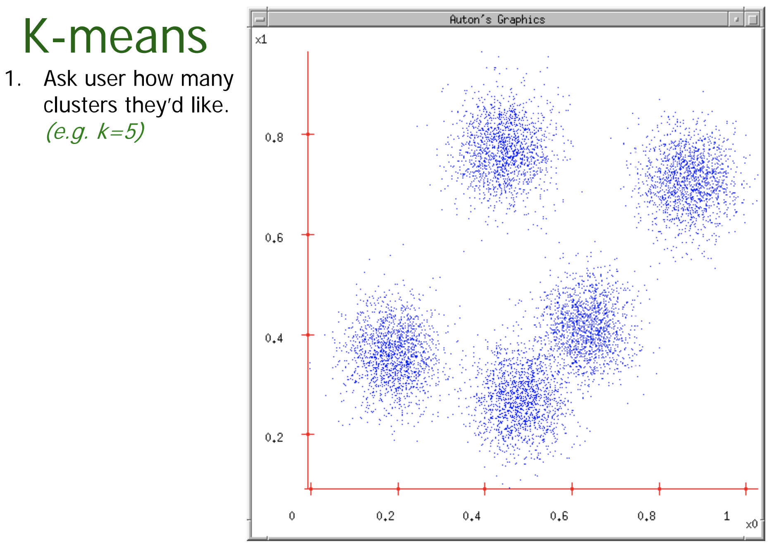

Slide 5
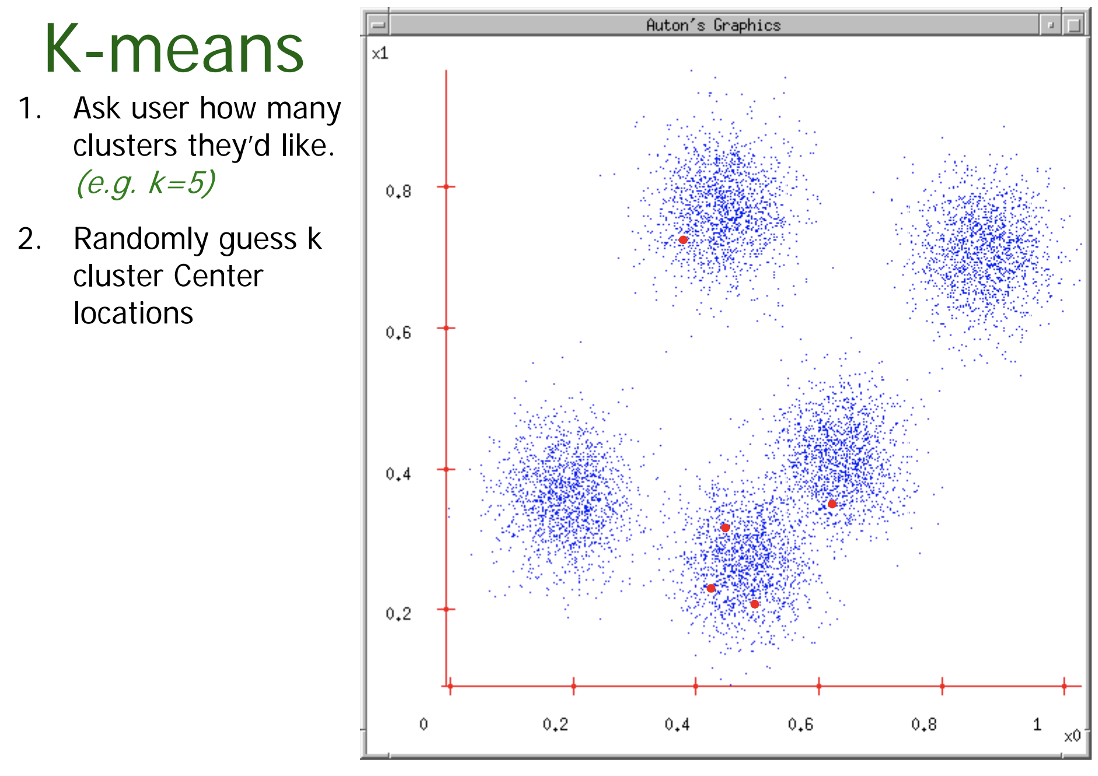

Slide 7
Note to other teachers and users of these slides. Portions of these slides are provided by Andrew Anton. Here is his message:
Andrew would be delighted if you found this source material useful in giving your own lectures. Feel free to use these slides verbatim, or to modify them to fit your own needs. PowerPoint originals are available. If you make use of a significant portion of these slides in your own lecture, please include this message, or the following link to the source repository of Andrew’s tutorials: http://www.cs.cmu.edu/~awm/tutorials . Comments and corrections gratefully received.

