Slide 1
Parallel Fuzzing
An Overview of Recent Works
Yifan Xia

Slide 2
Preliminaries
Introduction

Slide 3
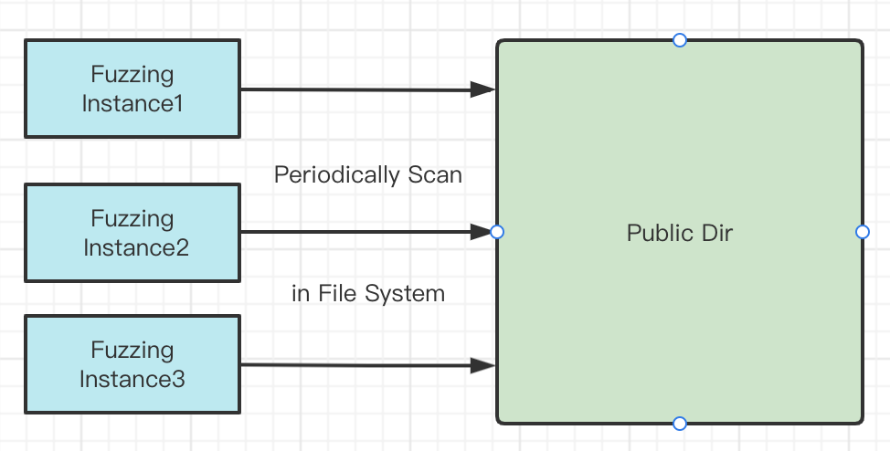
Introduction
Large-scale fuzzing is gaining popularity, Espeically in industry
Google's OSSFuzz powered by ClusterFuzz
Microsoft Springfield
Illustration of AFL Parallel Mode
When it comes to multiple-system,
AFL uses SSH to synchronize.
Notes:
所谓Parallel Fuzzing就是同时launch多个fuzzing instance协同工作。主要用于工业界测试，对效率有较高需求时。

Slide 4
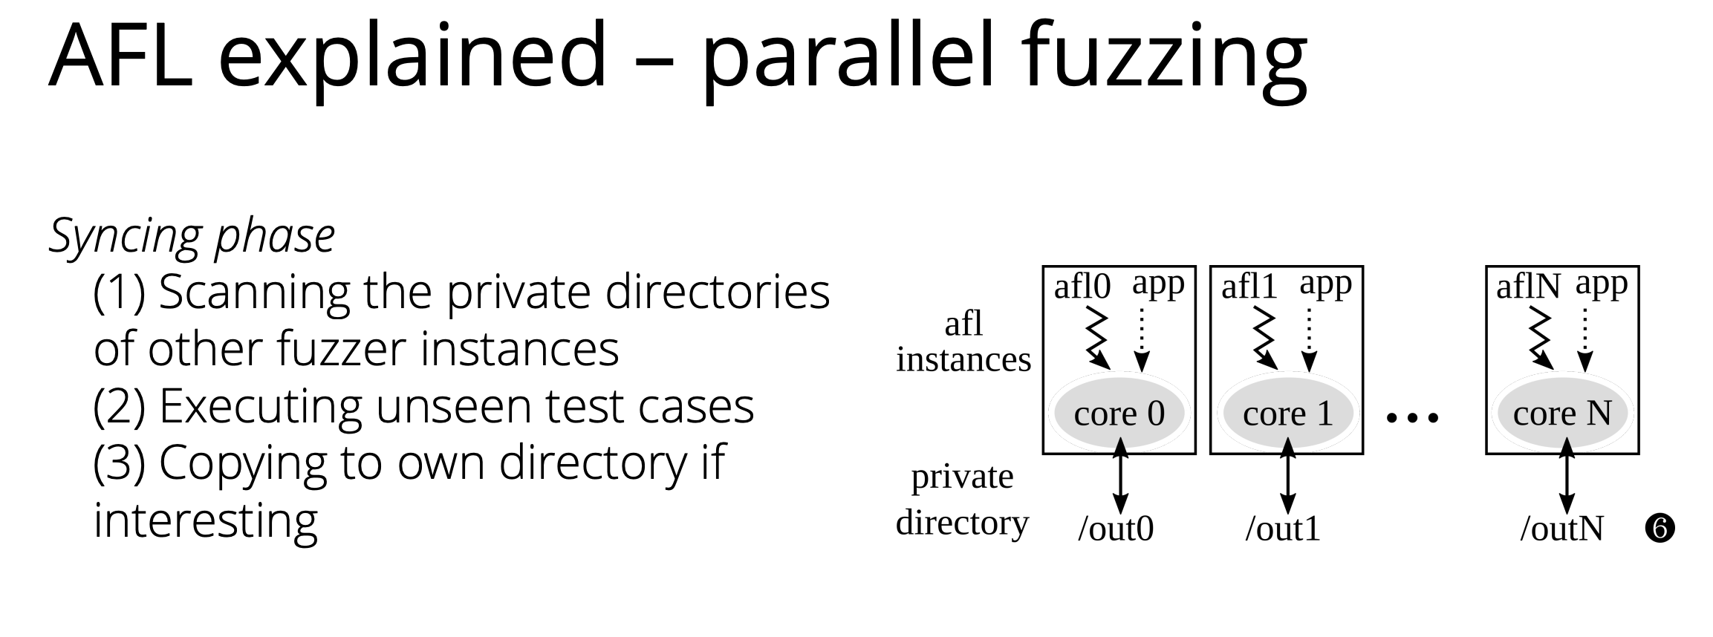
Introduction

Slide 5
Preliminaries
Scope

Slide 6
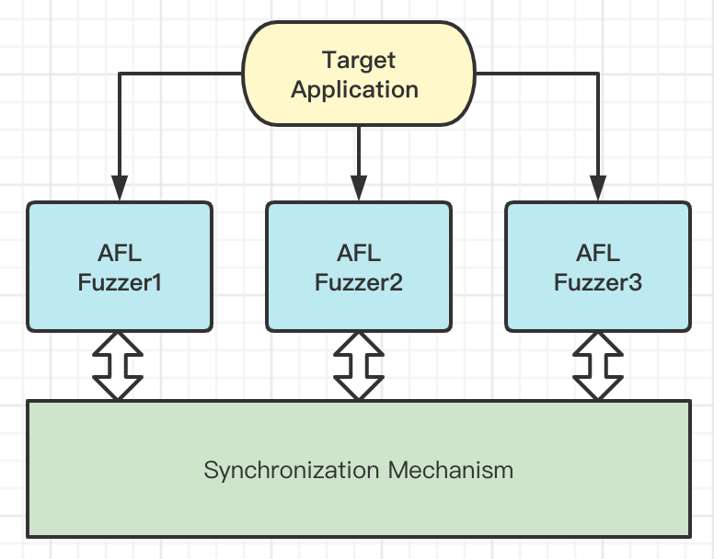
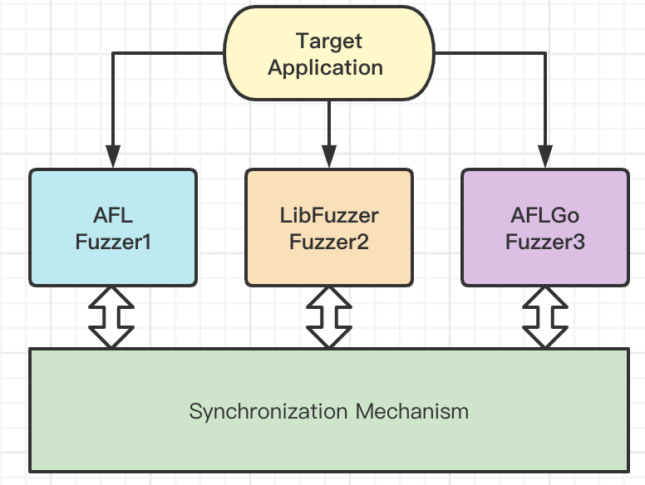
Scope
Existing work can be categorized by two features
Single-Sysyem or Multiple-System ?
Single Fuzzer-Type or Multiple Fuzzer-Type ?
Single Fuzzer-Type
Multiple Fuzzer-Type

Slide 7
Scope
And two main challenges
Synchronizing guiding information (with lower overhead)
For multiple-system, distributed architecture may be required.
Task Scheduling
For multiple-system, different computing capability should be taken into consideration

Slide 8
Preliminaries
The origin AFL parallel mode is simple
( with high overhead synchronization)

Slide 9
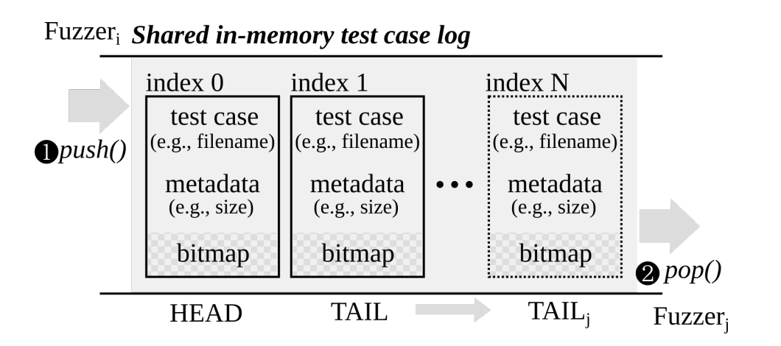
Designing New Operating Primitives to Improve
Fuzzing Performance ( CCS' 17 )
Shared in-memory test case log
No directory enumeration:
pop() to examine
test cases from neighbors
No test case re-execution:
direct reference on the bitmap

Slide 10
Preliminaries
Parallel mode is great
But not all fuzzers support that

Slide 11
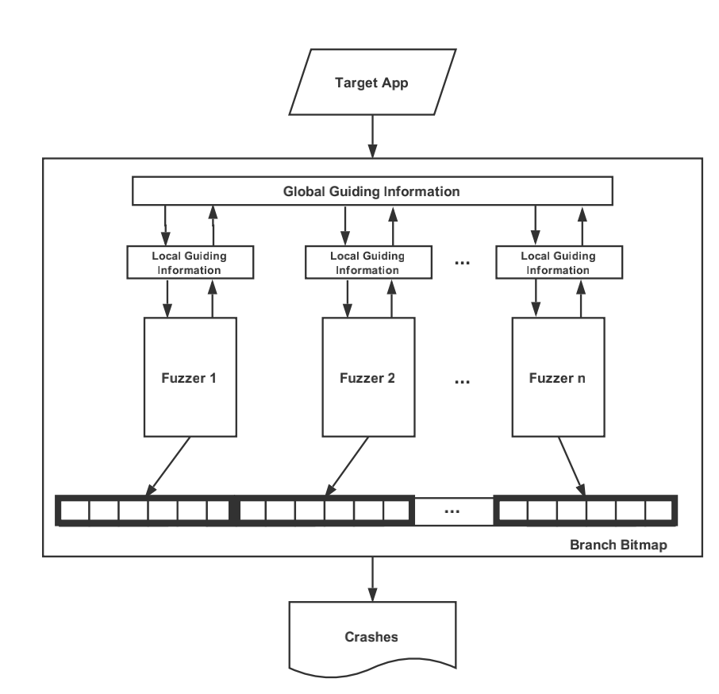

PAFL ( FSE'18 )
Extend Fuzzing Optimizations of Single Mode to Industrial Parallel Mode
Yu Jiang KLISS, Tsinghua University, China
Motivation
The performance of some optimizations(i.e. FairFuzz, AFLFast) degrade in parallel mode
due to the defect of design.
Two Problems
1. Guiding Information Loss
2. Task Conflicts
Two Contributions
1. Global Guiding Information
2. Task Division Mechanism

Slide 12
Preliminaries
Since instances with same type collabrate,
what about ensembling diverse fuzzers?

Slide 13
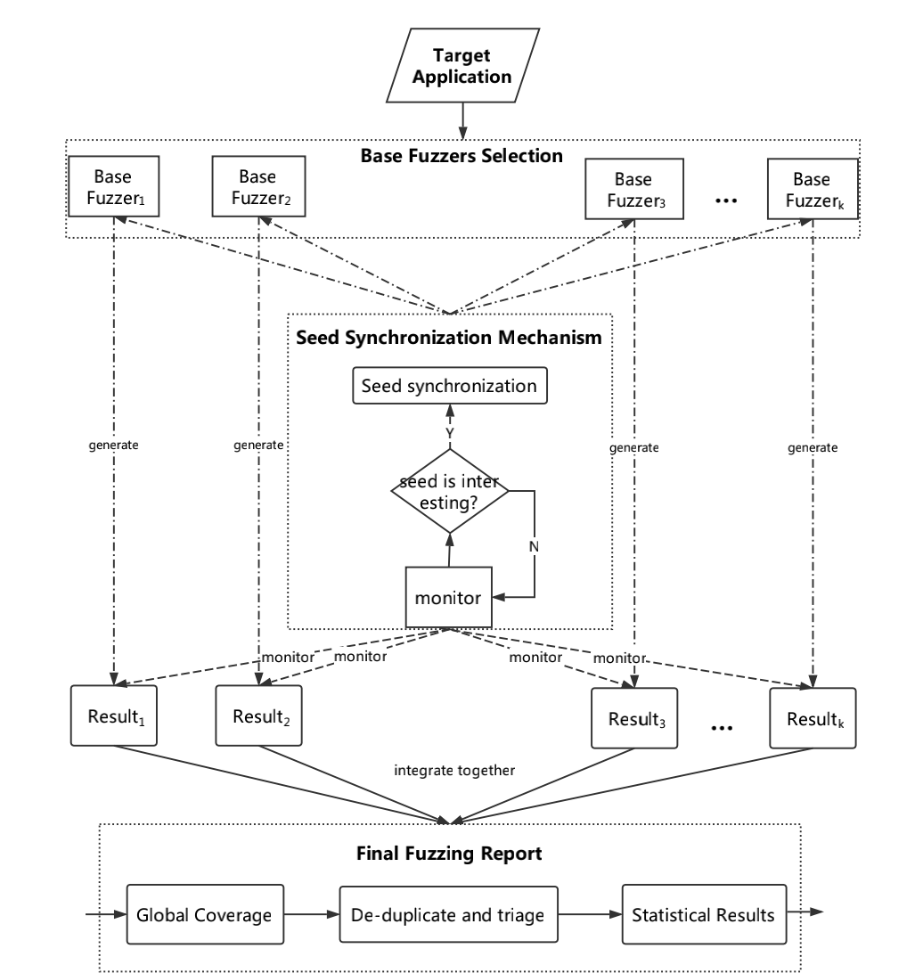
EnFuzz (USENIX Security '19)
Ensemble Fuzzing with Seed Synchronization among Diverse Fuzzers
Yu Jiang KLISS, Tsinghua University, China
Motivation
Well-designed fuzzing strategies perform weakly in industrial practice. (due to the complexity)
Insight
Collaborate advantages of diverse fuzzers
Contribution
1. a heuristic method for diverse fuzzers choosing
2. a GALS seed synchronization mechanism

Slide 14
Preliminaries
Task allocation is important，
while exsiting method is inefficient

Slide 15
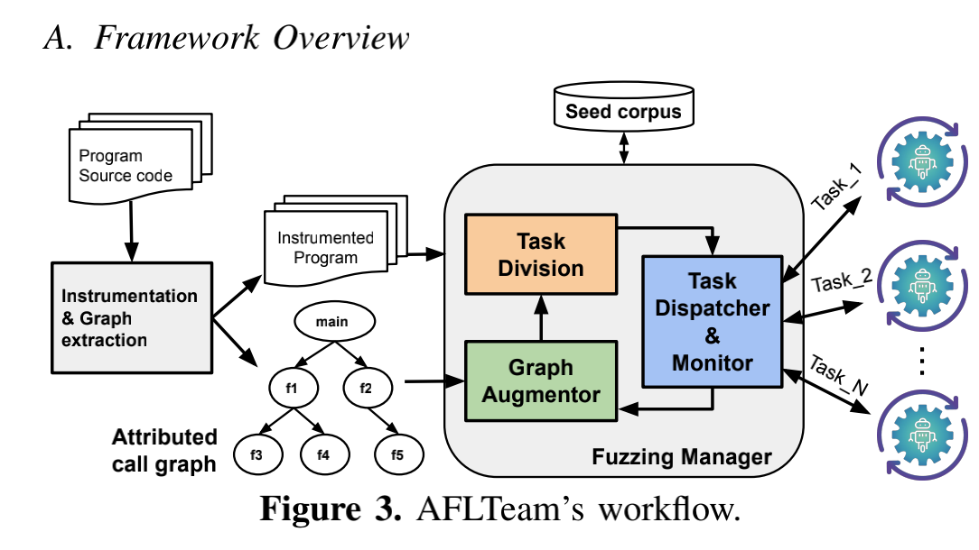
AFLTeam (ASE' 21)
Towards Systematic and Dynamic Task Allocation for Collaborative Parallel Fuzzing
University of Melbourne
Motivation
existing task-dividing algorithms might be ineffective
due to the lack of structural information of the input program. (i. bitmap is random. ii. static allocation )
Insight
1. Obtaining structural information from
attributed call graph.
graph => sub-graphs <=> tasks
2. Filtering seeds which can't reach target functions.
3. dynamic updating with execution information.

Slide 16
Preliminaries
How about Multiple-System?
No representative work yet,
but researchers are exploring.

Slide 17
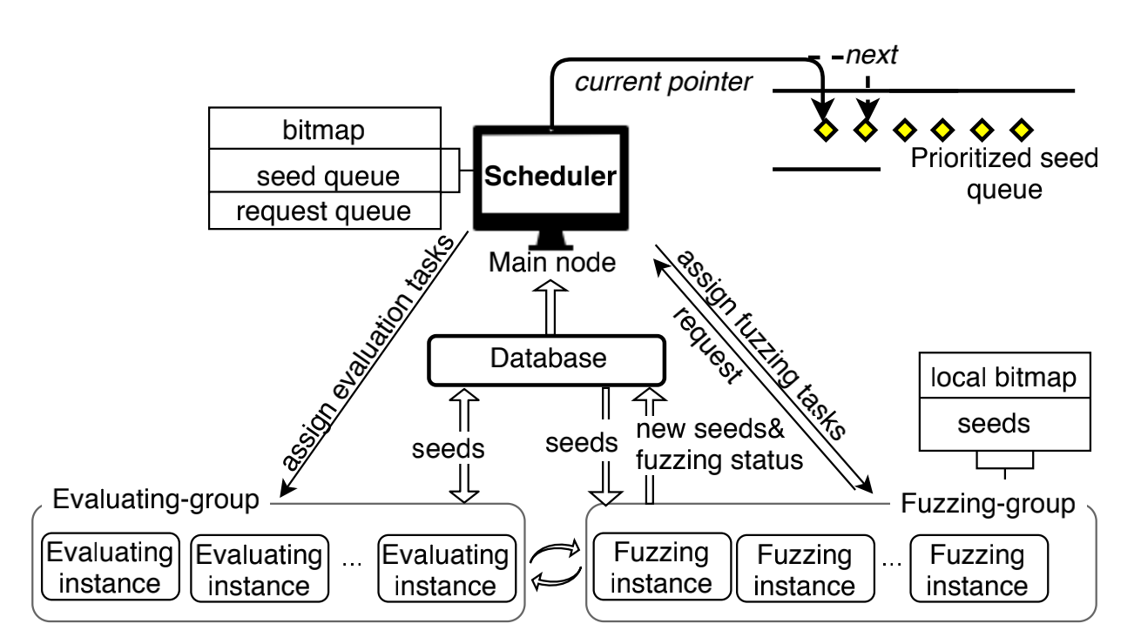
UniFuzz (NUDT)
Optimizing Distributed Fuzzing via Dynamic Centralized Task Scheduling
Motivation
1. Challenges mentioned before（information synchronization, task conflicts）
2. Difficulties in distributed environment (workload balance, synchronization overhead)
Insight
Distributed architecture to solve three challenges
1. a main scheduler which arranges fuzzing tasks for task conflicts
2. a request-response machanism for workload imbalance
3. a global information database for synchronization

Slide 18
Preliminaries
Future Direction

Slide 19
Future Direction
Single-System & Single Type
1. Better Task-Allocation Algorithm
2. Task-Aware Mutation
Single-System & Multiple Type
1. Heuristics for choosing diverse fuzzers
(ACSAC 20) Cupid: Automatic Fuzzer Selection for Collaborative Fuzzing
2. Improvement of the ensemble architecture
3. Intelligent resource allocation
Multiple-System
Distributed Architecture

Slide 20
THANKS

