Slide 1
Breaking Through Binaries: Compiler-quality
Instrumentation for Better Binary-only Fuzzing
Stefan Nagy
Virginia Tech
Yifan Xia

Slide 2
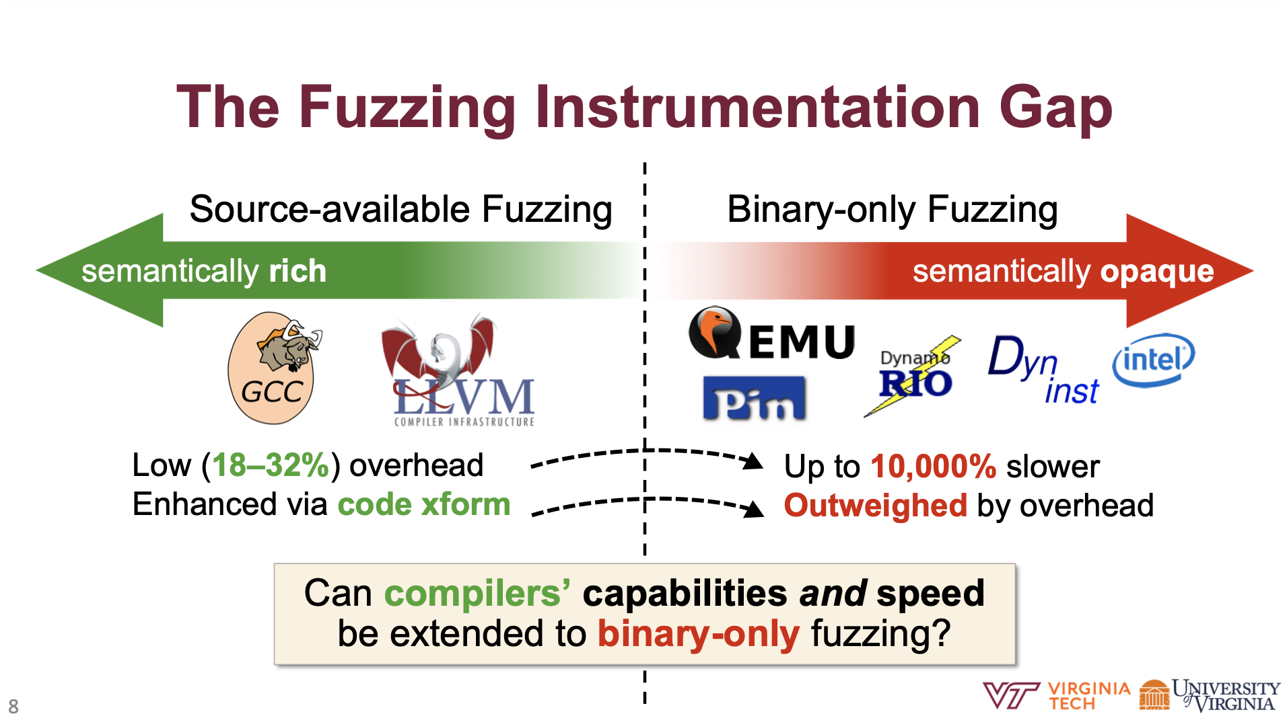
Background
Binary-only fuzzing lags behind due to the semantic and performance limitations of instrumenting code at the binary level.

Slide 3
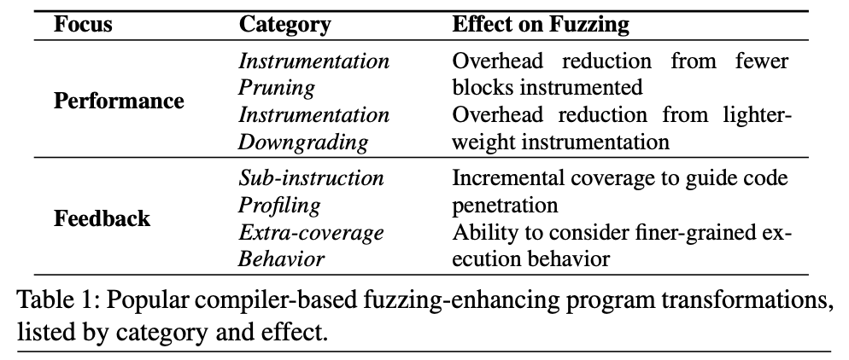
Background
Source-available Fuzzing
low overhead, semantically rich
fuzzing-enhancing program transformation
Binary-only Fuzzing
high overhead, semacticlly opaque
unable to uphold both the speed and transformation

Slide 4
Contribution
Main Purpose
Compiler-quality binary-only fuzzing
Contributions
Developing a criteria for compiler-quality binary-only instrumentation.
apply this criteria in designing ZAFL
achieve fuzzing-enhancing program transformation in binary-only fuzzing
Evaluate the effectiveness, efficiency and scalability of ZAFL

Slide 5
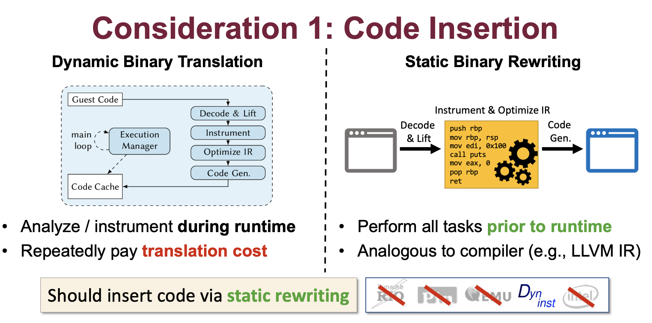
Criteria

Slide 6
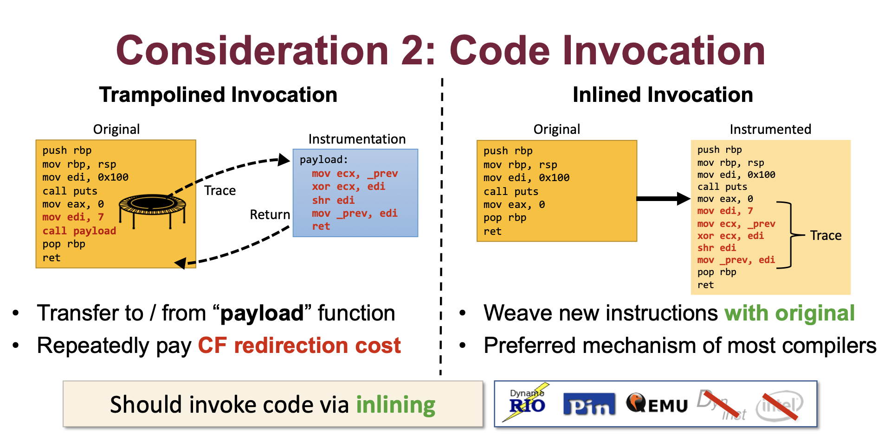
Criteria

Slide 7
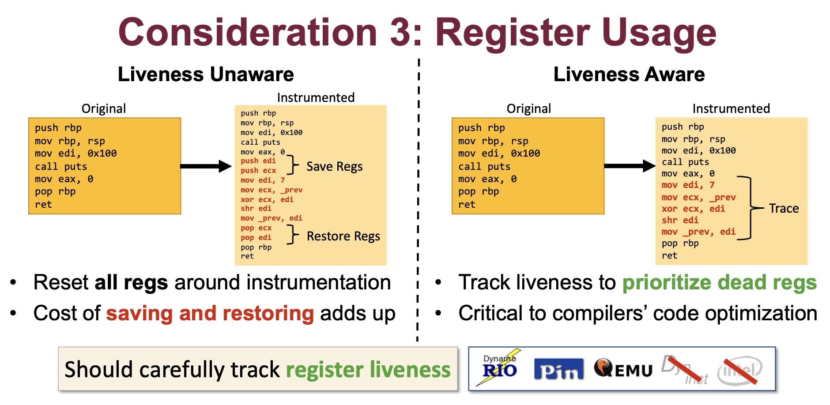
Criteria

Slide 8
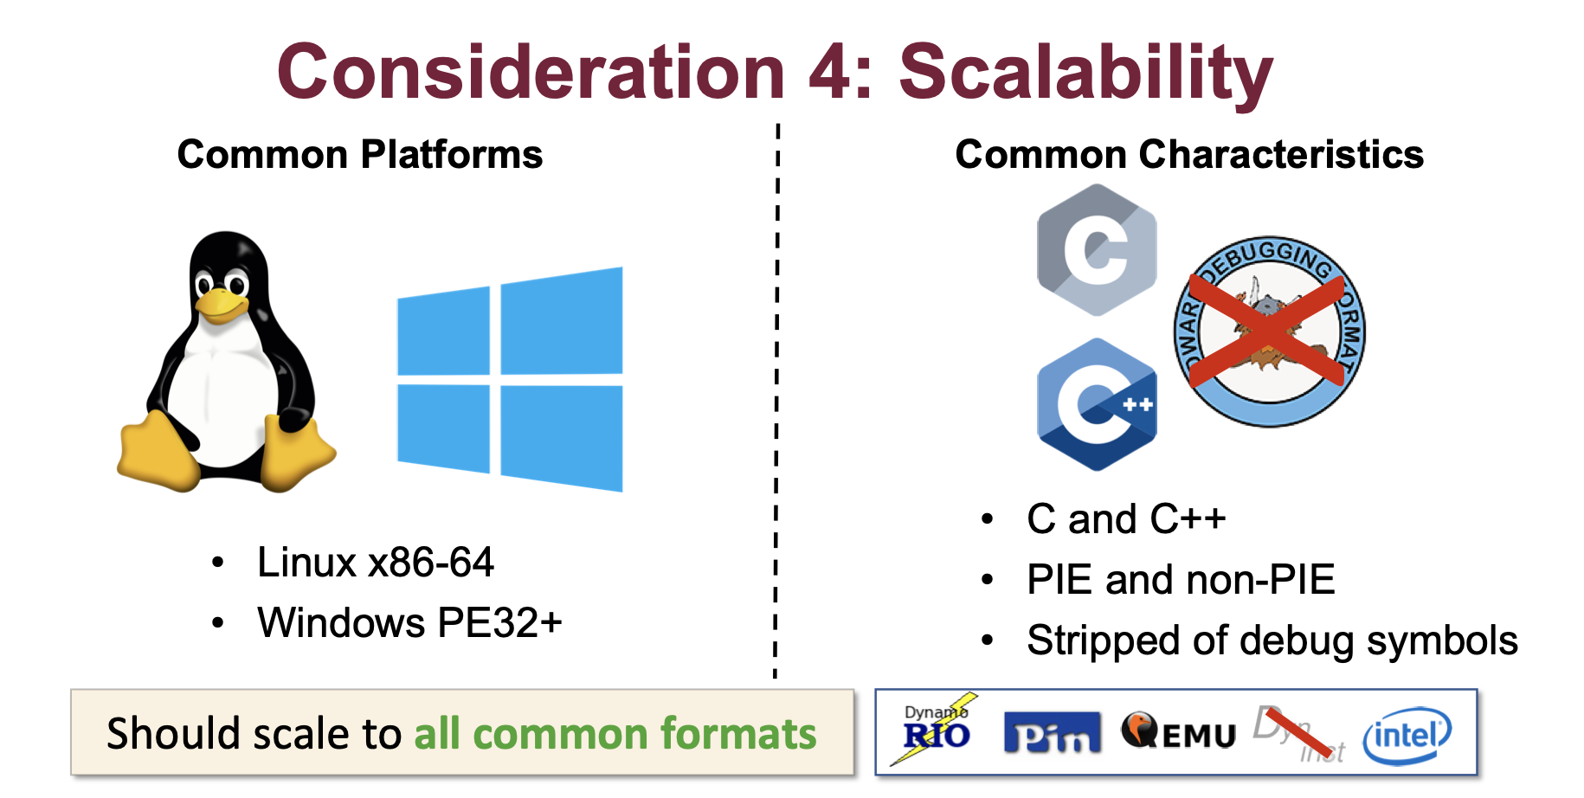
Criteria

Slide 9
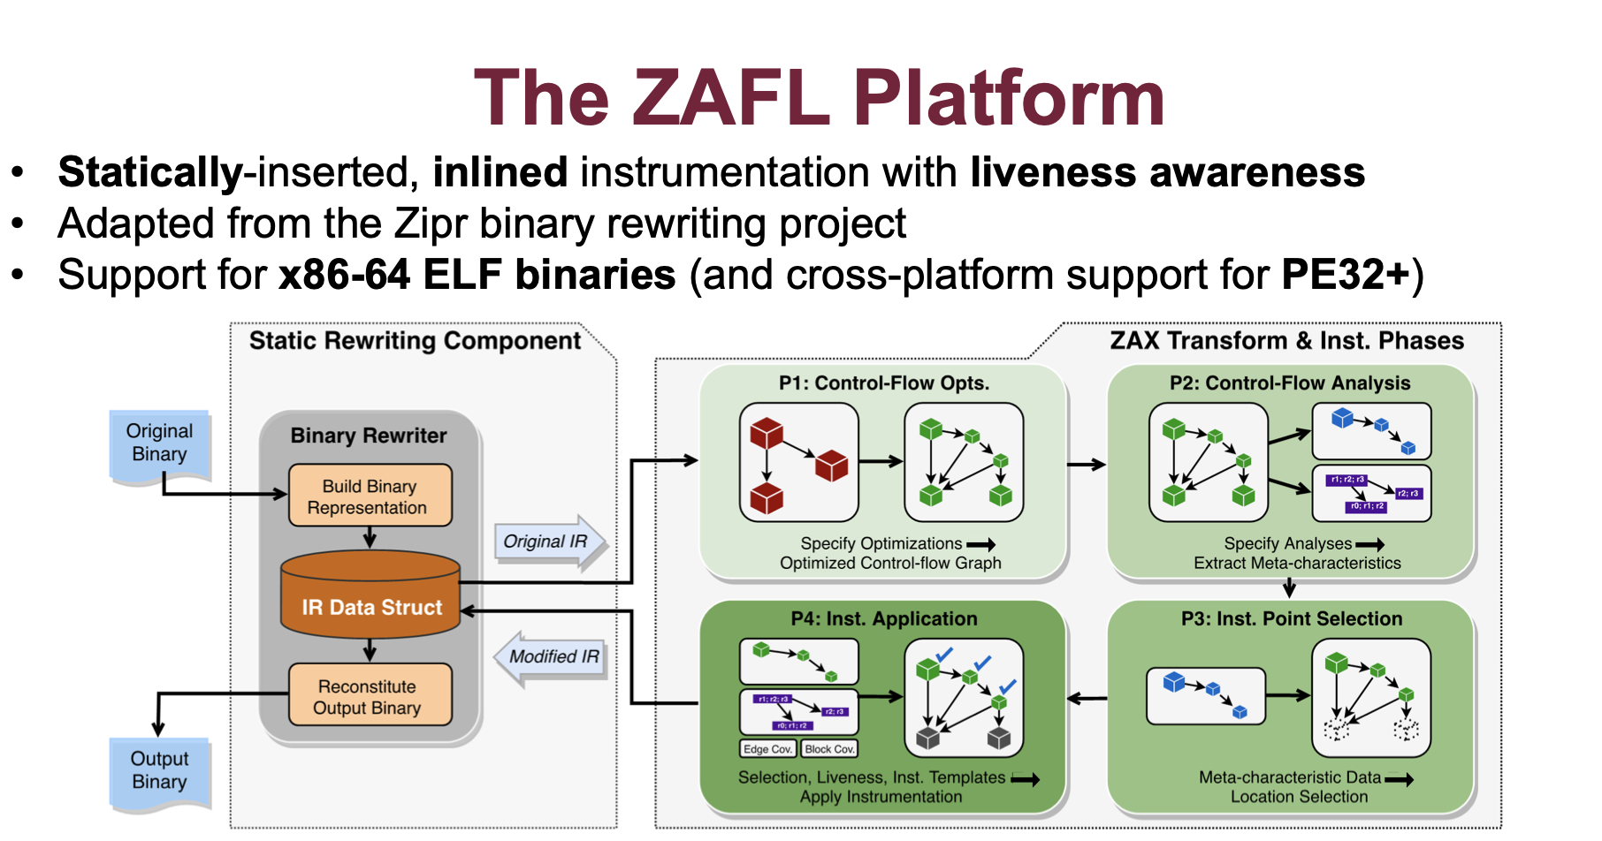
Implementation

Slide 10
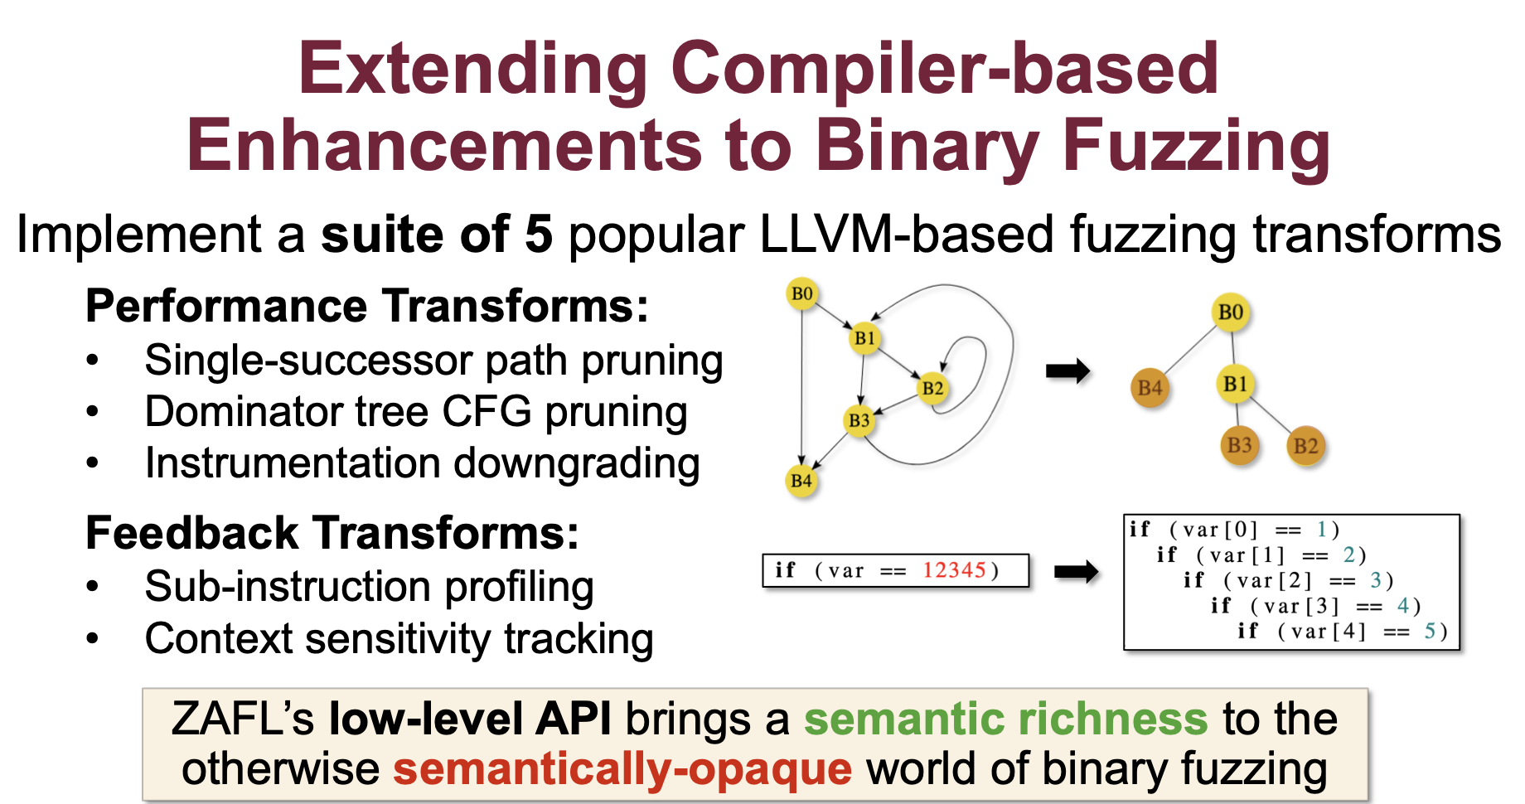
Implementation

Slide 11
Evaluation
Does ZAFL enable compiler-style program transformations while maintaining performance?
Better in both unique crashes, total test cases and queued test cases.
Three Corpus： Compared with AFL-Dyninst AFL-QEMU
LAVA-M(5h):
Real-world Software(24h):
Closed-source Binary(24h):

Slide 12
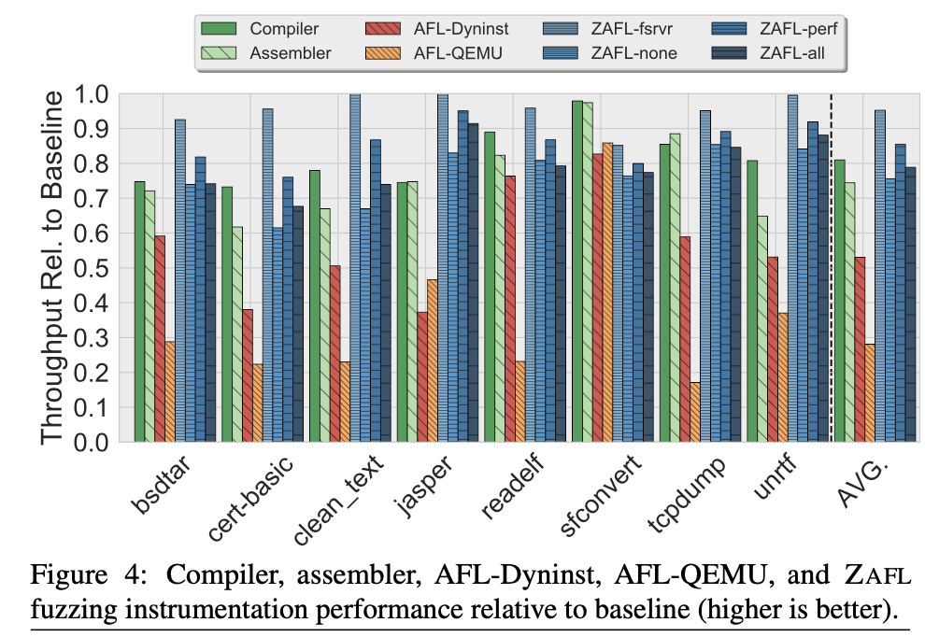
Evaluation
Does ZAFL enable compiler-style program transformations while maintaining performance?
higher throughput
ZAFL-FSRVR, ZAFL-NONE, ZAFL-PERF, and ZAFL-ALL obtain overheads of 5%, 32%, 17%, and 27%
while compiler and assembler instrumentation average 24% and 34%,
and AFL-Dyninst and AFL-QEMU average 88% and 256%,

Slide 13
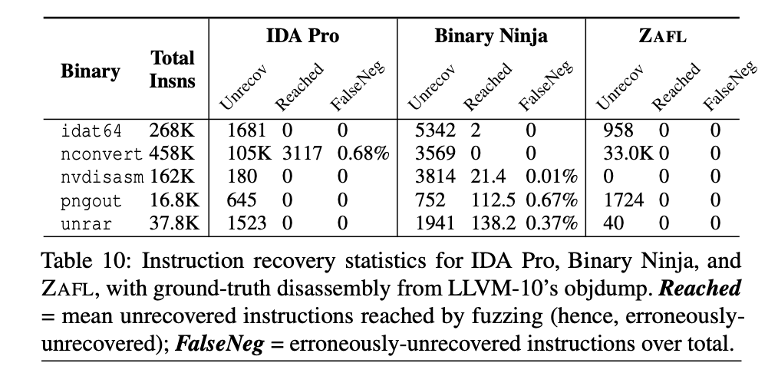
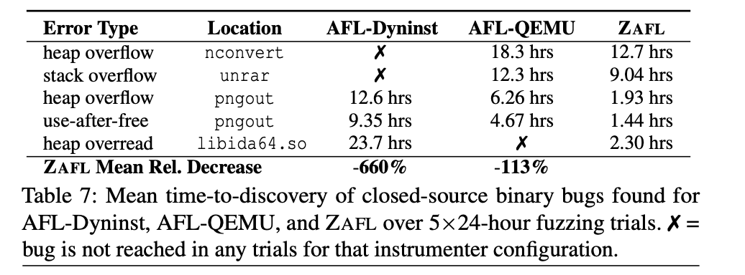
Evaluation
Does ZAFL enable compiler-style program transformations while maintaining performance?
Less time for exposing bugs Precise Instruction Recovery

Slide 14
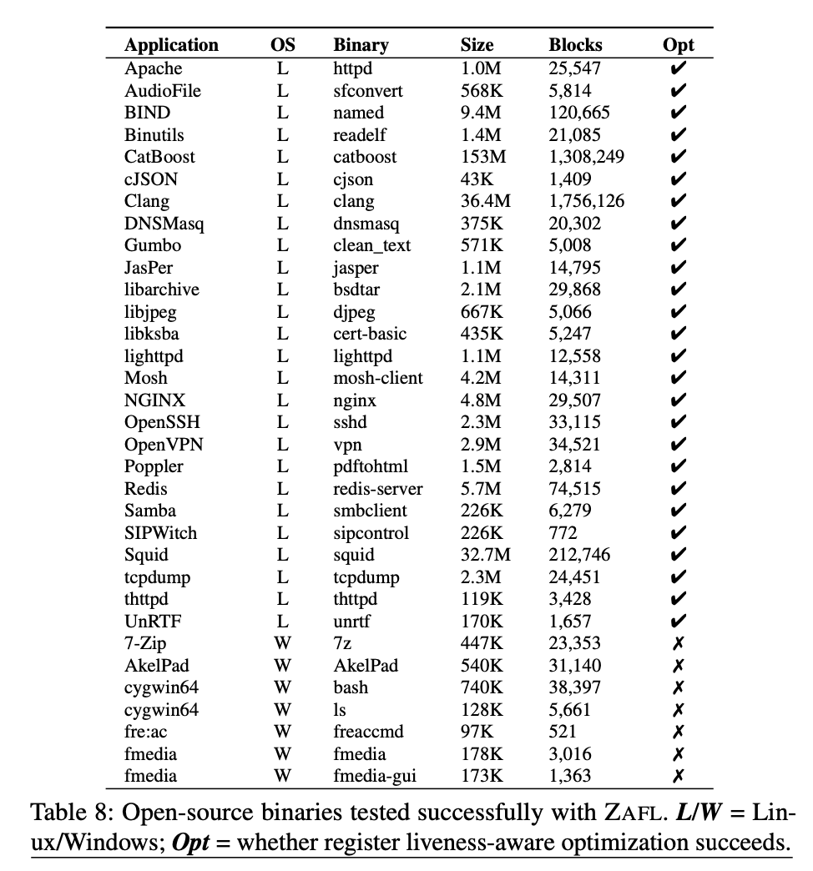
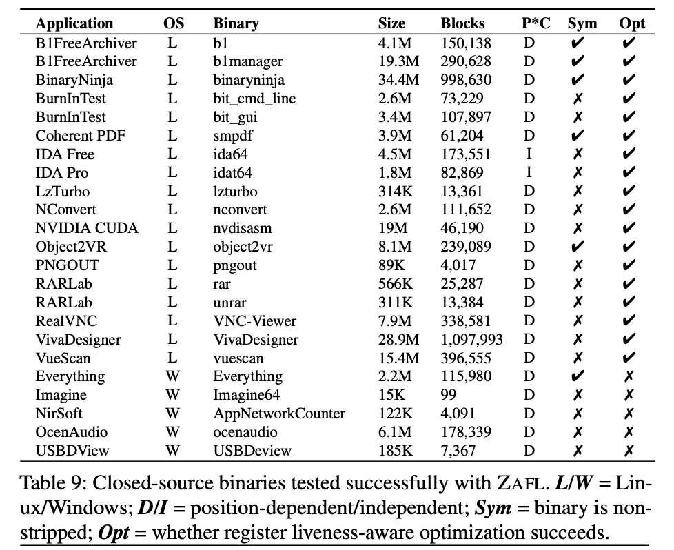
Evaluation
Does ZAFL enable compiler-style program transformations while maintaining performance?
Scalability：Different Platform，Language，and Size

