Slide 1
The Use of Likely Invariants as
Feedback for Fuzzers
Andrea Fioraldi¹, Daniele Cono D’Elia², Davide Balzarotti¹
¹EURECOM, ²Sapienza University of Rome

Slide 2
Preliminaries
Background

Slide 3
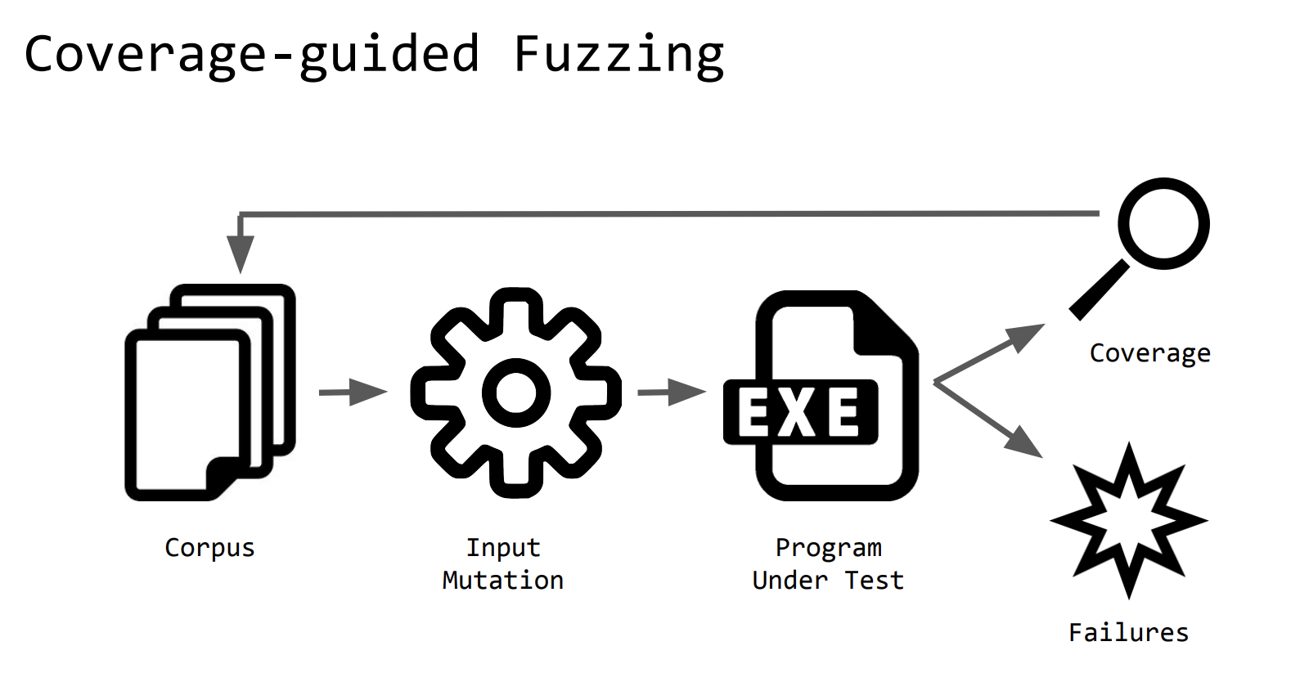
Background
Notes:
所谓Parallel Fuzzing就是同时launch多个fuzzing instance协同工作。主要用于工业界测试，对效率有较高需求时。

Slide 4
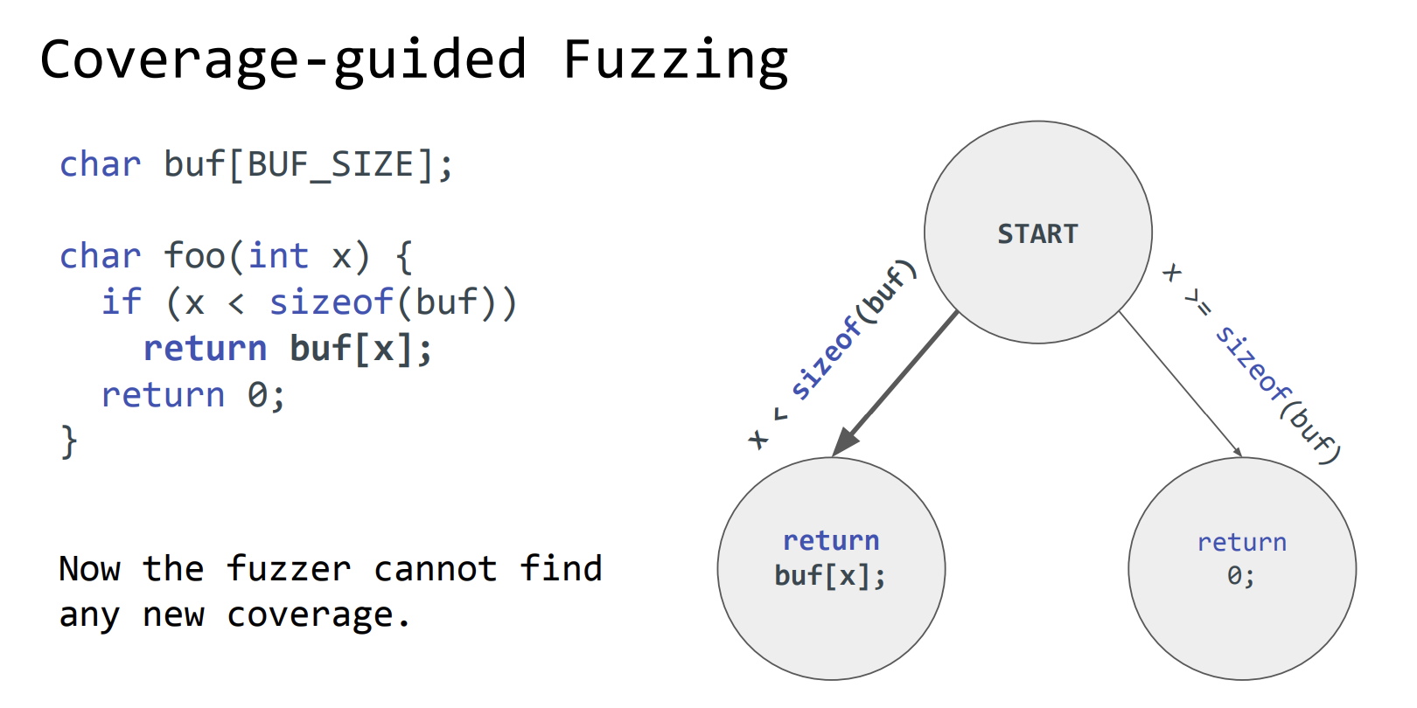
Background

Slide 5
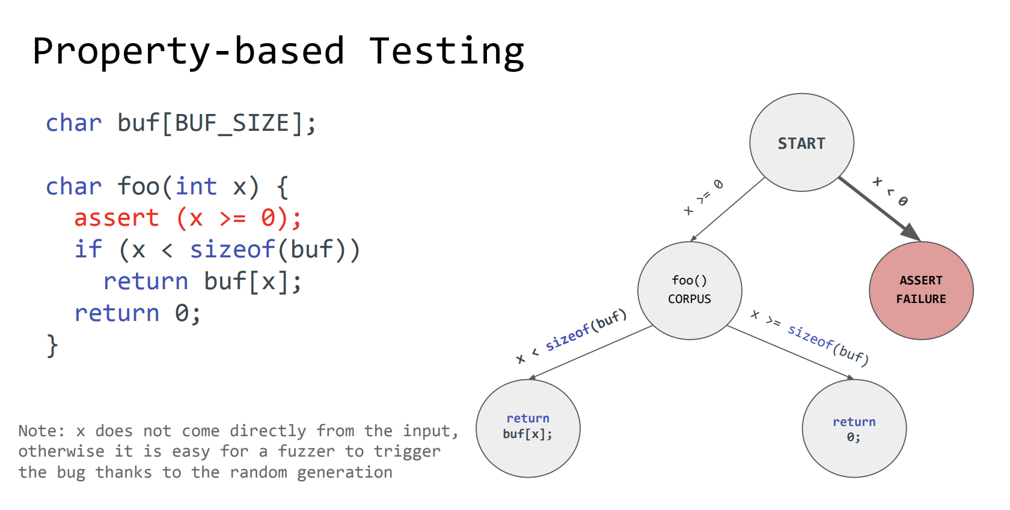
Background

Slide 6
Preliminaries
identify program properties manually is EXPENSIVE
automated methods are proposed

Slide 7
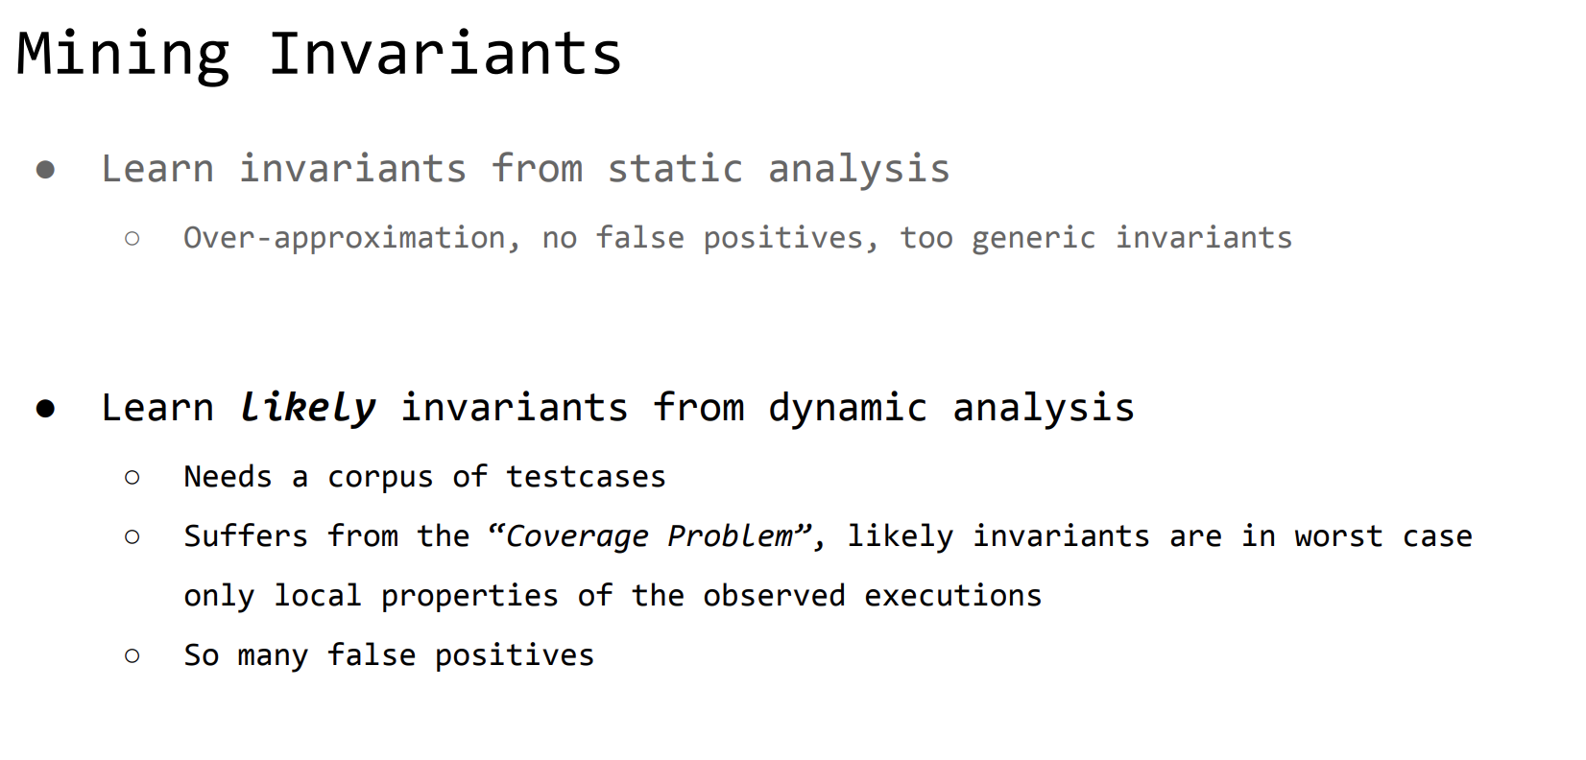
Background

Slide 8
Preliminaries
Insight

Slide 9
Insight
Idea: Likely Invariants as Feedback
In Fuzzing, we are interested in storing testcases that
trigger new program states. Violations of likely invariants
can distinguish “unusual” states of the variables.

Slide 10
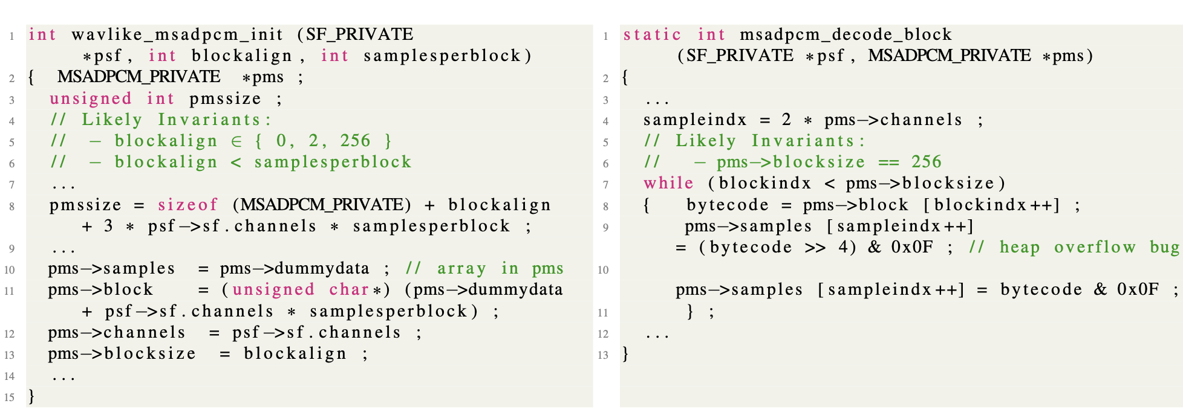
A Motivating Example
Crash only when there is a small allocation size for the pms buffer (line 8 in Listing 1) and a pms->blocksize value (line 13 in Listing 1)

Slide 11
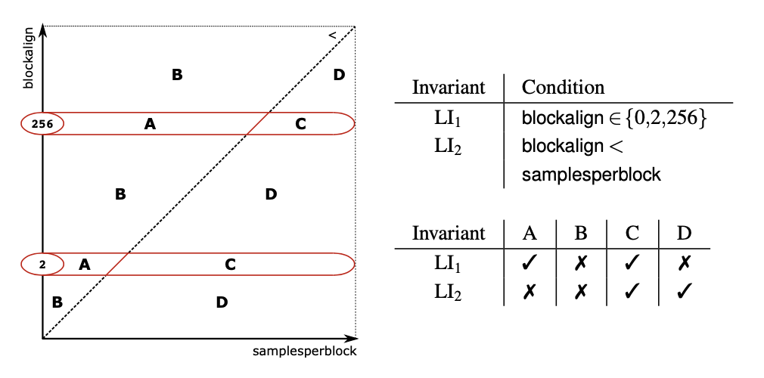
A Motivating Example
The bug can be exercised only when in partition B (LI1, LI2 both violated).

Slide 12
Preliminaries
Implementation

Slide 13
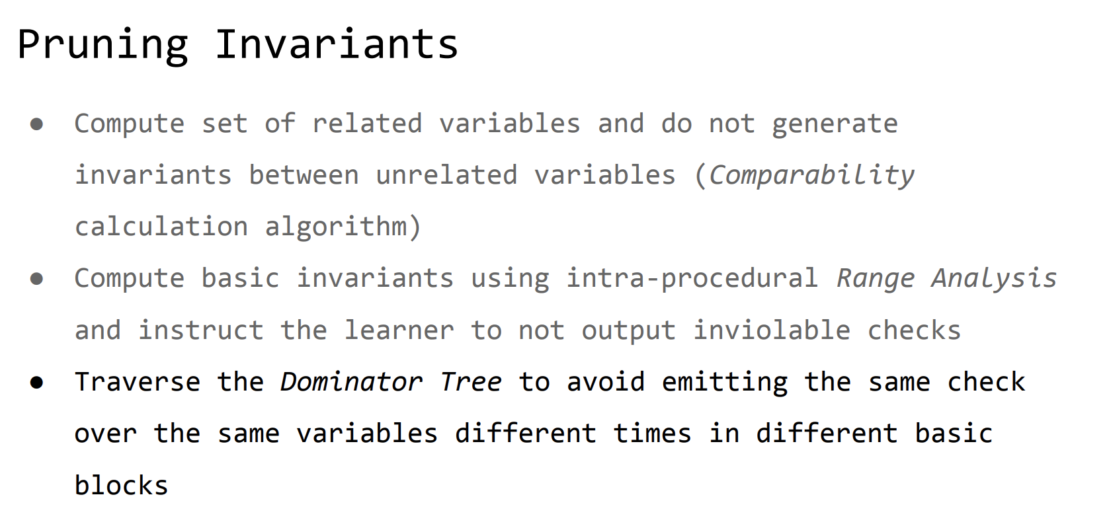
Implementaion

Slide 14
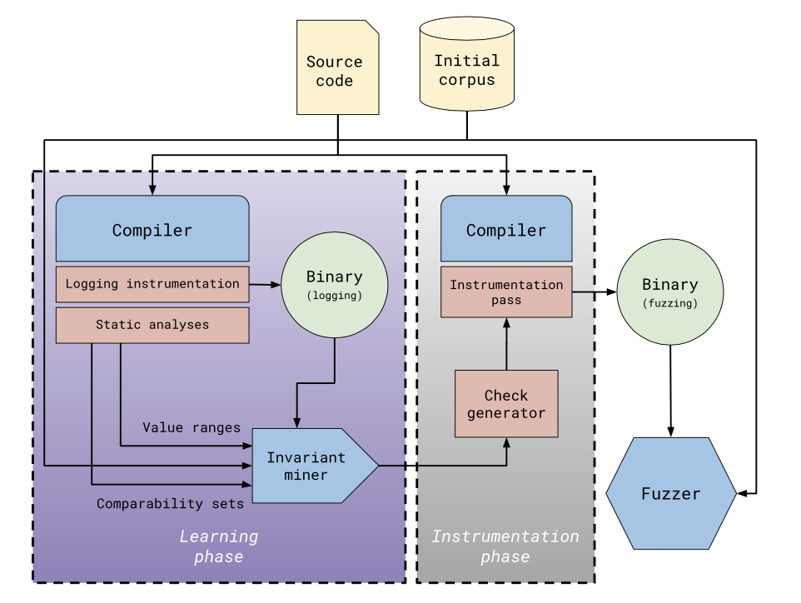
Implementaion
Learning phrase
1.using static analysis to get comparability and bound information of variables.
2.Learing likely invariants by Daikon, considering above information.
Instrumentation phrase
1.generating checkpoints and de-duplicating.
2.Instrumenting target program .
Fuzzing phrase

Slide 15
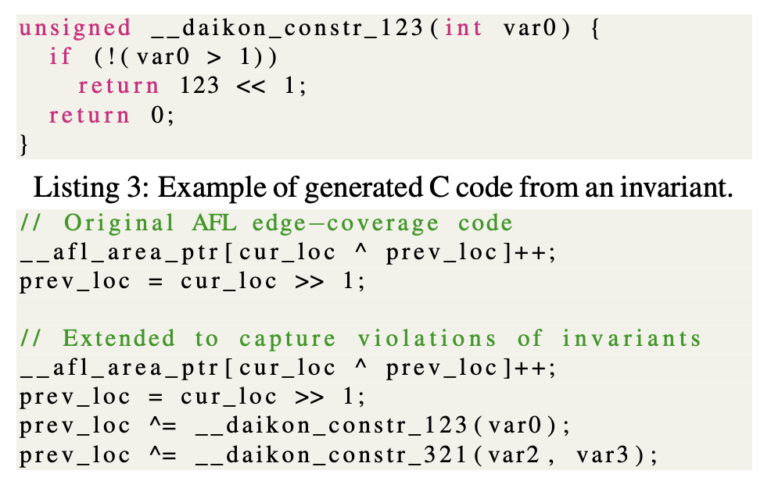
Implementaion
For every checkpoint(violation of invariants)
we generatre a unique index.

Slide 16
Preliminaries
Evaluation

Slide 17
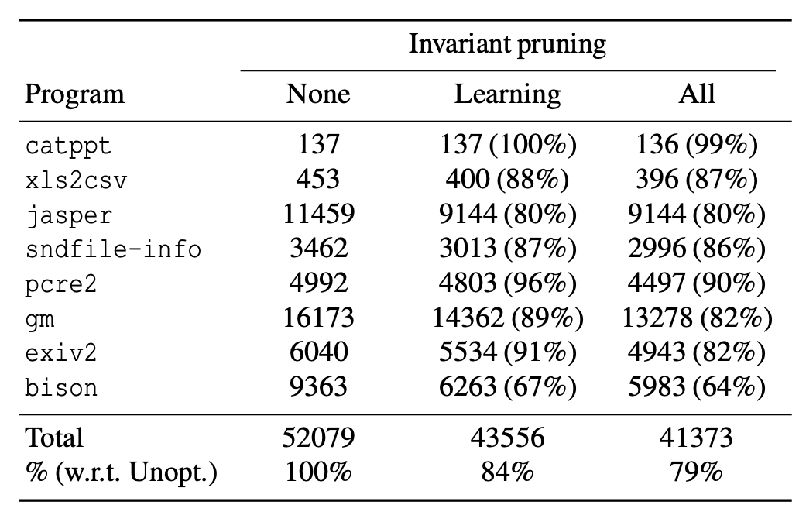
Evaluation
Invariant Pruning
the total number of invariants decreased by 21%.
resulting in a 10% net increase in the performance of the fuzzer.
Number of generated checks without any optimization, with optimizations for learning phase only,
and with optimizations for learning & instrumentation phases.

Slide 18
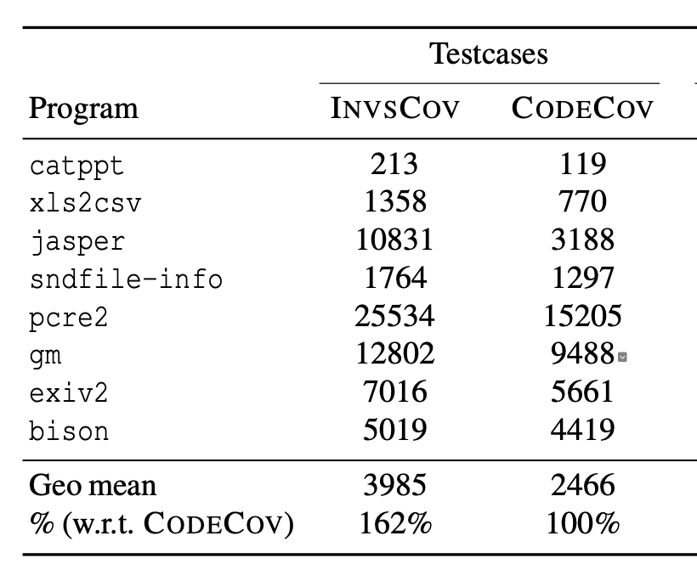
Evaluation
State Explosion
The growth due to the use of invariants is moderate, and only accounts for a 62% increase across all programs.
Median number of testcases stored in the
fuzzers’ queuesover 5 trials of 48h.

Slide 19
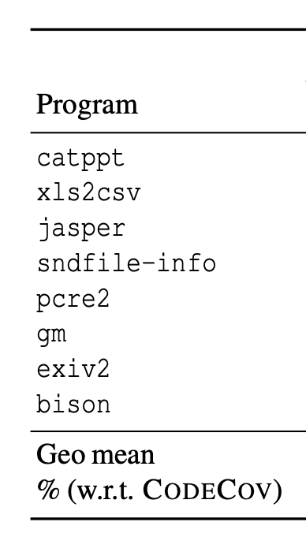
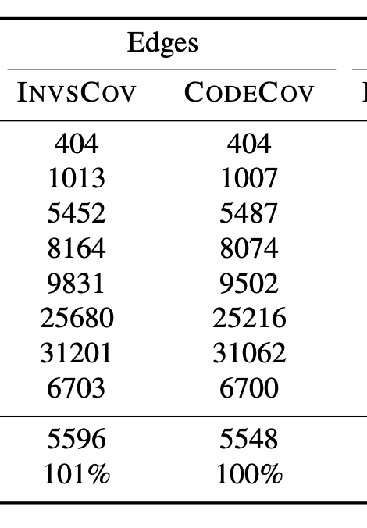
Evaluation
Program State Exploration
1% growth on total edge coverage
Median number of testcases stored in the
fuzzers’ queuesover 5 trials of 48h.

Slide 20
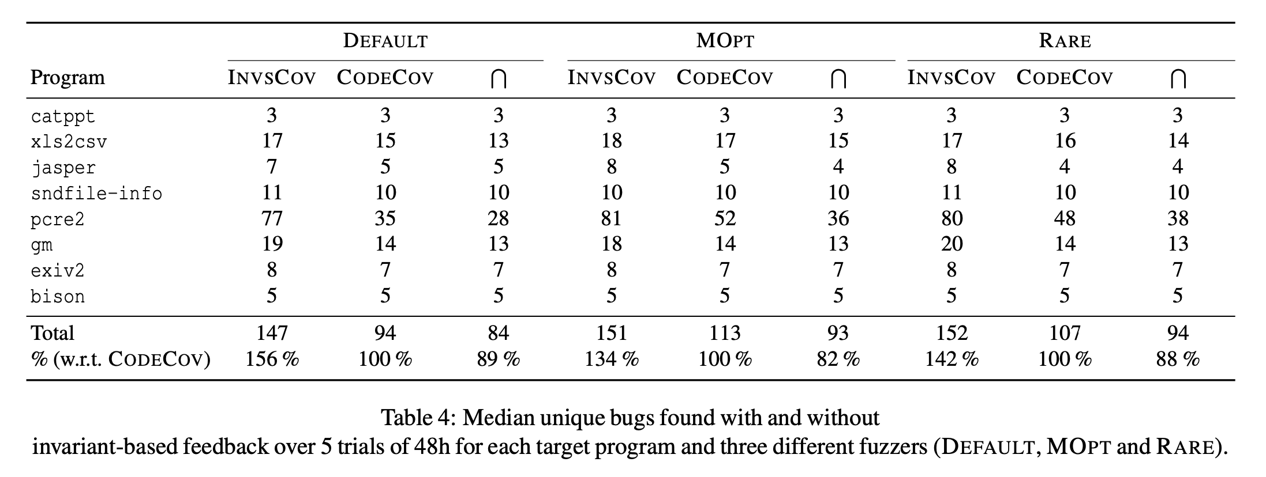
Evaluation
Bug Detection

Slide 21
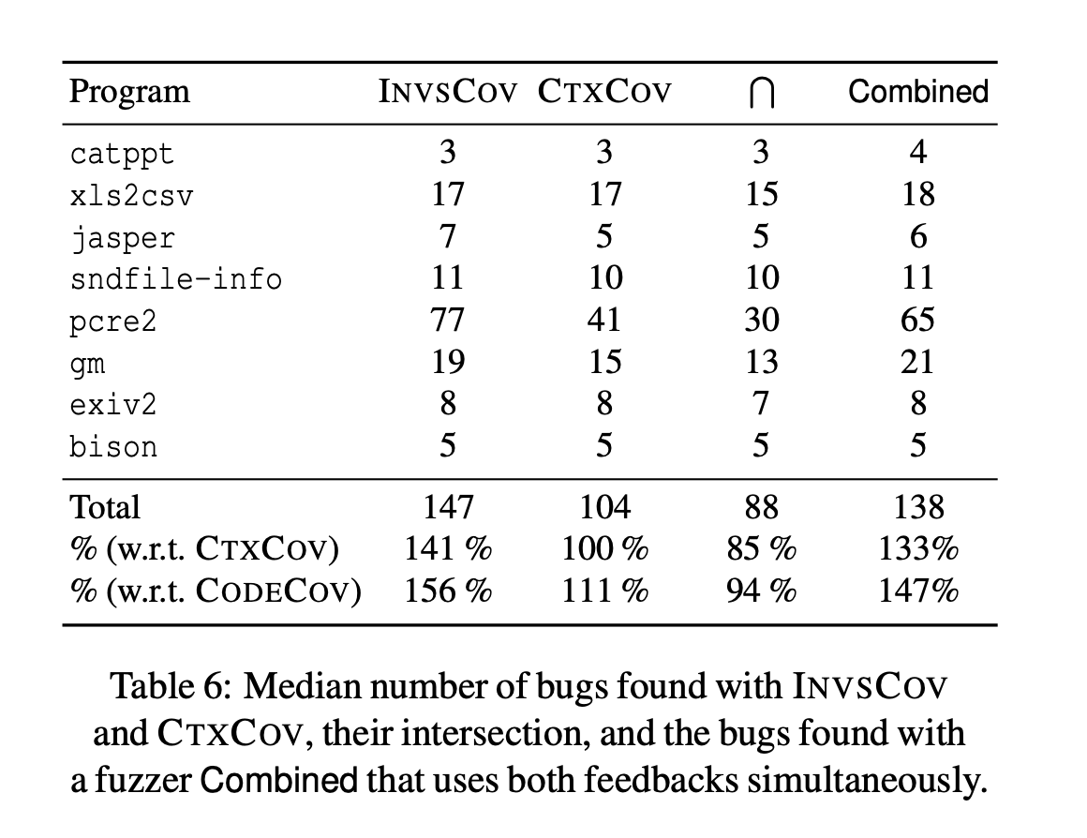
Evaluation
Bug Detection

