Slide 1
Robotics 101: Workshop
Part III: Buzzers
KCL Robotics Society

Slide 2
Before We Start
Have you signed up for KCL Robotics Membership via KCLSU? It’s FREE! https://tinyurl.com/y6pa9qyo
Have you done attendance? Talk to one of our team members!
Check if your computer has Arduino IDE installed. If not, download from here.
Have you downloaded this presentation? Get it from the discord server!

Slide 3
Today’s Goals
Base Tasks:
Turn on buzzer with code.
Programming different sounds using different voltages.
Challenge Task:
● Make a song with it or make buttons play different notes like a piano/keyboard.

Slide 4
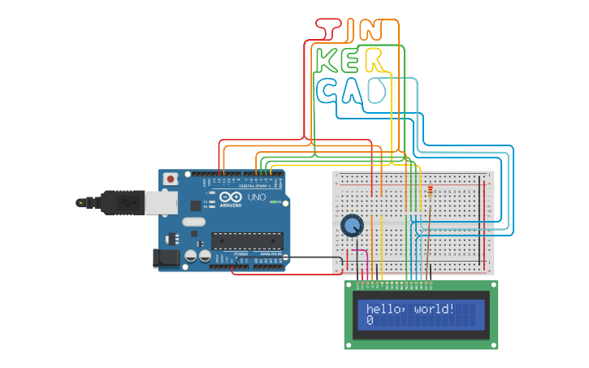
What is Tinkercad?
Tinkercad is an online software that can be used to simulate electronic circuits.

Slide 5
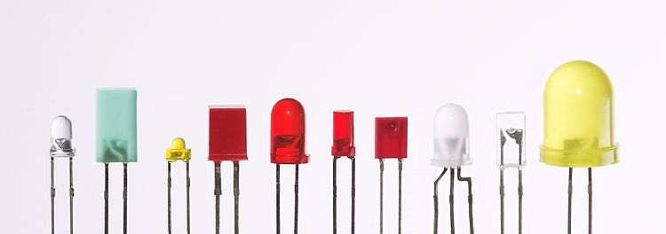
What is a LED?
LED stands for Light Emitting Diode.
It is a component that emits light when a sufficient voltage is applied across it.

Slide 6
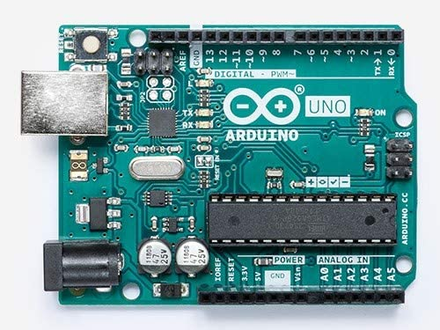
What is an Arduino?
An Arduino is a microcontroller that can be used to control electronic components.
It does this by using the pins to either output voltage or detect inputted voltage.

Slide 7
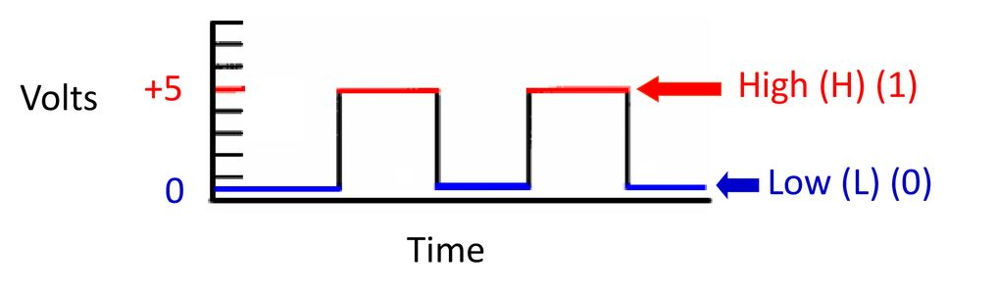
Voltage and Binary
In binary, there are two digits, 0 and 1. 0 represents off and 1 represents on.
We can map this to two different voltages, 0V and 5V. Therefore a binary value of 0 would be considered 0V, and a binary value of 1 would be 5V.
When programming the arduino, they refer to 5V as HIGH and 0V as LOW instead of binary values.

Slide 8
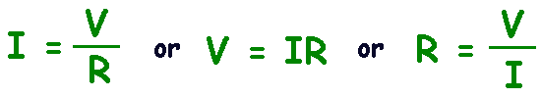
Ohm’s Law
Ohm’s Law states that voltage is equal to current times resistance.
This means we can limit the amount of current in a circuit by using resistance
This is great because we can avoid killing components!

Slide 9
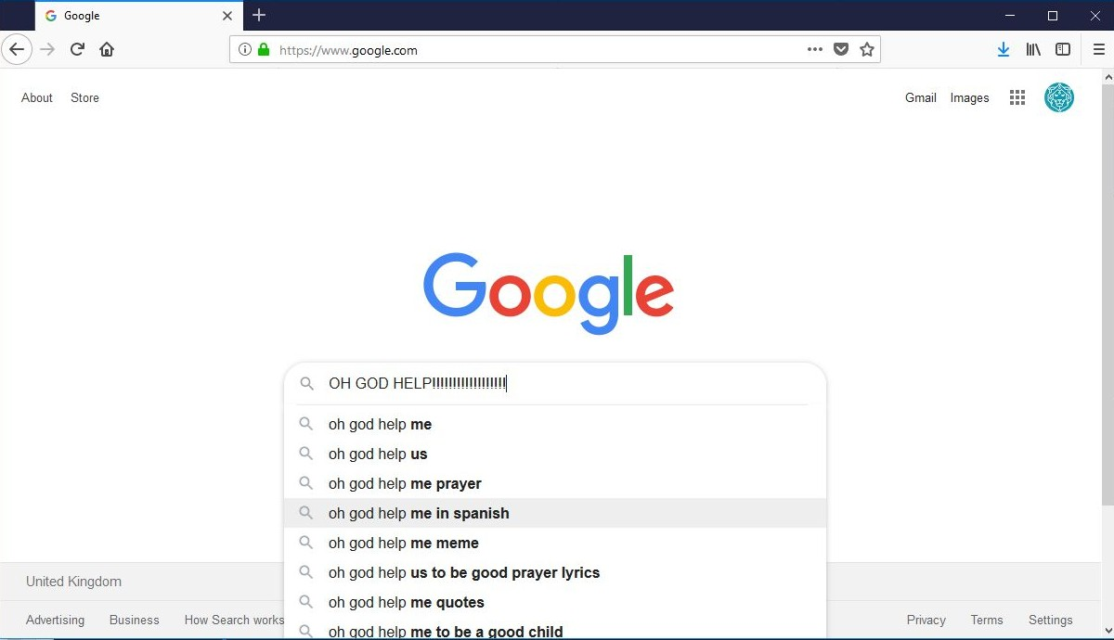
Confused? Just Google It!

Slide 10
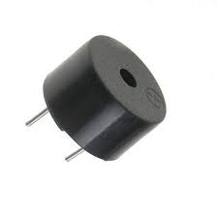
Buzzers
“An audio signaling device”

Slide 11
Three types of Buzzers
• Electromechanical.
• Mechanical.
• Piezoelectric.
In Tinkercad, this refers to a component called Piezo.

Slide 12
Applications of buzzers
• Alarm devices.
• Judging panels.
• Annunciator panels.
• Microwave ovens and other household appliances.
• Sporting events such as basketball games.

Slide 13
Let’s Get Our Hands Dirty!
Resources to help yourself ﬁnish today’s tasks:
Arduino coding basics: https://tinyurl.com/y5u8wreh
Circuits and breadboard basics: https://tinyurl.com/y5u8wreh
Anything else: Google!

Slide 14
Base task (1): Turn on buzzer with code.
Use Arduino Breadboard.
Don’t forget to include a resistor in your circuit.
Choose a digital pin for the buzzer.
Connect the buzzer to your circuit in the right pin.
Make sure to add a delay in your code and connect the Breadboard to the ground (GND).

Slide 15
Two main functions
Arduino programs have two basic functions that are automatically created for you.
//runs only once, at the very beginning of the program
void setup( ) { }
//runs in a loop continuously every 30ms
void loop() { }

Slide 16
Actual Implementation
void setup()
{
pinMode(7, OUTPUT);
}
void loop()
{
tone(7, 200, 100);
delay(1000);
}
tone(pin number, pitch, sound length)

Slide 17
Base task (2): Programming different sounds using different voltages.
You can use the previous circuit and modify the resistance value.
Or change the second parameter value within the tone() method.

Slide 18
Challenge task: Make a song or make buttons play different notes like a piano/keyboard.
You can make whatever you wish here.
An example here will be making an Arduino Piano, here are some tips:
Firstly use the largest Breadboard.
As piano has seven notes you need seven buttons (or eight if you want to step into the first note of the next cycle).
In your code, make sure to initialise the buttons/buzzer pin values and declare those pins as INPUT and OUTPUT before doing the actual implementations.
Add a delay for the sake of sound quality.

Slide 19
Thanks for listening!!!
Any Questions?

