Slide 2


Slide 3


Slide 5
IX = VI

Slide 6
SIX = VI

Slide 7


Slide 9
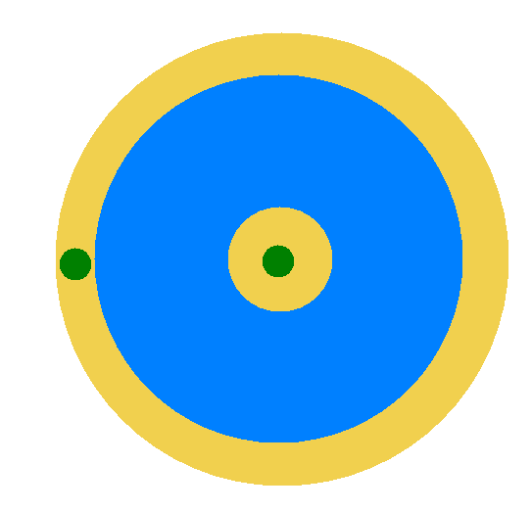

Slide 10


Slide 12
1 + 2 + 3 + … + 99 + 100 = ?
= (1 + 100) + (2 + 99) + … + (50 + 51)
= (100 / 2) * 101
= 5050

Slide 13
100 ק"מ
200 קמ"ש
50 קמ"ש

Slide 14
. . .
N

Slide 15
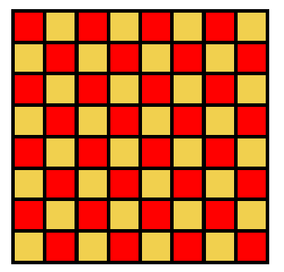

Slide 16
