Slide 1
מגניב

Slide 2
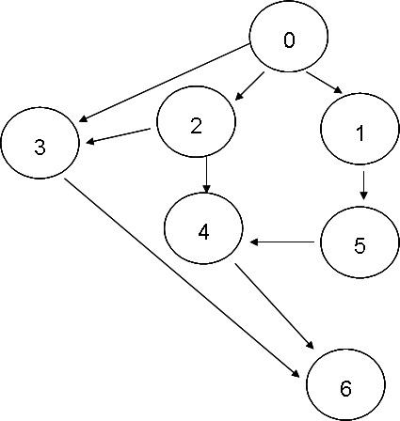

const int FIRST_NODE = -2;
const int EMPTY_NODE = -1;
int[] nodFather = new int[grInputGraph.NodesNum];
Queue quMyQueue = new Queue();
// Initialize the father nodes array with empty nodes
for (int nCounter = 0; nCounter < grInputGraph.NodesNum; ++nCounter)
{
nodFather[nCounter] = EMPTY_NODE;
}
nodFather[nodStart] = FIRST_NODE;
// Pushes the first node location to queue
quMyQueue.Enqueue(nodStart);
while (!quMyQueue.IsEmpty() && nodFather[nodFinish] == EMPTY_NODE)
{
// Pops the first visited node in queue
int nodPrevNode = (int)quMyQueue.Dequeue();
// Get all neighbours of visited nodes, and pushes to the queue
for (int nodCurrNode = 0;
(nodCurrNode < grInputGraph.NodesNum) ;
++nodCurrNode)
{
if (grInputGraph.Adjacent(nodPrevNode, nodCurrNode))
{
quMyQueue.Enqueue(nodCurrNode);
nodFather[nodCurrNode] = nodPrevNode;
}
}
}
// Checks if there is a way to the finish node
if (nodFather[(int)nodFinish] == EMPTY_NODE)
{
Console.WriteLine("Path from node " + nodStart + " to node " + nodFinish +
" not found.");
}
else
{
// Prints the shortest path found
Console.WriteLine("Shortest Path:");
Console.WriteLine(nodFinish);
int nodTemp = nodFinish;
while (nodFather[nodTemp] != FIRST_NODE)
{
Console.WriteLine(nodFather[nodTemp]);
nodTemp = nodFather[nodTemp];
}
}
BFS

Slide 3
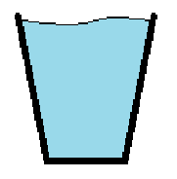

דליים
דוגמה 1
???
7L
5L
6L

Slide 4
5L
3L
3/2
0/5
3/0
0/3
0/0
3/5

Slide 5
אפשרויות בכל צומת:
מלא את הדלי
5L
3L
רוקן את הדלי
העבר לדלי השני

Slide 6
0/0
0/3
0/5
3/0
3/2
3/5
3/3
…
1/5
1/0
0/4
3/1
0/1

Slide 7
Flood
Fill
דוגמה 2

Slide 8
דוגמה 3
ניווט

Slide 9
define cool():
???

Slide 10
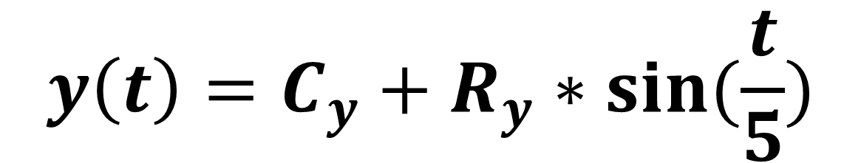
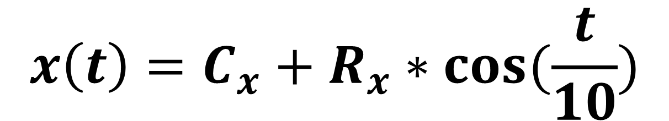
$$x\left(t\right)=C_{x}+R_{x}∗\cos{(\frac{t}{10})}$$
$$y\left(t\right)=C_{y}+R_{y}∗\sin{(\frac{t}{5})}$$

Slide 11
בהצלחה!

