Slide 1
¬16:9 style guide Title Page Title - Gill Sans regular 90pt #575756 Speakers name in footer – Gill Sans regular 34pt uppercase #E9E9E9 Divider Page Small speakers name at top – Gill Sans regular 23pt uppercase #868686 Main title - Gill Sans regular 90pt #575756 Single bullet point page Bullet – Gill Sans regular 57pt #575756 image and content page 3 / 2 column grid title – Gill Sans regular 72pt #575756 body copy – Gill Sans regular 36pt #706F6F green caption slide All other copy styled the same as 'image and content page 3 / 2 column grid' green text in caption – Gill Sans regular 30pt #706F6F Profile Page Title - Gill Sans regular 72pt #575756 Job title – Gill Sans regular 27pt #575756 company title – Gill Sans italic 27pt #575756 email address and twitter – Gill Sans regular 21pt as before> body copy – Gill Sans regular 36pt #706F6F Thank you Title - Gill Sans regular 90pt #575756 Speakers name in footer – Gill Sans regular 34pt uppercase #E9E9E9
15 Free CRO Tools
ROB MILLARD

Slide 2











Slide 3
Getting budget can stop you from starting

Slide 4
Web Analytics
Feedback
Usability
Wire
framing
Test
Review, Iterate
ROB MILLARD

Slide 5
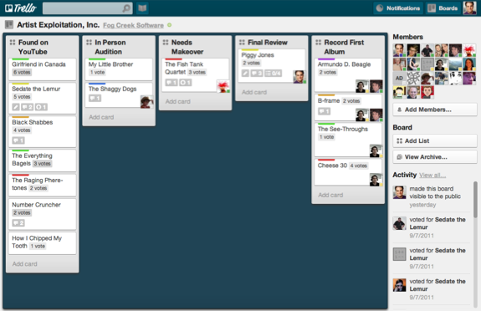
Project Management - Trello
trello.com

Slide 6
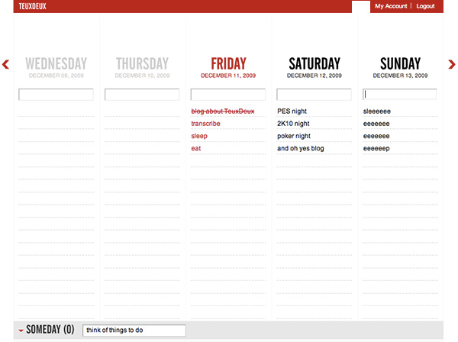
Project Management - Weekly
teuxdeux.com

Slide 7
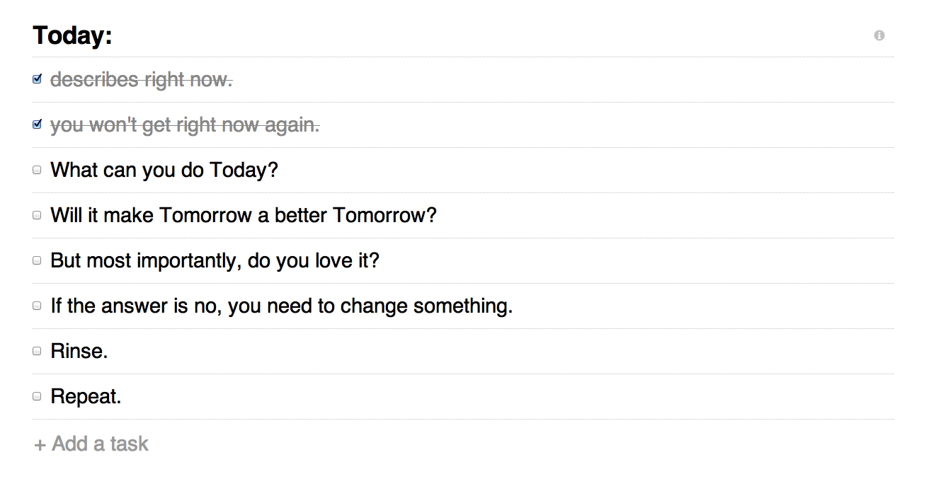
Project Management - Daily
todokyo.com

Slide 8

Web Analytics
www.google.com/analytics

Slide 9
Web Analytics – Google Analytics
GA
Goals
Ecommerce
Funnel Visualisation
Bounce Rates
Segmentation
New vs. Returning
Exit Rates
Navigation Summary

Slide 10
Web Analytics – Google Analytics
Custom Variables
Logged in?
Topics
Stock levels
Already purchased?
(session)
(visitor)
(page)
(page)

Slide 11
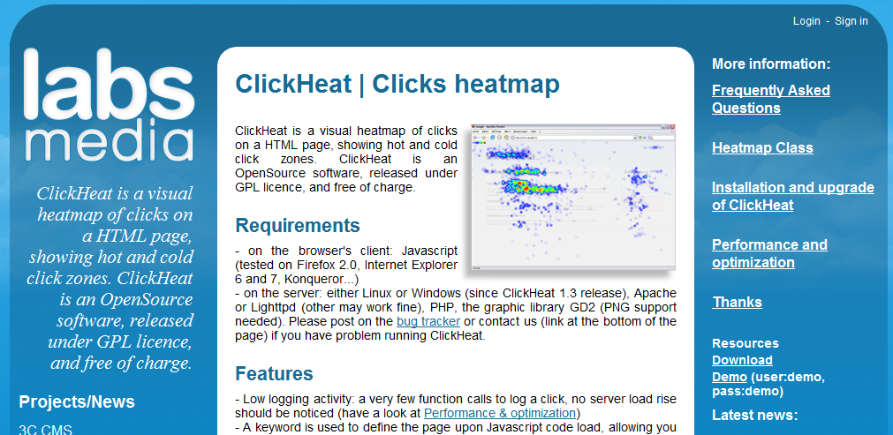
Web Analytics - ClickHeat
www.labsmedia.com/clickheat

Slide 12
Web Analytics
Feedback
Usability
Wire
framing
Test
Review, Iterate
ROB MILLARD

Slide 13
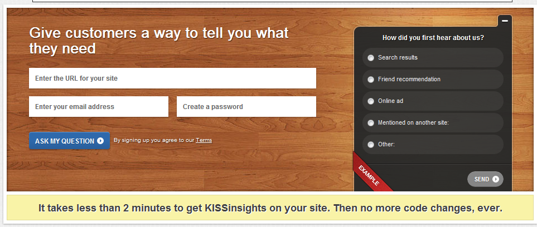
Feedback - KISSInsights
www.kissinsights.com

Slide 14
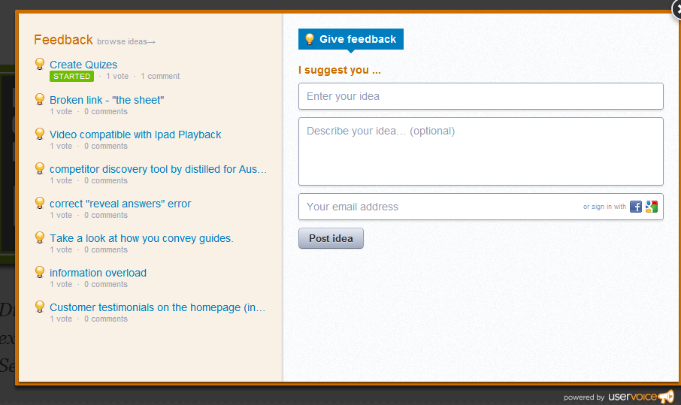
Feedback - Uservoice
www.uservoice.com

Slide 15
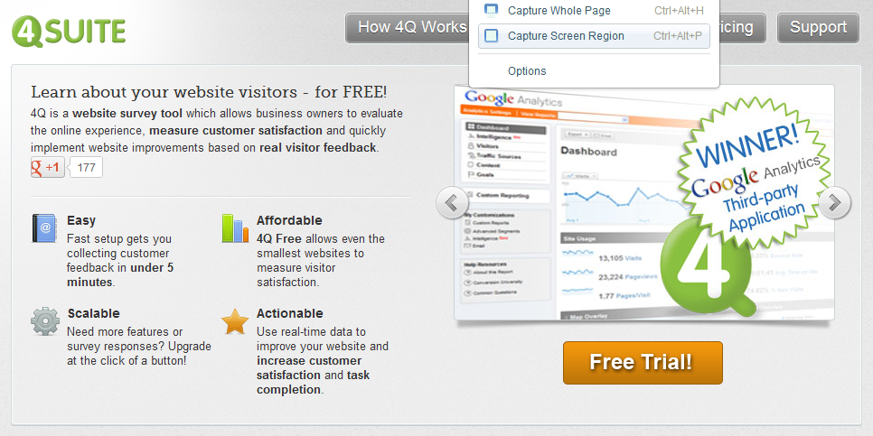
Feedback – 4Q Survey
www.4qsurvey.com

Slide 16
Feedback – Your Own Survey
Use Google Docs Forms to replicate
1. Based on today’s visit, how would you rate your site experience overall? 2. Which of the following best describes the primary purpose of your visit? 3. Were you able to complete the purpose of your visit today? 4a. (If yes) What do you value most about the [sitename] website? 4b. (If no) Please tell us why you were not able to fully complete the purpose of your visit today?
http://docs.google.com

Slide 17
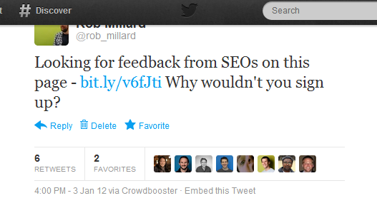
Feedback - Twitter
twitter.com

Slide 18
Feedback - Twitter
Use a hashtag to make curation easier…
http://www.distilled.net/blog/distilled/guide-to-google-docs-importxml/
https://seogadget.co.uk/playing-around-with-importxml-in-google-spreadsheets/
http://www.brelson.com/2009/11/using-google-spreadsheets-to-extract-twitter-data/

Slide 19
Web Analytics
Feedback
Usability
Wire
framing
Test
Review, Iterate
ROB MILLARD

Slide 20
Usability Testing
Recruit representative users (~5)
Give them representative tasks to perform
Encourage them to speak aloud
Capture and review

Slide 21


Usability Testing - Recruitment

Slide 22
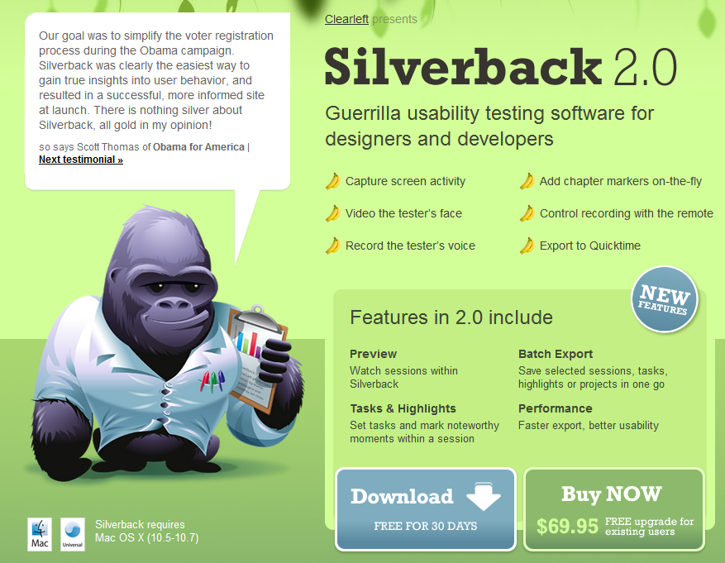
Usability Testing - Silverback
silverbackapp.com

Slide 23
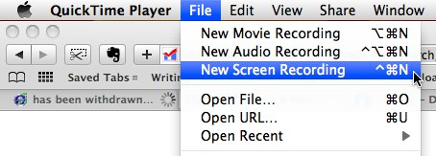
Usability Testing - Quicktime

Slide 24
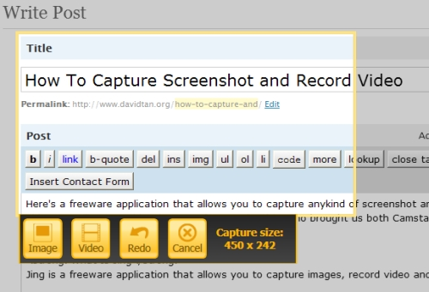
Usability Testing - Jing
www.techsmith.com/jing.html

Slide 25
Usability Testing - Scripts
http://www.howto.gov/sites/default/files/usability-test-script.pdf
http://24ways.org/2006/fast-and-simple-usability-testing
http://boagworld.com/usability/what-goes-into-a-user-testing-script/

Slide 26
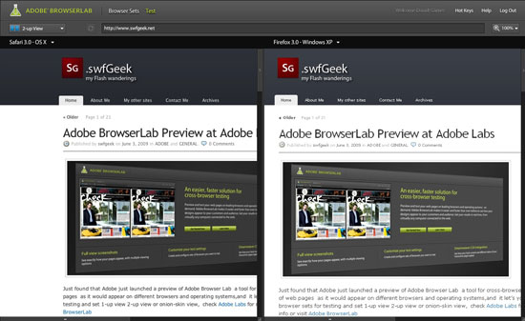
Usability (Accessibility?) - Browser
browserlab.adobe.com

Slide 27
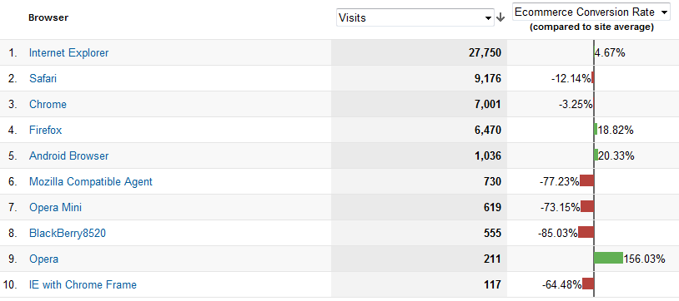
Usability (Accessiblity?) - Browser

Slide 28
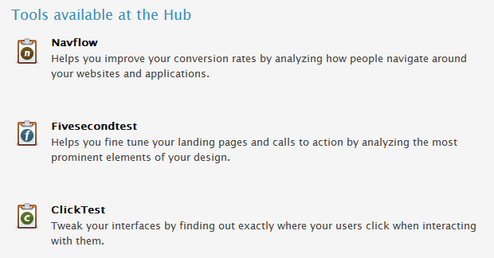
Usability - Usabilityhub
www.usabilityhub.com

Slide 29
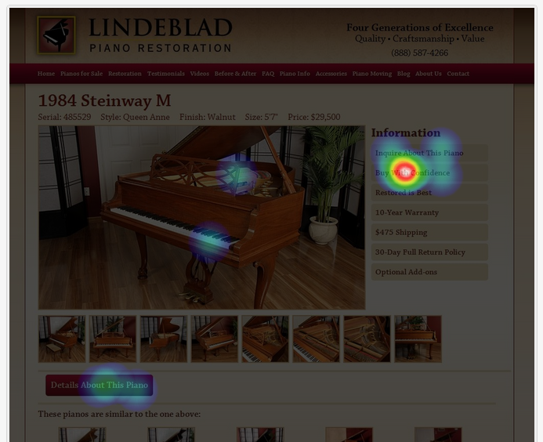
Usability - TheClickTest

Slide 30
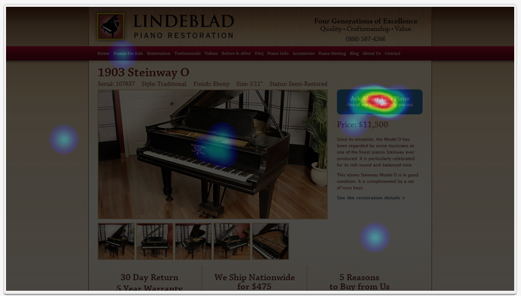
Usability - TheClickTest

Slide 31
Web Analytics
Feedback
Usability
Wire
framing
Test
Review, Iterate
ROB MILLARD

Slide 32
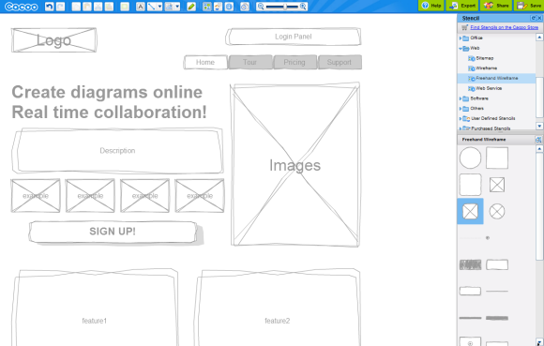
Wireframing - Cacoo
cacoo.com

Slide 33
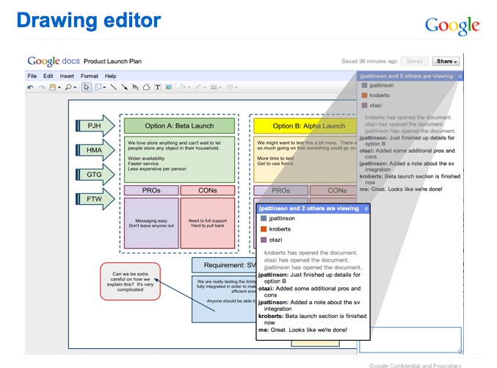
Wireframing – Google Docs Drawing
docs.google.com

Slide 34
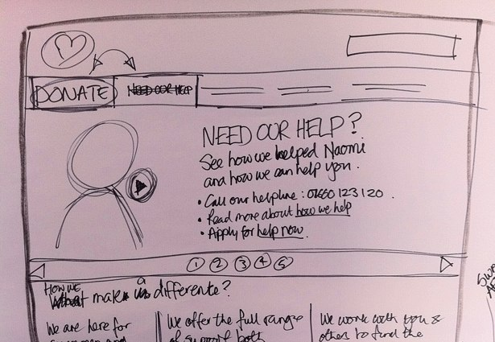

Wireframing – Pen, Paper, Camera

Slide 35
Web Analytics
Feedback
Usability
Wire
framing
Test
Review, Iterate
ROB MILLARD

Slide 36
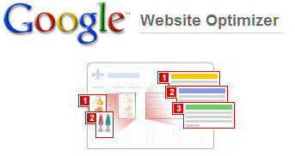
Testing - GWO
www.google.com/websiteoptimizer

Slide 37
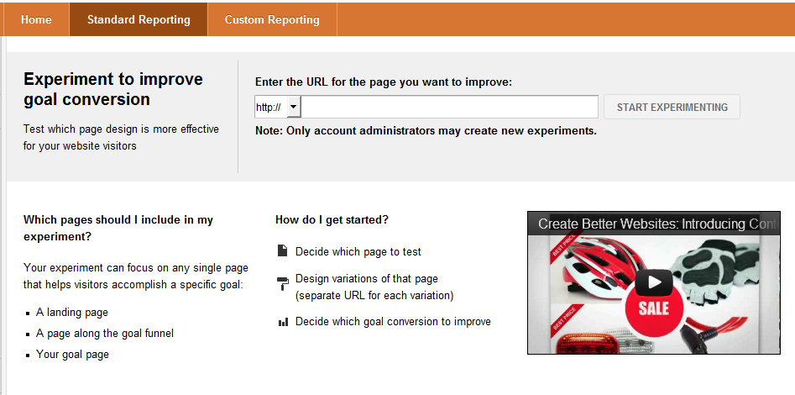
Testing – GA Experiments
http://marketingland.com/google-analytics-content-experiments-12170
https://support.google.com/analytics/bin/topic.py?hl=en&topic=1745146

Slide 38
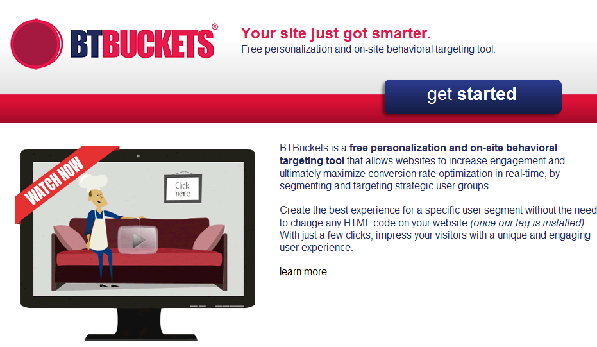
Testing – BT Buckets
btbuckets.com

Slide 39
BUT free tools aren’t a substitute for the real deal.

Slide 40
Thank You Any Questions
ROB MILLARD

