Slide 1
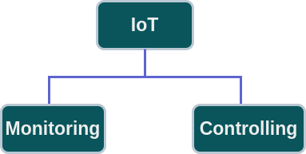
Internet of Things (IoT)

Slide 2
IoT
Monitoring
Controlling

Slide 3
Introduction to IoT
Definition of IoT: A network of interconnected devices exchanging data via the Internet.
Evolution: M2M (1990s) → Smart Sensors (2000s) → IoT Growth (2010s) → Present (AI & 5G).
Importance: Automation, Real-time Monitoring, Cost Reduction.
Applications: Healthcare, Smart Cities, Agriculture, Industrial IoT.

Slide 4
Understanding IoT Fundamentals
Components: Sensors, Connectivity, Cloud, User Interface.
Working: Sensors → Cloud → Data Analysis → Automated Response.
IoT vs Traditional Systems: Remote access, AI-driven insights.

Slide 5
IoT Architecture and Protocols
Architectures: 4-layer & 5-layer models.
Protocols: MQTT, CoAP, HTTP, AMQP, Zigbee, LoRa.
Communication: Device-to-Device, Cloud, Edge Computing.

Slide 6
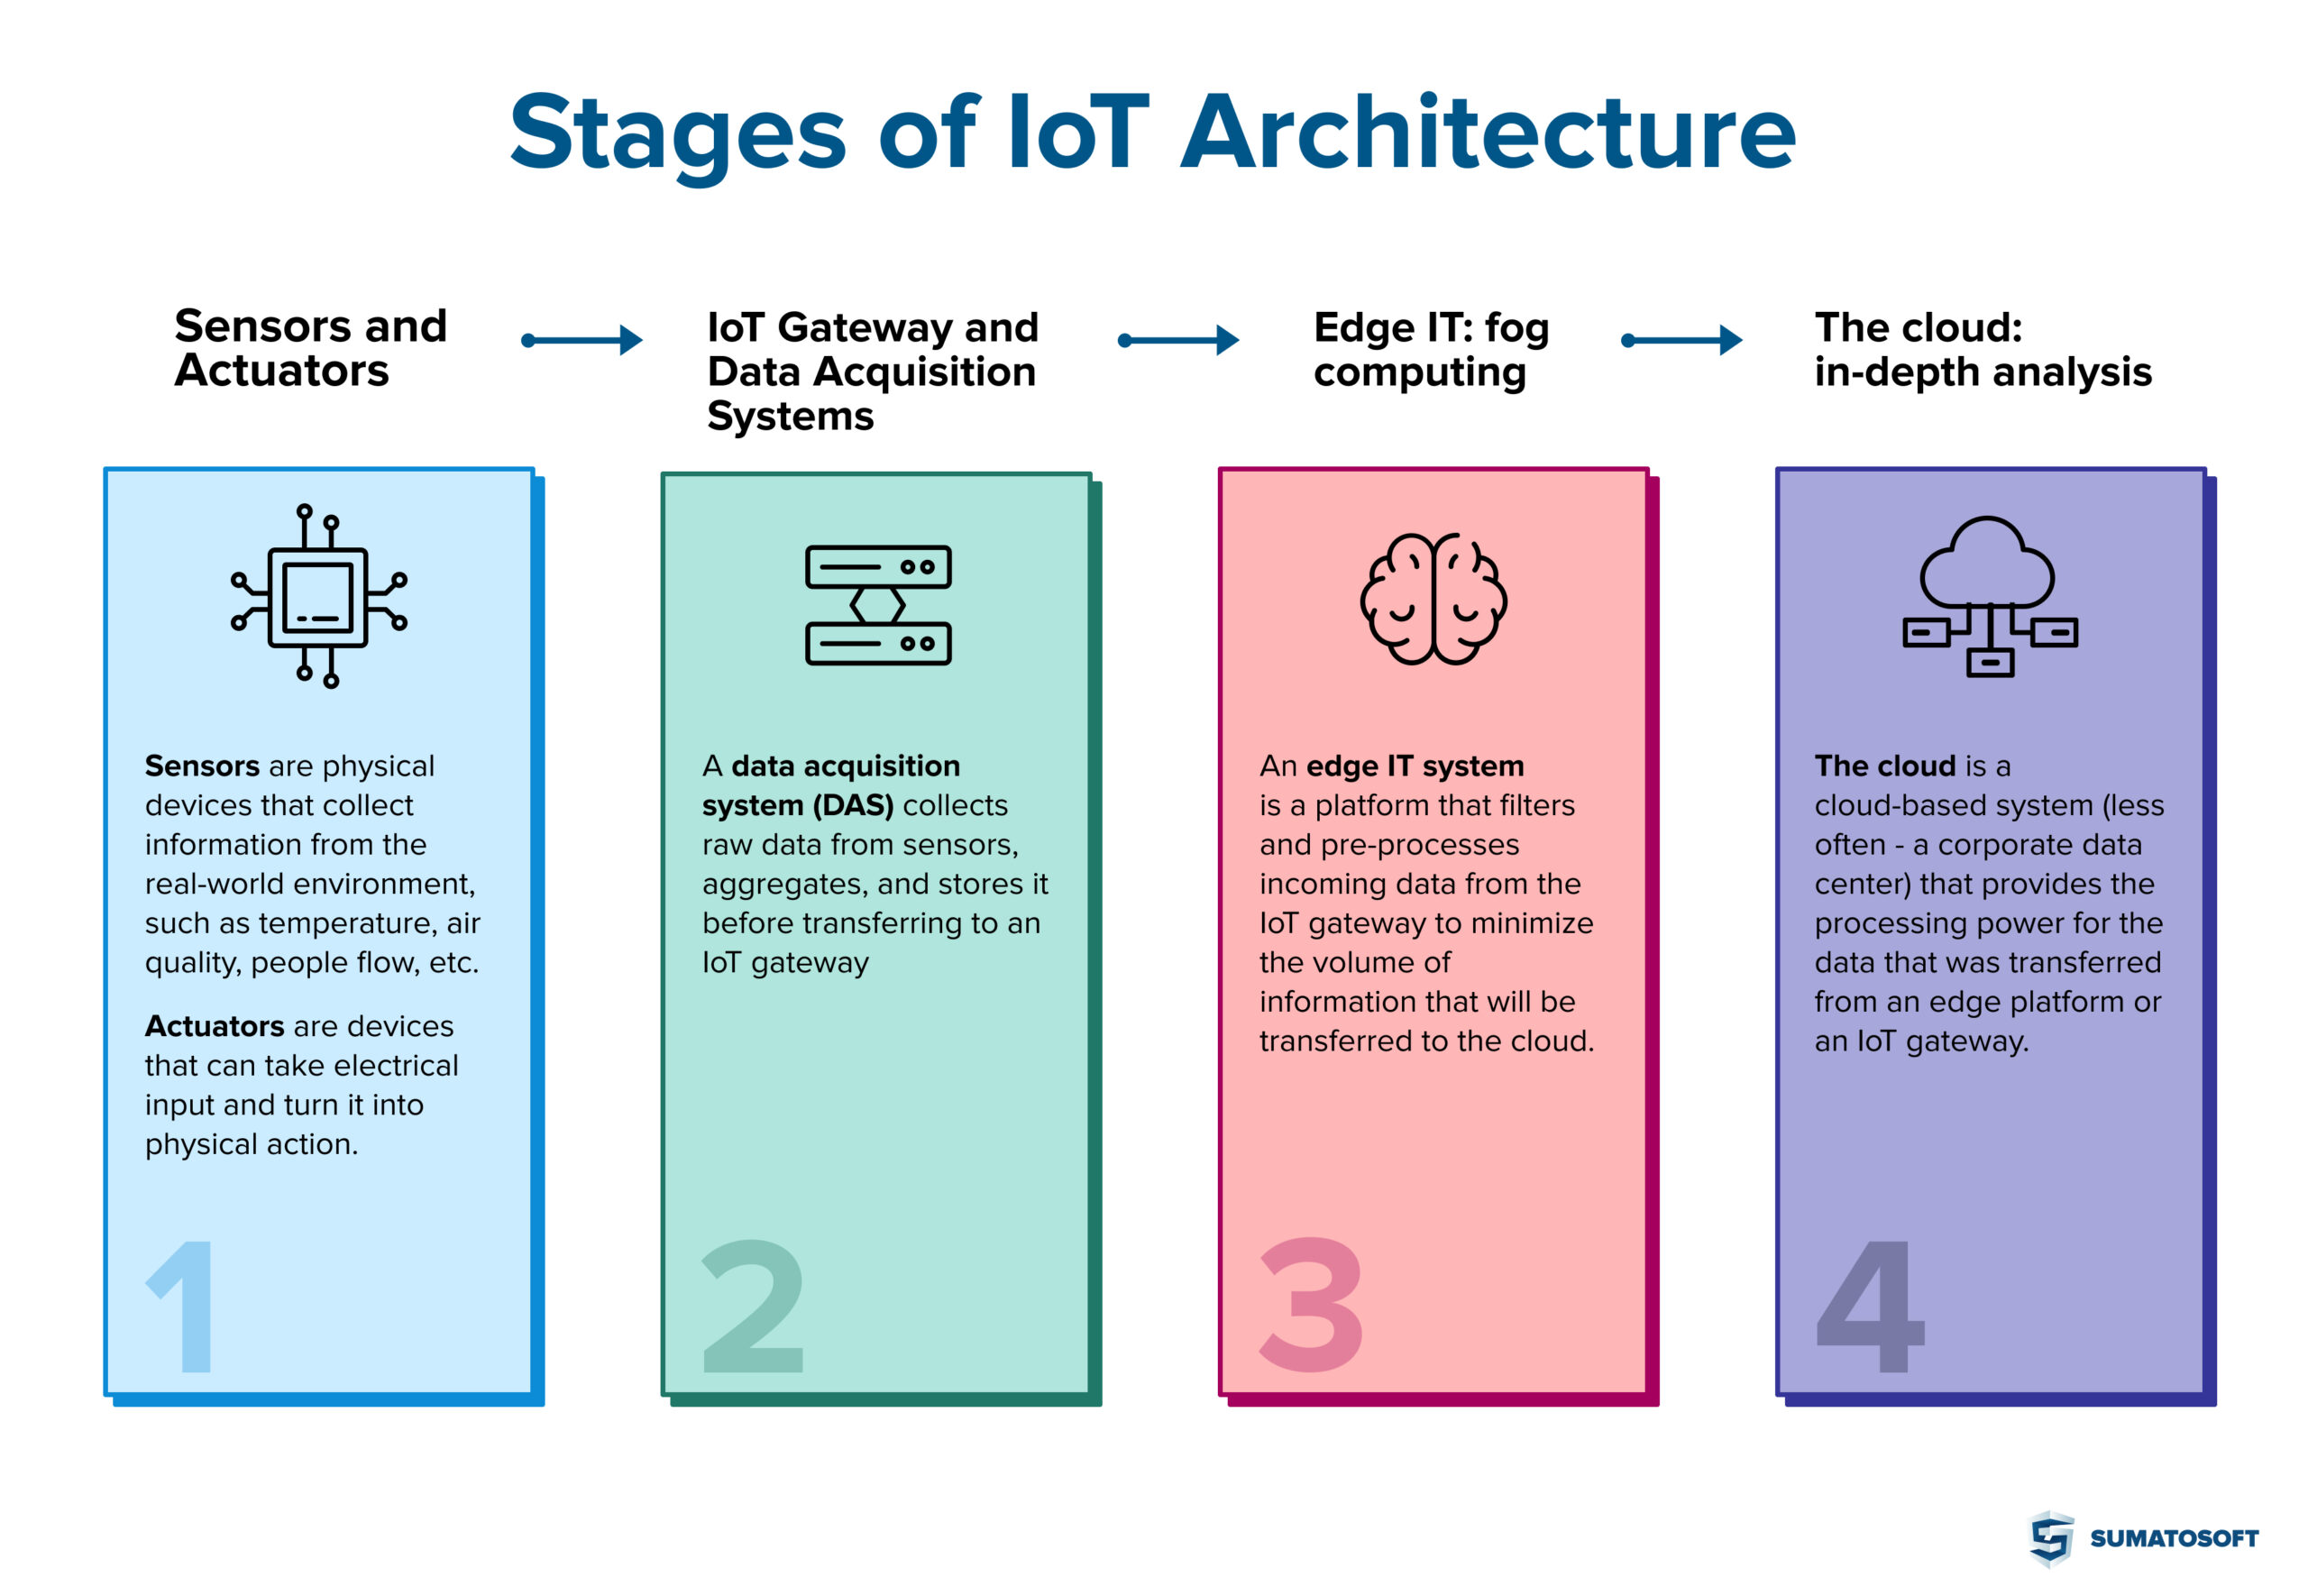
IoT Architecture

Slide 7
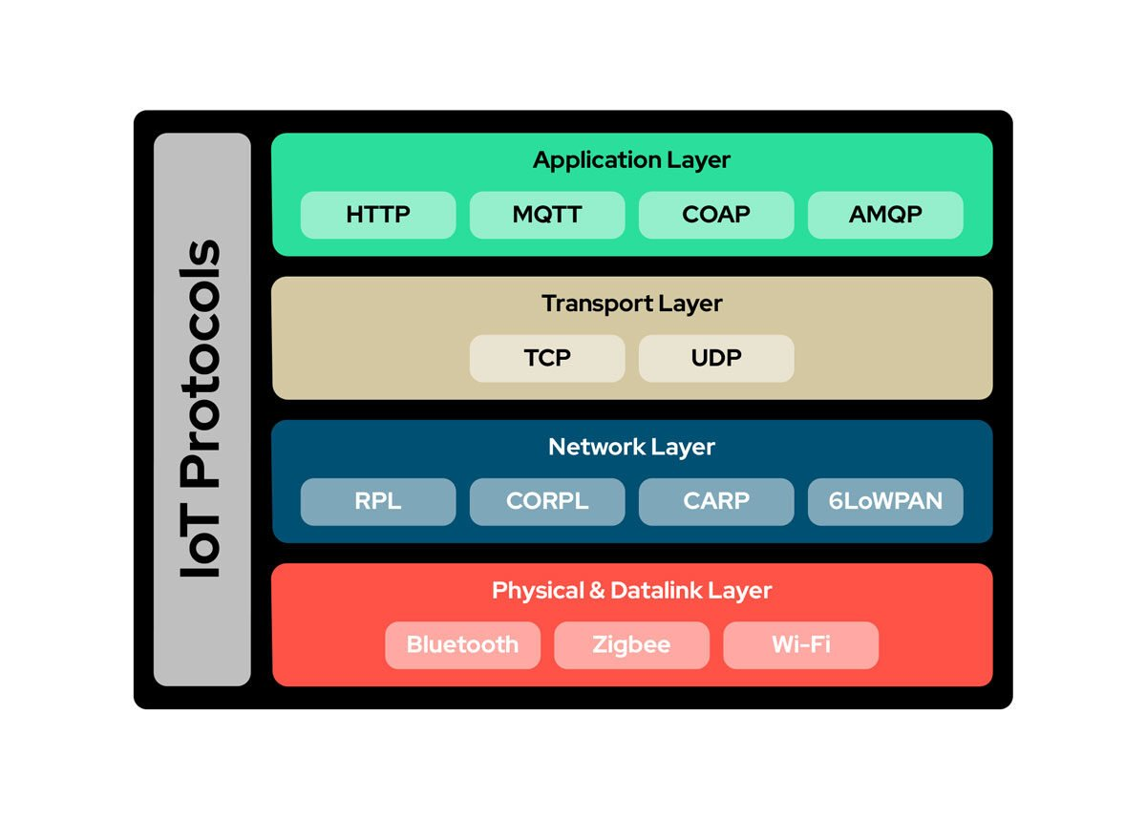
IoT Protocols

Slide 8
Various Platforms for IoT
Cloud Platforms: AWS IoT, Google Cloud IoT, Azure IoT.
Open-source: ThingsBoard, OpenHAB, Eclipse IoT.
Edge Platforms: NVIDIA Jetson, Raspberry Pi, EdgeX Foundry.

Slide 9
Characteristics of IoT
Connectivity, Data-driven Decision Making, Scalability.
Interoperability, Security & Privacy.

Slide 10
Current Market Trends in IoT
Industry 4.0, Smart Homes, AI-powered IoT.
Healthcare IoT, Market Growth Projections.

Slide 11
Real-Time Examples of IoT
Smart Cities: Traffic, Parking.
Smart Agriculture: Soil Monitoring, Irrigation.
Healthcare: Telemedicine, Wearables.
Industrial IoT: Smart Grids, Maintenance.

Slide 12
IoT Communication Technologies
Short-range: Bluetooth, Zigbee, Wi-Fi.
Long-range: LoRaWAN, NB-IoT, Sigfox.
Cellular Networks: 4G LTE, 5G, Satellite IoT.

Slide 13
Challenges in IoT
Security Risks, Data Privacy, Power Consumption.
Interoperability, High Costs, Infrastructure Challenges.
Solutions: Blockchain, AI Security, Improved Batteries.

Slide 14
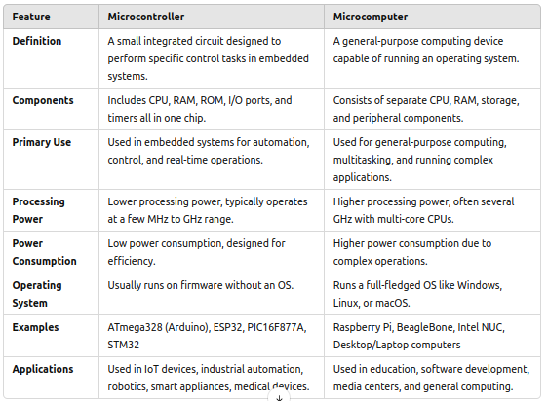

Slide 15
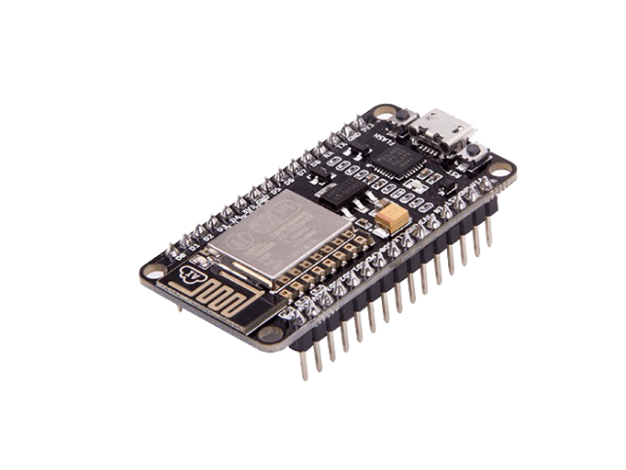
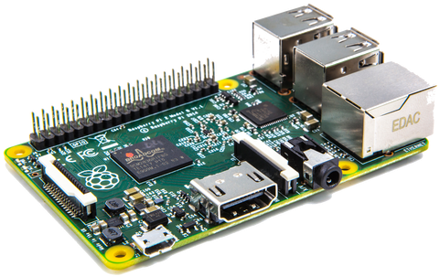
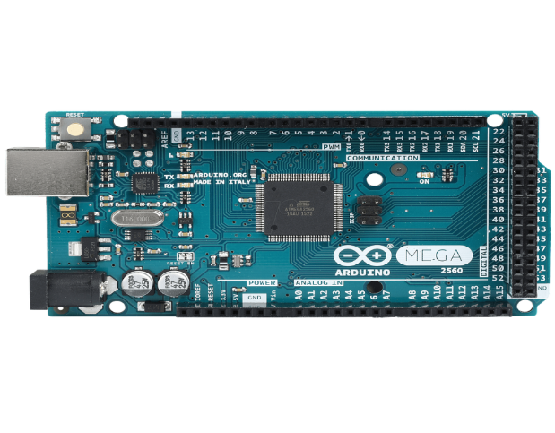
Example: Microcontroller & Microcomputer
ESP 32 (Microcontroller)
Arduino (Microcontroller)
Raspberry Pi (Microcomputer)

