Slide 1
WP#9
----------------------------------------------------
Anderson Paschoalon

Slide 2
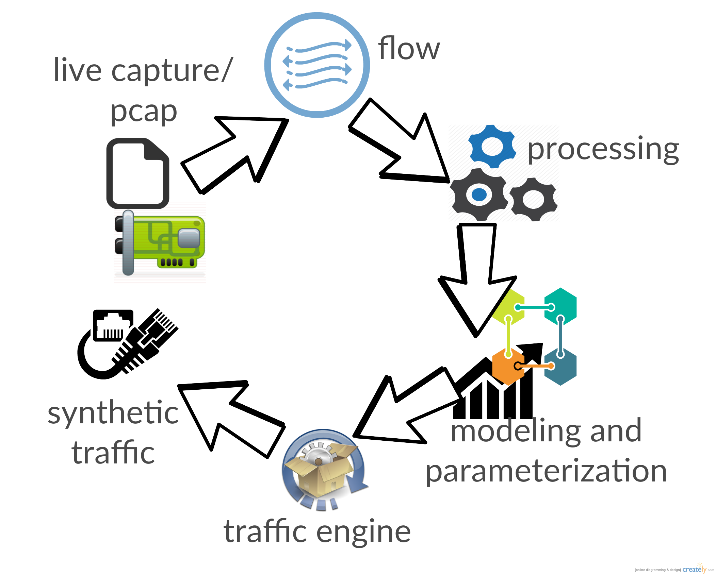
Qualification feedback
Modeling and parametrization
CORE

Slide 3
Goals clarification
We aim a framework for automatic configuration of TrafficGen tools.
We want to provide a compact and analytical description of huge PCAP traces. A lightweight PCAP descriptor, we call Compact Trace Descriptor.
It should automatize and decouple modeling from the traffic generator engine.
We want a framework able to provide a good* realism, at higher speeds compared to monolithic tools.
It should serve as an abstraction layer

Slide 4
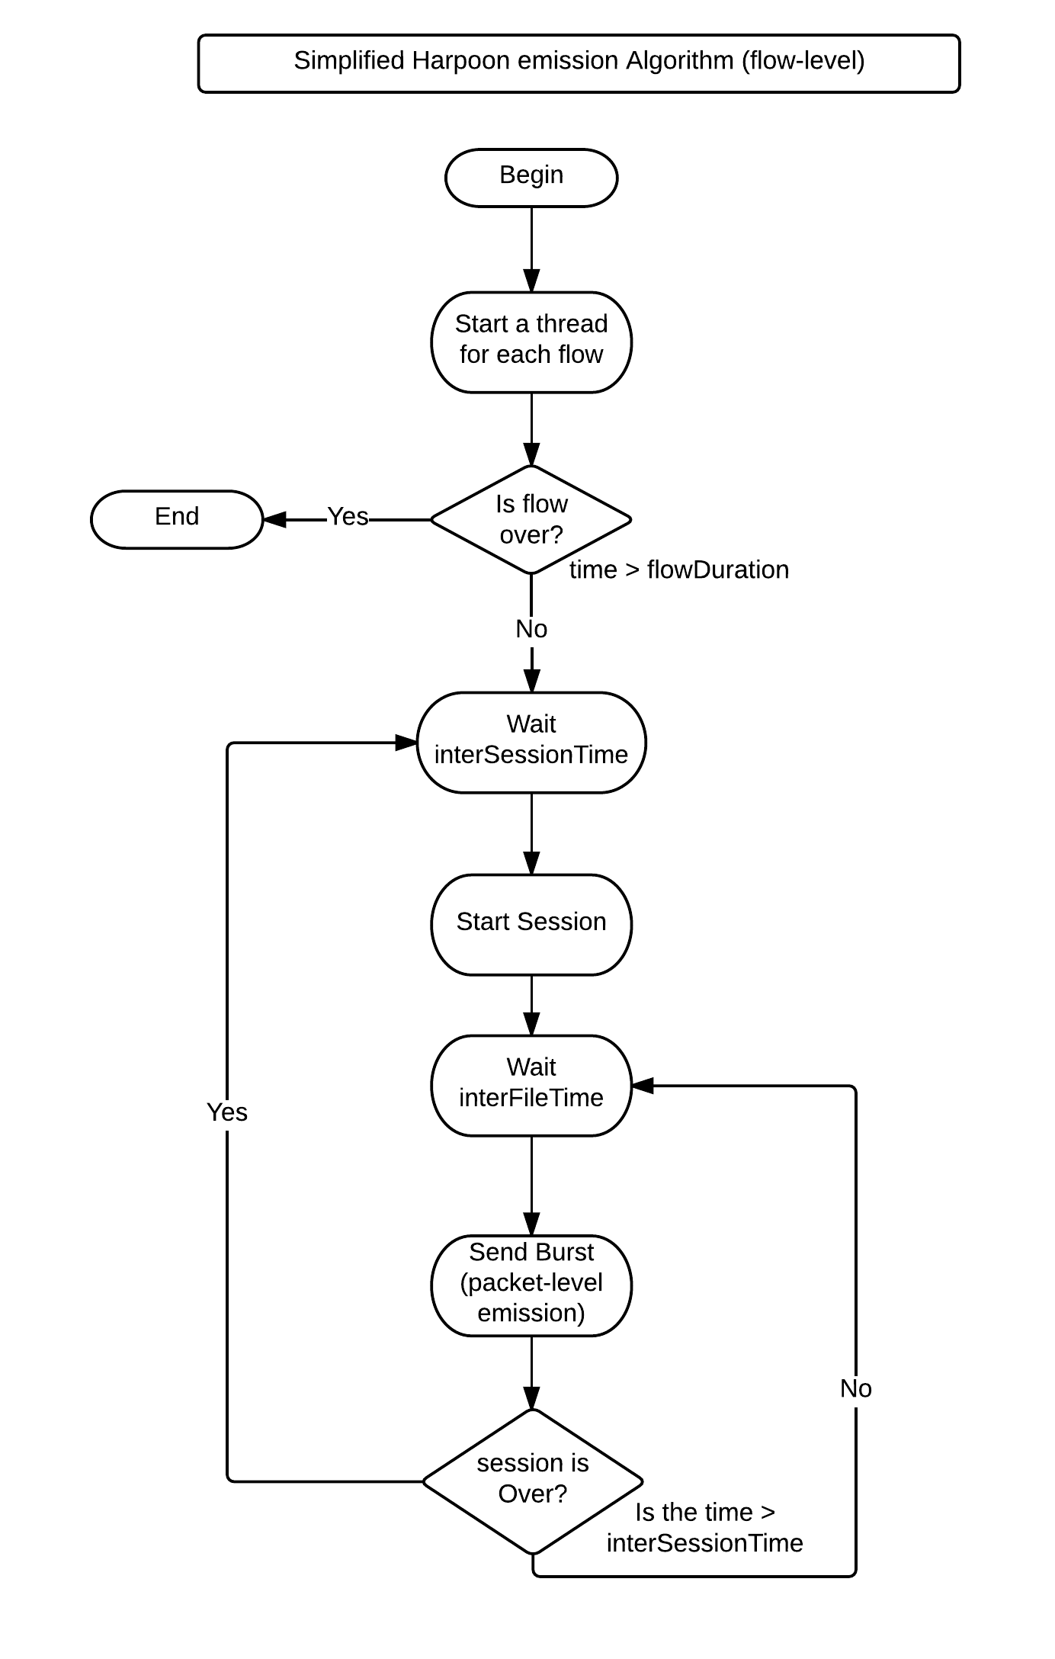
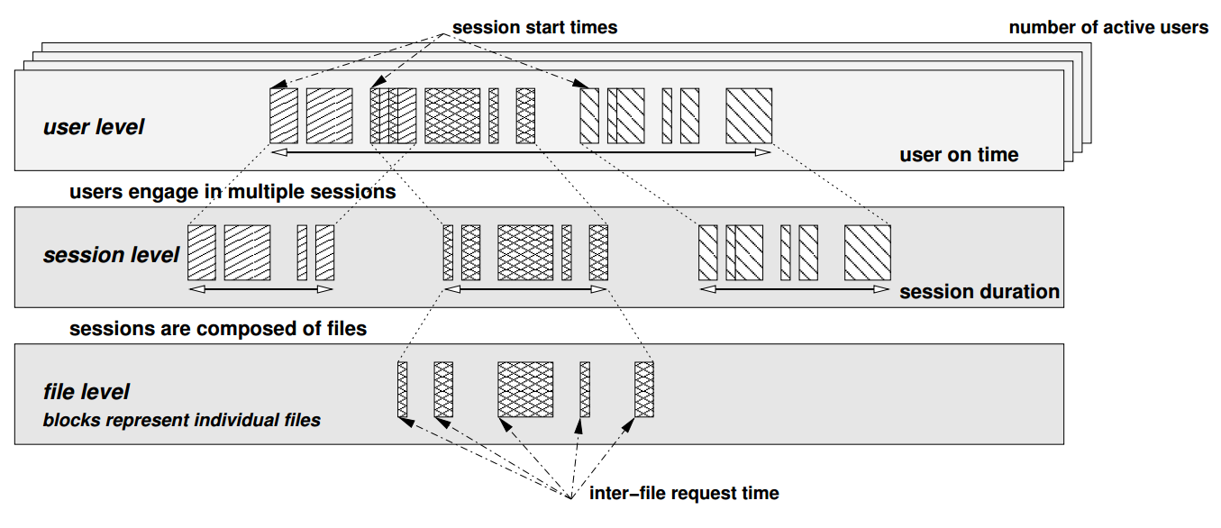
Flow-level: Harpoon

Slide 5
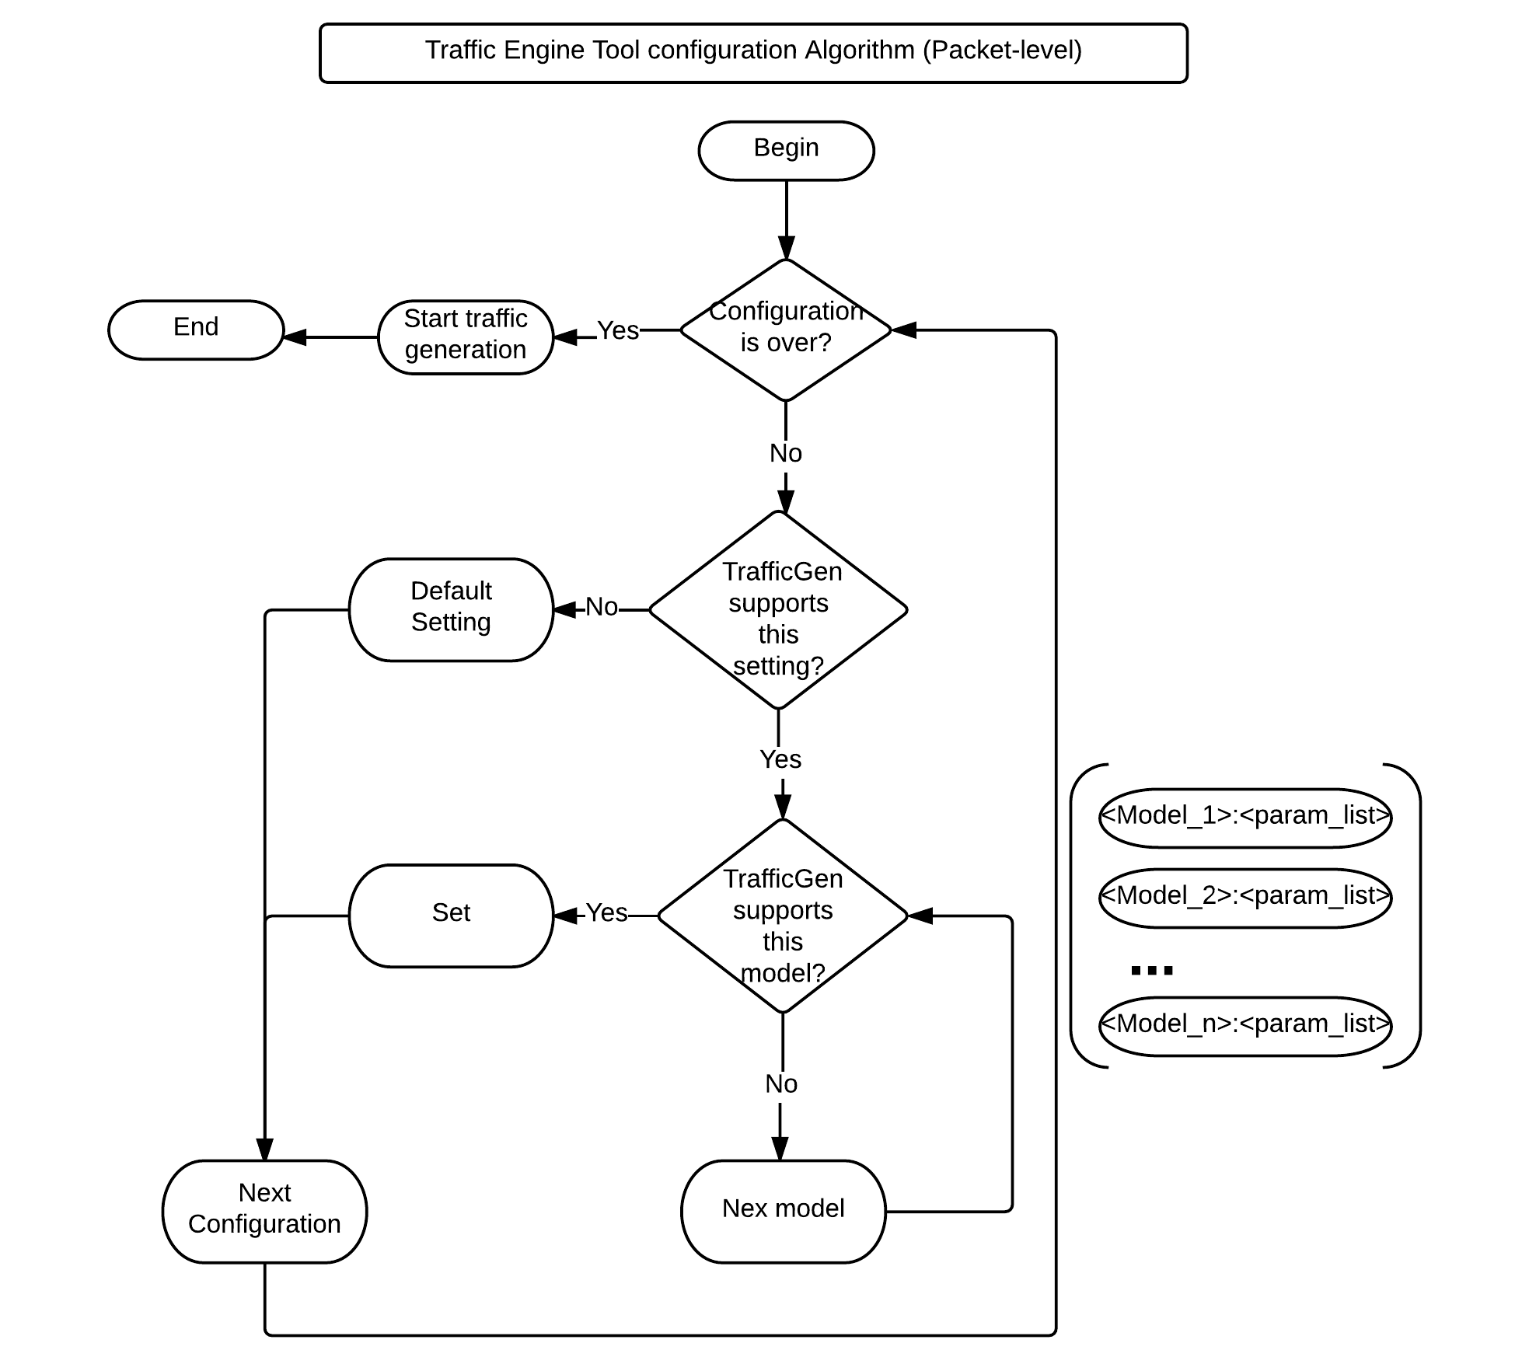
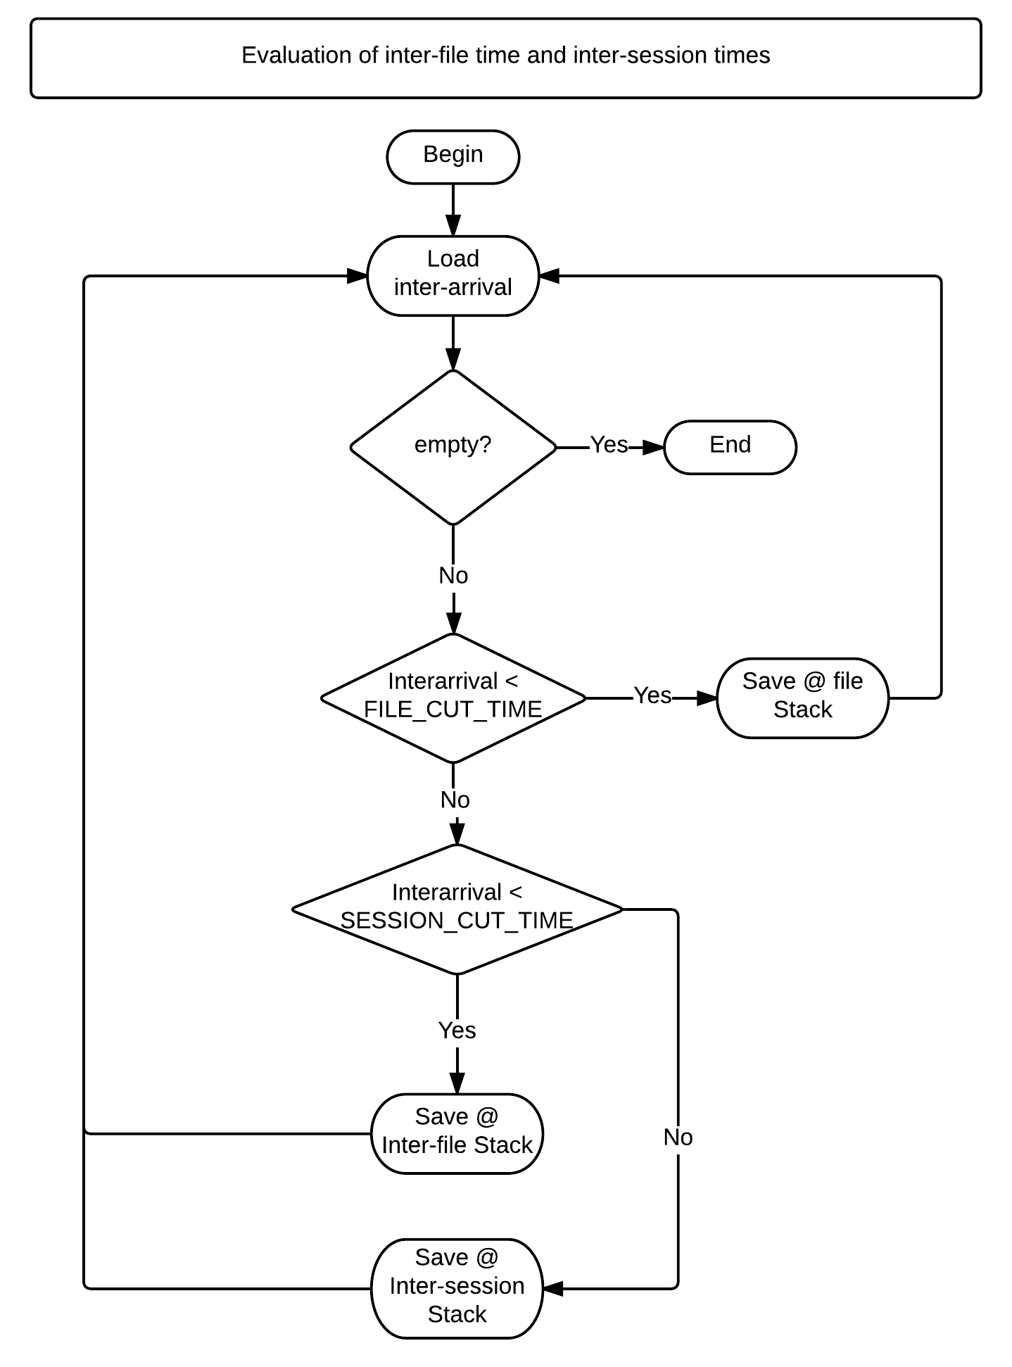
Packet-level/data extraction

Slide 6
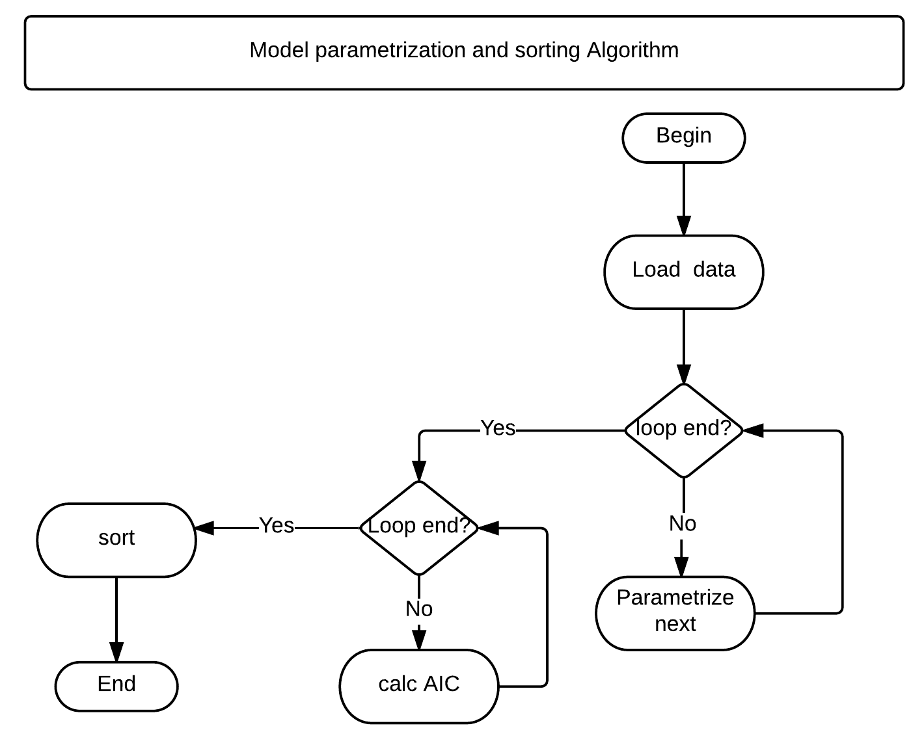
Modelling
Linear Regression vs. L-momments for fitting
AIK vs. BIC vs. Error for select the best fit

Slide 7
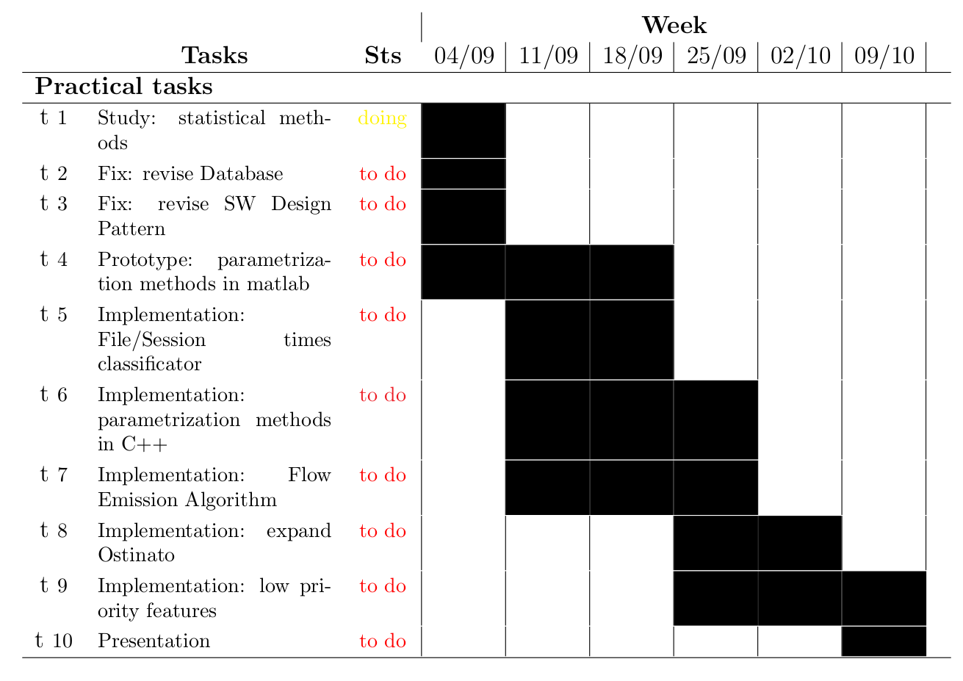
WP#9

