Slide 1
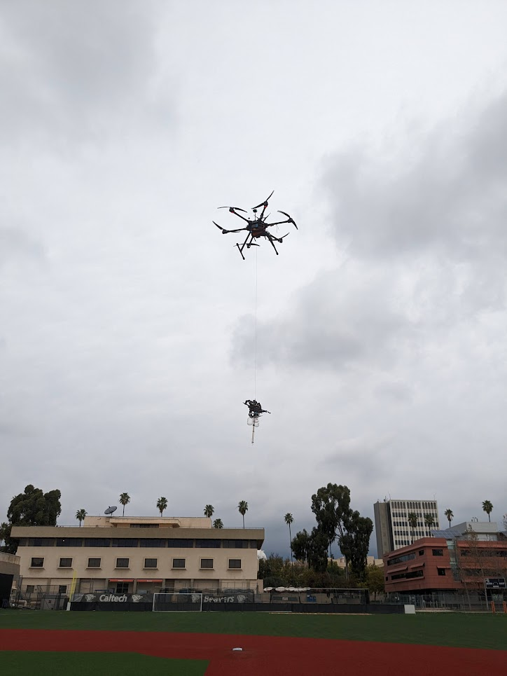
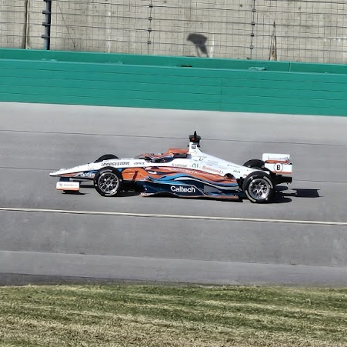
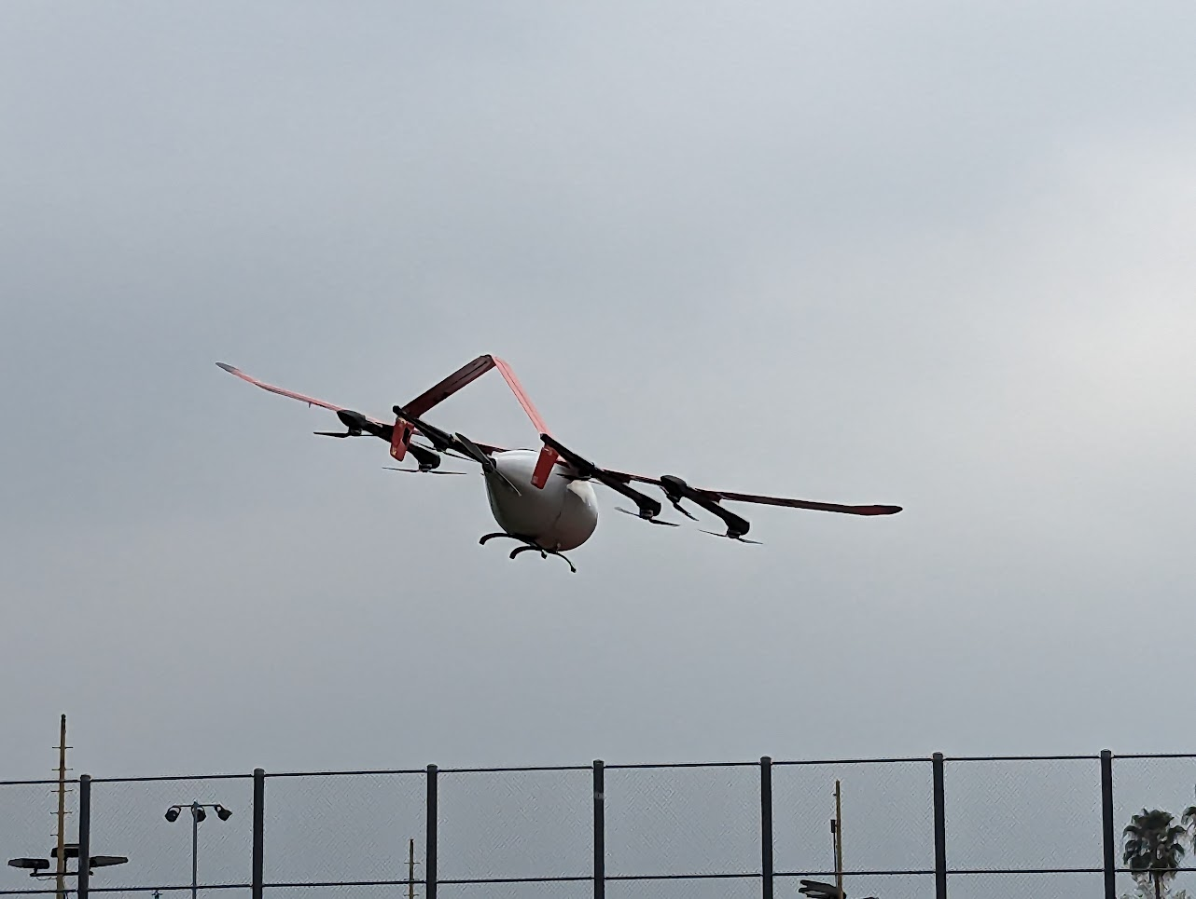
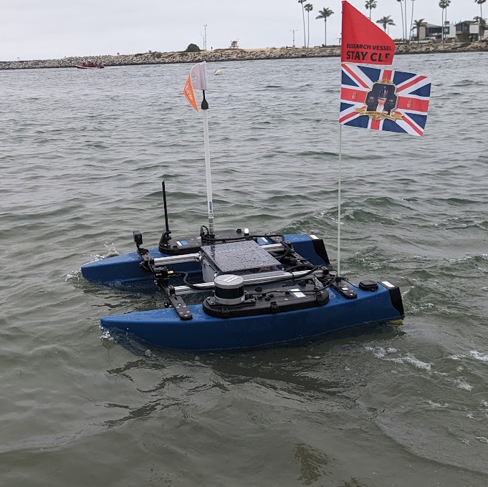
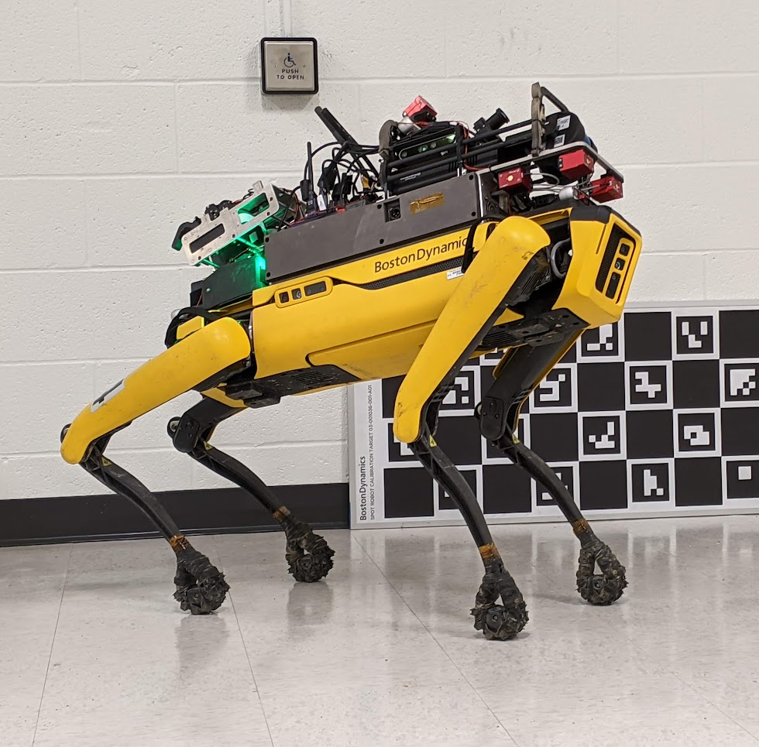
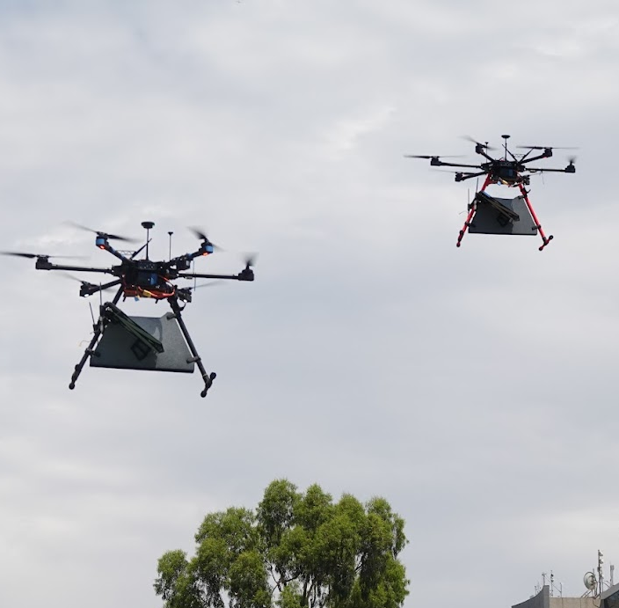

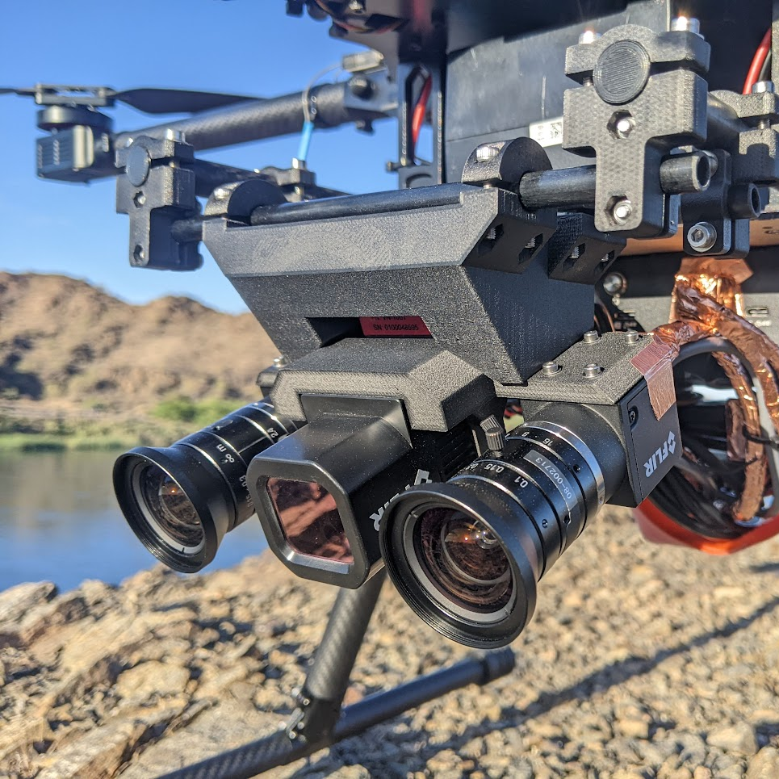

Matt Anderson
xGas sampler design for volcanic fumarolesx
Robotic Systems and Autonomy
Air | Land | Sea
System Architecture for complex robotics systems, specializing in extreme environment robotics
Supporting Science though robotic sensor / payload designs and deployment to harsh environments
Integration and Design of sensor and autonomy stacks under challenging size, weight, and power constraints
Leading Teams of any size towards success, from project conception through to field demonstrations
Executing Field Test Campaigns from the depths of coal mines to the skies over mountains and beyond line of sight
Ensuring Safety through years of experience in experimental robotics coupled with ongoing training
Test Pilotage for anything that flies, floats or drives
Capability Multiplication through a width breadth of knowledge in cutting-edge research and project support
Skills
- ROS1/2, MATLAB, C++, Python, Docker, bash, git
- ArduPilot, PX4, Mission Planner, qgroundcontrol
- SolidWorks, Inventor, KiCAD, rapid prototyping
- Part 107 (FAA), Fixed-Wing Gold Wings (MAAA)
- First Aid / CPR (American Red Cross)
xSystem architecture and team managementx
xAircraft designx
xPayload design and operationsx
xQuadrupedal systemsx
Experience
Staff Scientist (2019 – Current)
California Institute of Technology
Post Doc (2018 – 2019)
Jet Propulsion Laboratory
Researcher (2018)
The University of Sydney / ACFR
Education
Ph.D (System Identification)
University of Sydney /
University Libre de Bruxelles
B. Eng (Hons. I, Aeronautical)
University of Sydney
xMulti-UAS supporting SARx
xPayload design and integrationx
Up for a challenge?
Let’s succeed together
https://andersonrayner.github.io/
matt.jl.anderson@gmail.com
Last Updated: 10/05/2025

