Slide 1
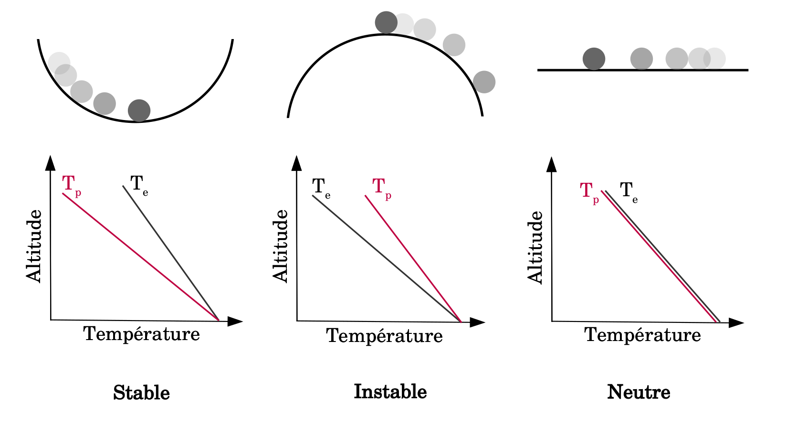
A
B
Altitude
Altitude
Altitude
Temperature
Temperature
Temperature
Stable
Unstable
Unstable
Neutral

Slide 2
