Slide 1
Grep
Andreas Schöngruber

Slide 2
Demo
Grep:
Regex in files and directories
TPL – Parallel Task Library
Simple to use
Fast
Do not need ordered results

Slide 3
Performance
1 Thread
“java”
C:\ProgramData
6.9 GB

Slide 4
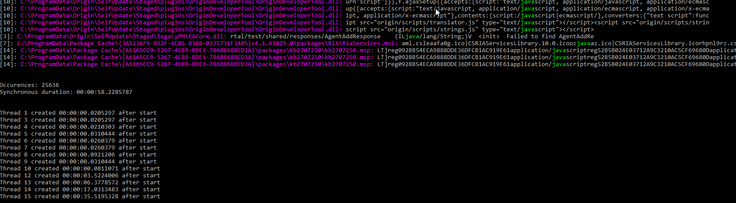
Performance
13 Threads
“java”
C:\ProgramData
6.9 GB

Slide 5
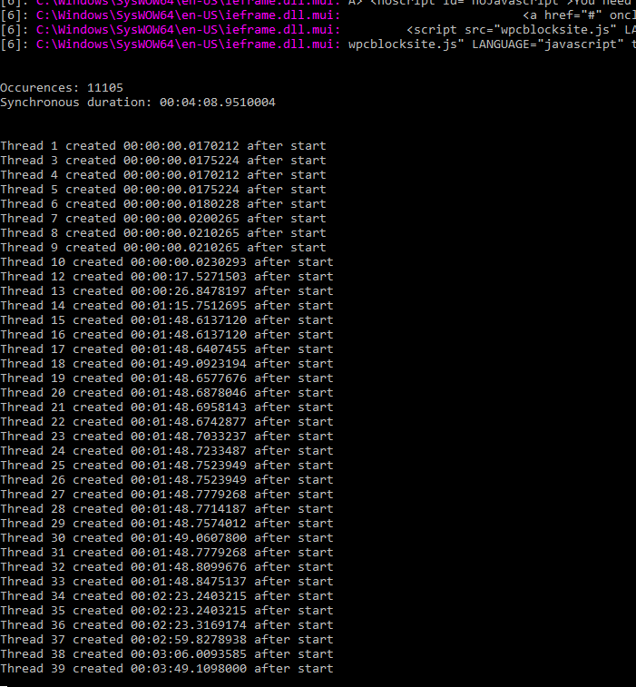
Performance
37 Threads
“java”
C:\Windows
~21 GB

Slide 6
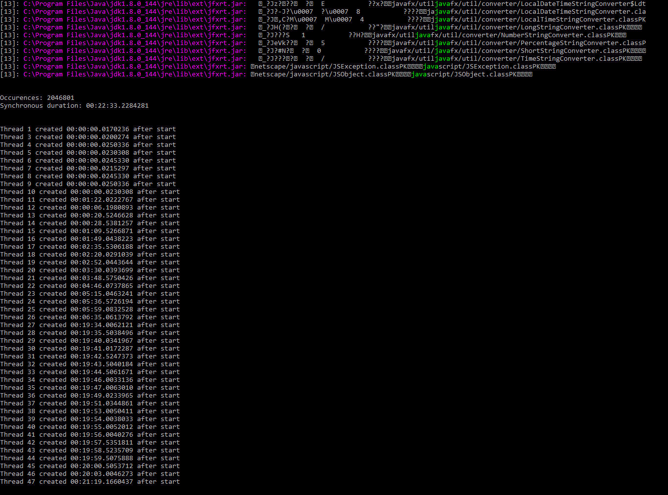
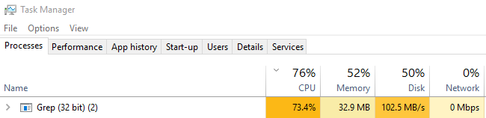
Performance
C:\Program Files
“java”
46 Threads
~100 GB

