Slide 1
TSUNAGU
Connecting local free stuff

Slide 2


PROBLEM
Mottainai
New stuff price
People who will leave the city will throw their stuff that they do not want to bring. For example, bicycle, fridge, rice cooker, or even small stuff like hanger, etc.
For a newcomer of the university students, workers. They need to buy many stuff as for daily life needs. Some people spend a lot of money on some needs.

Slide 3

SOLUTION
A web platform where the moving citizen can share their stuff freely, and the newcomer can find useful stuff easily.
Newcomer
Moving citizen
The new citizen who will stay for while/permanently in a city
The citizen who want to share their stuff freely
Connect

Slide 4
MARKET TARGET
University student
International student
Workers
local citizen

Slide 5


CONCEPT
Website
Smartphone App
Short-middle term plan
Long term plan
Everyone can share
Everyone can take
The donor can sell their stuff if they want
User communicate each other by chat in the system

Slide 6
PRODUCT
Search by category
Select item
Communicate with the owner

Slide 7
SCHEDULE
July
August
September
Database analysis, Frontend, and Backend Design.
Database and backend connection.
Backend and frontend connection.
Prototype of the website.
Complete and publish the website.
Testing and bug fix.
October
November
Advertisement and gather the users.
Major maintenance for bug and design
Minor maintenance
Evaluation

Slide 8





BUSINESS MODEL
For early development, we want to gather users who want to donor their items first.
Then, we can advertise the items to everyone in needs
For the seller, we will kindly ask commission.
Seller
Commision
Revenue

Slide 9



COMPETITION
Free
TSUNAGU
Buy used stuff
at secondhand shop
Affordable
Offline transaction
Online transaction
Buy new stuff
at secondhand shop
Expensive

Slide 10
COMPETITIVE ADVANTAGES
Free to Affordable
Stuff
Easy Transaction
Ease od Use
Helping
Environment
Connecting People

Slide 11
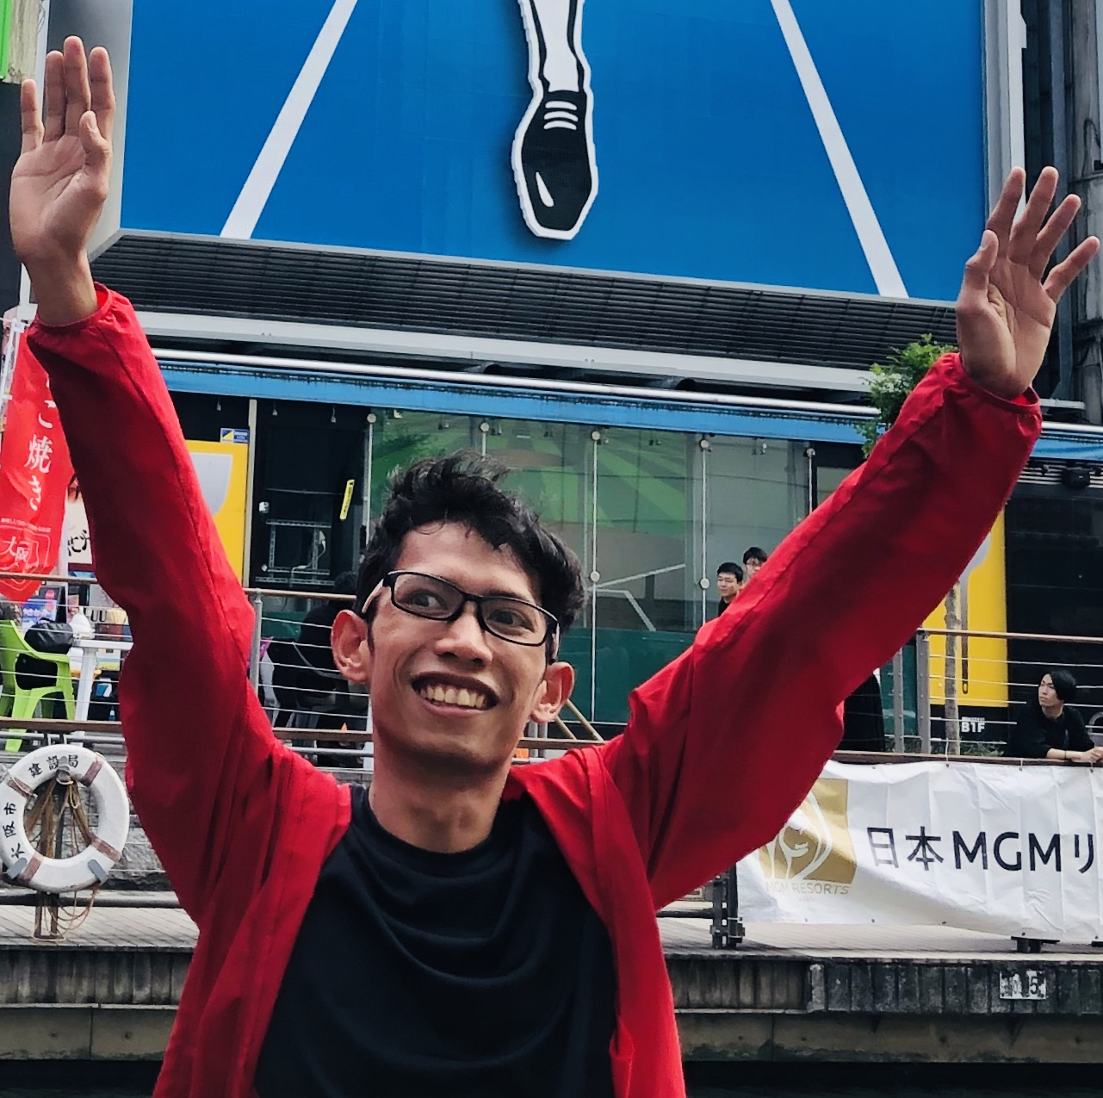
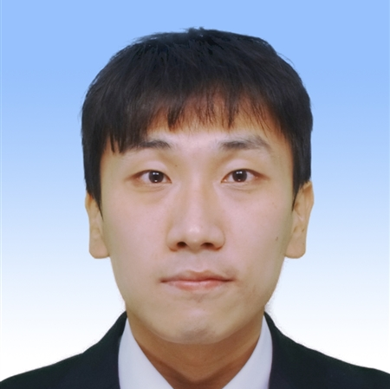
TEAM
Analyst and Backend Developer
Frontend Developer
Andi Prademon Yunus
Kang Sung Min
Human Interface Laboratory
Department of System Engineering
Faculty of Engineering
Low & Economics
Modern Economics
Japanese Economics

