Slide 1
Spark Hunter – Build Cycle 6
Team Members:
Travis Porter Jack Newton
Dhiraj Pandey Divyang Prateek

Slide 2
Feature
Demonstration

Slide 3
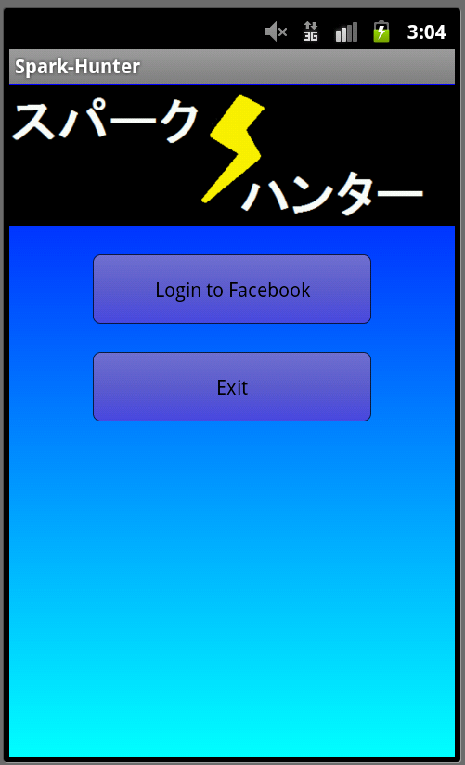
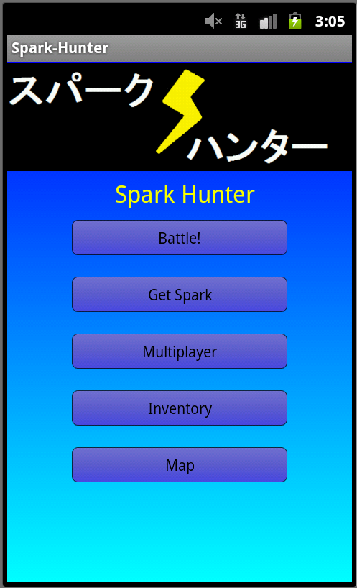
sssas
Facebook Login and Main Screen
5 available features to access.
s

Slide 4

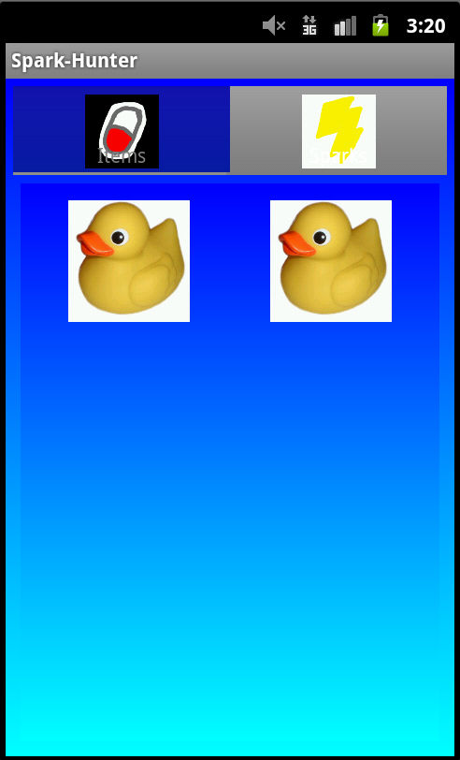
sssas
Inventory Page
Tabbed to separate the Items from Sparks.
s
Click-able to see their description.

Slide 5
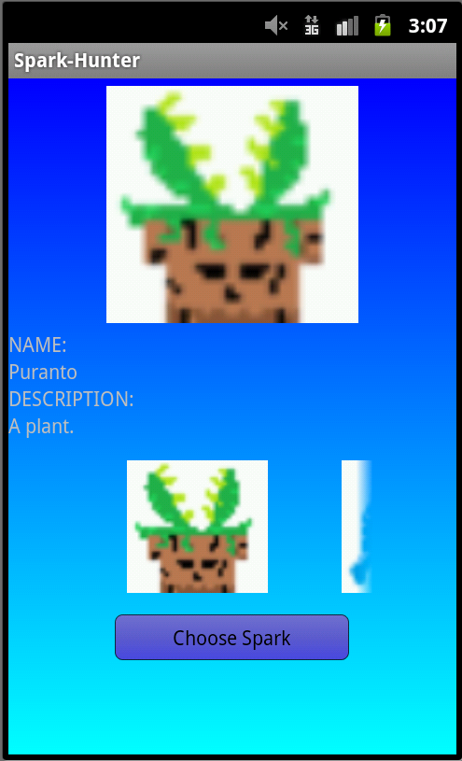
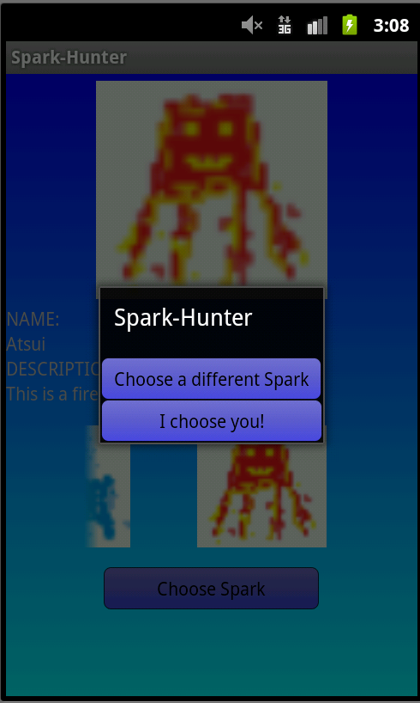
sssas
Get Spark Page
Choose between three starting Sparks.
s
Atsui is chosen.

Slide 6
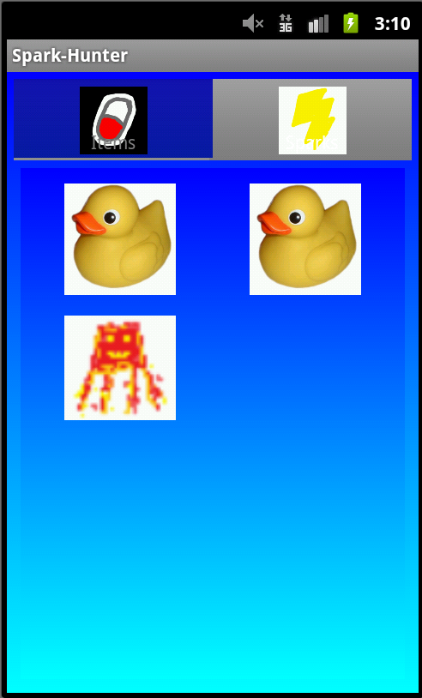
sssas
Inventory Page
Additional Spark is added
s

Slide 7
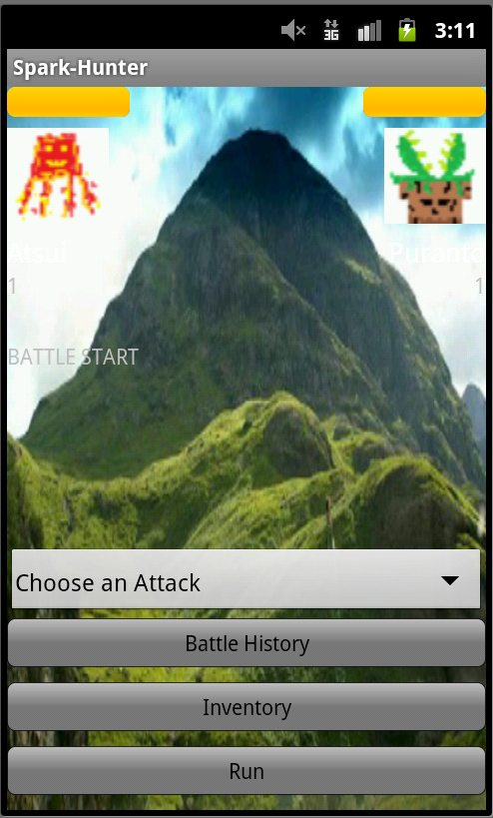
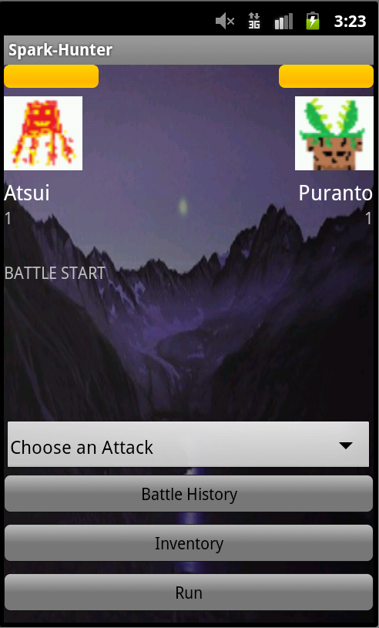
sssas
Battle Screen
Daytime Nighttime
s

Slide 8
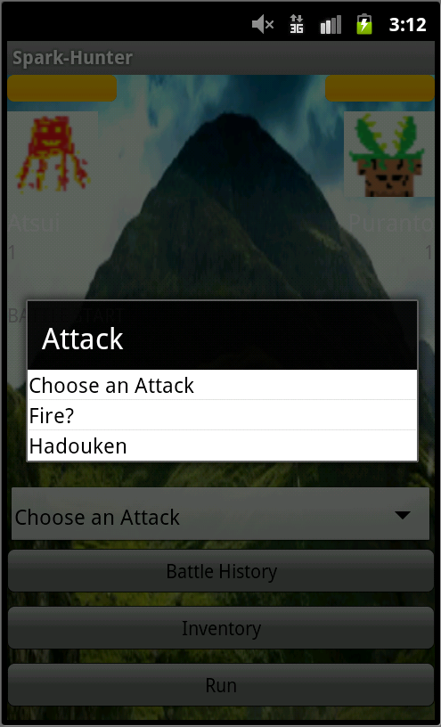
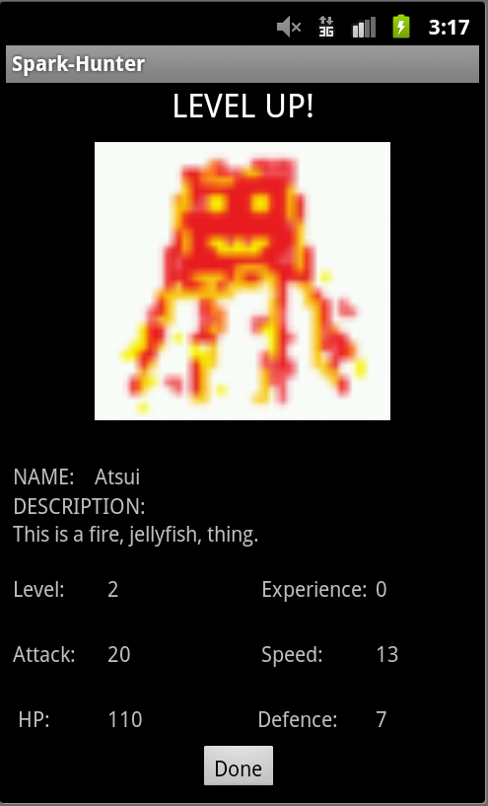
sssas
Battle Screen
Chose between several abilities that increases as you level up.
s
Level Up Screen

Slide 9
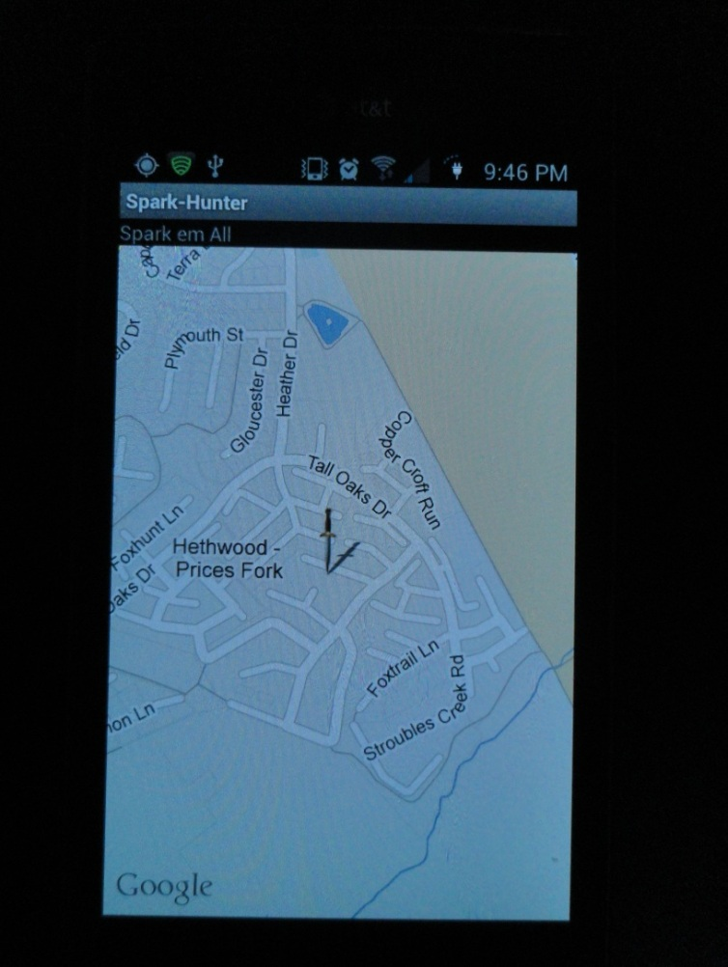
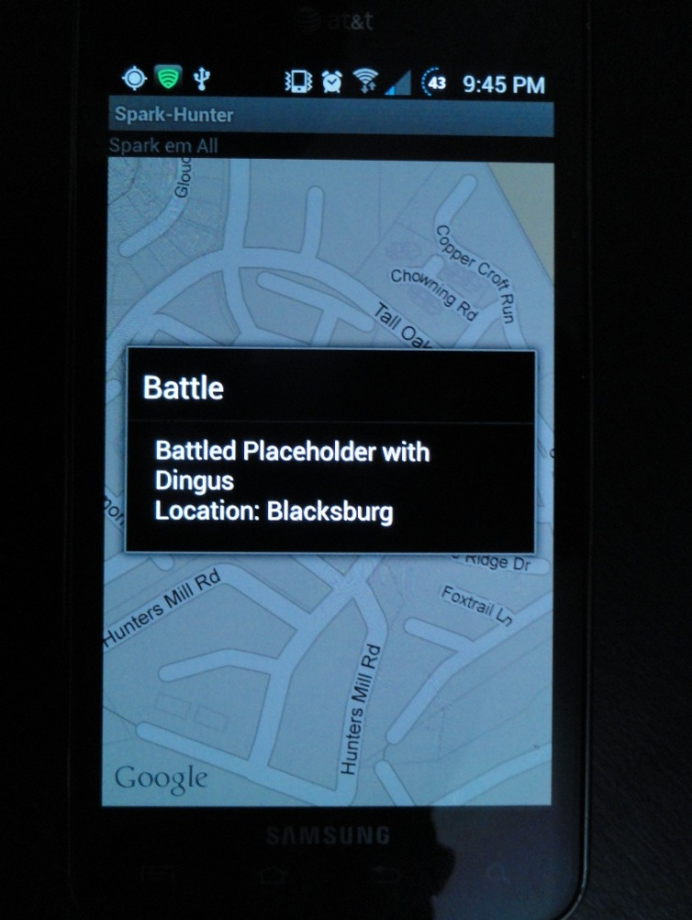
sssas
Battle Locations
s

Slide 10
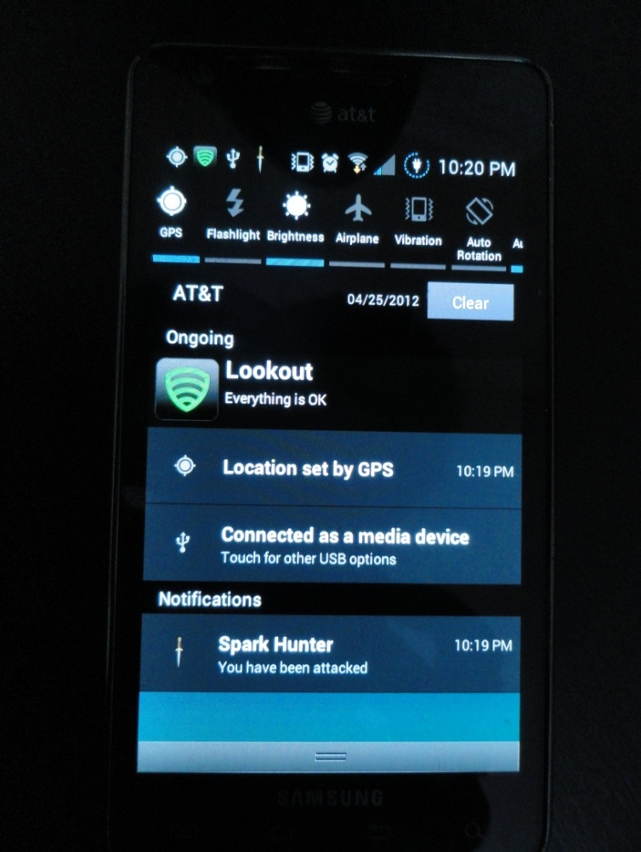
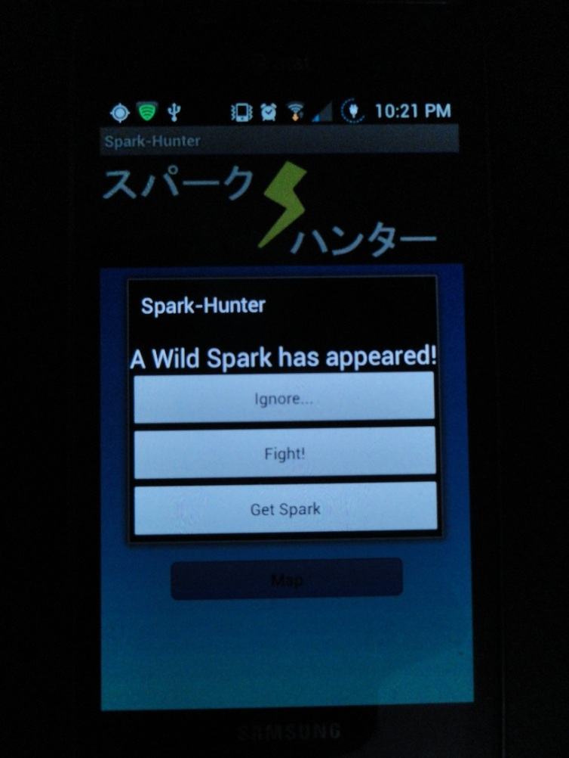
sssas
Surprise Spark Attack
s

Slide 11
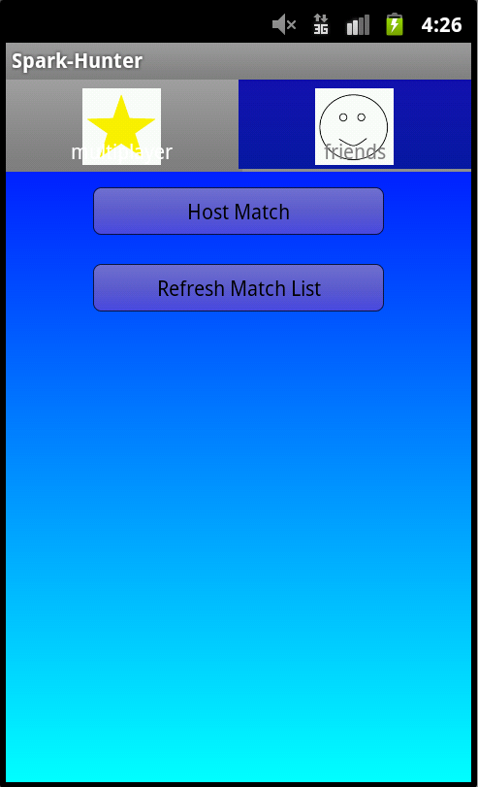
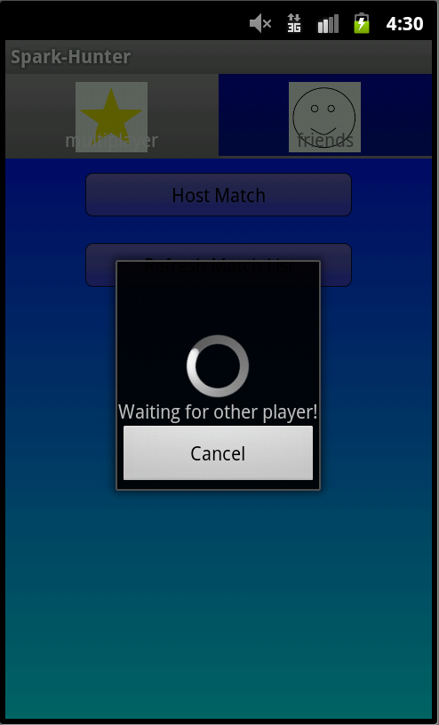
Multiplayer
Host Match starts a battle that other can find
Using the Refresh Match List button.
The friends tab shows all your Facebook friends.
While waiting for a match, you are unable to do anything else, however you can cancel it at any time.

Slide 12
Internal Design

Slide 13
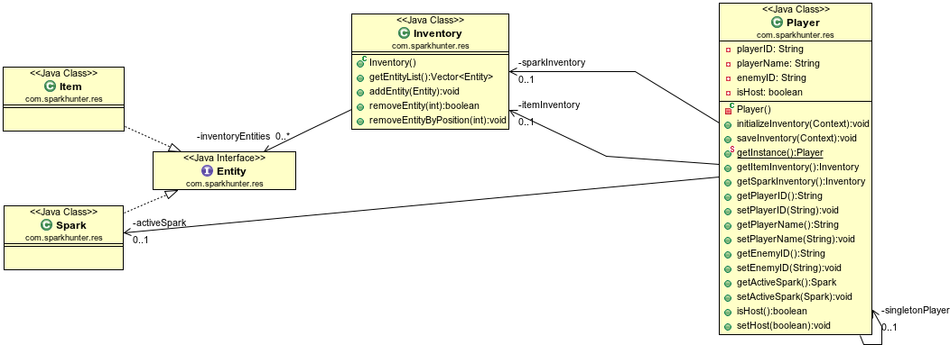
In-Game Entities

Slide 14
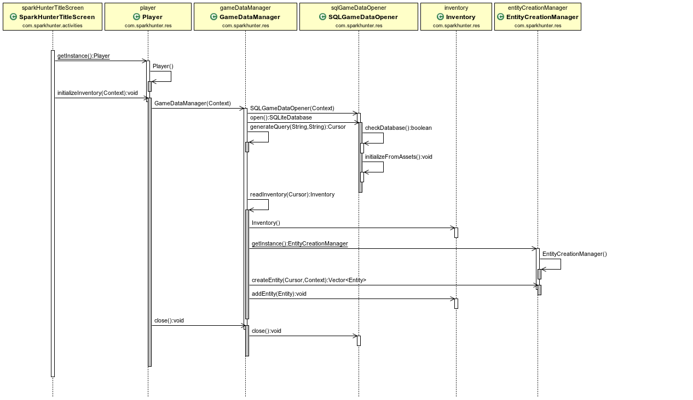
Data Management

Slide 15
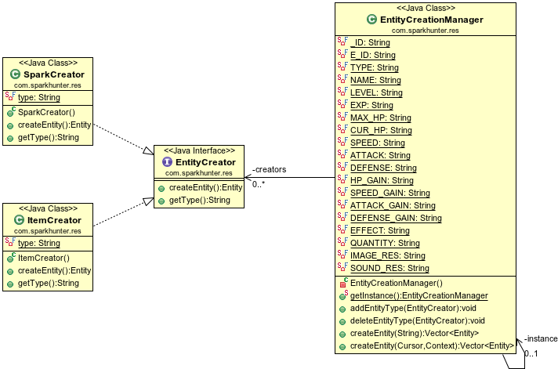
Entity Creation

Slide 16
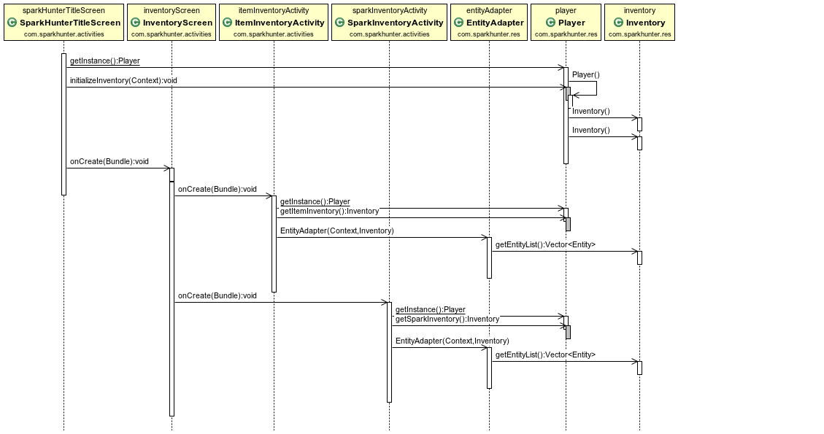
Inventory Display

Slide 17
In-Depth Code Review

Slide 18
Questions?

