Slide 1
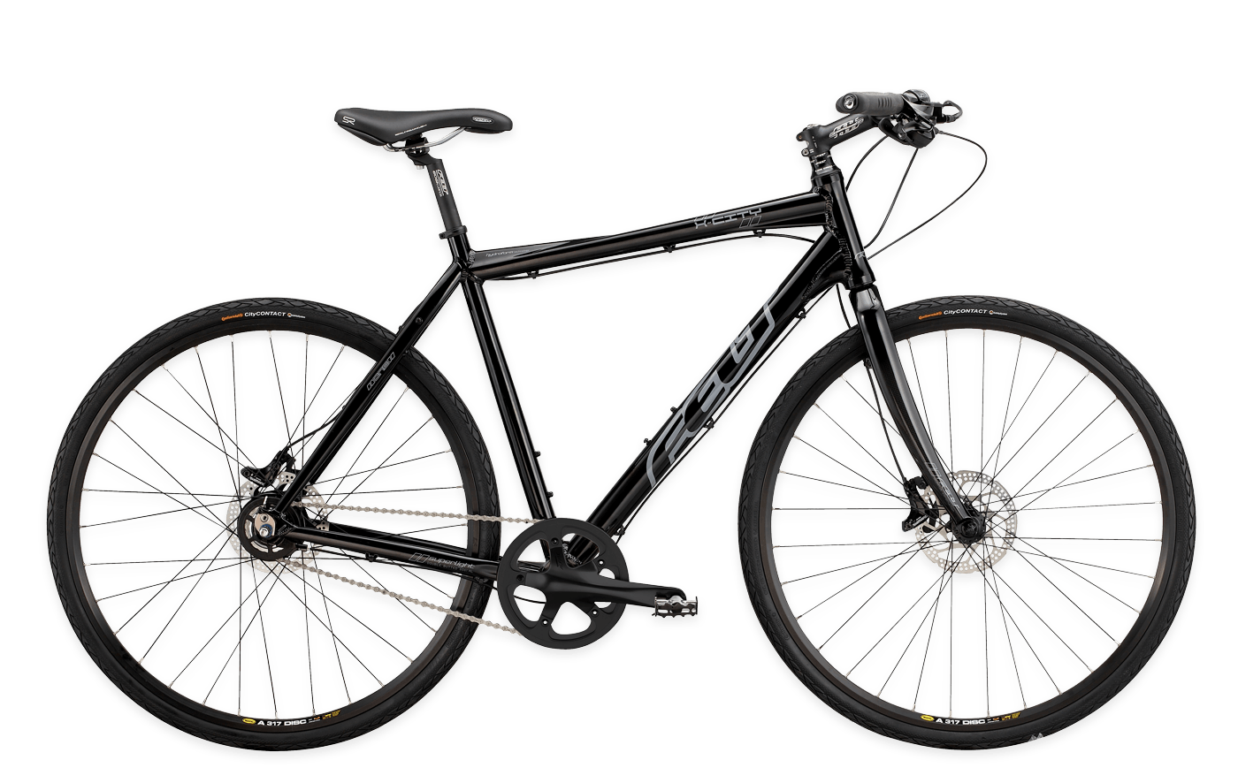
Bike-O-Mat to Bike-Shop
Team: Kern Oliver Pozegic Aldin Selinger Andreas

