Slide 1



Async or Parallel? No they aren’t the same thing!
Andie Saizan
Email: Andie.Saizan@gmail.com

Slide 2
Processes & Threads

Slide 3
Processes
A process is a collection of virtual memory space, code, data, and system resources.
Processes communicate with one another through messages, using Microsoft's Remote Procedure Call (RPC) technology to pass information to one another. There is no difference to the caller between a call coming from a process on a remote machine and a call coming from another process on the same machine.

Slide 4
Threads
A thread is code that is to be serially executed within a process.
A processor executes threads, not processes, so each application has at least one process, and a process always has at least one thread of execution, known as the primary or main thread.
A process can have multiple threads in addition to the primary thread.

Slide 5
When a thread begins to execute, it continues until it is killed or until it is interrupted by a thread with higher priority.
Each thread can run separate sections of code, or multiple threads can execute the same section of code. Threads executing the same block of code maintain separate stacks.
Each thread in a process shares that process's global variables and resources.

Slide 6
Deadlocks & Races
Multithreaded applications must avoid two threading problems: deadlocks and races.
A deadlock occurs when each thread is waiting for the other to do something.
A race condition occurs when one thread finishes before another on which it depends, causing the former to use an uninitialized value because the latter has not yet supplied a valid one.

Slide 7
So what’s the difference?

Slide 8
Asnyc != Parallel = true
Asnyc
For operations that are I/O bound.
Improves responsiveness
Frees up main thread to continue work on other processes.
Normally involved long running tasks & responsiveness is the goal
Parallel
For operations that are CPU bound.
Improves performance speed
Blocks main thread while processing.
Performance is the goal.

Slide 9
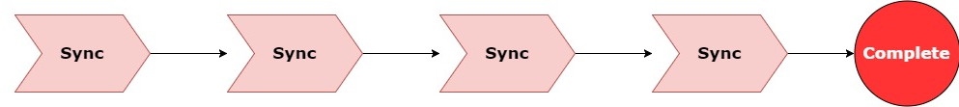
Synchronous Processing
Notes:
Boring!

Slide 10
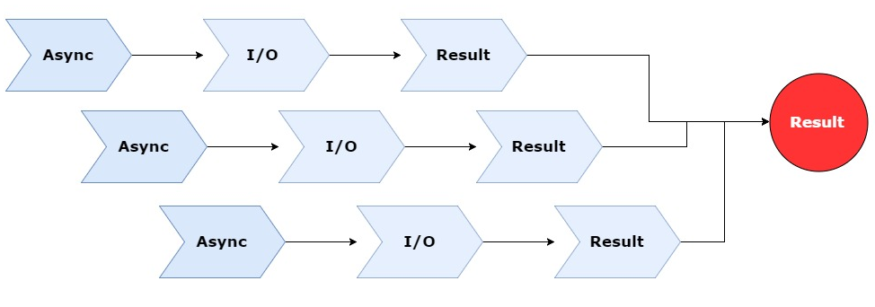
Asynchronous Processing
Async processing targets I/O bound requests such as requests to
Database Server, API Service, File Service etc.
Notes:
This normally involves longer running tasks and tasks which are perhaps waiting on some kind of external data or process to complete.

Slide 11
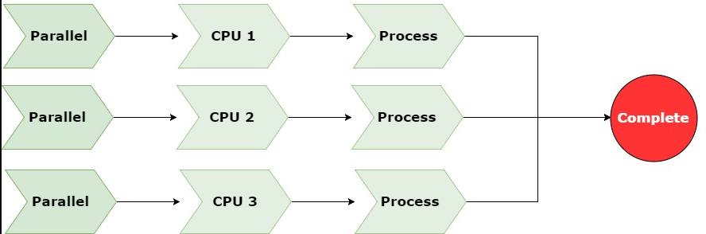
Parallel Processing
Parallel processing is targets CPU bound requests such as performing calculations are large collections. It allows us to utilize more available resources (cores) to perform a task.
Notes:
Normally with parallel programming performance is important and all the threads are working to a common goal.

Slide 12

Task Parallel Linq Library (TPL)

Slide 13
TPL
The Task Parallel Library (TPL) is a set of public types and APIs in the System.Threading and System.Threading.Tasks namespaces.
The purpose of the TPL is simply to simplify task basked programming.
Built-in async/await handles deadlocks & races

Slide 14
Simple Async Example
Show me the Code!

Slide 15
Web Api Async Example
In the UI Async we primarily use Async to keep the UI responsive. For server applications, the primary benefit of async is scalability.
Open Web Interface for .NET (OWIN) was designed from the ground up to be asynchronous; and ASP.NET can also be asynchronous. Async: It’s not just for UI apps!
Notes:
https://msdn.microsoft.com/en-us/magazine/dn802603.aspx
asynchronous code make better use of the managed thread pool by allowing idle threads to be re-used that might otherwise be blocked – which greatly improves scalability.

Slide 16
Web API Async Example
Show me the Code!

Slide 17
Parallel LINQ (PLINQ)

Slide 18
PLINQ
Parallel LINQ (PLINQ) is a full set of LINQ standard query operations as extensions methods for the System.Linq namespace that provides parallel operations to Objects
The purpose PLINQ is simply to simplify task based parallel programming.

Slide 19
Simple Parallel Examples
Task parallel or PLINQ is not automatically mean it’s always the most efficient. Knowing you application and testing variations of Task.ForEach, .AsParallel.ForAll, or simply .ForEach when optimizing performance, is needed.
Notes:
In the sample code, take time to note that the list is not processed in order. PLINQ does support order preservation but the ForAll doesn’t return results. You can use .AsParallel.AsOrdered.Select(…). The select will not process in order but it will return the result set as ordered.

Slide 20
Lets Review

Slide 21
Processors execute threads, and threads execute processes
All applications have at least one main thread.
Multiple threads do not mean, multiple cores
A single thread can execute across multiple cores

Slide 22
Asynchronous programming does NOT make your application faster. It makes it more responsive and/or scalable.
Async is best used for operations that are I/O bound.
Parallel programming does make you application faster, but it’s not always the best approach.
.Net provides and easy button with TPL and PLINQ

