Slide 1

Industrious IRISES PROJECT
ENTERPRISE-WIDE INTEGRATION OF AUTOMATION AT wsu CAMPUS

Slide 2
iNTRODUCTION
Project Manager: Miss A.P Gceba #1
Business Analyst: Miss N Mkwenkwe #2
Data Technician: Mr S Hlabeni #3
Database Administrator: Mr A Nomaqhiza #4
IT Auditor: Mr M Cimela #5
Resource Manger: Mr L Nyawo #6
Resource Manager: Mr T Mohale #6
Financial Analyst: Mr W Balemini #7
Network Engineer: Mr A Dotye #8
Network Engineer: Miss A Kilili #8

Slide 3
Introduction cont…
PROJECT OVERVIEW
In Ibika Campus we are integrating the existing network to work with our IoT solution having to look at the existing network and provide all the resources needed to make the network solution which will provide security, reliable connection and data processing using IoT to safeguard students and staff members.
The Industrious Irises Project is created to address challenges in the campus and create a network solution that will provide security and IoT in Ibika Campus

Slide 4
Design Decisions
We decided to use our star topology to represent our network diagram, where all our network components are physically connected to a central node such as router or switch.
Because each device only requires one I/O port and only wants to connect to the hub via one link, it is less expensive.
When adding or uninstalling devices, there are no network interruptions.
Users are given the option to only access particular network resources.
Because a network problem only affects the local subnet when it arises, it has better containment.

Slide 5
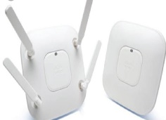
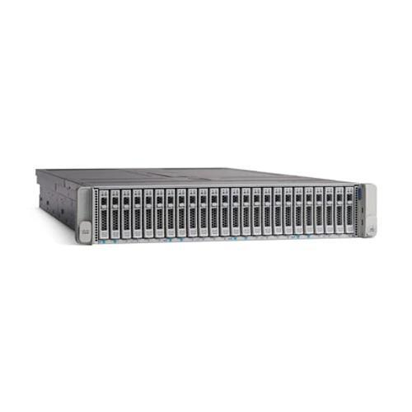
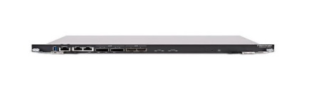
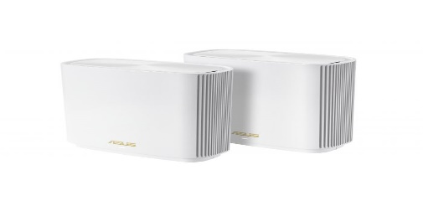
Resource and BUDGET
Mesh Access Point Server
Media: Wireless Media: Wired
Model: Airronet 552E Manufacture: Cisco
Cost: R2724 Cost R37844
Manufacturer : Cisco company
Fortigate Asus ZenWiFi XT8 AX6600
Media: Rj-45 rollover cable Vendor: Incredible Connection
Model: FG-5001E Price: R13999
Cost: R794589,26
Manufacture: Fortinet
Estimated date of delivery 20 November 2022

Slide 6
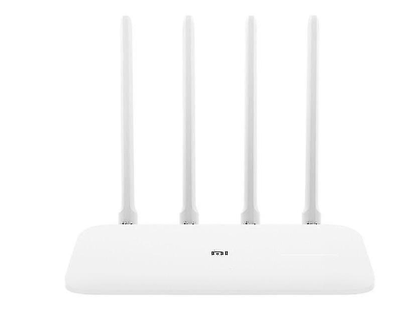
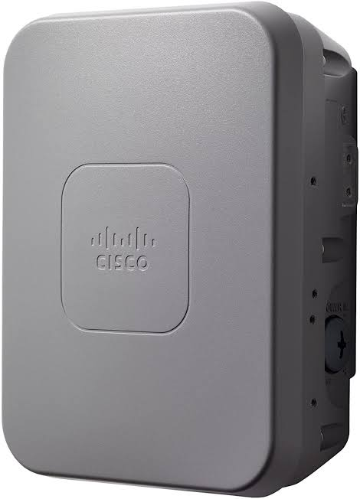
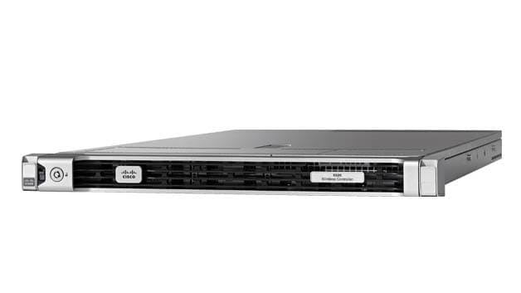
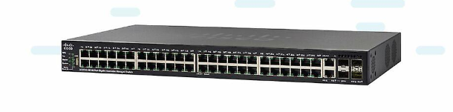
Resource Budget cont…
Access point Router
Media: Wireless Media: Wireless
Model: 1562i Model: EAN 9195427263549
Manufacturer: Cisco Manufacturer : Om Vasuhare
Cost: R10167,71 Cost: R1300,00
Wireless Controller Switch
Model: 5520 Model: 0882658808821
Media: Wireless Media: ethernet cable
Manufacturer: Cisco Manufacture: Cisco
Cost: R337480 Cost: R 64000,00
Estimated date of delivery : 20 November 2022

Slide 7
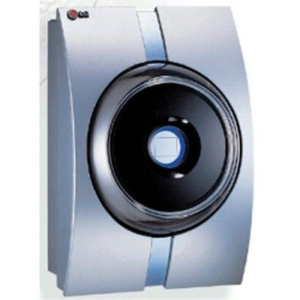
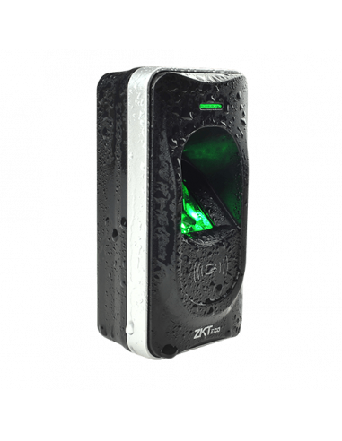
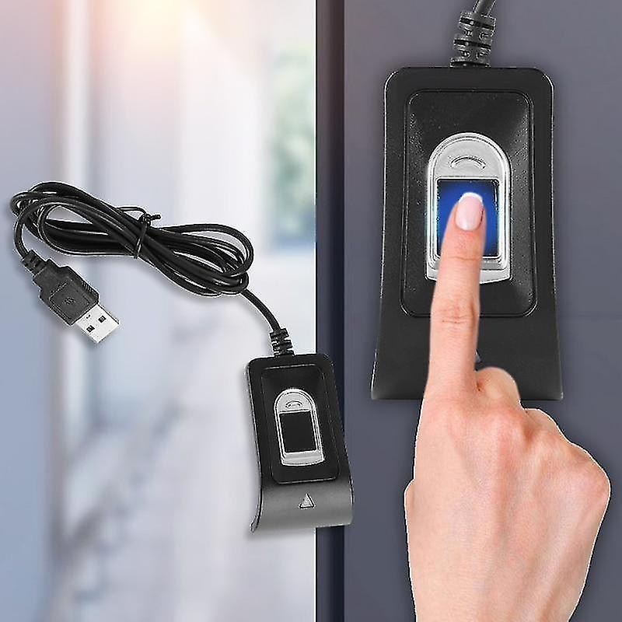
Resource and budget Cont…
Iris Scanner Biometric RFID Reader
Model: LG IRIS ACCESS 300 Model: ZKTeco-F12 RFID & Fingerprint Outdoor Slave Reader
Vendor: Iris ID inc Vendor: Miro
Price: R 8842,28 Cost: R 2849.70
Fingerprint Readers
Vendor: Fruugo
Price: R 849.00
Estimated Date of Delivery: 20 November 2022

Slide 8
Constraints
Time
Because a portion of our work had a set deadline, we encountered some delays in our project as a result of covid-19. It led to deliverable durations that were longer than expected. The project team suffered greatly from miscommunication since it hindered teamwork.
Cost
To discuss changes that might affect the present budget, the business analyst must always consult with the stakeholders.
Scope
The scope of every project is a crutial factor. If the ordered equipment is not in sufficient condition to be used for the duration of the project, it can have an effect on our budget. Trying to adjust our budget while purchasing project products that are not of the required quality.

Slide 9
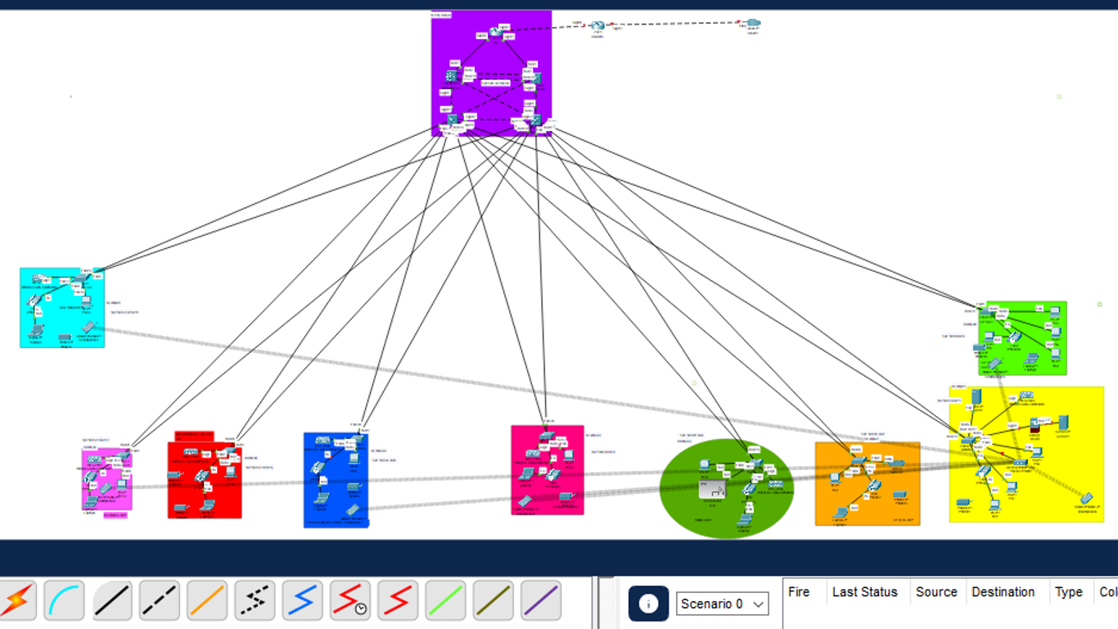
Topology

Slide 10
DEMONSTRATION
We have created a star topology which allows users only to access specific network resources.
It allows the network to be configured easily using VLAN’s which makes it better manageable by administrators.
This type of topology helps in securing the Ibika campus network and also helps administrators to better manage network updates and reliability.

Slide 11
CONCLUSION
We found that scope of work is a vital element for the project. We saw that dividing the duties and breaking the down makes the project easier, more controllable, easier to manage, less difficult to see the future and existing risks and successes with the help of work breakdown structure.
Objectives include what the project needs to do. As a team we specified them correctly so the results depended on them made a good effect in how the work was completed.

Slide 12
The end

