Slide 1
Achieving Timing Closure
Notes:
Trainer Note: This module describes how to read the Timing Analyzer reports and use the information to gain timing closure. 45 minutes
Editor note: In LGP, put this instructor note in the Purpose block. No need to create a separate Trainer Note block.

Slide 2
Objectives
After completing this module, you will be able to:
Describe a flow for obtaining timing closure
Interpret a timing report and determine the cause of timing errors
Apply Timing Analyzer report options to create customized timing reports

Slide 3
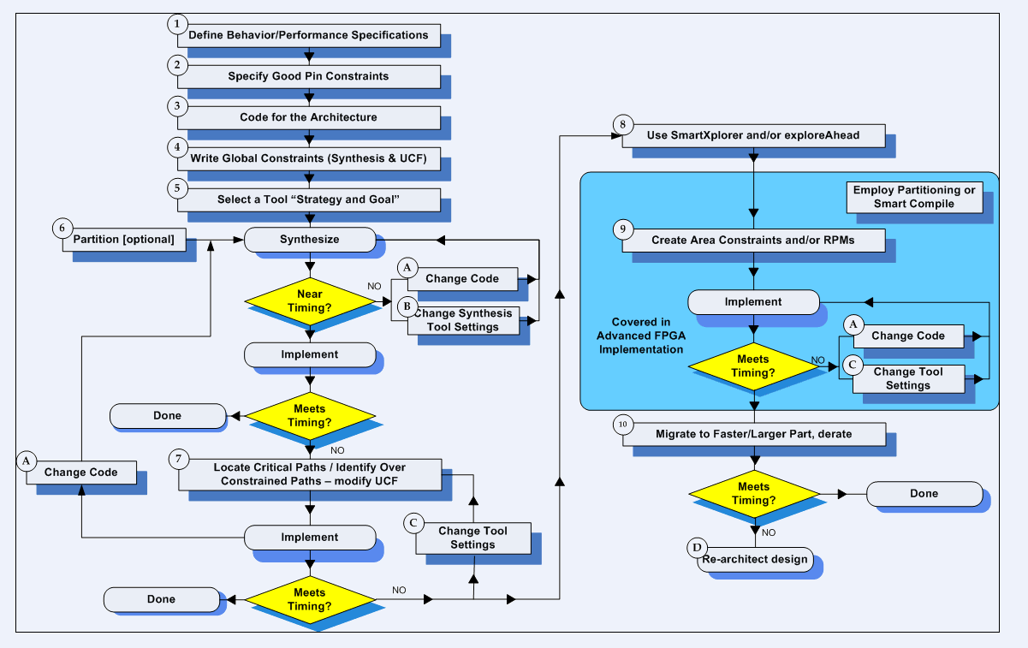
Timing Closure
Notes:
Editor Note: Pull out graphic in LGP

Slide 4
Timing Reports
Timing reports help you determine why your design fails to meet its constraints
Reports contain detailed descriptions of paths that fail their constraints
The implementation tools can create timing reports at two points in the design flow
Post-Map Static Timing Report
Use for an early indication as to whether your design might meet timing
Post-Place & Route Static Timing Report
Use as a final analysis of whether your design has met timing
The Timing Analyzer is a utility for creating and reading timing reports
Notes:
After implementing a design, use timing reports to determine overall design performance.
You should review the details for each failed constraint to determine why the design does not meet performance objectives.

Slide 5
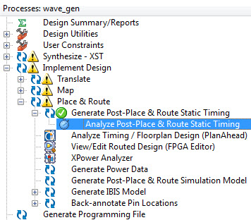
Using the Timing Analyzer
Double-click Analyze Post-Place & Route Static Timing
Opens the Post-Place & Route Static Timing Report
Allows you to create custom reports
Open a plain text version by clicking Static Timing Report in the Design Summary screen
Notes:
Although the plain text timing report contains the same information as the Timing Analyzer version, it does not contain hyperlinks to other tools.
Facilitator Note:
Demo Instructions:
Launch the Project Navigator and open the Timing Closure lab project.
Expand the Implement, Place & Route, and Generate Post-Place & Route Static Timing processes.
Double-click Analyze Post-Place & Route Static Timing.

Slide 6
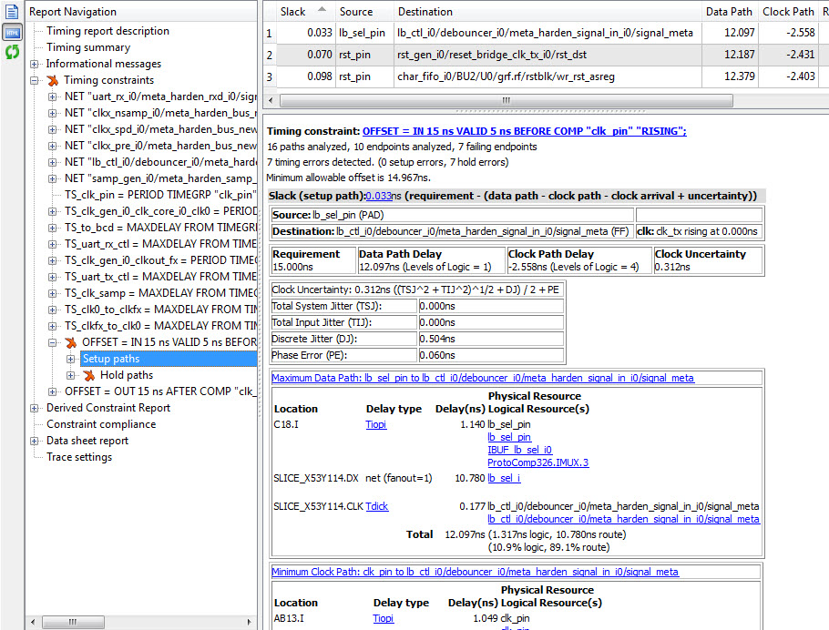
Timing Analyzer GUI
Hierarchical browser
Quickly navigate to specific report sections
Failing constraints indicated with a red “X”
Timing objects window
Summarizes the path displayed in the path detail window
Report text
Logic highlighted in blue can be cross-probed
Notes:
The vertical toolbar to the left of the hierarchical browser allows you to report text as plain text or HTML.
With the OFFSET IN/OUT constraint, you can see the path details of both the data and clock paths.

Slide 7
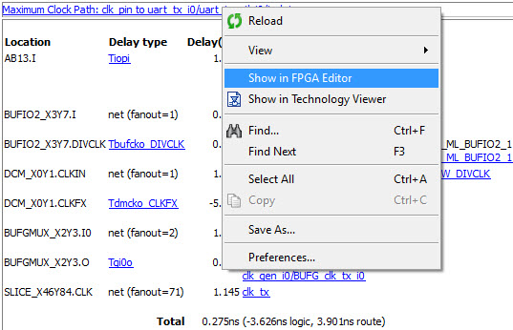
Cross-Probing
Shows the placement of logic in a delay path
Right-click on the delay path to see this option
The FPGA Editor view is used for seeing the actual placement and routing used
The Technology view shows logical path through components
Notes:
This enables you to quickly view the placement of logic in critical paths.
With the OFFSET IN/OUT constraint you can probe both the data and clock paths.

Slide 8
Timing Report Structure
Timing constraints
Number of paths covered and number of paths that failed for each constraint
Detailed descriptions of the longest paths
Data sheet report
Setup, hold, and clock-to-out times for each I/O pin
Timing summary
Timing errors (number of failing paths)
Timing score (total number of ps of all constraints that were missed)
Timing report description
Allows you to easily duplicate the report
Notes:
Timing reports (TWR files) also contain headers with information such as design name, device targeted, and software version.
The timing score is a key indicator of overall design performance. The timing score represents the total number of picoseconds by which the design fails to meet constraints. A design that meets all constraints has a timing score of 0.

Slide 9
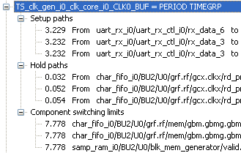
Paths Reported
Setup paths
Slowest delay paths for each constraint
Defaults to the three longest paths
Hold paths
Fastest delay paths for each constraint
Component switching limits
Checks that the toggle rate and duty cycle are in limits with specification

Slide 10
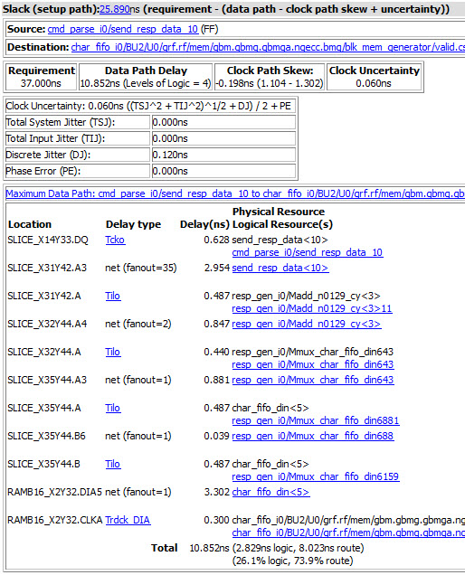
Report Example
Constraint summary
Number of paths analyzed
Number of timing errors
Length of critical path
Total delay
Clock and data breakdown
Clock jitter analysis
Detailed path description
Delay types are described in the data sheet
Worst-case conditions are assumed, unless pro-rated
Notes:
The Timing Constraint Report lists each constraint as well as the longest delay paths for each constraint. The report also breaks down the delay paths into incremental delays.
Use the detailed path description to locate the logic in the design that is causing the path to fail. If you do not label nets or choose descriptive instance names, or if your synthesis tool has created default net names, analyzing this report may be difficult.
The tools account for clock distribution delay on input and output paths as well as clock skew on internal flip-flop to flip-flop paths.
All delays reported are for worst-case temperature and voltage. You can prorate delays by specifying the worst-case temperature and voltage that you expect your device to encounter. Prorating will be discussed later in this module and also in the “Path-Specific Timing Constraints” module.
In the far right column, the blue names are logical resources, which can be used to locate the logic in the FPGA Editor or in the RTL viewer of your synthesis tool.
Logic and routing breakdown can be useful during post-MAP timing analysis to determine whether the constraints are reasonable. This will be discussed further in the next lesson.

Slide 11
Estimating Design Performance
Performance estimates are available before implementation is complete
Synthesis Report
Logic delays are accurate
Routing delays are estimated based on fanout
Reported performance is generally accurate to within 30 percent
Post-Map Static Timing Report
Logic delays are accurate
Routing delays are estimated based on placement and fanout
Notes:
The Synthesis Report is the first place where performance estimates are given. The estimate is not very accurate this early in the implementation process, but it can be an indicator of whether synthesis results are good enough to proceed to the next step.
The Post-Map Static Timing Report is useful because it is based on the Xilinx timing constraints, and this report shows detailed descriptions of the longest paths covered by each constraint.

Slide 12
Analyzing Post-Place & Route Timing
There are many factors that contribute to timing errors, including
Poor micro-architecture
Neglecting synchronous design rules or using incorrect HDL coding style
Poor synthesis results (too many logic levels in the path)
Inaccurate or incomplete timing constraints
Poor logic mapping or placement
Each root cause has a different solution
Rewrite HDL code
Ensure that synthesis constraints are correct and use proper synthesis options
Add path-specific timing constraints
Resynthesize or reimplement with different software options
Correct interpretation of timing reports can reveal the most likely cause
Therefore, the most likely solution
Notes:
The next several slides show examples of timing errors and how to identify the root cause of the failure.

Slide 13
Case 1
Data Path: source to dest
Delay type Delay(ns) Logical Resource(s)
---------------------------- -------------------
Tcko 0.290 source
net (fanout=7) 0.325 net_1
Tilo 0.060 lut_1
net (fanout=1) 1.500 net_2
Tilo 0.060 lut_2
net (fanout=1) 0.245 net_3
Tilo 0.060 lut_3
net (fanout=1) 0.204 net_4
Tdick 0.300 dest
---------------------------- ------------------------------
Total 3.044ns (0.770ns logic, 2.274ns route)
(25.3% logic, 74.7% route)
This path is constrained to 3 ns
What is the primary cause of the timing failure?

Slide 14
Case 1 Answer
Data Path: source to dest
Delay type Delay(ns) Logical Resource(s)
---------------------------- -------------------
Tcko 0.290 source
net (fanout=7) 0.325 net_1
Tilo 0.060 lut_1
net (fanout=1) 1.500 net_2
Tilo 0.060 lut_2
net (fanout=1) 0.245 net_3
Tilo 0.060 lut_3
net (fanout=1) 0.204 net_4
Tdick 0.300 dest
---------------------------- ------------------------------
Total 3.044ns (0.770ns logic, 2.274ns route)
(25.3% logic, 74.7% route)
What is the primary cause of the timing failure?
The net_2 signal has a long delay and low fanout
Most likely cause is poor placement

Slide 15
Poor Placement: Solutions
Increase placement effort level (or overall effort level)
PAR extra effort or SmartXplorer
Covered in the “Advanced Implementation Options” module
Area constraints with the PlanAhead™ tool
Covered in the Designing with the PlanAhead Analysis and Design Tool course

Slide 16
Case 2
Data Path: source to dest
Delay type Delay(ns) Logical Resource(s)
---------------------------- -------------------
Tcko 0.290 source
net (fanout=7) 0.125 net_1
Tilo 0.060 lut_1
net (fanout=187) 2.500 net_2
Tilo 0.060 lut_2
net (fanout=1) 0.174 net_3
Tilo 0.060 lut_3
net (fanout=1) 0.204 net_4
Tdick 0.300 dest
---------------------------- ------------------------------
Total 3.773ns (0.770ns logic, 3.003ns route)
(20.0% logic, 80.0% route)
This path is also constrained to 3 ns
What is the primary cause of the timing failure?

Slide 17
Case 2 Answer
Data Path: source to dest
Delay type Delay(ns) Logical Resource(s)
---------------------------- -------------------
Tcko 0.290 source
net (fanout=7) 0.125 net_1
Tilo 0.060 lut_1
net (fanout=187) 2.500 net_2
Tilo 0.060 lut_2
net (fanout=1) 0.174 net_3
Tilo 0.060 lut_3
net (fanout=1) 0.204 net_4
Tdick 0.300 dest
---------------------------- ------------------------------
Total 3.773ns (0.770ns logic, 3.003ns route)
(20.0% logic, 80.0% route)
What is the primary cause of the timing failure?
The signal net_2 has a long delay, but the fanout is not low
Most likely cause is high fanout

Slide 18
High Fanout: Solutions
Most likely solution is to duplicate the source of the high-fanout net
If the net is the output of a flip-flop, the solution is to duplicate the flip-flop
Use manual duplication (recommended) or synthesis options
If the net is driven by combinatorial logic, locating the source of the net in the HDL code can be more difficult
Use synthesis options to duplicate the source
Duplicate one or more flip-flops upstream from the net
Notes:
For more information about duplicating flip-flops, see the “FPGA Design Techniques” module.

Slide 19
Case 3
Data Path: source to dest
Delay type Delay(ns) Logical Resource(s)
---------------------------- -------------------
Tcko 0.290 source
net (fanout=7) 0.521 net_1
Tilo 0.060 lut_1
net (fanout=1) 0.280 net_2
Tilo 0.060 lut_2
net (fanout=1) 0.223 net_3
Tilo 0.060 lut_3
net (fanout=1) 0.223 net_4
Tilo 0.060 lut_4
net (fanout=1) 0.310 net_5
Tilo 0.060 lut_5
net (fanout=1) 0.233 net_6
Tilo 0.060 lut_6
net (fanout=1) 0.308 net_7
Tdick 0.300 dest
---------------------------- --------------------------------------
Total 3.048ns (0.950ns logic, 2.098ns route)
(31.2% logic, 68.8% route)
This path is also constrained to 3 ns
What is the primary cause of the timing failure?

Slide 20
Case 3 Answer
Data Path: source to dest
Delay type Delay(ns) Logical Resource(s)
---------------------------- -------------------
Tcko 0.290 source
net (fanout=7) 0.521 net_1
Tilo 0.060 lut_1
net (fanout=1) 0.180 net_2
Tilo 0.060 lut_2
net (fanout=1) 0.223 net_3
Tilo 0.060 lut_3
net (fanout=1) 0.123 net_4
Tilo 0.060 lut_4
net (fanout=1) 0.310 net_5
Tilo 0.060 lut_5
net (fanout=1) 0.233 net_6
Tilo 0.060 lut_6
net (fanout=1) 0.308 net_7
Tdick 0.300 dest
---------------------------- --------------------------------------
Total 3.048ns (0.950ns logic, 2.098ns route)
(31.2% logic, 68.8% route)
What is the primary cause of the timing failure?
There are no really long delays, but there are a lot of logic levels

Slide 21
Too Many Logic Levels: Solutions
The implementation tools cannot do much to improve performance
The netlist must be altered to reduce the amount of logic between flip-flops
Possible solutions
Check whether the path is a multicycle path
If yes, add a multicycle path constraint
Ensure that proper constraints were used during synthesis
Use the retiming option during synthesis to distribute logic more evenly among flip-flops
Confirm that good coding techniques were used to build this logic (no nested if or case statements)
Change the micro-architecture of this path
Add a pipeline stage, manually re-pipeline...
Notes:
Prior to coding a block it must be architected. This architecture determines how the block will be implemented.
What are the main state machines?
How algorithms will be implemented?
How many pipeline stages will be used?
When a timing path within that block fails, this micro-architecture may need to be revisited and revised in favor of a new architecture that minimizes or splits the failing path.
Facilitator Note:
This is a good opportunity to warn students about the possible dangers of multicycle paths, and that they should be used only when necessary.
Accidentally declaring a path as multicycle when it is not will generally result in designs that pass both simulation and implementation, but will have unpredictable and hard to reproduce (and diagnose) problems in the lab or in the field.
In addition, as architectures evolve, it is relatively easy to make a minor code change (to fix a bug) that changes a previously multicycle path into a single cycle path. Again, this will result only in problems in the lab and field.

Slide 22
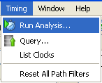
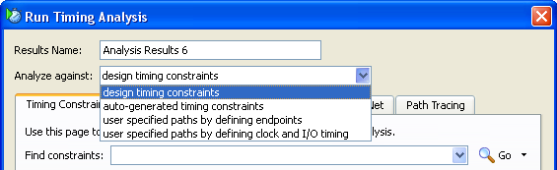
Selecting a Timing Report
Select Timing > Run Analysis to create a report using the currently defined options
From there you can select from four different types of timing reports

Slide 23
Types of Timing Reports
Analyze Against Design Timing Constraints
Compares design performance with timing constraints
Most commonly used report format
Used for Post-Map and Post-Place & Route Static Timing Reports if the design contains constraints
Analyze Against Auto-Generated Design Constraints
Determines the longest paths in each clock domain
Use with designs that have no constraints defined
Used for Post-Map and Post-Place & Route Static Timing Reports if the design contains no constraints

Slide 24
Types of Timing Reports
Analyze Against User Specified Paths by Defining Endpoints
Custom report for selecting sources and destinations
Analyze Against User Specified Paths by Defining Clock and I/O Timing
Allows you to define PERIOD and OFFSET constraints on-the-fly
Use with designs that have no constraints defined

Slide 25
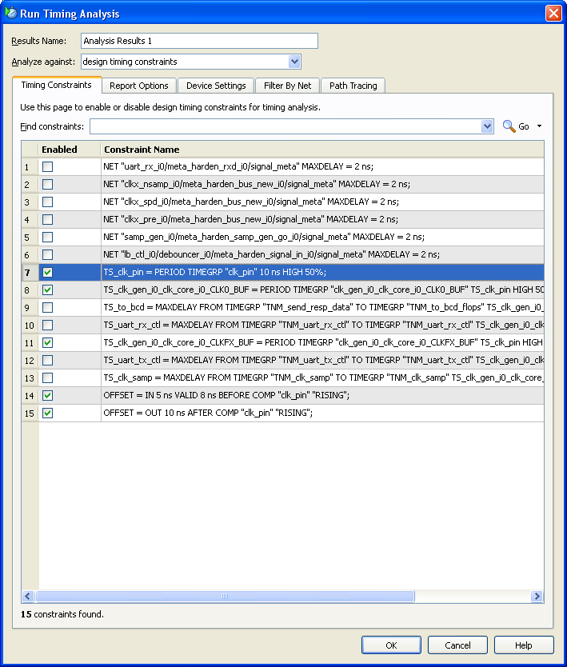
Timing Constraints Tab
After selecting a type of report, you can select from various report options
Select a name for the timing report
You can select which constraints you want reported
Notes:
Selecting a report from the Analyze menu displays the Run Timing Analysis dialog box.
You can select which constraints that you want to apply to the design during the report creation. If a constraint is not selected, the tools will act as if the constraint did not exist.
For example, if you disable a multicycle path constraint, those paths will be analyzed and reported under the global PERIOD constraint (probably as timing errors).
Facilitator Note:
Demo Instructions:
Viewing the report options:
Select Timing > Run Analysis.
Note: There may not be timing constraints for this design. If there are timing constraints, they are listed in the Timing Constraints tab as in the figure above.

Slide 26
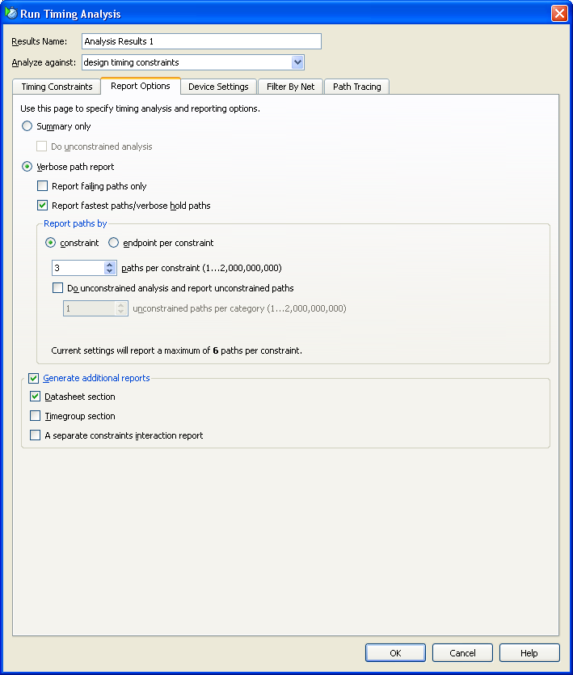
Report Options Tab
Report failing paths only: Lists only the paths that fail to meet your specified timing constraints
Constraint details
Specify the number of detailed paths reported per constraint
Do unconstrained analysis: Allows you to list some or all of the unconstrained paths in your design
You can also generate additional report sections
Notes:
The default, Report fastest paths/verbose hold paths, will additionally show your fastest paths to help you determine if your design is meeting your hold times.
Select the Report paths against timing constraints option to see the worst paths, even if they meet the timing constraints. This may be necessary when doing reports on the post-map netlist (without timing driven packing) because only cell delays are included (no net delay).
Do unconstrained analysis is useful to ensure that no paths were accidentally left unconstrained by your timing constraints.
Generate the Timegroup section of the report if you have created custom groups for path-specific timing constraints. This section will list each member of all timing groups, allowing you to confirm that the correct elements are in each group. More information on path-specific timing constraints can be found in the “Path-Specific Timing Constraints” modules in this course.
Facilitator Note:
Demo Instructions:
Viewing the report options:
Select Timing > Run Analysis.
Note: There may not be timing constraints for this design. If there are timing constraints, they are listed in the Timing Constraints tab as in the figure above.

Slide 27
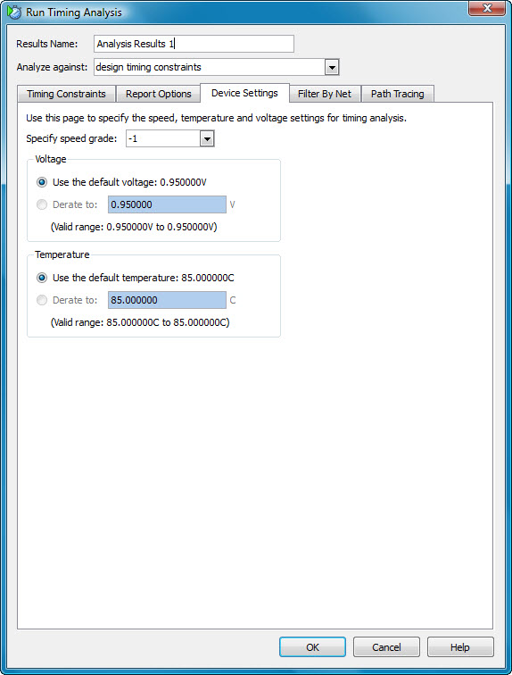
Device Settings
Speed grade
Do the analysis using the timing of a different speed grade part
Prorating
Specify your own worst-case environment
Notes:
The Speed Grade option lets you easily determine whether moving to a faster or slower speed-grade device will meet your timing needs. Note: the implementation tools, which are timing driven, will have optimized against the initial speed grade; this is just a “what if” analysis.
Prorating values in this dialog box is also a “what if” analysis; this only analyzes the implemented design against the prorated constraints.
Prorating may not initially be available for new architectures—install the latest service packs to be sure that you have the latest timing information.
If prorating gets you close to timing closure, try entering the prorated values in the Constraints Editor and reimplement.

Slide 28
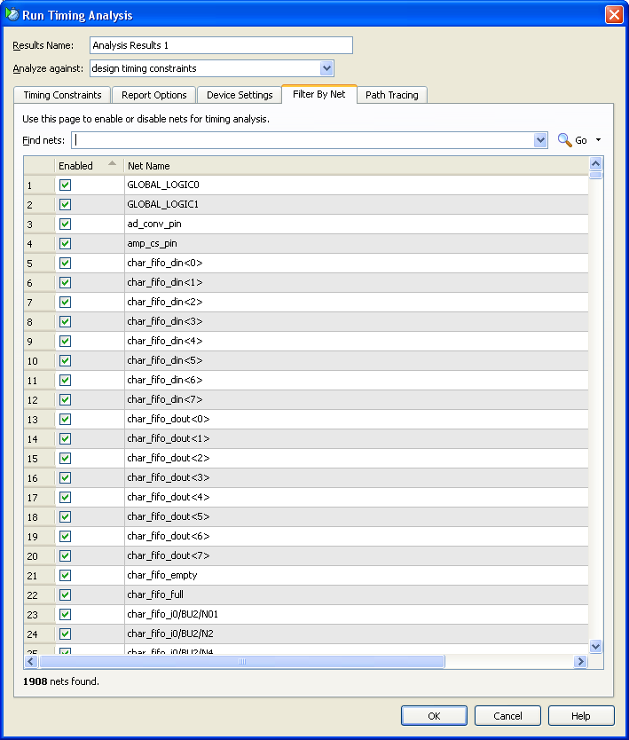
Filter by Net Tab
Restrict which paths are reported by selecting specific nets
Each net is set to default
Disabling any net excludes paths containing that net from being analyzed and included with the timing report
If all nets are left as Default, all nets are included
Notes:
Filtering is a method for reducing the number of reported paths by covering or excluding paths that contain a particular net.
This allows you to find the paths that interest you, but analysis against your constraints is still performed.

Slide 29
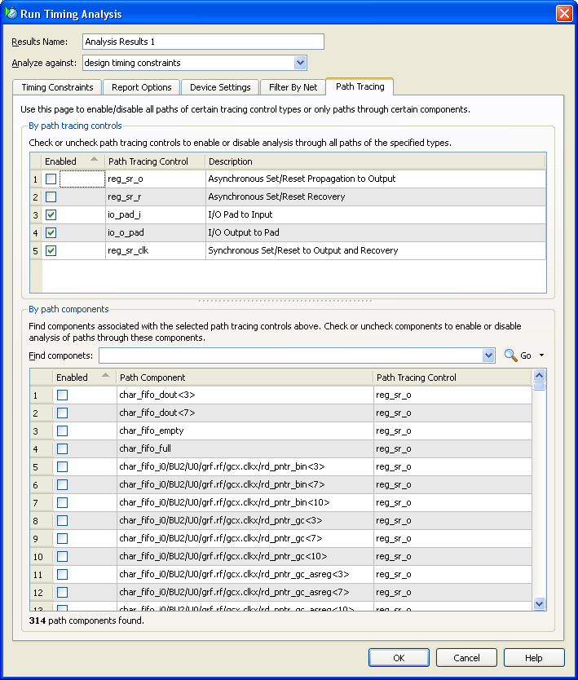
Path Tracing Tab
Enables or disables certain propagation paths
reg_sr_o: If enabled, the path from the async preset/clear port of a flip-flop to the output is considered a combinatorial path
Describes the asserting edge of the preset/clear
Should be used when the preset/clear is not driven by a global reset, which is not recommended
reg_sr_r: If enabled, the recovery arc of the flip-flop is checked
Ensures that the preset/clear condition was deasserted sufficiently before the clock to ensure that the flip-flip assumes its non-reset behavior
Required to ensure that all flip-flops come out of reset at the same time
Should be enabled in the constraints: ENABLE = reg_sr_r;

Slide 30
Summary
Timing reports enable you to determine how and why constraints were not met
Use the Synthesis Report and Post-Map Static Timing Report to estimate performance before running Place & Route
The detailed path description offers clues to the cause of timing failures
Cross-probe to see the placement and a technology view of a timing path
The Timing Analyzer can generate various types of reports for specific circumstances
Notes:
Editor Note: Put the Where Can I Learn More content in LGP after the Summary slide.
Where Can I Learn More?
Timing Analyzer Overview/Online Help
Help > Help Topics
Click the Index tab and enter Timing Analyzer in the Look for window

