Slide 1
Overview of Dynamic Systems
UESTCHN3007 Dynamics & Control
Lecture 1
Dr Julien Le Kernec email: Julien.lekernec@glasgow.ac.uk
James Watt School of Engineering, University of Glasgow, UK

Slide 2
Systems
Sets of connected objects or things
They can be living things
They can be mechanical things
Behaviors of these systems are shaped by many factors
All these systems exhibit some common behavior patterns

Slide 3
What is a Dynamic System?
A dynamic system can be set in motion by applying an input (or excitation) or by disturbing it from its equilibrium.
The motion of the system is described by its output (or response).
The output of the system is dependent on the input and the behaviour of the system itself.
If we know what the behaviour of the system is, we can specify an input so that we get a desired output.
But how do we describe the behaviour of the system?
Notes:
Examples of inputs:
Applying a voltage to a circuit
Applying a force to an object
Examples of disturbing equilibrium:
Stretching a spring
Moving a pendulum

Slide 4
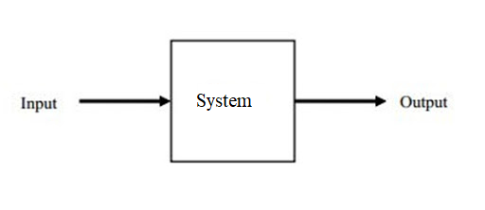
The output of the system is dependent on the input and the behaviour of the system itself.
Notes:
Dynamic systems are systems that change or evolve in time according to a fixed rule. For many physical systems, this rule can be stated as a set of first-order differential equations a set of first-order differential equations x(dot)= dx/dt = f(x(t), u(t), t) In the above equation, x(t) is the state vector, a set of variables representing the configuration of the system at time t . For instance, in a simple mechanical mass-spring-damper system, the two state variables could be the position and velocity of the mass. u(t) is the vector of external inputs to the system at time t , and f is a (possibly nonlinear) function producing the time derivative (rate of change) of the state vector, dx/dt , for a particular instant of time.

Slide 5
I/P and O/P relationship
Model dynamic systems in mathematical terms (Why?)
A set of equations that represents the dynamics of the system
System may have many mathematical models
The dynamics of systems may be described in terms of differential equations
Use physical laws governing a particular system
Testing a prototype of the device, or measuring its response to inputs
Deriving reasonable mathematical models is the most important part
Notes:
1. Quantify and digitised suitable for CAD simulation

Slide 6
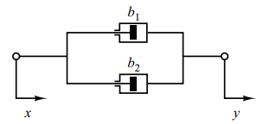
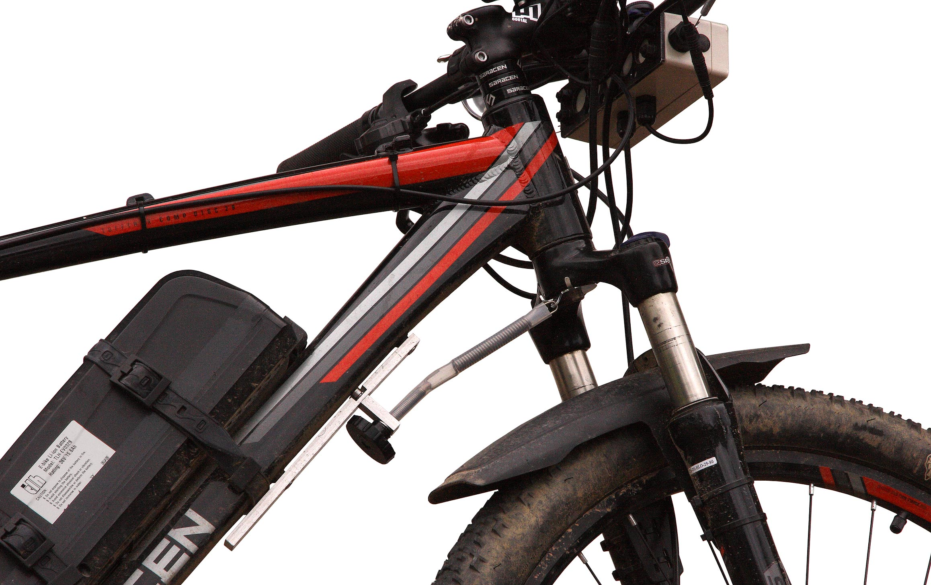
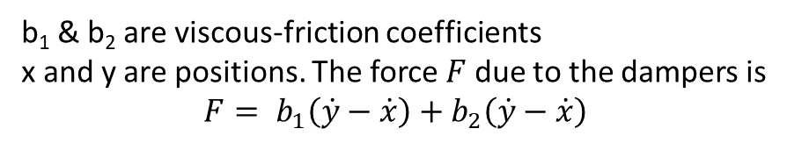
Mechanical System Modelling
System consisting of two dampers connected in parallel
Piston
Cylinder
b₁ & b₂ are viscous-friction coefficients
x and y are positions. The force $F$ due to the dampers is $$F= b_{1}\left(\dot{y}−\dot{x}\right)+b_{2}\left(\dot{y}−\dot{x}\right)$$
Notes:
Find the equivalent system. Where F=b•x(dot); x and y are positions and x (dot) is the velocity = (y-x )/t

Slide 7


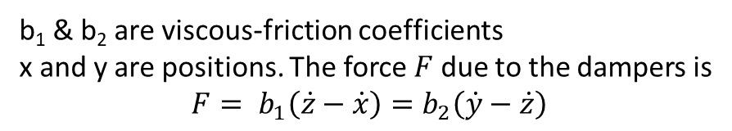
Exercise: Mechanical System Modelling
System consisting of two dampers connected in series
x
y
z
b₁ & b₂ are viscous-friction coefficients
x and y are positions. The force $F$ due to the dampers is $$F= b_{1}\left(\dot{z}−\dot{x}\right)=b_{2}\left(\dot{y}−\dot{z}\right)$$
Notes:
beq=b2b1/(b1+b2)

Slide 8
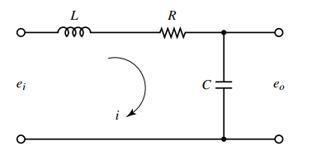
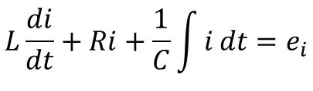
Electrical System Modelling
Consider the electrical circuit as shown below
$$L\frac{di}{dt}+Ri+\frac{1}{C}\int{i}dt=e_{i}$$

Slide 9
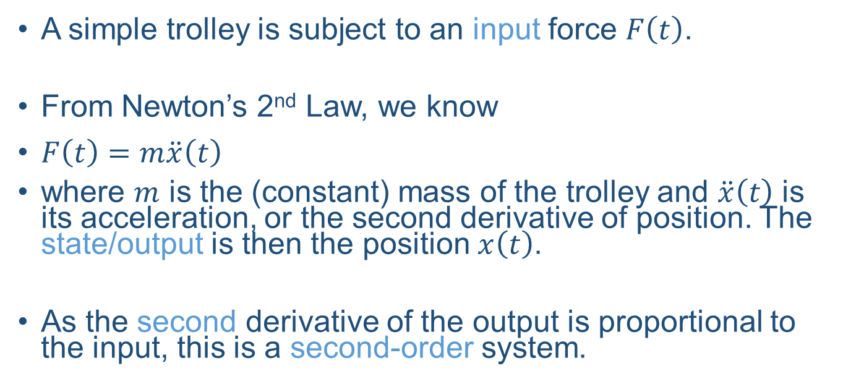
A Mechanical System
A simple trolley is subject to an input force $F\left(t\right)$.
From Newton’s 2nd Law, we know
$F\left(t\right)=m\ddot{x}\left(t\right)$
where $m$ is the (constant) mass of the trolley and $\ddot{x}\left(t\right)$ is its acceleration, or the second derivative of position. The state/output is then the position $x\left(t\right)$.
As the second derivative of the output is proportional to the input, this is a second-order system.

Slide 10
Describing a Dynamic System
Equations describing the systems known as system’s equation of motion.
Describes the O/P of the system
Describes its derivatives as a function of the I/P
Can have MIMO

Slide 11
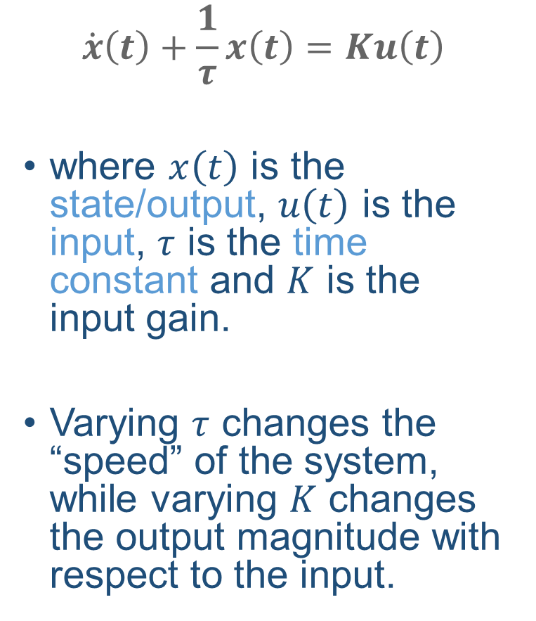
First-Order System
$$\dot{x}\left(t\right)+\frac{1}{τ}x\left(t\right)=Ku\left(t\right)$$
where $x\left(t\right)$ is the state/output, $u\left(t\right)$ is the input, $τ$ is the time constant and $K$ is the input gain.
Varying $τ$ changes the “speed” of the system, while varying $K$ changes the output magnitude with respect to the input.
Notes:
RC circuit where tau is time constant and K is gain.

Slide 12
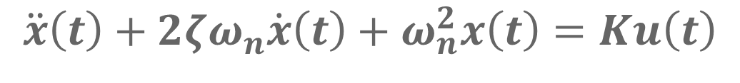

Second-Order System
$$\ddot{x}\left(t\right)+2ζω_{n}\dot{x}\left(t\right)+ω_{n}^{2}x\left(t\right)=Ku\left(t\right)$$
where $x\left(t\right)$ is the state/output, $u\left(t\right)$ is the input, $ζ$ is the damping ratio, $ω_{n}$ is the natural frequency and $K$ is the input gain.
Varying $ζ$ changes how much the system oscillates, while varying $ω_{n}$ changes the “speed” of the system.
Notes:
Zeta damping ratio ; wn is natural frequency of the system; RLC circuit.

Slide 13
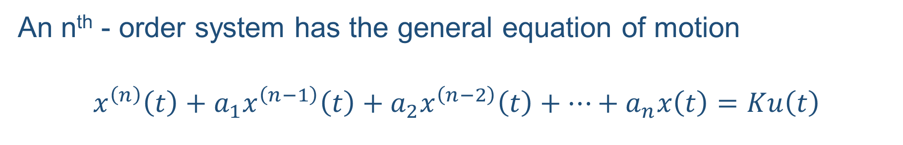
Higher-Order Systems
An n^{th} - order system has the general equation of motion
$$x^{\left(n\right)}\left(t\right)+a_{1}x^{\left(n−1\right)}\left(t\right)+a_{2}x^{\left(n−2\right)}\left(t\right)+…+a_{n}x\left(t\right)=Ku\left(t\right)$$

Slide 14

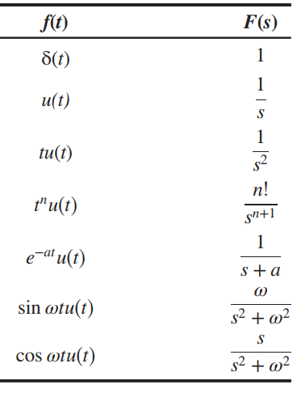
The Laplace Transform
Differential and integral equations are difficult to model as a block diagram
The input, output, and system are represented separately with their own equations
Their interrelationship will be represented as algebraic equations
Notes:
Table is provided on the exam paper. Sketch some waveforms

Slide 15
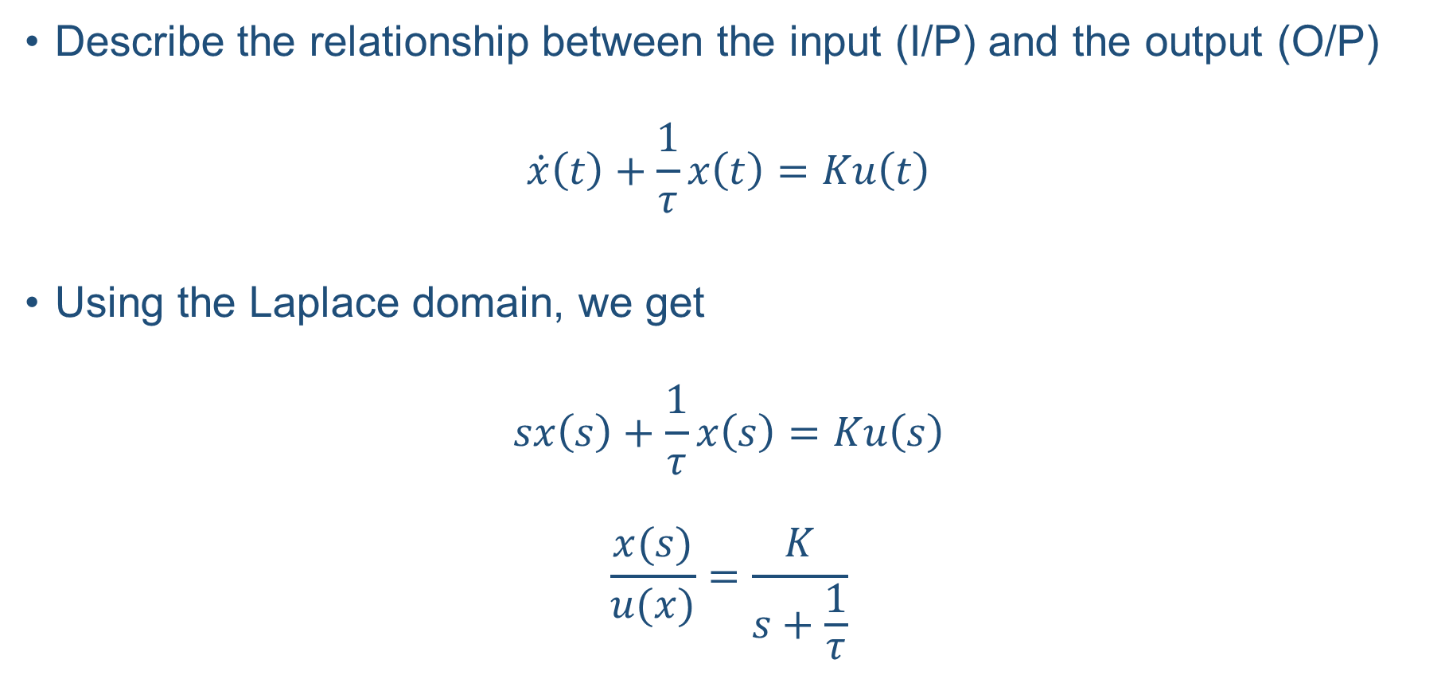
Transfer Functions
Describe the relationship between the input (I/P) and the output (O/P)
$$\dot{x}\left(t\right)+\frac{1}{τ}x\left(t\right)=Ku\left(t\right)$$
Using the Laplace domain, we get
$$sx\left(s\right)+\frac{1}{τ}x\left(s\right)=Ku\left(s\right)$$
$$\frac{x(s)}{u(x)}=\frac{K}{s+\frac{1}{τ}}$$

Slide 16

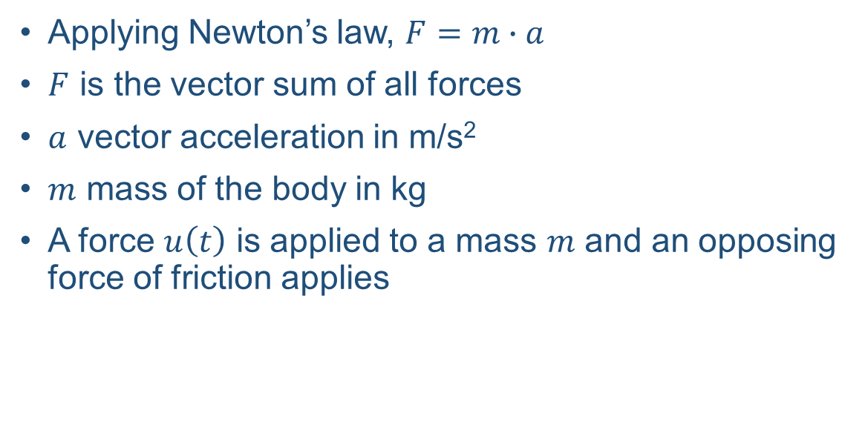
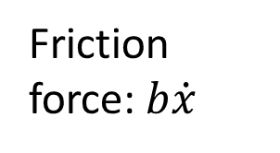


Exercise: Transfer Function for a mechanical system
Applying Newton’s law, $F=m∙a$
$F$ is the vector sum of all forces
$a$ vector acceleration in m/s²
$m$ mass of the body in kg
A force $u\left(t\right)$ is applied to a mass $m$ and an opposing force of friction applies
$$\ddot{x}$$
$$x$$
Friction force:$b\dot{x}$
m
$$u$$
Notes:
X is displacement , x(dot) is accelerator; x (dot dot) is the velocity ; b-bx(dot)=mx(dot dot)

Slide 17
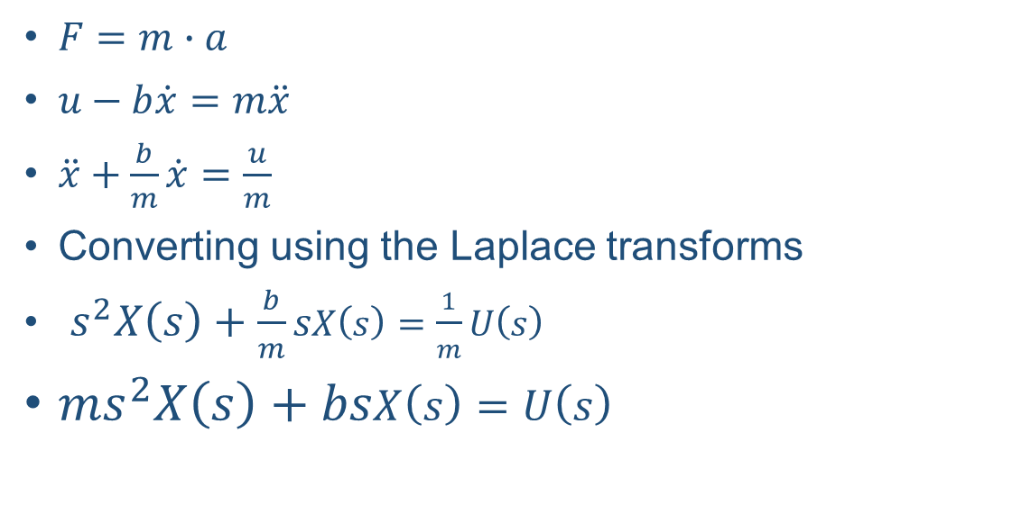

Exercise: Transfer Function for a mechanical system
$F=m∙a$
$u−b\dot{x}=m\ddot{x}$
$\ddot{x}+\frac{b}{m}\dot{x}=\frac{u}{m}$
Converting using the Laplace transforms
$s^{2}X\left(s\right)+\frac{b}{m}sX\left(s\right)=\frac{1}{m}U\left(s\right)$
$ms^{2}X\left(s\right)+bsX\left(s\right)=U\left(s\right)$
$$\ddot{x}$$
$$x$$
Friction force:$b\dot{x}$
m
$$u$$
$$\frac{X(s)}{U(s)}=\frac{1}{ms^{2}+bs}$$
Notes:
X is displacement , x(dot) is accelerator; x (dot dot) is the velocity ; b-bx(dot)=mx(dot dot)

Slide 18

Obtain transfer functions for the below systems
Second-order system:$\ddot{x}\left(t\right)+2ζω_{n}\dot{x}\left(t\right)+ω_{n}^{2}x\left(t\right)=Ku\left(t\right)$
$n$^{th}-order system:${ x}^{\left(n\right)}\left(t\right)+a_{1}x^{\left(n−1\right)}\left(t\right)+a_{2}x^{\left(n−2\right)}\left(t\right)+…+a_{n}x\left(t\right)=Ku\left(t\right)$

Slide 19
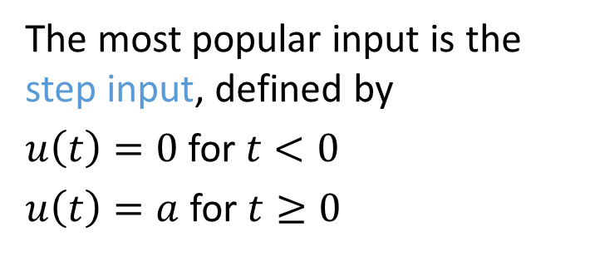
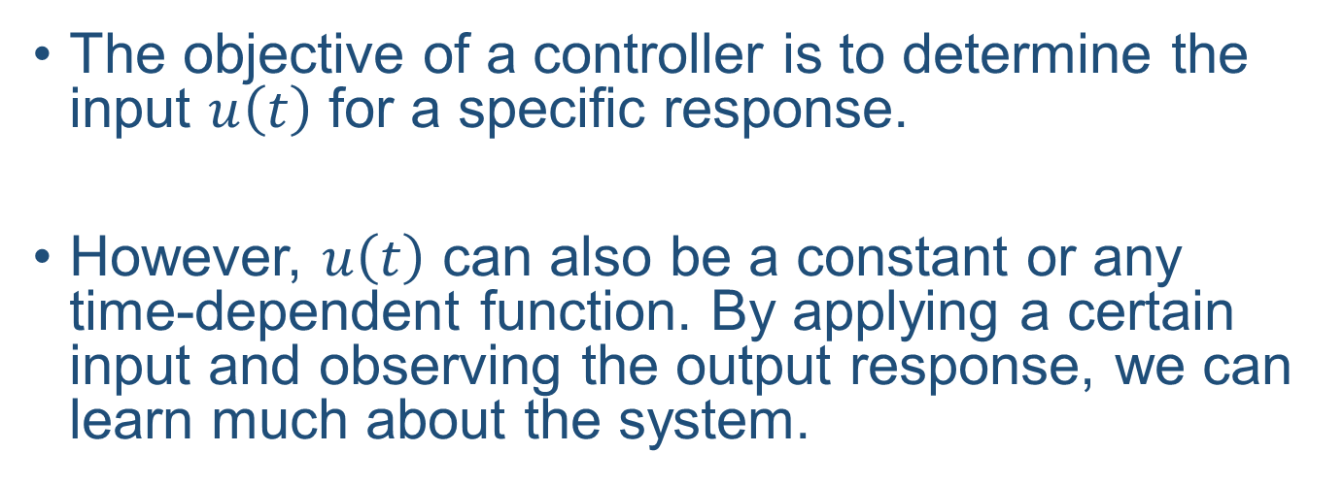
Types of Input
The objective of a controller is to determine the input $u\left(t\right)$ for a specific response.
However, $u\left(t\right)$ can also be a constant or any time-dependent function. By applying a certain input and observing the output response, we can learn much about the system.
The most popular input is the step input, defined by
$u\left(t\right)=0$ for $t<0$
$u\left(t\right)=a$ for $t≥0$
$$\frac{a}{s}$$

Slide 20
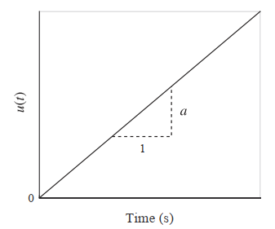
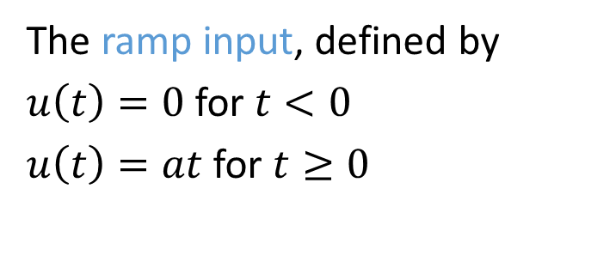

Types of Input
The ramp input, defined by
$u\left(t\right)=0$ for $t<0$
$u\left(t\right)=at$ for $t≥0$
$$\frac{a}{s^{2}}$$

Slide 21
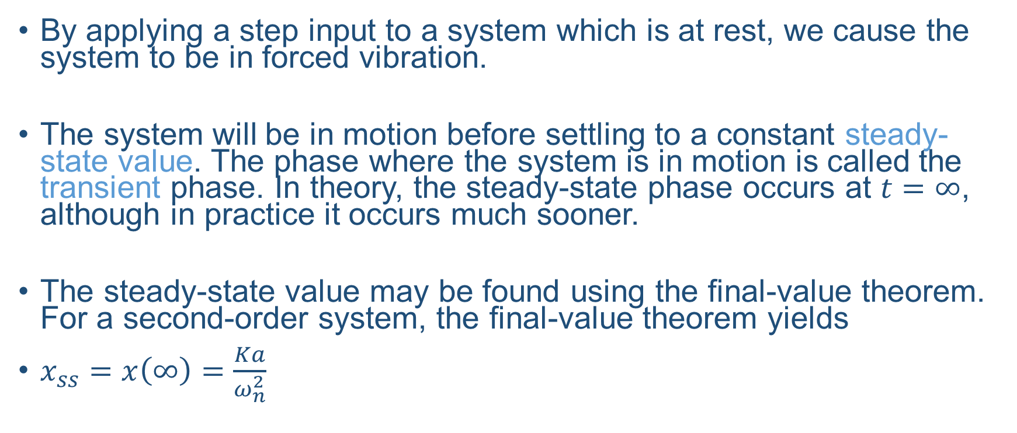
Response Properties
By applying a step input to a system which is at rest, we cause the system to be in forced vibration.
The system will be in motion before settling to a constant steady-state value. The phase where the system is in motion is called the transient phase. In theory, the steady-state phase occurs at $t=∞$, although in practice it occurs much sooner.
The steady-state value may be found using the final-value theorem. For a second-order system, the final-value theorem yields
$x_{ss}=x\left(∞\right)=\frac{Ka}{ω_{n}^{2}}$
Notes:
This is described in much greater detail in the notes.

Slide 22
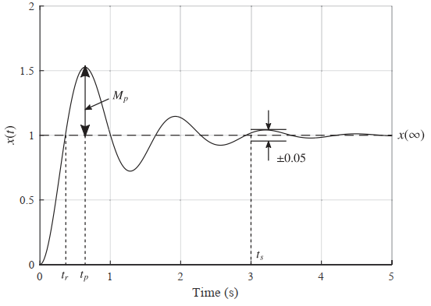
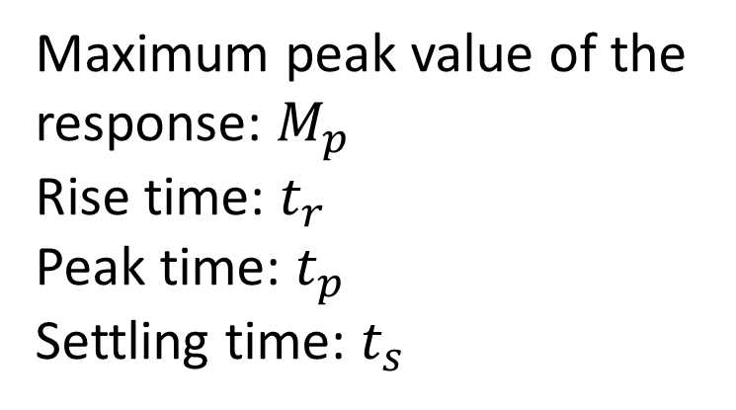
Response Properties etc.
The response of a system can be described by several properties
Maximum peak value of the response: $M_{p}$
Rise time: $t_{r}$
Peak time: $t_{p}$
Settling time: $t_{s}$
Notes:
Settling time

Slide 23
Controlling a System
These properties only hold if a system is stable. An unstable system will never reach a steady-state value after receiving an input, or will never reach an equilibrium after being disturbed.
Some systems, such as fighter aircraft, are deliberately unstable. In these cases, we design a control system which stabilises the aircraft.
We can design our control system so that it gives our complete a system a desired property or set of properties.
Notes:
Desired properties:
Natural frequency
Damping ratio
Settling time
Overshoot
Steady-state value

Slide 24
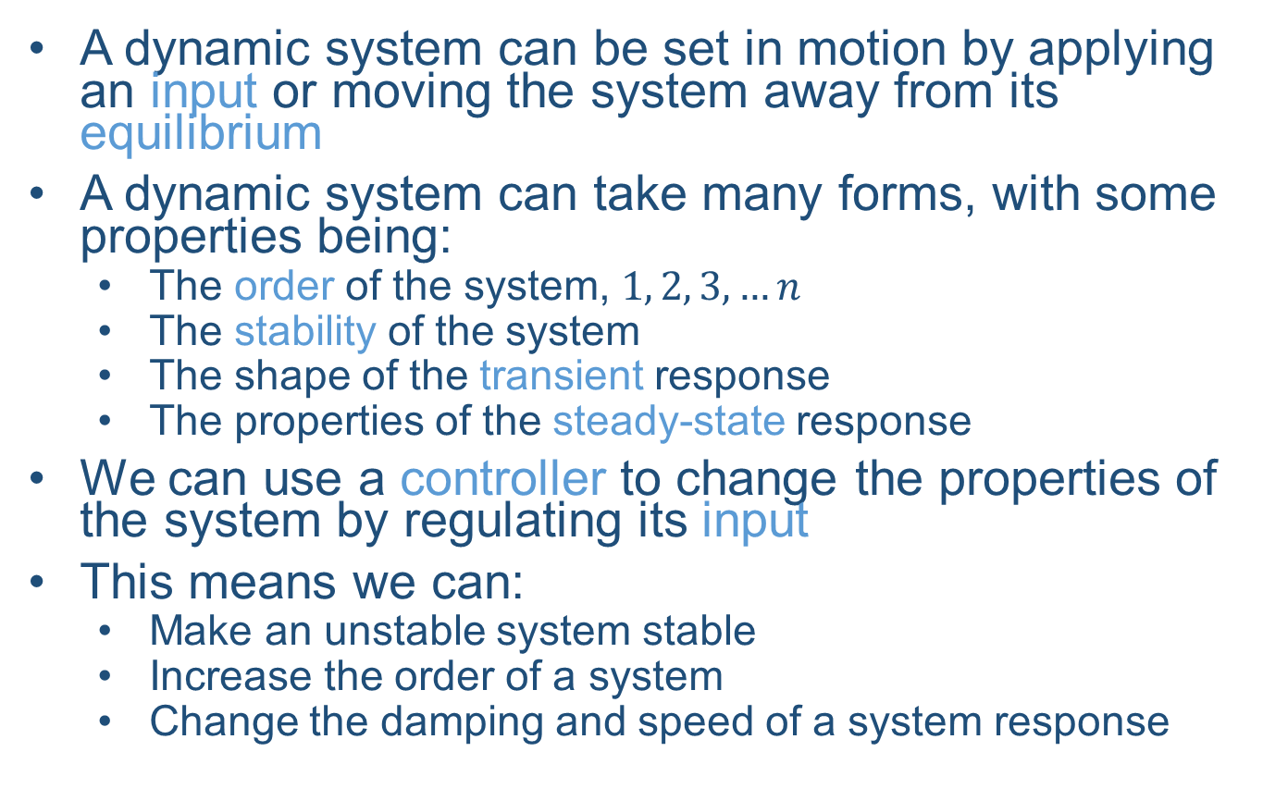
Summary of Section 1
A dynamic system can be set in motion by applying an input or moving the system away from its equilibrium
A dynamic system can take many forms, with some properties being:
The order of the system, $1, 2, 3,…n$
The stability of the system
The shape of the transient response
The properties of the steady-state response
We can use a controller to change the properties of the system by regulating its input
This means we can:
Make an unstable system stable
Increase the order of a system
Change the damping and speed of a system response

Slide 25
Summary
Basics of Dynamic Systems
Mathematical Models
Transfer Function
Response Characteristics
References:
-Modern Control Engineering, 5th Edition, K. Ogata
-UESTC3001 2019/20 Notes, J. Le Kernec etc.

