Slide 1
Basics of Control System Analysis
UESTCHN3007 Dynamics & Control
Lecture 2
Dr Julien Le Kernec email: Julien.lekernec@glasgow.ac.uk
James Watt School of Engineering, University of Glasgow, UK

Slide 2
Outline
Introduction to Control Systems
Block Diagram Representation

Slide 3
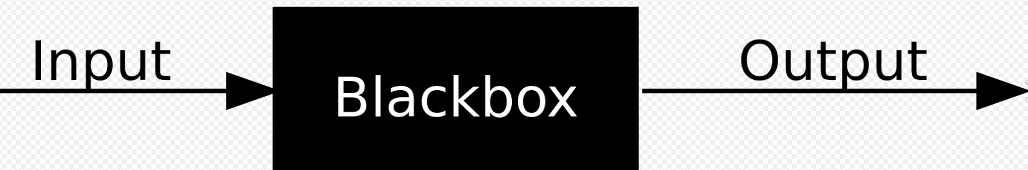


Introduction to Control System
Notes:
If the output is controllable, then the system is called a control system. Manual vs automatic control. Man made or in nature. Circulation, respiration, thinking

Slide 4
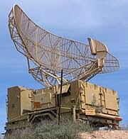
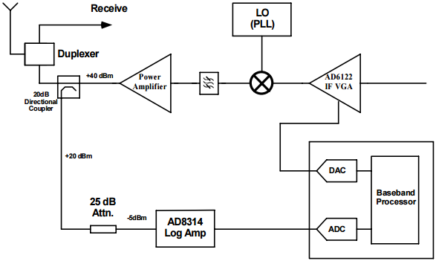
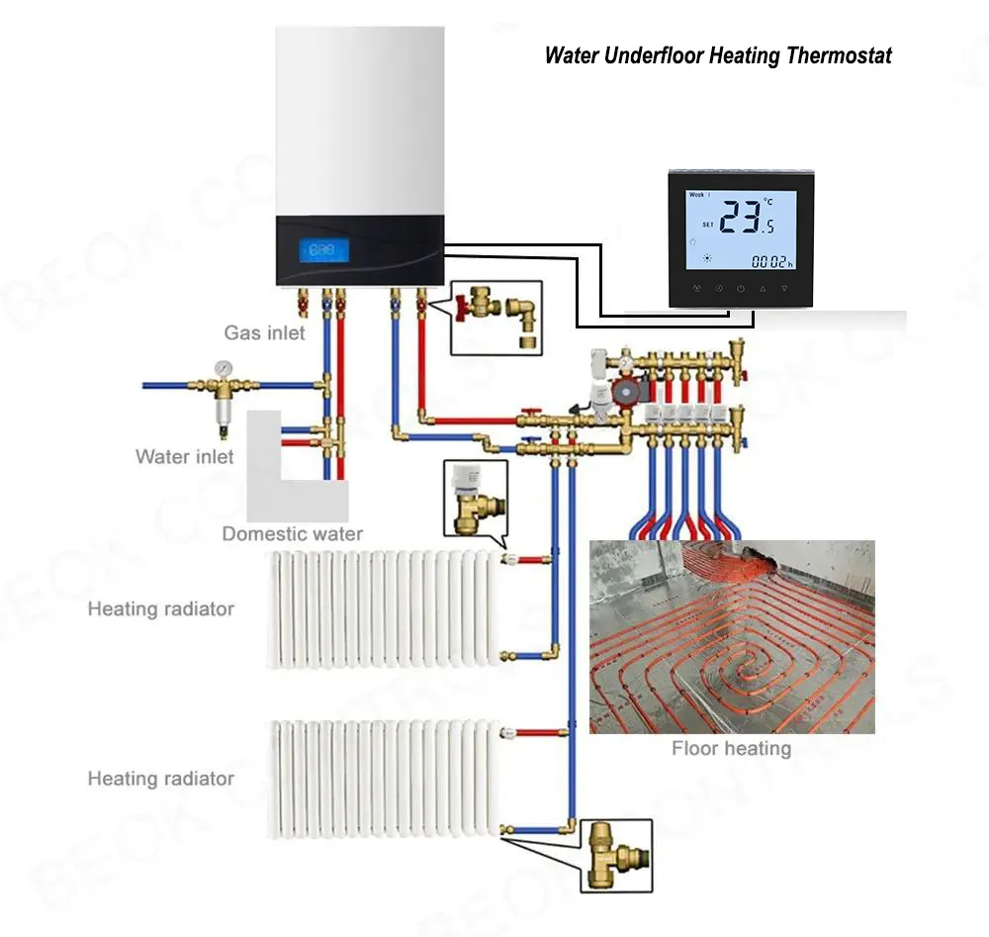


Advantages of Control Systems
Power amplification
Remote control
Convenience of input form
Compensation for disturbances
Notes:
With control systems we can move large equipment with precision that would otherwise be impossible.
We can point huge antennas toward the farthest reaches of the universe to pick up faint radio signals; controlling these antennas by hand would be impossible.
Because of control systems, elevators carry us quickly to our destination, automatically stopping at the right floor.
We alone could not provide the power required for the load and the speed; motors provide the power, and control systems regulate the position and speed.
We build control systems for four primary reasons:
Power amplification
Remote control
Convenience of input form
Compensation for disturbances
For example, a radar antenna, positioned by the low-power rotation of a knob at the input, requires a large amount of power for its output rotation.
A control system can produce the needed power amplification, or power gain-Robots designed by control system principles can compensate for human disabilities.
Control systems are also useful in remote or dangerous locations. For example, a remote-controlled robot arm can be used to pick up material in a radioactive environment.
Control systems can also be used to provide convenience by changing the form of the input. For example, in a temperature control system, the input is a position on a thermostat. The output is heat.
Thus, a convenient position input yields a desired thermal output. Another advantage of a control system is the ability to compensate for disturbances.
Typically, we control such variables as temperature in thermal systems, position and velocity in mechanical systems, and voltage, current, or frequency in electrical systems.
The system must be able to yield the correct output even with a disturbance. For example, consider an antenna system this point in a commanded direction.
If wind forces the antenna from its commanded position, or if noise enters internally, the system must be able to detect the disturbance and correct the antenna's position.
Obviously, the system's input will not change to make the correction.
Consequently, the system itself must measure the amount that the disturbance has repositioned the antenna and then return the antenna to the position commanded by the input.

Slide 5
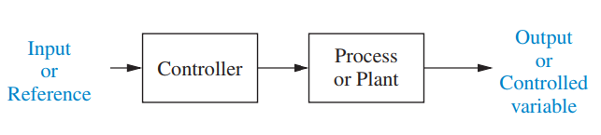


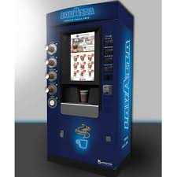
Open-loop Control
Notes:
Toaster , washing machine, vending machine; what about there is disturbance

Slide 6
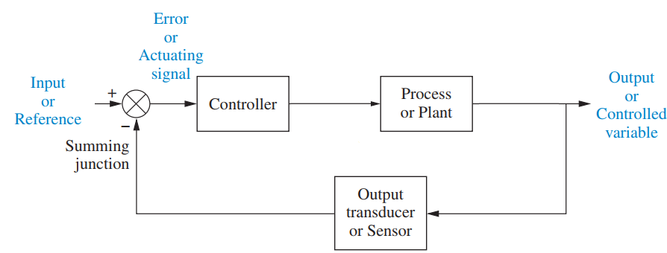
Closed-loop Control
101 C
100 C
99 C
Notes:
Sensor required for feedback, improve accuracy, but increase costs

Slide 7
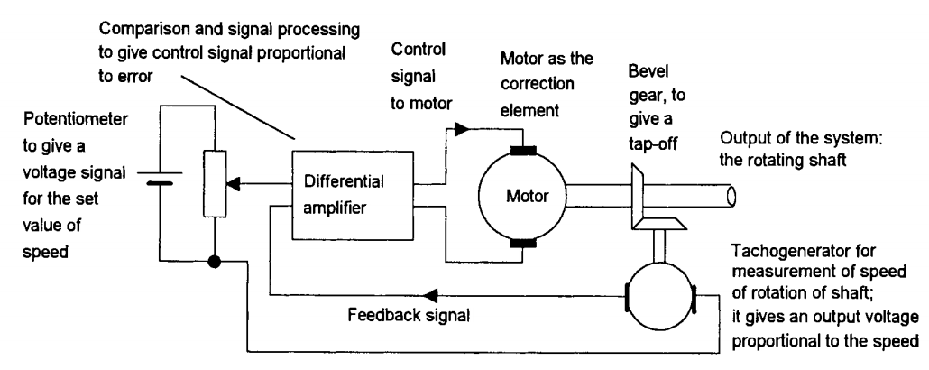
Example Control of the speed of rotation of a motor shaft
Notes:
Think about the TDPS project, how to control the rover. Develop a block diagram

Slide 8
Potentiometer
Motor
Rotating shaft
Tachogenerator
Notes:
Think about the TDPS project, how to control the rover. Develop a block diagram ; required in exam

Slide 9
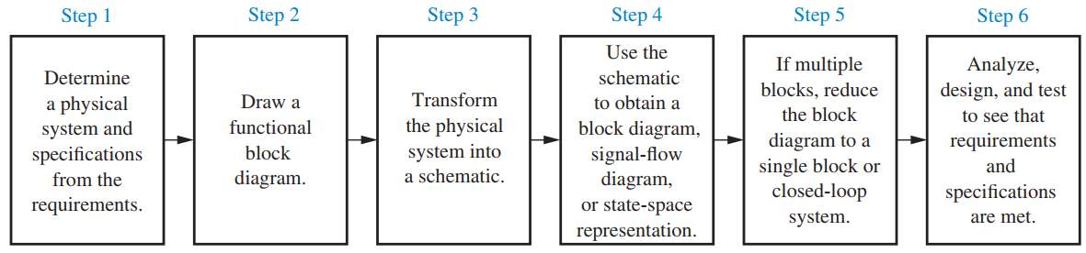
The Design Process

Slide 10
Introduction to Block Diagrams
Use for time/frequency-domain analysis and design
Graphical representation of the interconnections between the components of the system and the flow of signals
Diagram is composed of functional blocks
Notes:
Signal: Input R(s); output C(s)
System: I/P R(s)-> G(s)->output C(s)
Summing junction: +R1(s), +R2(s), -R3(s) …
Pick off points:

Slide 11
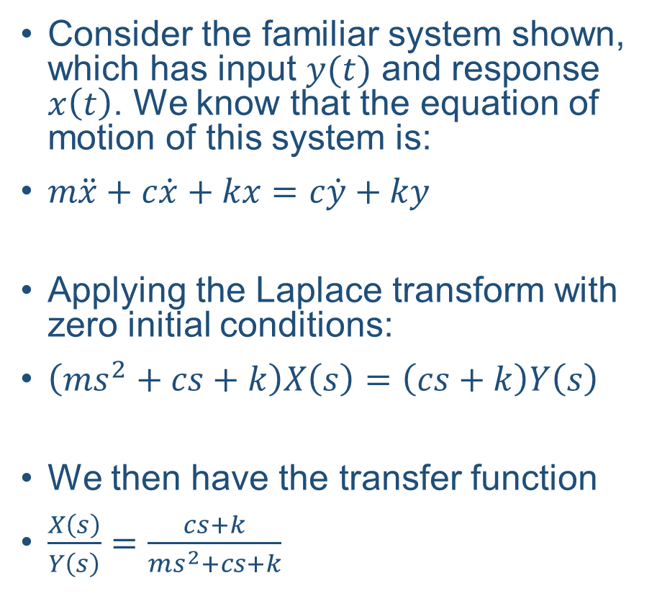
Example: Block Diagram Representation of Control Systems
Consider the familiar system shown, which has input $y(t)$ and response $x\left(t\right)$. We know that the equation of motion of this system is:
$m\ddot{x}+c\dot{x}+kx=c\dot{y}+ky$
Applying the Laplace transform with zero initial conditions:
$\left(ms^{2}+cs+k\right)X\left(s\right)=\left(cs+k\right)Y\left(s\right)$
We then have the transfer function
$\frac{X\left(s\right)}{Y\left(s\right)}=\frac{cs+k}{ms^{2}+cs+k}$

Slide 12
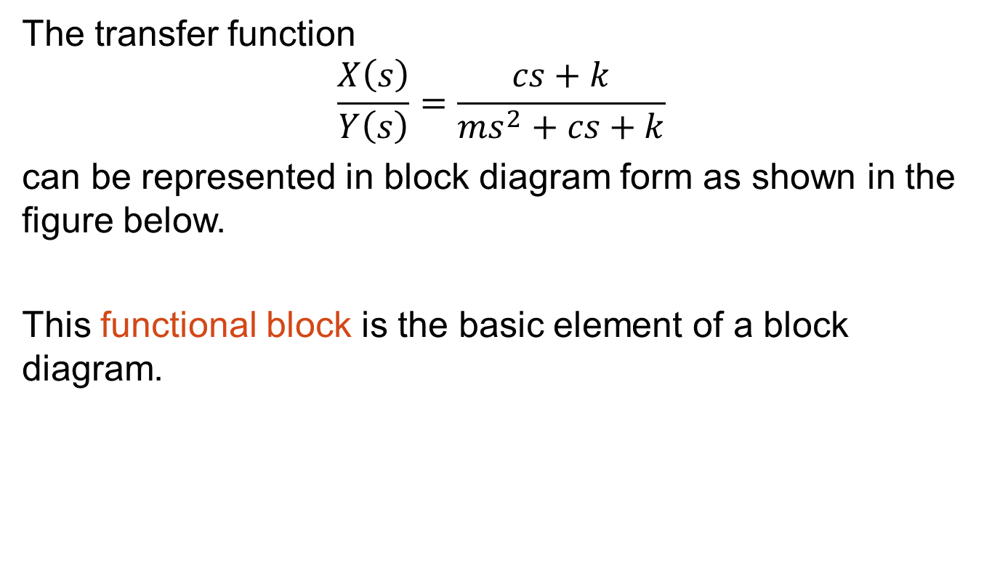
Transfer Function Blocks
The transfer function
$\frac{X\left(s\right)}{Y\left(s\right)}=\frac{cs+k}{ms^{2}+cs+k}$
can be represented in block diagram form as shown in the figure below.
This functional block is the basic element of a block diagram.

Slide 13
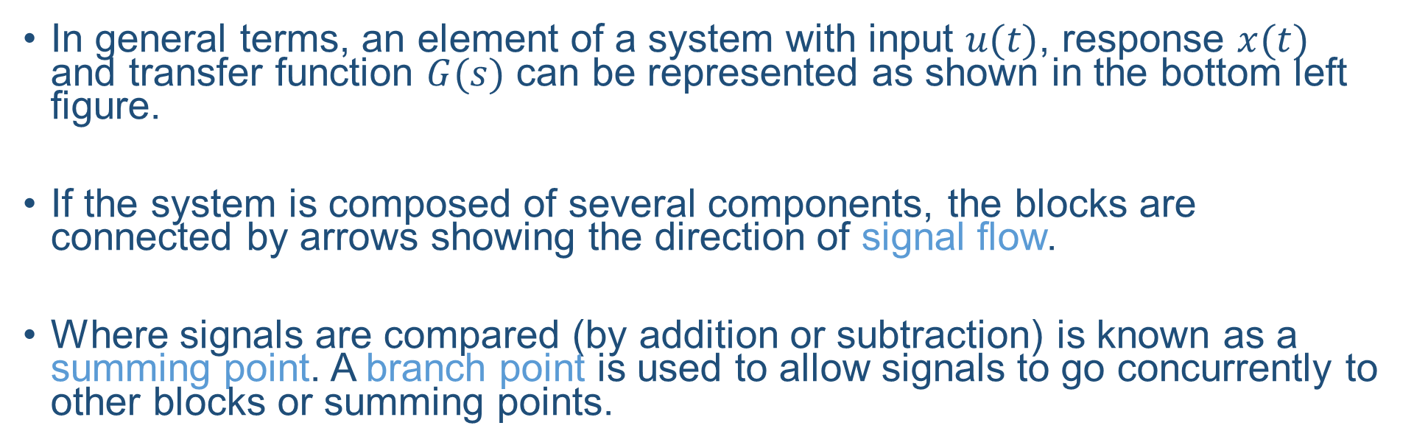
Block Diagram Elements
In general terms, an element of a system with input $u(t)$, response $x(t)$ and transfer function $G(s)$ can be represented as shown in the bottom left figure.
If the system is composed of several components, the blocks are connected by arrows showing the direction of signal flow.
Where signals are compared (by addition or subtraction) is known as a summing point. A branch point is used to allow signals to go concurrently to other blocks or summing points.

Slide 14
Block Diagram Reduction
Control systems can be complex in structure and design and naturally the resulting block diagram may also be complex.
The block diagram will show all inputs, outputs and disturbances to the system.
It is possible to reduce the block diagram to a simple transfer function relating a single input (or disturbance) to a single output.
This process of reduction is carried by application of seven basic rules.

Slide 15
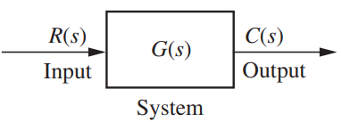
Block Diagram Reduction

Slide 16
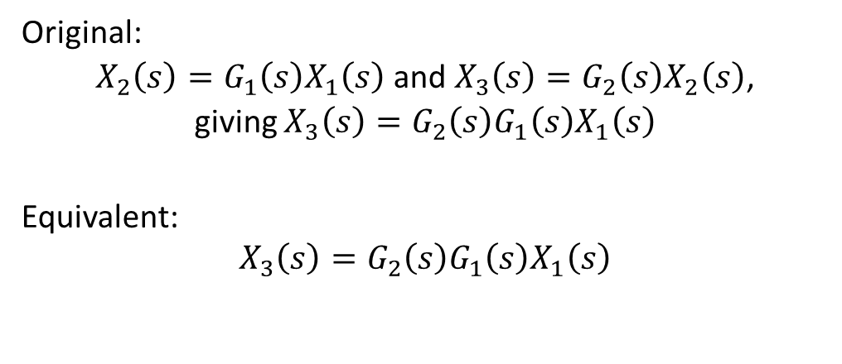
1: Cascaded Blocks
Original
Equivalent
Original:
$X_{2}\left(s\right)=G_{1}\left(s\right)X_{1}\left(s\right)$ and $X_{3}\left(s\right)=G_{2}\left(s\right)X_{2}\left(s\right)$,
giving $X_{3}\left(s\right)=G_{2}\left(s\right)G_{1}\left(s\right)X_{1}\left(s\right)$
Equivalent:
$$X_{3}\left(s\right)=G_{2}\left(s\right)G_{1}\left(s\right)X_{1}\left(s\right)$$

Slide 17
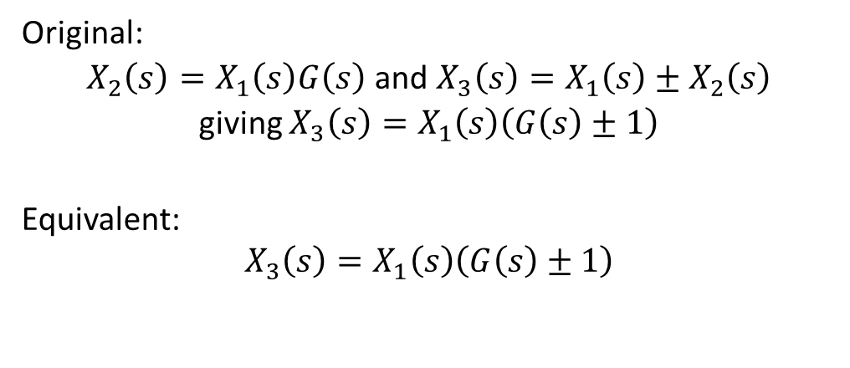
2: Summing Two Signals
Original
Equivalent
Original:
$X_{2}\left(s\right)=X_{1}\left(s\right)G\left(s\right)$ and $X_{3}\left(s\right)=X_{1}\left(s\right)±X_{2}\left(s\right)$
giving $X_{3}\left(s\right)=X_{1}\left(s\right)\left(G\left(s\right)±1\right)$
Equivalent:
$$X_{3}\left(s\right)=X_{1}\left(s\right)\left(G\left(s\right)±1\right)$$

Slide 18

3: Moving a Summing Point Behind a Block
Original
Equivalent
Original:
$$X_{3}\left(s\right)=\left(X_{1}\left(s\right)±X_{2}\left(s\right)\right)G\left(s\right)$$
Equivalent:
$$X_{3}\left(s\right)=X_{1}\left(s\right)G\left(s\right)±X_{2}\left(s\right)G\left(s\right)$$
Notes:
The summing block is moved to after the functional block. Both contributing signals must then be multiplied by the transfer function.

Slide 19

4: Moving a Summing Point Ahead of a Block
Original
Equivalent
Original:
$$X_{3}\left(s\right)=X_{1}\left(s\right)G\left(s\right)±X_{2}\left(s\right)$$
Equivalent:
$$X_{3}\left(s\right)=\left(X_{1}\left(s\right)±\frac{X_{2}\left(s\right)}{G\left(s\right)}\right)G\left(s\right)$$
Notes:
The summing block is moved to before the functional block. The summed signal must then be multiplied by the transfer function, while the feedback must be multiplied by its inverse.

Slide 20

5: Moving a Branch Point Ahead of a Block
Original
Equivalent
Original:
$$X_{2}\left(s\right)=X_{1}\left(s\right)G\left(s\right)$$
Equivalent:
$$X_{2}\left(s\right)=X_{1}\left(s\right)G\left(s\right)$$

Slide 21
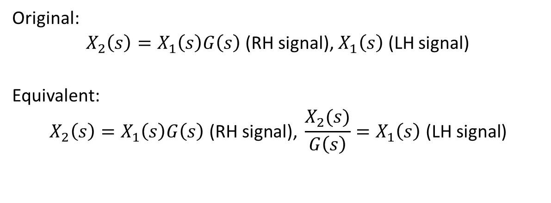
6: Moving a Branch Point Behind a Block
Original
Equivalent
Original:
$X_{2}\left(s\right)=X_{1}\left(s\right)G\left(s\right)$ (RH signal), $X_{1}\left(s\right)$ (LH signal)
Equivalent:
$$X_{2}\left(s\right)=X_{1}\left(s\right)G\left(s\right)\text{ (}\text{RH} \text{signal}\text{), }\frac{X_{2}(s)}{G\left(s\right)}=X_{1}\left(s\right)\text{ (}\text{LH} \text{signal}\text{)}$$

Slide 22
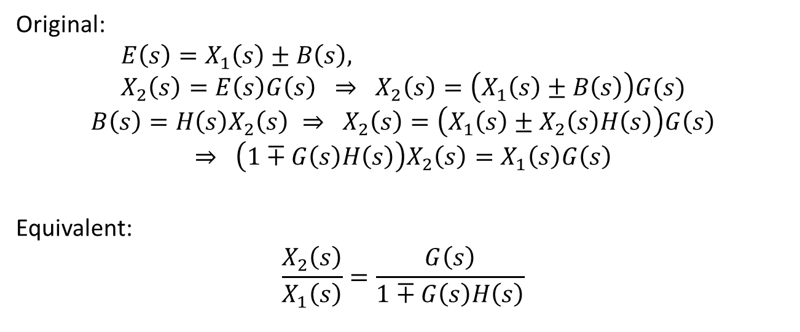
7: Eliminating a Feedback Loop
Original
Equivalent
Original:
$$E\left(s\right)=X_{1}\left(s\right)±B\left(s\right), X_{2}\left(s\right)=E\left(s\right)G\left(s\right) ⇒ X_{2}\left(s\right)=\left(X_{1}\left(s\right)±B\left(s\right)\right)G(s)$$
$$B\left(s\right)=H\left(s\right)X_{2}\left(s\right) ⇒ X_{2}\left(s\right)=\left(X_{1}\left(s\right)±X_{2}\left(s\right)H\left(s\right)\right)G\left(s\right)$$
$$⇒ \left(1∓G\left(s\right)H\left(s\right)\right)X_{2}\left(s\right)=X_{1}\left(s\right)G\left(s\right)$$
Equivalent:
$$\frac{X_{2}\left(s\right)}{X_{1}\left(s\right)}=\frac{G\left(s\right)}{1∓G\left(s\right)H\left(s\right)}$$

Slide 23
Summary
There are two types of controllers:
Open-loop
Closed-loop
A system, with or without control, can be represented by a block diagram
A complex block diagram can be reduced to describe the system as a single transfer function
References:
-Control Systems Engineering, 7th Edition, N.S. Nise
-UESTC3001 2019/20 Notes, J. Le Kernec

